Slide 1
Simulating Clinical Trial Designs
Prof Adrian Mander
Cardiff University

Slide 2
We got to the chapter on simulating trials

Slide 3
Traditional and Adaptive Clinical Trial Simulator (tacts)
I thought I would write my own simulator that needs
How to generate data data()
What is the analysis analysis()
What are the within trial decisions decisions()
Output and summarise the results output()

Slide 4
Fixed sample two-arm parallel group trial
Set sample size
ss(n=400)
Data step
Generate x to be a 0 for half the people and 1 otherwise
x~fixed(0.5,0.5)
Generate y to be normally distributed with the mean 2.6 for those on the experimental arm and 0 otherwise
y~N(2.6*x,8)
data(x~fixed(0.5,0.5); y~N(2.6*x,8);)
Experimental
group
(1)
RandomiseTrial
Population
Control group (0)

Slide 5
Fixed sample two-arm parallel group trial
Analysis step
A t-test using a standard Stata command
analysis(ttest y, by(x);)
Output step
Generate a new variable called power that contains whether the p-value from the t-test is below 0.05
output(power = {r(p)}<0.05;)
Experimental
group
(1)
RandomiseTrial
Population
Control group (0)

Slide 6
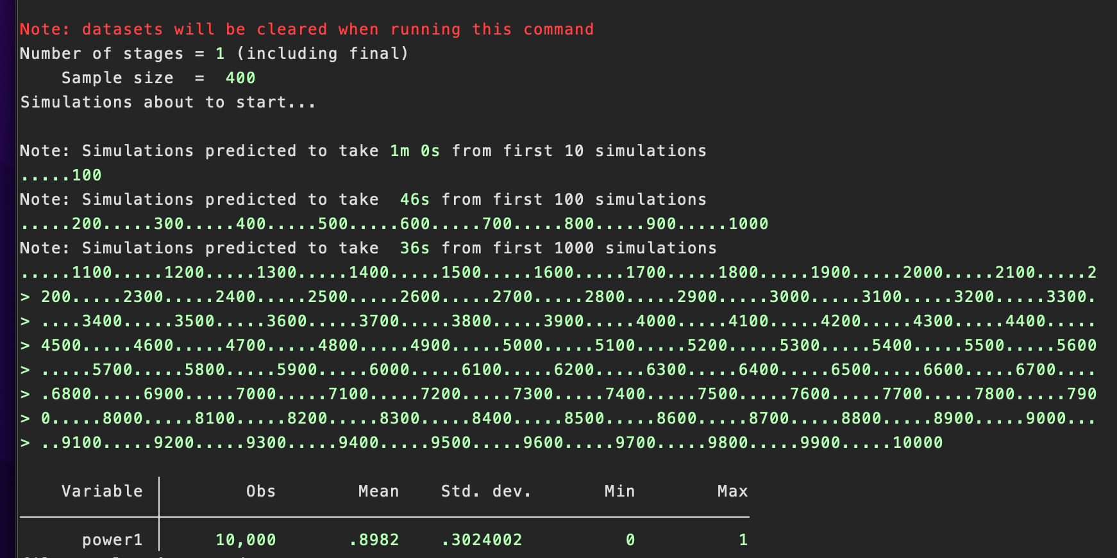
Fixed sample two-arm parallel group trial
Full command
tacts, ss(n=400) data(x~fixed(0.5,0.5); y~N(2.6*x,8);) analysis(ttest y, by(x);) output(power={r(p)}<0.05;) nsims(10000) saving(results) replace seed(1)
Experimental
group
(1)
RandomiseTrial
Population
Control group (0)

Slide 7
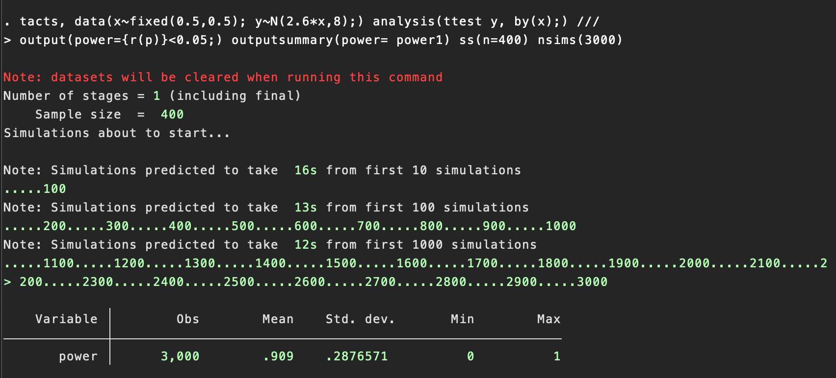
Fixed sample two-arm parallel group trial

Slide 8
Group-sequential two-arm parallel group trial
N=100
N=200
N=400
Exp arm
Exp arm
Exp arm
Trial
Pop
Trial
Pop
Trial
Pop
Con arm
Con arm
Con arm
Decide whether to continue?
Decide whether to continue?

Slide 9
Group-sequential two-arm parallel group trial
Set sample size
ss(n=100 n=200 n=400)
Data step
Data are generated after passing each interim decision to continue
data(x~fixed(0.5,0.5); y~N(2.6*x,8);)
Analysis step
Use a regression model
analysis(reg y x;)

Slide 10
Group-sequential two-arm parallel group trial
Decisions
A design could be that the trial stops based on the Wald test statistic at each interim taken from the linear regression.
The decision here is to stop the trial for a GO or Efficacy decision
decision(
n=100: stoptrialE if _b[x]/_se[x]> 2.5;
n=200: stoptrialE if _b[x]/_se[x]> 2.2;
n=400: stoptrialE if _b[x]/_se[x]> 2;
)

Slide 11
Group-sequential two-arm parallel group trial
Output
Capture the stopping criteria, Wald test statistics and estimate of slope at EACH stage and simulation
output(stop = {stoptrialE}; ttest = _b[x]/_se[x]; slope=_b[x];)
Summaries
The power is whether the stopping criterion is met at any stage (including the final one) and the probability of stopping early (PET) is a positive result in the first two interims.
outputsummary(
Power=(stop1==1)+(stop2==1)+(stop3==1);
PET=(stop1==1)+(stop2==1);
ESS_H1 = 100*(stop1==1)+200*(stop2==1)*(stop1==0) +400*(stop1==0)*(stop2==0);
Bias= cond(stop1==1,slope1-2.6,cond(stop2==1,slope2-2.6,slope3-2.6));
)

Slide 12
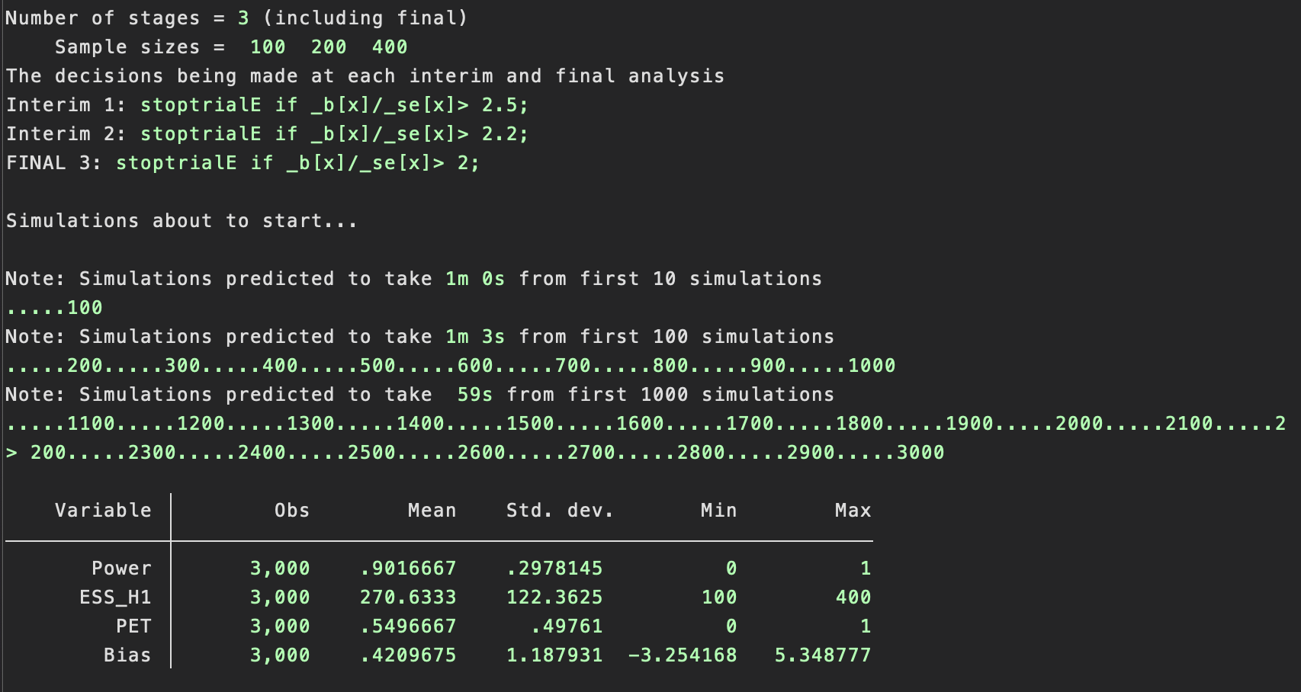

Slide 13
Sample size re-estimation two-arm parallel group trial
In the situation of a continuous outcome the sample size calculation (n per arm) for superiority for a two-arm parallel group trial
n = $\frac{{\left(Z_{1−α/2}+Z_{1−β}\right)}^{2}{2σ}^{2}}{∆^{2}}$
The variance in this calculation is assumed from external information (this is a risk in the trial design).
Re-estimating the variance during a trial reduces this risk (can be done blinded or unblinded)
Set sample size
Maximum sample size chosen using an of the SD of 8, $∆=2.6, α=0.05$and $β=0.1$
ss(n=199 n=398)
Data step
Data are generated after passing each interim decision to continue, note the smaller SD
data(x~fixed(0.5,0.5); y~N(2.6*x,7);)

Slide 14
Sample size re-estimation two-arm parallel group trial
Analysis step
Use a regression model
analysis(
reg y x;
local maxn = ceil(4*(invnorm(0.975)+invnorm(0.9))^2*(e(rmse)^2)/(2.6^2));
local SS=e(N);
test x;
)
Output
Capture the stopping criteria, Wald test statistics and estimate of slope at EACH stage and simulation
output(pv = {r(p)}; maxn= {maxn}; ss = {SS};)

Slide 15
Sample size re-estimation two-arm parallel group trial
Decisions
The decision here is to either re-estimate the sample size OR stop the trial for a GO or Efficacy decision
decision(
n=199: SSR local n2 = {maxn};
stoptrialE if {maxn}<=199;
)
Summaries
In our simulations the trial did not stop after the first interim so there is always an analysis at the end of the trial
outputsummary(Power = pv2<0.05; maxn=maxn1; final_ss=ss2;)

Slide 16
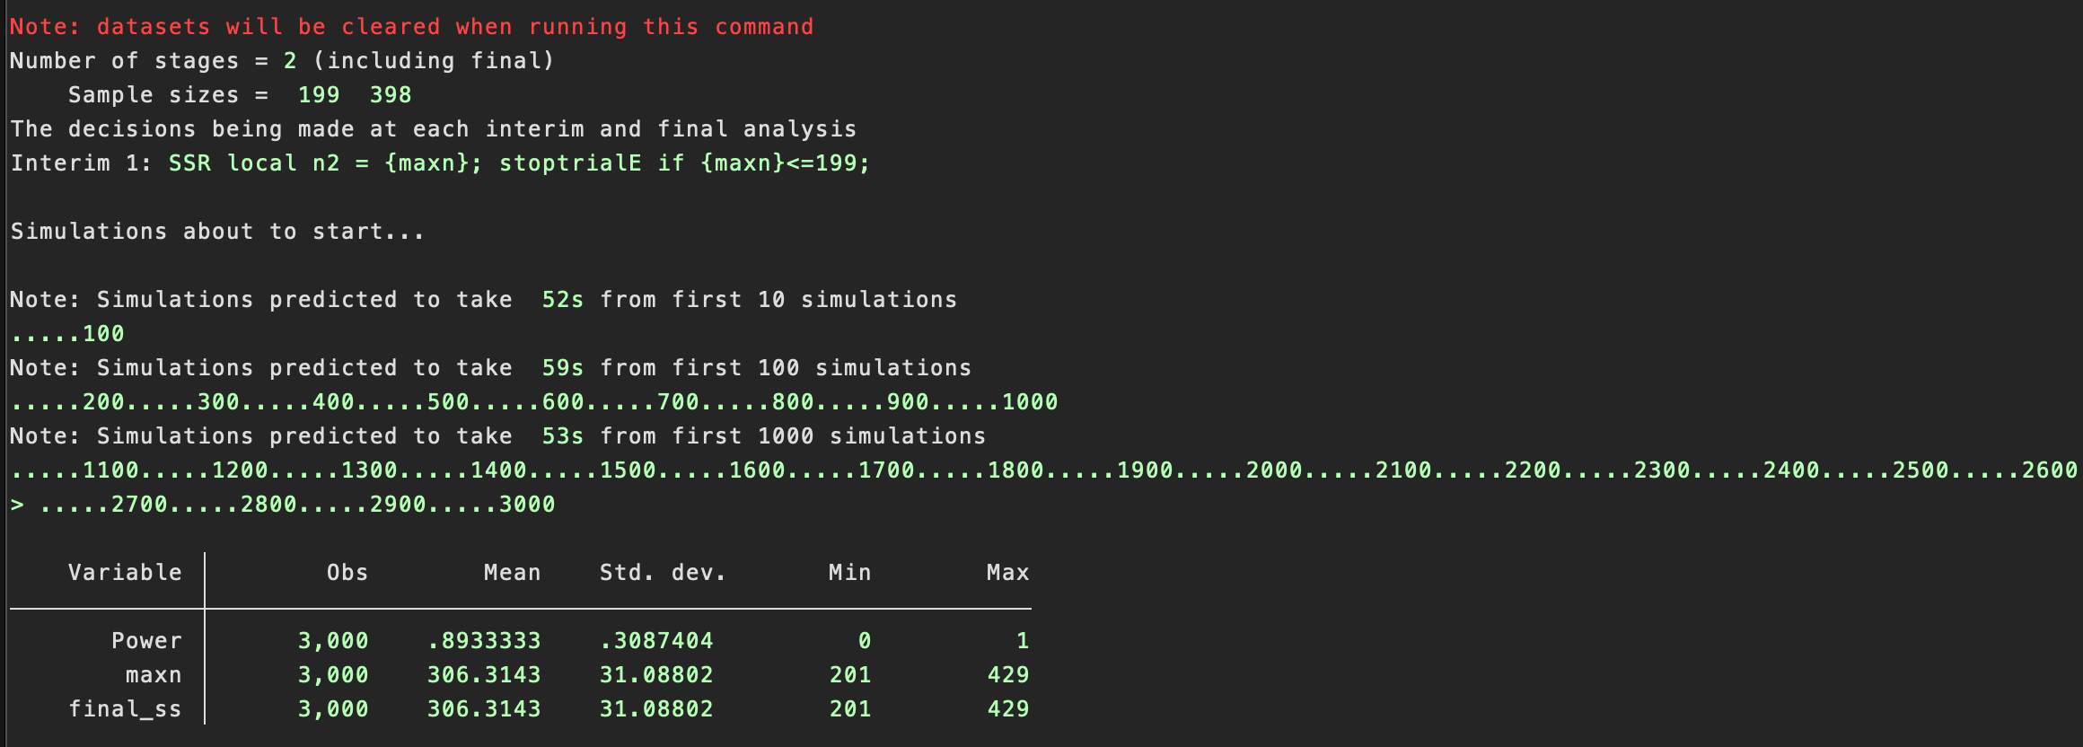
Sample size re-estimation two-arm parallel group trial

Slide 17
Response adaptive randomization 4-arm parallel group trial
We often design trials with a fixed allocation ratio throughout the trial, for example, the balanced design allocates equal numbers to each arm
The response adaptive design alters the balance in favour of better performing treatments
In this simple case at the interim calculate the p-value of each active arm versus control.
Then the probability the active treatment i is given is 0.75*(1-pv1)/(3-pv1-pv2-pv3) the control probability is 0.25.
Set sample size
Maximum sample size chosen using an of the SD of 6, $∆=2.6, α=0.0166$and $β=0.1$and is 146 per arm, using a Bonferroni correction
ss(n=200 n=584)

Slide 18
Response adaptive randomization 4-arm parallel group trial
Data step
Data are generated where treatment 3 is better than treatment 1 which is better than treatment 2
setup(local p0 0.25; local p1 0.25; local p2 0.25; local p3 0.25;)
data(
x~fixed({p0},{p1},{p2},{p3});
x1=x==1;
x2=x==2;
x3=x==3;
y~N(-1*x1-0.5*x2-2.6*x3, 6);
)
The allocation ratio starts as a 1:1:1:1 design (up to participant 200)

Slide 19
Response adaptive randomization 4-arm parallel group trial
Analysis and Output steps
A linear regression, using the test command to obtain the p-values and the rest are counting numbers in each treatment group
analysis(
reg y x1 x2 x3;
test x1; local pv1=r(p);
test x2; local pv2=r(p);
test x3; local pv3=r(p);
count if x1==1; local N1=r(N);
count if x2==1; local N2=r(N);
count if x3==1; local N3=r(N);
count if x1==0&x2==0&x3==0; local N0=r(N);
)
output( n_x0={N0}; n_x1= {N1}; n_x2={N2}; n_x3={N3};
pv_x1={pv1}; pv_x2={pv2}; pv_x3={pv3};)

Slide 20
Response adaptive randomization 4-arm parallel group trial
Decision step
A linear regression, using the test command to obtain the p-values and the rest are counting numbers in each treatment group
decision(
n=200: RAR local p1 = 0.75*(1-{pv1})/(3-{pv1}-{pv2}-{pv3});
RAR local p2 = 0.75*(1-{pv2})/(3-{pv1}-{pv2}-{pv3});
RAR local p3 = 0.75*(1-{pv3})/(3-{pv1}-{pv2}-{pv3});
)
Output summary step
outputsummary(
Power1 = pv_x12<0.0166; Power2 = pv_x22<0.0166; Power3 = pv_x32<0.0166;
Stage2_SS_0=n_x02; Stage2_SS_1=n_x12; Stage2_SS_2=n_x22; Stage2_SS_3=n_x32;)

Slide 21
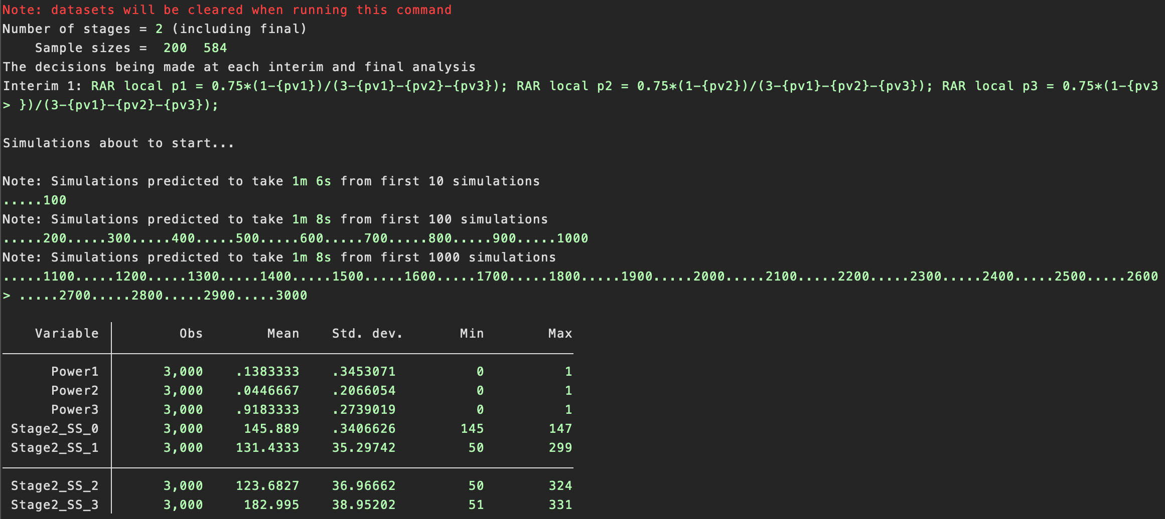
Response adaptive randomization 4-arm parallel group trial

Slide 22
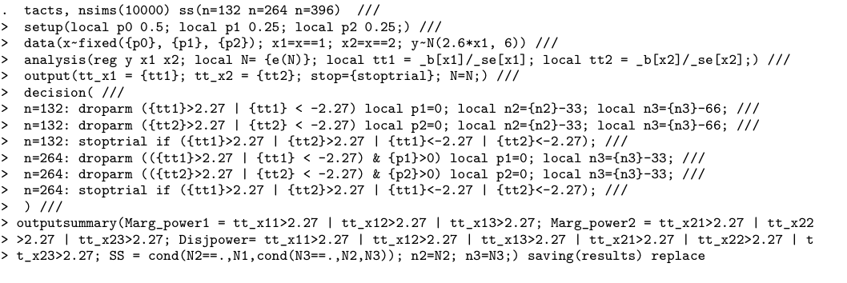
MAMS designs

Slide 23
Conclusions
Created a flexible command to handle many trial designs including:
Fixed sample size designs
Group-sequential designs
RAR designs
MAMS designs
Can handle other designs
Crossover designs
Longitudinal designs
Other distributions not just normal (Bernoulli, Survival, Expontential, etc…)
Buy our book to find out how to do the other simulations (hopefully later this year)

