Slide 1
bipolate: A Stata command for bivariate interpolation with particular application to 3D graphing
Joseph Canner, MHS
Xuan Hui, MD ScM
Eric Schneider, PhD
Johns Hopkins University
Stata Conference
Boston, MA
August 1, 2014

Slide 2
Background
Educational outcome study
  Continuous outcome
  Two categorical (1-5) predictors
Panel data
  8 time periods
  285 observations per time period
Researcher desired 3D plot of outcome versus two predictors

Slide 3
Solution #1: contour

Slide 4
Solution #2: surface*
. surface CommunicationNEW EduNEW COMPSS, xlabel(1/5) ylabel(1/5)
* by Adrian Mander, available from SSC

Slide 5
Result

Slide 6
collapse first
. collapse (mean) mCOMPSS=COMPSS, by(EduNEW CommunicationNEW)
. surface CommunicationNEW EduNEW mCOMPSS, xlabel(1/5) ylabel(1/5)

Slide 7
Result

Slide 8
SAS Solution
proc g3grid data=a out=b ;
grid EduNEW*CommNEW=mCOMPSS / axis1=1 to 5 by 0.1
axis2=1 to 5 by 0.1;
run;

Slide 9
SAS Solution (cont’d)
proc g3d data=b;
plot EduNEW*CommNEW=mCOMPSS / xticknum=5 yticknum=5 grid;
run;

Slide 10
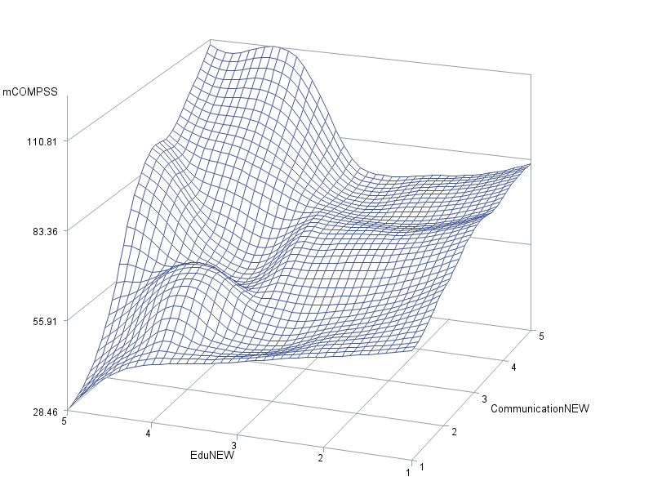
SAS Result

Slide 11
Stata Conference 2013
Wishes and grumbles session: no plans to implement 3D graphing

Slide 12
SAS PROC G3GRID
Interpolation options:
  <default>: biquintic polynomial
    PARTIAL: use splines for derivatives
    NEAR=n: number of nearest neighbors (default=3)
  SPLINE: bivariate spline
    SMOOTH=numlist: smoothed spline
  JOIN: linear interpolation

Slide 13
Bivariate interpolation
SAS G3GRID default
Akima, Hiroshi (1978), "A Method of Bivariate Interpolation and Smooth Surface Fitting for Irregularly Distributed Data Points," ACM Transaction on Mathematical Software, 4, 148-159.
Fortran 77 originally in the NCAR library; Fortran 77 and Fortran 90 versions freely available on the web

Slide 14
History
“The original version of BIVAR was written by Hiroshi Akima in August 1975 and rewritten by him in late 1976. It was incorporated into NCAR's public software libraries in January 1977. In August 1984 a new version of BIVAR, incorporating changes described in the Rocky Mountain Journal of Mathematics article cited below, was obtained from Dr. Akima by Michael Pernice of NCAR's Scientific Computing Division, who evaluated it and made it available in February, 1985.”
Ref: Hiroshi Akima, On Estimating Partial Derivatives for Bivariate Interpolation of Scattered Data, Rocky Mountain Journal of Mathematics, Volume 14, Number 1, Winter 1984.

Slide 15
Algorithm summary
XY plane divided into triangular cells
Bivariate quintic polynomial in X and Y fitted to each triangular cell
Coefficients are determined by continuity requirements and by estimates of partial derivatives at the vertices and along triangle edges

Slide 16
Algorithm features
Invariant to certain transformations:
  Rotation of XY coordinate system
  Linear scale transformation of the Z axis
  Tilting of the XY plane

Slide 17
Algorithm features (cont’d)
Interpolating function and first-order partial derivatives are continuous
Local method: change in data in one area does not effect the interpolating function in another area
Gives exact results when all points lie in a plane

Slide 18
bipolate command
Syntax: bipolate xvar yvar zvar [if] [in] [using] [, options]

Slide 19
bipolate options
method: interpolation or filling
xgrid, ygrid: specify x-axis and y-axis values to use for interpolation
fillusing: specify data set to use for filling
collapse: how to handle multiple values of z at a given x and y
saving: save the resulting data to set to disk

Slide 20
Use of bipolate
. bipolate CommunicationNEW EduNEW COMPSS, xgrid(1(0.1)5) ygrid(1(0.1)5) method(interp) saving(test_bip)
. use test_bip, clear
. surface EduNEW CommunicationNEW COMPSS_mod

Slide 21
Result

Slide 22
SAS Result

Slide 23
Remaining puzzles
Why are there small differences between interpolated values?
  SAS: “This default method is a modification of that described by Akima (1978)”
Re-orienting axis

Slide 24
surface …, … xscale(reverse)

Slide 25
bipolate+contour

Slide 26
Future plans
Make available on SSC within a few weeks
Test other data sets
Testing and debugging by Stata community

Slide 27
Cobar Mine Data

Slide 28
Cobar Mine Data method(interp)

Slide 29
Cobar Mine Data method(fill)

Slide 30
Cobar Mine Data twoway contour

Slide 31
Cobar Mine Data bipolate+twoway contour

Slide 32
Possible Future Enhancements
Implement partial and near options
Implement scale/noscale option
Implement spline and smooth spline interpolation
See if Mata has functions that can reproduce the algorithm more compactly

