Slide 1
Stata to Excel: From do-file to VBA James Pike email: james.pike@omc.com
11th September 2025 | UK Stata Conference

Slide 2
putexcel
Introduced in Stata 13, the putexcel command provides a flexible way of exporting Stata results directly to Microsoft Excel files.
We can programmatically export matrices, scalars, expressions, images and stored results to specified cells or ranges in an Excel worksheet.
The command supports a variety of output customisations, including cell formatting, formulas, and placement of results.
putexcel enables integration of Stata analyses with Excel-based reporting often used in professional environments.

Slide 3
How Adelphi Real World uses putexcel – An Example
One of my current pieces of work has 19 sheets that are generated via a do-file. A mixture of:
Descriptive statistics
Regressions
Survival analysis
Elastic net
Accompanying figures
If data is updated with new patients, the file is repopulated with updated analysis by simply running the do-file.
We use a mixture of manual putexcel (exporting specific results from stored results), and in-house commands to produce outputs for our project teams that have a similar/consistent format.

Slide 4

Some things Adelphi Real World wishes putexcel did
conditional formatting
Highlighting interesting data
autofit of cells
We nearly always resize cells to show the full contents
removing excess formatting
When we make Excels with lots of manipulation it sometimes hits a formatting limit and errors out

Slide 5
What is VBA?
Visual Basic for Applications (VBA) for Office - a simple, but powerful programming language that you can use to extend Office applications.
Nearly every operation that you can perform with a mouse, keyboard, or a dialog box can also be done by using VBA.
The automation of repetitive tasks is one of the most common uses of VBA in Office.
At Adelphi we have Macros set up for all sorts of tasks
Prior to putexcel we would paste delimited data into excel from a Stata log file with custom tags, and use a “TagFormatting” Macro to create formatted Excel documents
A Macro that creates standardised protocol/analysis plan documents from user inputs
We use them to format/adjust Stata output

Slide 6
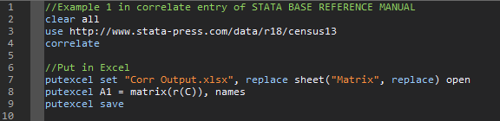
Example 1 - Stata

Slide 7
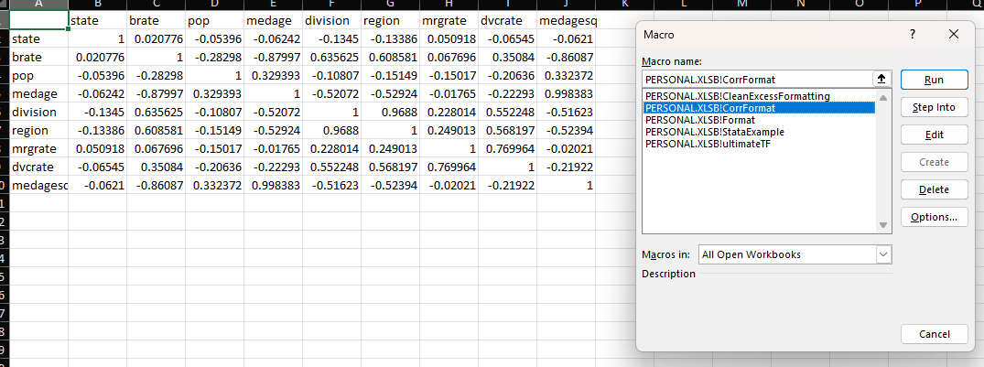
Example 1 – Excel VBA

Slide 8
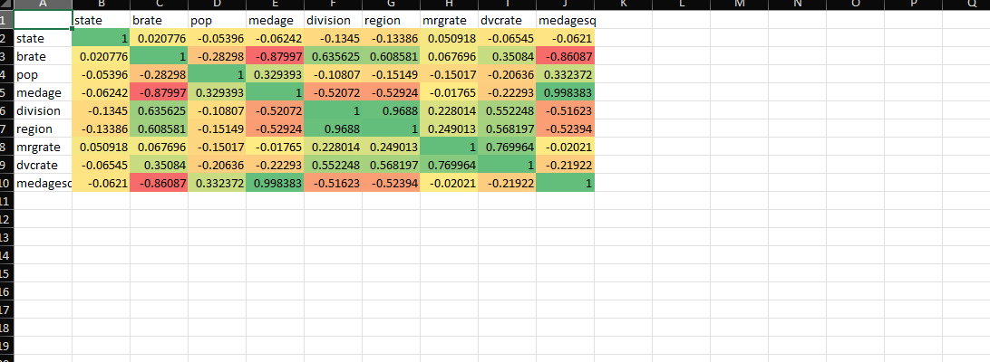
Example 1 – Resulting File

Slide 9
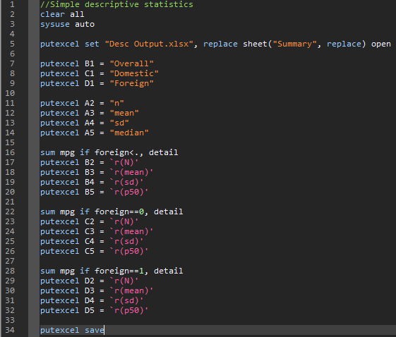
Example 2 – Stata

Slide 10
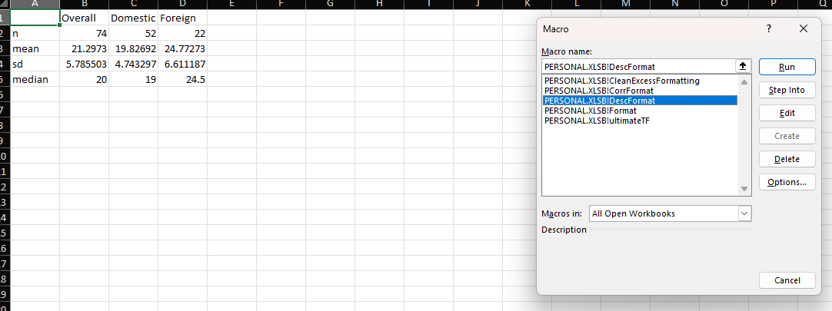
Example 2 – Excel vba

Slide 11
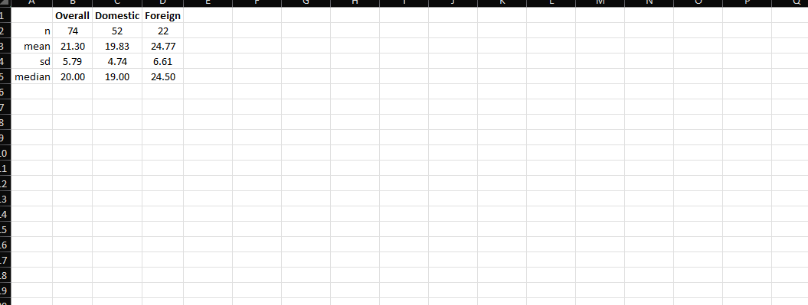
Example 2 – Resulting File

Slide 12
New Process – Part 1
Store your Excel VBA macros in PERSONAL.XLSB
This is usually saved in “C:\Users\username\AppData\Roaming\Microsoft\Excel\XLSTART”
(This file is created by Excel the first time you record a Macro)
Use the putexcel suite of commands in Stata to create an Excel file.
As usual, end with putexcel save

Slide 13
New Process – Part 2
Create the following vbs file in Stata using the file suite of commands:
Dim xlApp, xlWorkbook, personalWorkbook
Set xlApp = CreateObject("Excel.Application")
xlApp.Visible = False
Set personalWorkbook = xlApp.Workbooks.Open(xlApp.Application.StartupPath & "\PERSONAL.XLSB")
Set xlWorkbook = xlApp.Workbooks.Open("C:\YourExcelFile.xlsx")
xlApp.Run "PERSONAL.XLSB!YOURMACRONAME"
xlWorkbook.Save
xlWorkbook.Close
personalWorkbook.Close False
xlApp.Quit
Set xlWorkbook = Nothing
Set personalWorkbook = Nothing
Set xlApp = Nothing
Replace the blue text with appropriate substitutes
Save it as a tempfile.vbs
This vbs file opens your PERSONAL.XLSB, opens your specified Excel file, then runs the specified macro from PERSONAL.XLSB in your specified Excel file.

Slide 14
New Process – Part 3
Use the shell command in Stata to run the vbs file.
shell "c:\windows\system32\cscript.exe" "tempfile.vbs“
Note: While I’ve not done it, it would be trivial to turn the code that generates the vbs file into an ado program that accepts two inputs:
The name of the Excel file you want to run a Macro on
The name of any Macro you want to run

Slide 15
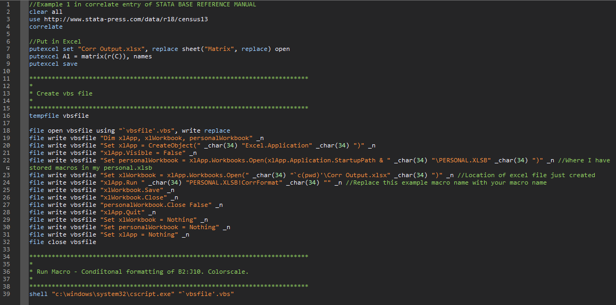
Example 1 VBA from Stata

Slide 16
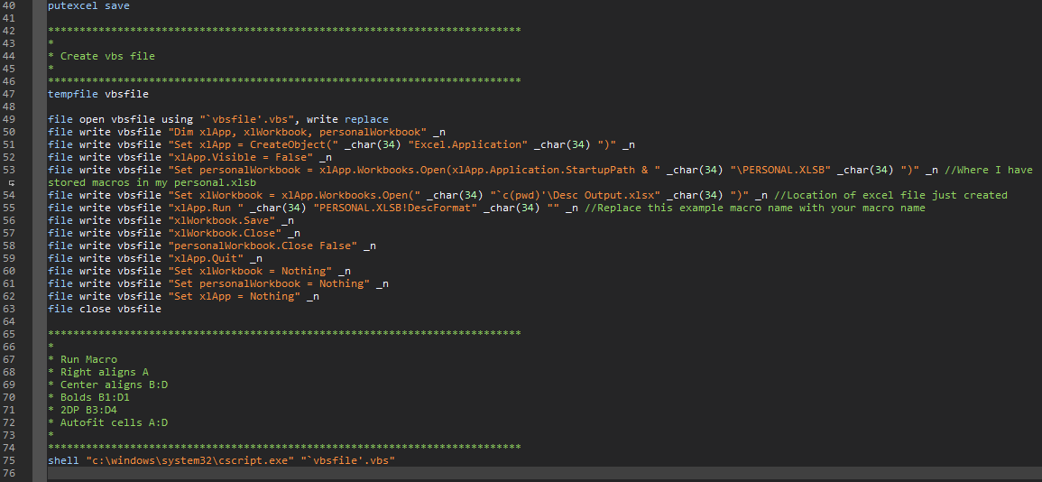
Example 2 – VBA from Stata

Slide 17
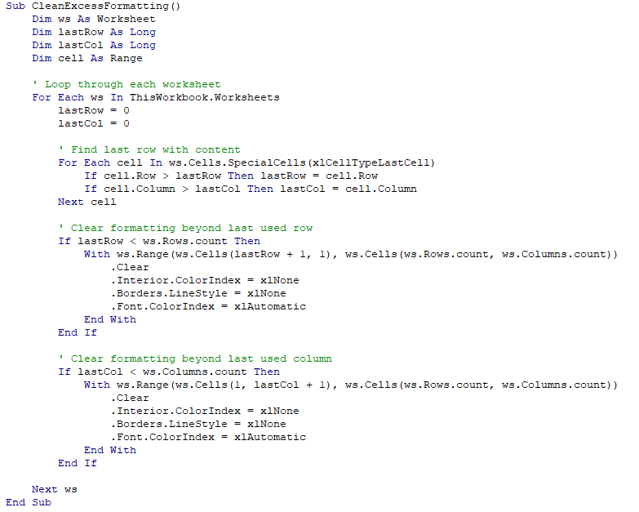
Practical Application – Clean Excess Formatting
I wrote a simple VBA script that clears cell formatting from beyond the last used row and the last used column
This is useful to mitigate against hitting the formatting limit

Slide 18
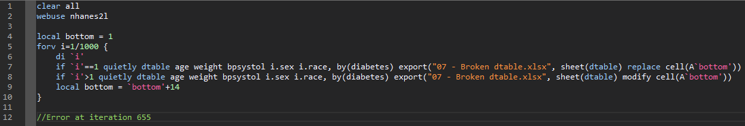
Stata code to break Excel

Slide 19
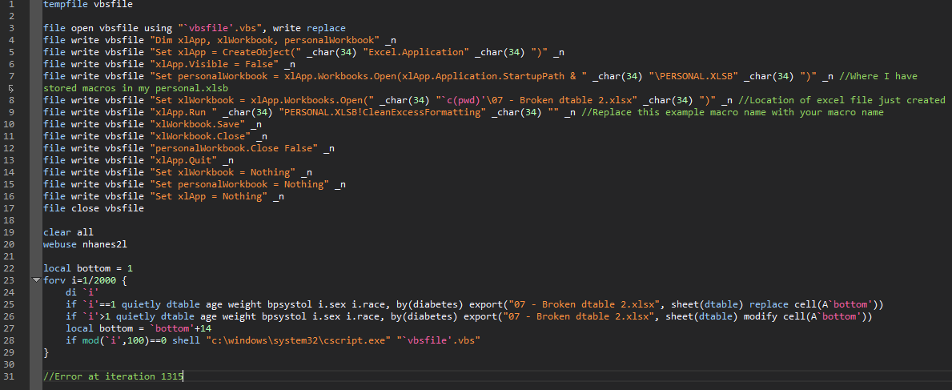
Stata code to break Excel while also using a VBA fix

Slide 20
Summary
You may enjoy a more streamlined workflow as you can run VBA Macros from your Stata do-files
No need to open Excel and rely on your hand/eye coordination
Fewer button clicks when you repeat analysis after new data, error corrections, updated assumptions, etc
With some adjustments to the vbs file this should also work in Word.

