Slide 1
Adventures with the profile log-likelihood
Ian White and Patrick Royston
Stata UK conference | London 11-12 Sep 2025
Notes:
15+5
Abstract:
pllf, written by Patrick Royston in 2007, computes and graphs the profile log-likelihood function for a wide variety of regression commands. This enables calculation of confidence intervals that do not rely on the standard Wald approximation that (estimate-true)/SE is Normally distributed: pllf confidence intervals are likely to perform better than Wald ones in smaller samples.
We believe pllf is an under-used command for analysis, and we also find it useful for understanding and explaining statistical methods. We aim to demonstrate its usefulness for teaching purposes and for understanding bias in two-stage meta-analysis.
We also describe some recent minor improvements in pllf (e.g. it is now a prefix command). The latest version is available on github and SSC.

Slide 2
Outline
Introduction to profile likelihood and pllf
Sparse data
Perfect prediction
Understanding bias in two-stage meta-analysis
Package
Newly updated package (tested but not finalised) is at github.com/UCL/pllf
Original package:
Royston P. Profile likelihood for estimation and confidence Intervals. Stata Journal (2007). doi:10.1177/1536867X0700700305

Slide 3
Example: German breast cancer data
. webuse brcancer, clear
(German breast cancer data)
. stset rectime, fail(censrec)
. stcox x1 x4a x5e x6 hormon, nohr
Cox regression with Breslow method for ties
No. of subjects = 686 Number of obs = 686
No. of failures = 299
Time at risk = 771,400
LR chi2(5) = 127.19
Log likelihood = -1724.5758 Prob > chi2 = 0.0000
[ctd.]
Notes:
webuse brcancer, clear
stset rectime, fail(censrec)
stcox x1 x4a x5e x6 hormon, nohr

Slide 4
Simple example
[ctd.]
Log likelihood = -1724.5758 Prob > chi2 = 0.0000
------------------------------------------------------------------------------
_t | Coefficient Std. err. z P>|z| [95% conf. interval]
-------------+----------------------------------------------------------------
x1 | .0010071 .0060449 0.17 0.868 -.0108407 .0128548
x4a | .6464434 .2466192 2.62 0.009 .1630787 1.129808
x5e | -1.994528 .2258596 -8.83 0.000 -2.437204 -1.551851
x6 | -.002276 .0005416 -4.20 0.000 -.0033376 -.0012144
hormon | -.3821333 .1280919 -2.98 0.003 -.6331889 -.1310778
------------------------------------------------------------------------------
Suppose we’re interested in the log odds ratio for x5e
How accurate are these “asymptotic” inferences?

Slide 5
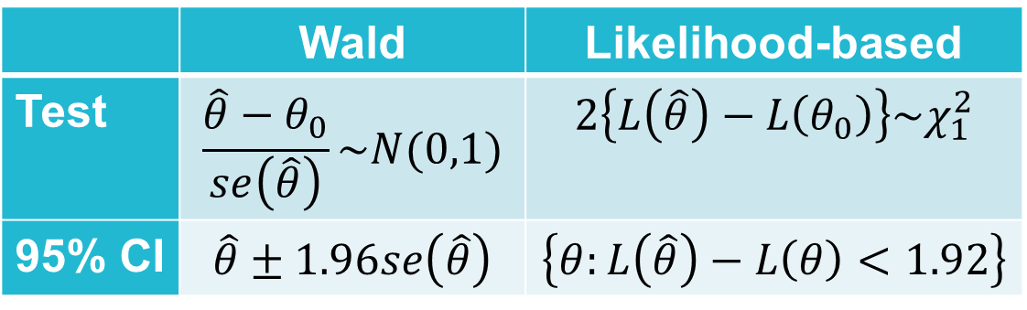
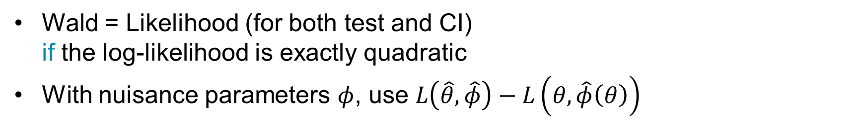
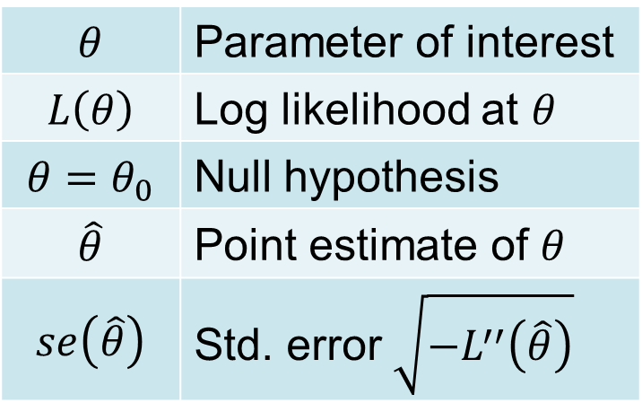
Tests and CIs
 | Wald | Likelihood-based
Test | $$\frac{\hat{θ}−θ_{0}}{se\left(\hat{θ}\right)}\sim N(0,1)$$ | $$2\left\{L\left(\hat{θ}\right)−L\left(θ_{0}\right)\right\}\sim χ_{1}^{2}$$
95% CI | $$\hat{θ}±1.96se\left(\hat{θ}\right)$$ | $$\left\{θ:L\left(\hat{θ}\right)−L\left(θ\right)<1.92\right\}$$
$$θ$$ | Parameter of interest
$$L\left(θ\right)$$ | Log likelihood at $θ$
$$θ=θ_{0}$$ | Null hypothesis
$$\hat{θ}$$ | Point estimate of $θ$
$$se\left(\hat{θ}\right)$$ | Std. error $\sqrt{{−L}^{′′}\left(\hat{θ}\right)}$
Wald = Likelihood (for both test and CI) if the log-likelihood is exactly quadratic
With nuisance parameters $φ$, use $L\left(\hat{θ},\hat{φ}\right)−L\left(θ,\hat{φ}\left(θ\right)\right)$
Profile log-likelihood

Slide 6
MLE=-1.99
1.92
In moderate-large data sets, Wald and profile likelihood give very similar results
95% CI
-------------------------------------------------------------
_t | Coef. Std. Err. [95% PLL Conf. Int.]
-------------+-----------------------------------------------
x5e | -1.994528 .2259809 -2.435381 -1.549552
-------------------------------------------------------------
Note: Std. Err. is pseudo standard error, derived from PLL CI
pllf
Wald: -2.437204 -1.551851
Notes:
pllf, profile(x5e) range(-3 -1) mleline gropt(title("")): stcox x1 x4a x5e x6 hormon, nohr

Slide 7
Sparse data

Slide 8
Sparse data
 | Outcome
Treatment | Y=0 | Y=1 | All
Z=0 | 38 | 4 | 42
Z=1 | 36 | 1 | 37
Log-likelihood may not be quadratic, or even symmetrical
Notes:
clear
input Z Y n
0 0 38
0 1 4
1 0 36
1 1 1
end
tab Z Y [fw=n]
pllf, profile(Z) range(-6 2) mleline: logit Y Z [fw=n]

Slide 9
pllf output
pllf, profile(Z): logit Y Z [fw=n]
Asymmetry = -20.8%
-18
PLL (& hence CI) is asymmetrical on log OR scale
-20
-22
-24
-4
-2
0
2
-------------------------------------------------------------
Y | Coef. Std. Err. [95% PLL Conf. Int.]
-------------+-----------------------------------------------
Z | -1.332227 1.266862 -4.330396 .6356139
-------------------------------------------------------------
Note: Std. Err. is pseudo standard error, derived from PLL CI
_b[Z]
profile log likelihood function
Normal approximation
Wald: -3.570446 .9059913

Slide 10
Perfect prediction
A setting where the PLLF is very useful

Slide 11
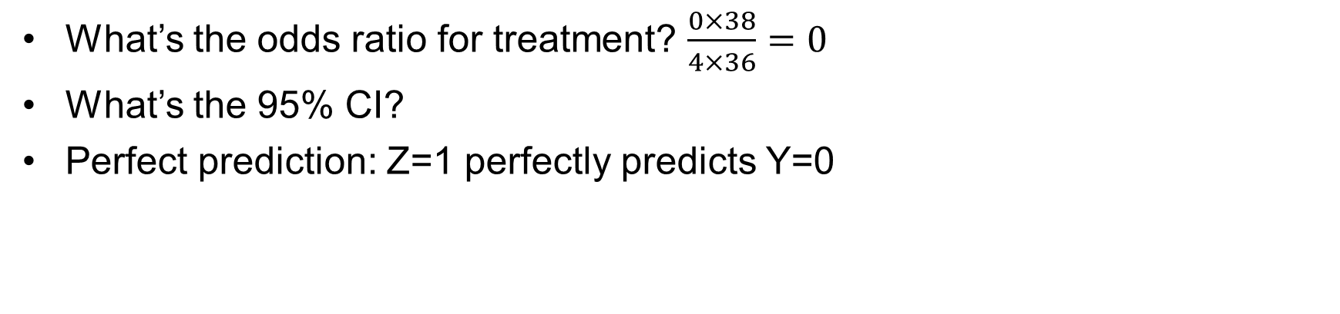
Data with perfect prediction
 | Outcome
Treatment | Y=0 | Y=1 | All
Z=0 | 38 | 4 | 42
Z=1 | 36 | 0 | 36
What’s the odds ratio for treatment? $\frac{0×38}{4×36}=0$
What’s the 95% CI?
Perfect prediction: Z=1 perfectly predicts Y=0
Notes:
clear
input Z Y n
0 0 38
0 1 4
1 0 36
1 1 0
end
tab Z Y [fw=n]

Slide 12
logit output
. logit Y Z [fw=n]
note: Z != 0 predicts failure perfectly;
Z omitted and 1 obs not used.
Logistic regression Number of obs = 42
LR chi2(0) = -0.00
Prob > chi2 = .
Log likelihood = -13.208672 Pseudo R2 = -0.0000
------------------------------------------------------------------------------
d | Coefficient Std. err. z P>|z| [95% conf. interval]
-------------+----------------------------------------------------------------
Z | 0 (omitted)
_cons | -2.251292 .5256575 -4.28 0.000 -3.281562 -1.221022
------------------------------------------------------------------------------
Notes:
logit Y Z [fw=n]

Slide 13
logit output
. logit Y Z [fw=n], asis
[11 iterations]
Logistic regression Number of obs = 78
LR chi2(0) = 5.14
Prob > chi2 = .
Log likelihood = -13.208672 Pseudo R2 = 0.1628
------------------------------------------------------------------------------
Y | Coefficient Std. err. z P>|z| [95% conf. interval]
-------------+----------------------------------------------------------------
Z | -15.88548 . . . . .
_cons | -2.251292 .5256575 -4.28 0.000 -3.281561 -1.221022
------------------------------------------------------------------------------
Note: 36 failures and 0 successes completely determined.
Notes:
logit Y Z [fw=n], asis

Slide 14

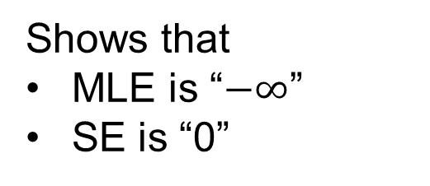
pllf output
pllf, profile(Z) range(-5 0): logit Y Z [fw=n]
Shows that
MLE is “$−∞$”
SE is “0”
Report as OR = 0 (95% CI, 0 to 0.68)
$$exp⁡(−0.389)$$
-------------------------------------------------------------
Y | Coef. Std. Err. [95% PLL Conf. Int.]
-------------+-----------------------------------------------
Z | . . . -.3892171
-------------------------------------------------------------
Note: Std. Err. is pseudo standard error, derived from PLL CI
pllf
Notes:
pllf, profile(Z) range(-5 0) gropt(title("") $PPT) mleline: logit Y Z [fw=n]

Slide 15
Understanding two-stage meta-analysis

Slide 16
A simple meta-analysis data set to explore asymmetric log-likelihoods
Study | Treatment group, events/person-years | Control group, events/person-years
1 | 10/1000 | 40/1000
2 | 60/1000 | 60/1000
To make the point, I’ll do common-effect meta-analysis (i.e. wrongly assume no heterogeneity in treatment effect between studies)
Ideal analysis: poisson d i.z i.study, exp(py)
gives log rate ratio = -0.36 (SE 0.16) or RR = 0.70 (0.516 to 0.95)
Notes:
“meta\Federated analysis\Poisson idea for 2-stage\why two-stage is biased.do”

Slide 17
Meta-analysis: two-stage Normal
Study | Treatment, events/pyears | Control, events/pyears | Log RR | Se(log RR)
1 | 10/1000 | 40/1000 | -1.39 | 0.35
2 | 60/1000 | 60/1000 | 0.00 | 0.18

Slide 18
Poisson vs two-stage Normal
Study | Treatment, events/pyears | Control, events/pyears | Log RR | Se(log RR)
1 | 10/1000 | 40/1000 | -1.39 | 0.35
2 | 60/1000 | 60/1000 | 0.00 | 0.18
Poisson: log RR = -0.36 (SE 0.16)
2-stage Normal: log RR = -0.29 (SE 0.16)
It’s a common finding that 2-stage Normal is closer to [biased towards] the null

Slide 19
Meta-analysis data: profile log-likelihoods
Study 1: 10 vs 40 events.
Study 2: 60 vs 60 events.
Notes:
“meta\Federated analysis\Poisson idea for 2-stage\why two-stage is biased.do”

Slide 20
Pooled estimate
Impact of Normal approx. on profile likelihood for study 1 (10 vs 40):
too steep on the left
too shallow on the right
What matters for the MA is how it behaves near the pooled estimate (~-0.3)
too shallow where it matters
Impact of Normal approx. on study 2 (60 vs 60): small
Impact of Normal approx. on MA: under-weight study 1
Bias towards null!

Slide 21
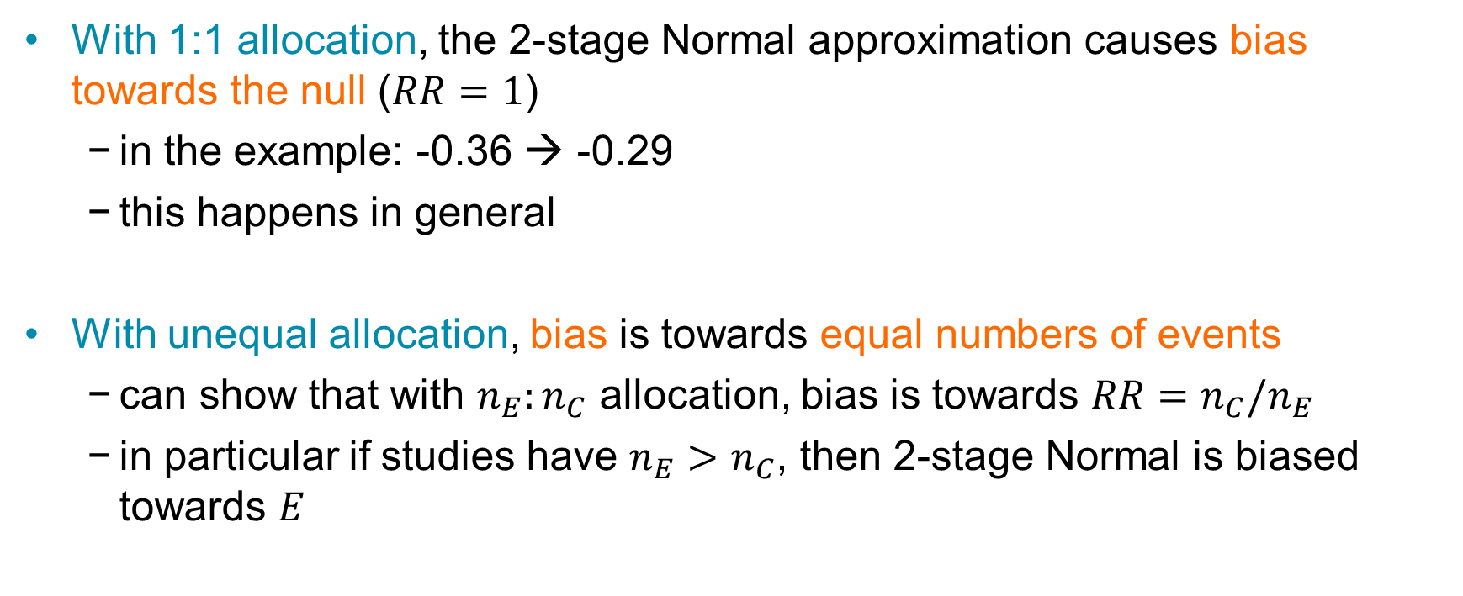
Conclusion for meta-analysis
With 1:1 allocation, the 2-stage Normal approximation causes bias towards the null ($RR=1$)
in the example: -0.36 → -0.29
this happens in general
With unequal allocation, bias is towards equal numbers of events
can show that with $n_{E}:n_{C}$ allocation, bias is towards $RR=n_{C}/n_{E}$
in particular if studies have $n_{E}>n_{C}$, then 2-stage Normal is biased towards $E$

Slide 22
Updated package pllf

Slide 23
pllf: syntax and changes
Syntax: now a prefix command: pllf, profile(varname) [pllf_opts]: regcmd …
Bug fixes
works with perfect prediction
excessive collinearity check dropped
exposure() and offset() enabled
New functionality
allow profiling the constant
eform option reports on exponentiated scale
normal option also graphs Normal approximation to PLLF
Package is at: github.com/UCL/pllf

Slide 24
Discussion
pllf is a useful command for checking the Wald approximation
Typically useful in sparse data
usually meaning very few events in at least one group
Useful in teaching
Wald vs LRT
perfect prediction
It helps explain why two-stage meta-analysis is often biased towards the null

