Slide 1
Seamless Multi-Arm Multi-Stage (MAMS) designs with treatment selection: A new Stata command nstagects
Yumeng Liu
Supervisor: Dr Babak Choodari-Oskooei
MRC Clinical Trials Unit at UCL
Institute of Clinical Trials & Methodology,
University College London
UK Stata Conference | London 11-12 September 2025
1/28

Slide 2
Overview
Background of MAMS design
Standard MAMS framework and extensions
New command nstagects with examples
Design considerations in practice
2/28

Slide 3



Two-arm RCT vs. MAMS
Advantages of Multi-Arm Multi-Stage design
Multi-stage | Multi-arm
Interims analyses
When reaching the “stagewise” target sample size
Hypothesis tests, accumulating data
Stopping rules:
lack of benefit – a safety net; overwhelming efficacy; promising but not excelling …
Control
Experimental
Control
E1
E2
E3
Stage 1
Stage 2
Stage 3
3/28
Notes:
Brief of MAMS, may mention the OG from Royson’s framework

Slide 4
Advantages of Multi-Arm Multi-Stage design
Multi-stage | Multi-arm
Why multiple experimental arms?
Simultaneous drug evaluation
- select the best, increased efficiency
Shared control samples
- smaller overall sample size relative to multiple separate two-arm RCTs
Common trial infrastructure and regulatory pathway
- robust decision making; less competition for patients
Control
E1
E2
E3
Stage 1
Stage 2
Stage 3
4/28

Slide 5









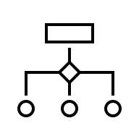




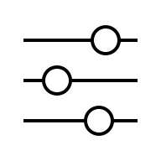

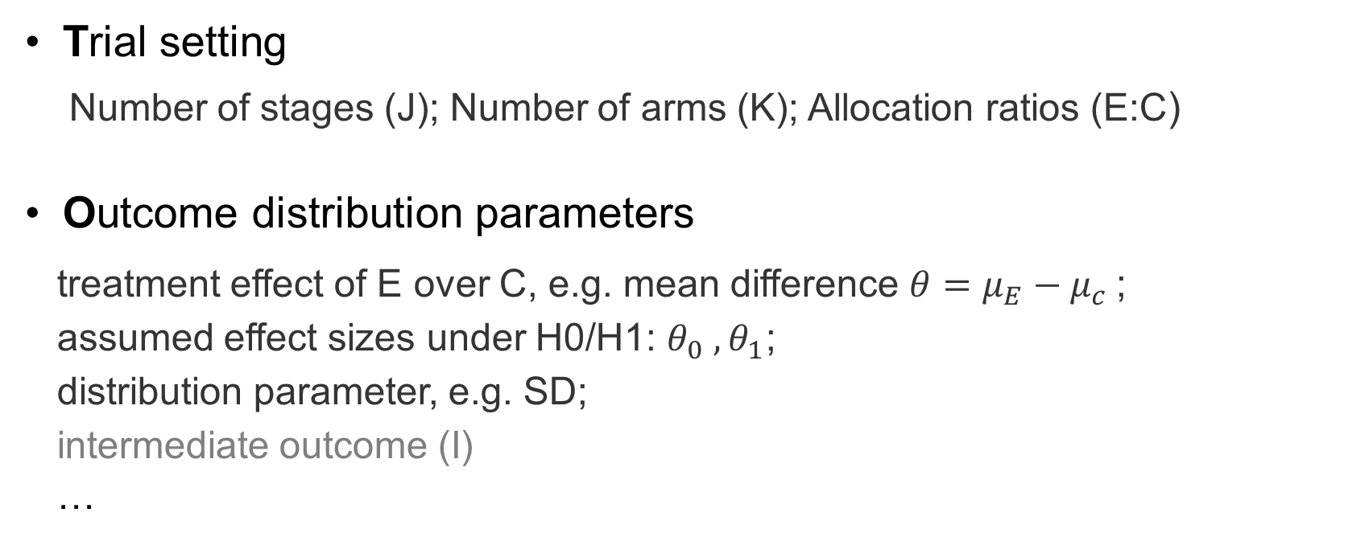
General MAMS framework
TOAST part 1 | TOAST part 2 | Objectives
Specifying a MAMS design (TOAST)
Trial setting
Number of stages (J); Number of arms (K); Allocation ratios (E:C)
Outcome distribution parameters
treatment effect of E over C, e.g. mean difference ${θ=μ_{E}−μ_{c}}_{ }$;
assumed effect sizes under H0/H1: $θ_{0} , θ_{1}$;
distribution parameter, e.g. SD;
intermediate outcome (I)
…
5/28

Slide 6




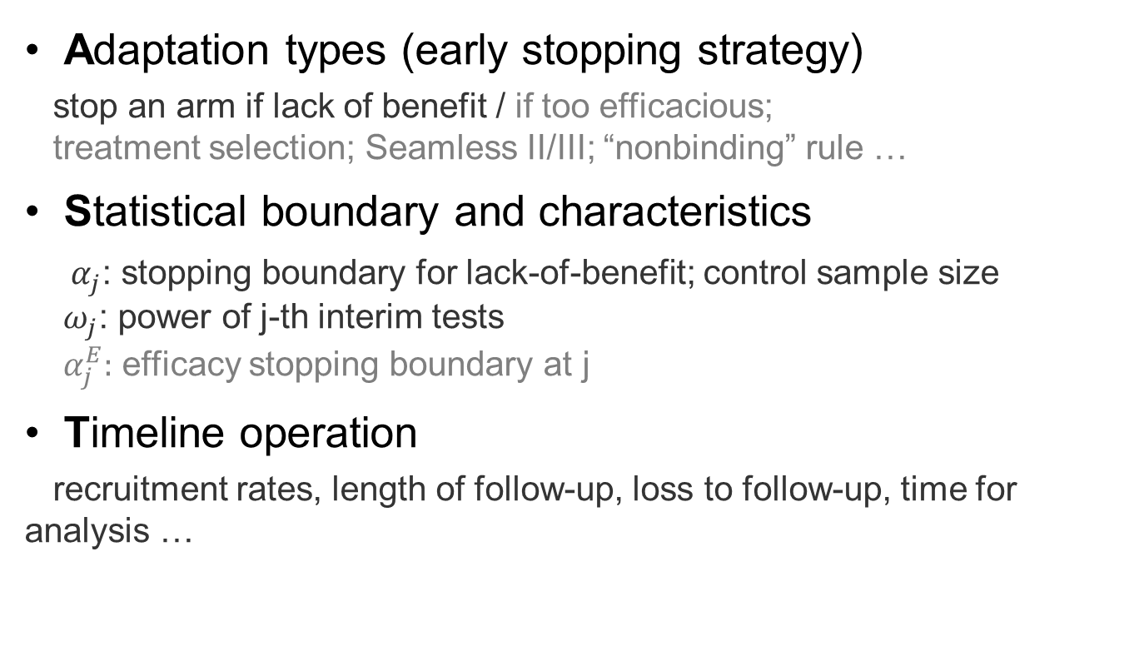
General MAMS framework
TOAST part 1 | TOAST part 2 | Objectives
Specifying a MAMS design (TOAST) continue…
Control
E1
E2
E3
Adaptation types (early stopping strategy)
stop an arm if lack of benefit / if too efficacious;
treatment selection; Seamless II/III; “nonbinding” rule …
Statistical boundary and characteristics
$α_{j}$: stopping boundary for lack-of-benefit; control sample size
$ω_{j}$: power of j-th interim tests
$α_{j}^{E}:$ efficacy stopping boundary at j
Timeline operation
recruitment rates, length of follow-up, loss to follow-up, time for analysis …
${(α}_{1}$, $ω_{1}$)
${(α}_{2}$, $ω_{2}$)
${(α}_{3}$, $ω_{3}$)
6/28

Slide 7




General MAMS framework
TOAST part 1 | TOAST part 2 | Objectives
What should we address?
Sample size required to plan for each stage
Overall type I errors / powers given adaptive rules
Familywise Error Rate (FWER) controlling for multiple testing
Prob(At least one arm tested false positive)
If any efficiency could be gained?
7/28

Slide 8
MAMS design implementation in Stata
New features | IBS study | Syntax | Outputs
A new Stata program: nstagects
 | New | Existing “nstage” suite for MAMS
Name | nstagects | nstage | nstagebin
Outcome type | Continuous | Time-to-event | Binary
I- outcome | Y | Y | Y
Futility stop | Y | Y | Y
Efficacy stop | Y | Y | Y (TBR)
Nonbinding default | Y | N | N (TBR)
Selection rule | Y | N | N (TBR)
FWER control | Y | Y | N (TBR)
Custom I-stage | Y | N | N (TBR)
Custom Eff-stage | Y | N | N (TBR)
TBR – new version to be released to SSC
8/28

Slide 9
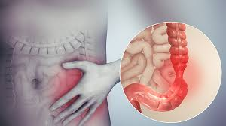
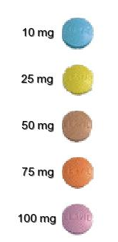
MAMS design implementation in Stata
New features | IBS study | Syntax | Outputs
Example -- the IBS study
Irritable Bowel Syndrome (IBS)
Four amitriptyline doses, One placebo;
Primary outcome: IBS Severity Scoring System (IBS-SSS),0-500, at 6 months
A 5-arm 3-stage trial:
Analysis 1
Analysis 2
Final analysis
?
?
?
Claim any efficacy
Placebo
9/28
Graphs sources: https://en.wikipedia.org/wiki/Irritable_bowel_syndrome; https://thepainsource.com/amitriptyline-elavil/
Notes:
Mention controlling FWER, multiple comparisons

Slide 10
MAMS design implementation in Stata
New features | IBS study | Syntax | Outputs
The syntax: nstagects
Example 1. The IBS study
Continuous outcome: Irritable Bowel Syndrome (IBS) Severity Score at 6 months
Five arms: 4 amitriptyline doses + 1 placebo, stop for lack-of-benefit
Target effect size: 35-point reduction in IBS score
nstagects, nstage(3) arms(5 5 5) aratio(0.5) ///
theta0(0) theta1(-35) sd(100) ///
binding ///
alpha(0.35 0.1 0.01) power(0.95 0.93 0.90) ///
accrate(240 240 240) fu(0.5) ltfu(0.125) ///
ess seed(9122025) fwercontrol(0.025)
Trial setting (T)
Outcome parameters (O)
Adaptation types (A)
Statistical boundaries (S)
Time operation (T)
10/28

Slide 11
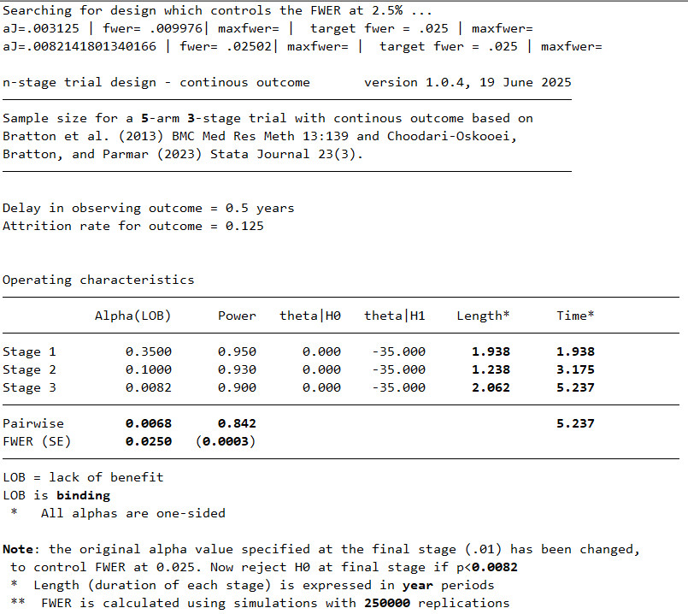
MAMS design implementation in Stata
New features | IBS study | Syntax | Outputs
nstagects outputs
（sections x2）
Section 1
Overall operating characteristics (to control)
Projected timeline (for planning)
nstagects, nstage(3) arms(5 5 5) aratio(0.5) theta0(0) theta1(-35) sd(100) alpha(0.35 0.1 0.01) power(0.95 0.93 0.90) binding accrate(240 240 240) fu(0.5) ltfu(0.125) ess seed(9122025)fwercontrol(0.025)
11/28

Slide 12
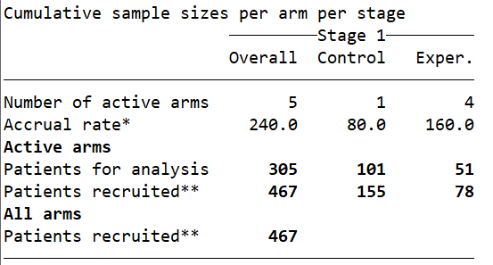
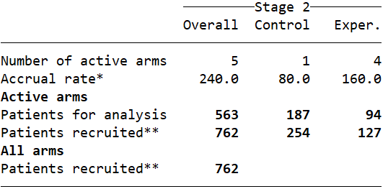
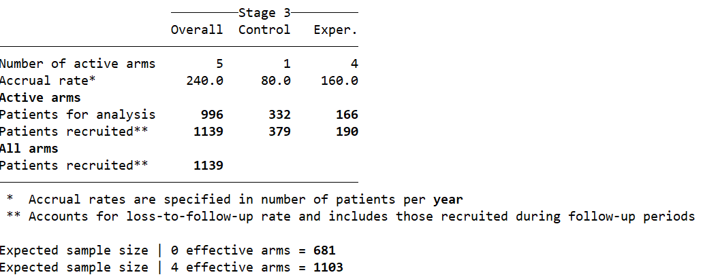
MAMS design implementation in Stata
New features | IBS study | Syntax | Outputs
nstagects outputs
sections 2
Target sample size for each stage
Expected sample size (ESS) when arms can be stopped for lack-of-benefit
12/28

Slide 13

MAMS design implementation in Stata
New features | IBS study | Syntax | Outputs
Back to the IBS trial
4x two-arm RCTs
All fixed sample sizes
E:C = 1:1
Pairwise significance level = 0.025
Power = 0.85
5-arm MAMS trial
Three stages
E:C = 1:2
Familywise Error rate (FWER) = 0.025
Power = 0.85
No | Design | Type I error rate Control (value) | Pairwise type I error | Overall power | Total/ max. SS | ESS|H0
1 | 4x two-arm | Pairwise (0.025) | 0.025 | 0.85 | 1344 | -
2 | 5-arm MAMS | Familywise (0.025) | 0.008 | 0.85 | 1139 | 681
Note: The FWER across 4x two-arm trials is 1-(1-0.025)^4 = 0.096
Potential increase in trial efficiency!
13/28
Graph source: https://www.vectorstock.com/royalty-free-vectors/vs-cartoon-vectors

Slide 14
MAMS with change of outcome
MAMS Trial Design: Extensions
I-outcome | Selection | Seamless | Efficacy stop
Intermediate outcome (I)
- why: shorter follow-up time, faster “information” accrual rate on I
- can differ from the primary/definitive outcome (D), Royston et al. (2011)
- only for interim decision-making, whether go to next stage
Parameters specified separately for I and D
nstagects, nstage(3) arms(5 5 5) aratio(0.5) ///
theta0(0 0) theta1(-30 -35) sd(80 100) rho(0.7) /// <- corr(I,D), (O)
istage(2) /// <- I used by stage 2 (A)
fu(0.25 0.5) ltfu(0.10 0.125) /// <- shorter FU period (T)
alpha(0.35 0.1 0.0082) power(0.95 0.93 0.90) accrate(240 240 240) seed(6192025) ess
14/28

Slide 15
MAMS Trial Design: Extensions
I-outcome | Selection | Seamless | Efficacy stop
MAMS with change of outcome
Example 2. The 5-arm 3-stage IBS study (continue)
Intermediate outcome (continuous): IBS Score at 3 months
I-outcome used at Stage 1 OR Stage1&2 .
Target effect size (SD): -30 (80) on I ; -35 (100) on D
Correlation between I and D: 0.7
Can stop arm for lack-of-benefit earlier if happens
Stage | Sig. level (One-sided) | Design power | Outcome |  | Overall Sample size |  | Timeline (years) |  | Timeline without I
 |  |  | S1 | S1&2 | S1 | S1&2 | S1 | S1&2
1 | 0.35 | 0.95 | I | I | 354 | 354 | 1.475 | 1.475 | 1.938
2 | 0.10 | 0.93 | D | I | 762 | 605 | 3.175 | 2.513 | 3.175
3 | 0.0082 | 0.90 | D | D | 1139 | 1139 | 5.237 | 5.238 | 5.237
Overall | 0.03* | 0.90
* Familywise type I error rate (FWER) under nonbinding rule
15/28

Slide 16
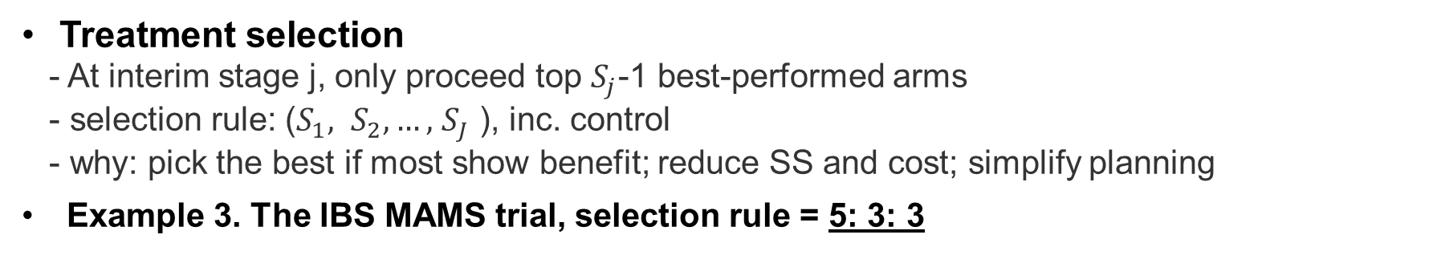
MAMS selection design
MAMS Trial Design: Extensions
I-outcome | Selection | Seamless | Efficacy stop
Treatment selection
- At interim stage j, only proceed top $S_{j}$-1 best-performed arms
- selection rule: ($S_{1}, S_{2}, …,$ $S_{J}$ ), inc. control
- why: pick the best if most show benefit; reduce SS and cost; simplify planning
Example 3. The IBS MAMS trial, selection rule = 5: 3: 3
Analysis 1
Analysis 2
Final analysis
?
?
?
Claim any efficacy (max= 2)
Placebo
16/28

Slide 17
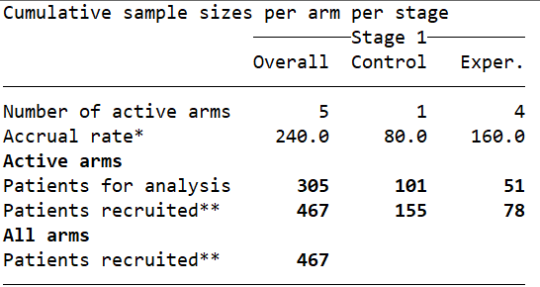
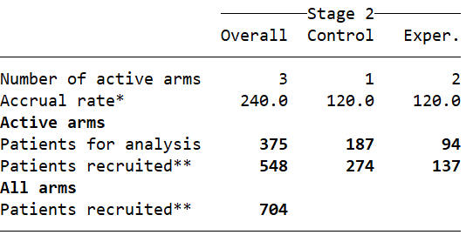
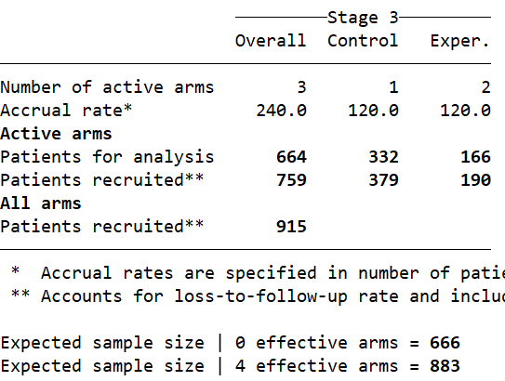
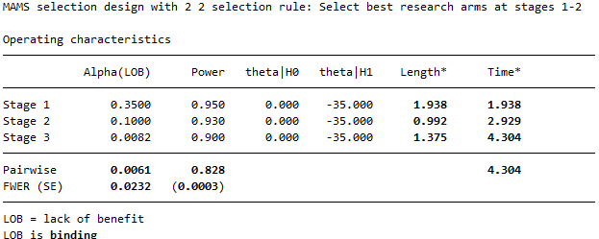
MAMS selection design
MAMS Trial Design: Extensions
I-outcome | Selection | Seamless | Efficacy stop
Selection rule specified in Stata
nstagects,
nstage(3) arms(5 3 3) aratio(0.5) /// <- specify selection in arm()(B)
theta0(0 0) theta1(-30 -35) sd(80 100) rho(0.7) ///
selection binding/// <- conduct treatment selection (A)
fu(0.25 0.5) ltfu(0.10 0.125) alpha(0.35 0.1 0.0083) power(0.95 0.93 0.90) accrate(240 240 240) seed(6192025) ess
17/28

Slide 18
MAMS Trial Design: Extensions
I-outcome | Selection | Seamless | Efficacy stop
MAMS selection design
Example 3. The IBS MAMS trial (continue)
3-stage, 5-arm - Primary outcome: IBS score at 6 months
Significance level: 0.35 0.1 0.0083 - Power = 0.95 0.93 0.90
Selection rule: (5 3 3)
No | Design | Type I error rate control (value) | Pairwise type I error | Power | Total/ max. SS | ESS|H1
1 | 4x two-arm | Pairwise (0.025) | 0.025 | 0.85 | 1344 | 1344
2 | 5-arm MAMS | Familywise (0.025) | 0.007 | 0.85 | 1139 | 1103
3 | selection MAMS | Familywise (0.023) | 0.006 | 0.83 | 915 | 883
Note: compared to 5-arm MAMS, the selection MAMS reduces the total study duration from 5.237 to 4.304 (years) by almost one year!
18/28

Slide 19
Seamless MAMS with treatment selection
MAMS Trial Design: Extensions
I-outcome | Selection | Seamless | Efficacy stop
A combination: Selection MAMS design + change of outcome
Seamless II/III trial setting:
phase II: select top-K drugs among candidates, on a clinical outcome (I)
phase III: to claim efficacy of any drug, on the definitive outcome (D)
Example 4. The IBS seamless II/III MAMS with selection (5:3:3)
Phase II analysis ( I-Outcome)
Phase III interim ( D-outcome)
Phase III Final
( D-outcome)
?
Max =2 drugs proceeded
?
?
Claim any efficacy
Placebo
19/28

Slide 20
Seamless MAMS with treatment selection
MAMS Trial Design: Extensions
I-outcome | Selection | Seamless | Efficacy stop
Example 4. IBS seamless II/III MAMS design |  |  |  |  |  |  | Previous timelines (years)
Stage | Phase | Sig. level (One-sided) | Design power | I/D | Overall SS | Timeline (years) | Selection (5:3:3) | I at 1st stage | I=D
1 | II | 0.35 | 0.95 | I | 354 | 1.475 | 1.938 | 1.475 | 1.938
2 | III | 0.10 | 0.93 | D | 666 | 2.775 | 2.929 | 3.175 | 3.175
3 | III | 0.0082 | 0.90 | D | 877 | 4.150 | 4.304 | 5.237 | 5.237
Overall |  | 0.0234 | 0.852
In Stata:
nstagects, nstage(3) arms(5 3 3) aratio(0.5) /// <- select 2 drugs for phase III (T)
theta0(0 0) theta1(-30 -35) sd(80 100) rho(0.7) ///
istage(1) selection /// <- I-outcome used for one-stage phase II (A)
fu(0.25 0.5) ltfu(0.10 0.125) alpha(0.35 0.1 0.0082) power(0.95 0.93 0.90) accrate(240 240 240) seed(6192025) ess
20/28

Slide 21
MAMS with stop for efficacy
MAMS Trial Design: Extensions
I-outcome | Selection | Seamless | Efficacy stop
Note: Negative z-value means better treatment effect of E over C
So far, stop an arm when lack-of-benefit (LoB )
Test statistics z are compared against stopping boundaries at each interim.
Stop for efficacy (EFF )
- z is derived based on primary outcome
- claim E1 efficacious at stage 2, then stop recruiting to E1/ whole trial.
EFF
E1
E2
LoB
E4
Interim 1
Interim 2
Final
: O’Brien Fleming (OBF) boundary for efficacy
: Customised boundary for LoB in IBS MAMS, ${α_{j}}_{ }^{LoB}=0.35, 0.1, 0.0082$
21/28

Slide 22
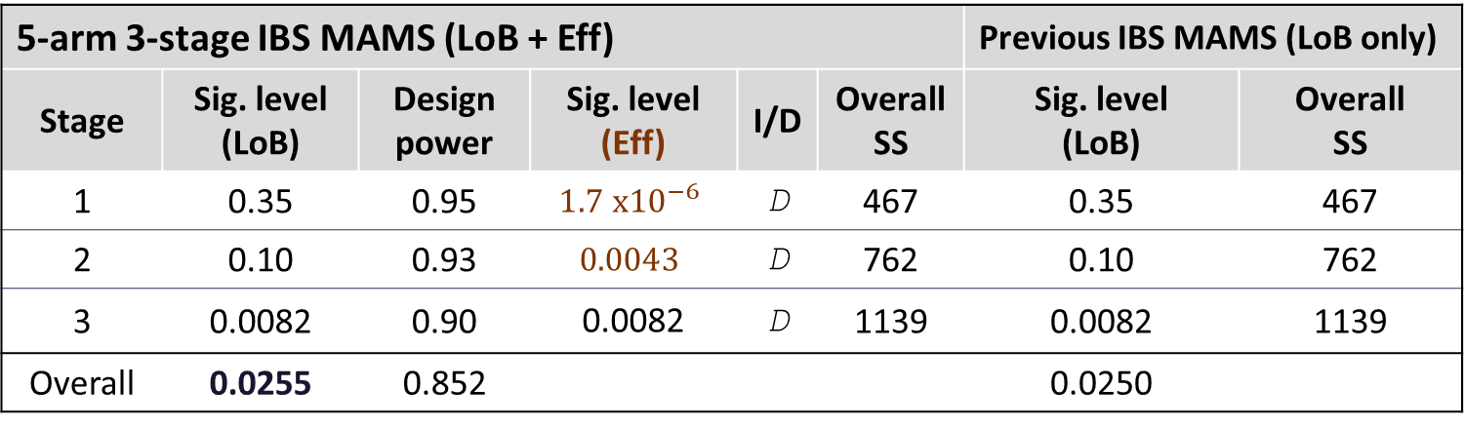
MAMS with stop for efficacy
MAMS Trial Design: Extensions
I-outcome | Selection | Seamless | Efficacy stop
Example 5. IBS MAMS design with early efficacy stopping, D = IBS score at 6 months
5-arm 3-stage IBS MAMS (LoB + Eff) |  |  |  |  |  | Previous IBS MAMS (LoB only)
Stage | Sig. level (LoB) | Design power | Sig. level (Eff) | I/D | Overall SS | Sig. level (LoB) | Overall SS
1 | 0.35 | 0.95 | $$1.7 x{10}^{−6}$$ | D | 467 | 0.35 | 467
2 | 0.10 | 0.93 | $$0.0043$$ | D | 762 | 0.10 | 762
3 | 0.0082 | 0.90 | 0.0082 | D | 1139 | 0.0082 | 1139
Overall | 0.0255 | 0.852 |  |  |  | 0.0250
Stata codes:
nstagects, nstage(3) arms(5 5 5) aratio(0.5) ///
theta0(0 0) theta1(-30 -35) sd(80 100) rho(0.7) ///
esb(obf) esbstage(1) binding ///<-- efficacy stop from stage 1, OBF boundary (A)
fu(0.25 0.5) ltfu(0.10 0.125) alpha(0.35 0.1 0.0082) power(0.95 0.93 0.90) accrate(240 240 240) seed(6192025) ess
22/28

Slide 23
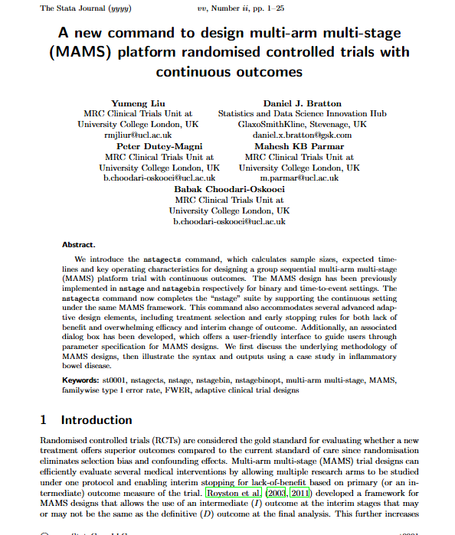
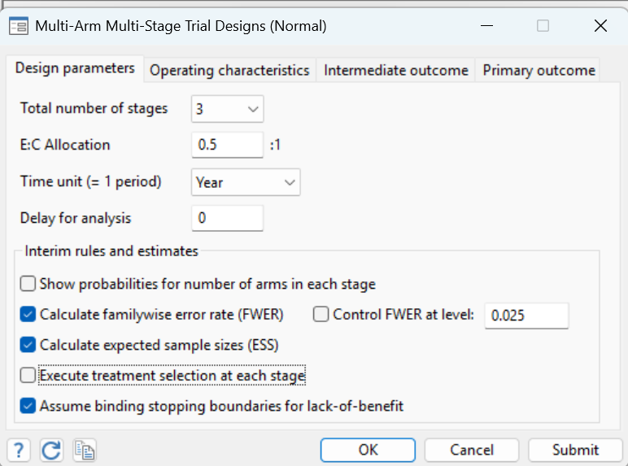
nstagects : Future Stata release
Stata Dialog-box program:
db nstagects
Stata Journal:
23/28

Slide 24
Software testing
The FWER and overall power:
- Checked against analytical solutions where possible
- Used mvnormal Stata command (Grayling and Mander)
Sample size calculations:
Compare results for continuous outcome, two arms settings
Used power Stata command
Continuing maintenance: https://github.com/peterdutey/nstagects
24/28

Slide 25
Some design considerations in practice
Number of arms? Number of stages? Outcomes?
https://link.springer.com/rwe/10.1007/978-3-319-52677-5_110-1
How to select treatments?
https://journals.sagepub.com/doi/full/10.1177/17407745221136527?rfr_dat=cr_pub++0pubmed&url_ver=Z39.88-2003&rfr_id=ori%3Arid%3Acrossref.org
Pre-specification of statistical design characteristics?
https://link.springer.com/article/10.1177/009286150103500408 Journal, 35(4), 1113–1121.
PWER or FWER, which to control?
https://pubmed.ncbi.nlm.nih.gov/11146147/
When considering a complex design with multiple adaptation types, carefully evaluate design options through simulation.
25/28

Slide 26
Summary
MAMS design framework and extensions
Showcase the “IBS-based” example MAMS designs in Stata
The new command nstagects for MAMS design in continuous setting: timeline, sample size, error rates …
Practical considerations and challenges
Upcoming release: program, dialog box, SJ …
26/28

Slide 27
Acknowledgements
Thanks to:
Babak Choodari-Oskooei (UCL)
Daniel Bratton (GSK)
Peter Dutey (UCL)
Ian White (UCL)
All statisticians, trialists and developers in adaptive trial area
Disclaimer: “[Yumeng Liu, Pre-Doctoral Research Fellow, NIHR304849] is funded by the NIHR for this research project. The views expressed in this publication are those of the author(s) and not necessarily those of the NIHR, NHS or the UK Department of Health and Social Care."
27/28

Slide 28
References
Choodari-Oskooei, et al. (2024) Multi-arm multi-stage (MAMS) randomised selection designs: impact of treatment selection rules on the operating characteristics. BMC Medical Research Methodology 24(124). DOI: 10.1186/s12874-024-02247-w
Pampallona, S., Tsiatis, A. A., & Kim, K. (2001). Interim monitoring of group sequential trials using spending functions for the type I and typeII error probabilities. Drug Information Journal, 35(4), 1113–1121.
Proschan MA, Waclawiw MA. Practical guidelines for multiplicity adjustment in clinical trials. Control Clin Trials. 2000 Dec;21(6):527-39. doi: 10.1016/s0197-2456(00)00106-9. PMID: 11146147.
Choodari-Oskooei, et al. (2023) Treatment selection in multi-arm multi-stage designs: With application to a postpartum haemorrhage trial. Clinical Trials. 20(1):71-80. DOI: 10.1177/17407745221136527
Choodari-Oskooei, et al. (2022) Multi-arm multi-stage (MAMS) platform randomized clinical trials. In: Principles and Practice of Clinical Trials. Springer. DOI: 10.1007/978-3-319-52677-5_110-1
Royston, et al. (2003) Novel designs for multi-arm clinical trials with survival outcomes with an application in ovarian cancer. Statistics in Medicine. 22:2239–2256. doi: 10.1002/sim.143
28/28

Slide 29
Q&A?
Yumeng Liu: rmjliur@ucl.ac.uk /
nw21727@bristol.ac.uk

