Slide 1
2018 Stata Conference in Columbus, Ohio
Welfare Gain of Rice-Grading Information
July 19-20, 2018
Doo Bong Han
with
Ji Yong Lee, Young Won Choi
(Korea University, University of Arkansas)

Slide 2
Overview
Introduction
Empirical Methods
Experimental Results
Conclusions

Slide 3
1. Introduction
This study conducted welfare analysis using an experimental auction on mandatory rice grade labeling starting October 1, 2018 in South Korea.
Why do we conduct surveys and experiments?
There are many cases when we don’t have data on what
people will do.
  new products
  technological innovations
  non-market or public goods
  new policy changes (e.g. traceability, GMO labeling)
We control randomization and replication through experiments.

Slide 4
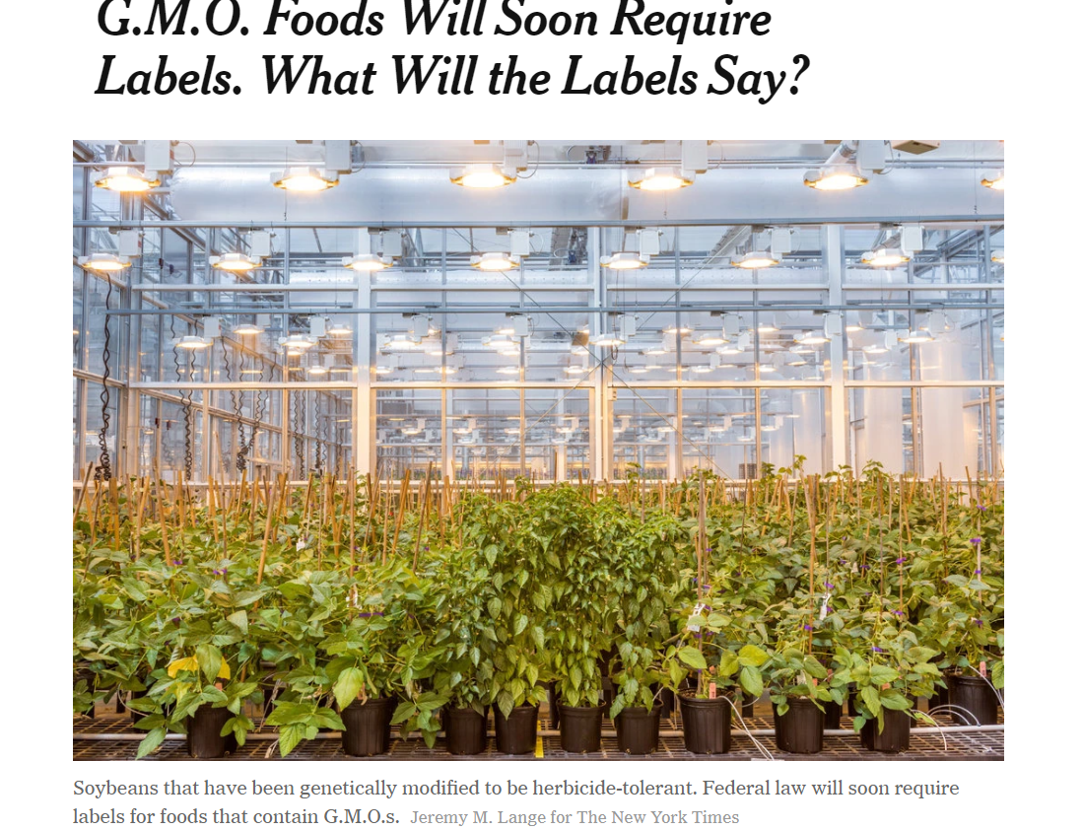
1. Introduction
Welfare analysis on food labeling (rice grade)
A mandatory rice grade labeling in October 1, 2018
A required federal law for GMOs in the US in 2020
Vermont is the first state that introduced the laws in 2014

Slide 5
1. Introduction
Economic valuation
1) State preference: contingent valuation method (CVM),
conjoint analysis, choice experiment
- hypothetical valuations: lack salient economic commitment
2) Revealed preference: experimental auction
- non-hypothetical valuation in which an individual makes
a consequential economic commitment
- incentive-compatible mechanism:

Slide 6
1. Introduction
Hypothetical bias and overestimate the WTP on novel goods and non-market goods’ value in CVM studies: no budget constraint binding in CVM and no purchasing required
Involve people hypothetically rating, ranking, or choosing between competing products or alternatives
A company develop a new product. State preference method such as CVM is hypothetical, so no commitment make overstatement and hypothetical bias.
Experimental auctions:
generate actual market, trade goods and money like a real
market through experimental design

Slide 7
1. Introduction
Importance of correct valuation of new products and new policies because the success rate of new products is only 10 percent.
How to determine the prices of new products or taxes such as Galaxy 9 or mandatory labeling (rice grade, GMO)?

Slide 8
1. Introduction
Dilemmas of the Korean rice industry
: Rice import increase and import regime change from minimum market
access (quota) to tariffication in 2015
: Decrease in rice consumption per capita and huge inventory
(106.5kg in 1995 to 65.1kg in 2014)
Important to maintain stable demand for domestic rice
: Food security (about 5 percent self-sufficiency in grain without rice)
: Multifunctionality of paddy field and farm land
To keep the stable consumption of domestic rice
: Differentiate the quality of domestic rice from imported rice
: Quality of domestic rice should be satisfied by consumers

Slide 9
1. Introduction
The Korean government revised the rice-grading system in 2013
: To make the policy less restrictive to rice suppliers
: Domestic rice was classified into 3 grades (super, good, normal)
: However, “No test” option for rice grade was allowed
Ineffectiveness of the revised rice-grading system
: No incentive for rice suppliers to test the quality of their rice
given an “no test” option
: About 73% of domestic rice in retail markets were labeled
“no test of rice grade”
: Consumers face a difficulty to differentiate high-quality rice

Slide 10
1. Introduction
Rice Classification and Grade by Appearance
- Rice grade works as one of non-tariff barriers
1) Classification by size:
– Long grain, Medium grain, Short grain, Mixed grain
– Short grain, Japonica from California*
*Japonica was first introduced by 2014 US Farm Bill
2) Grade by color, whole/broken kernels
– US No. 1 – No. 6.
• Color: white, creamy, gray, rosy, dark.
• Damaged: heat damaged, objectionable, red rice, chalky, broken
– Japan 3 grades in brown rice, 6 grades of brown rice for Sake
– Thailand: 8 grades for white rice, 7 grades for fragrant rice
– Taiwan: 3 grades
– Korea: 3 grades and no test of rice grade

Slide 11
1. Introduction: Rice Grade in Korea
Variety of rice | Chujeong | Weight | 20kg
Grade | Super, Good, normal, no test | Protein content level (voluntary label) | low, general, high, no test
 |  | The lower protein content, the better rice taste
Production year | 2015 | Milling date | 2016. 05. 2.

Slide 12
1. Introduction
The percentage of rice grades available in the market
Source: 2014 National Survey, National Agricultural Products Quality Management Service

Slide 13
1. Introduction
The new rice-grading system will be introduced in October 2018
: The government decided to discard the “no test” option
: Rice in the market should be tested for quality grading and be
labeled with grades to compete imported rice.

Slide 14
1. Introduction
Objectives of this study are:
1) To assess the net effectiveness of the new mandatory
rice-grading system by estimating consumers’ value of
grade labeling information
2) Examining whether consumers’ values of grade labeling
information differ across the quality grades under the new
rice-grading system

Slide 15
2. Empirical Methods
A total of 212 consumers participated in the experiment
We mainly recruited housewives in their 20s to 60s with considering subjects’ ages and regions
Valuation of rice grades by an experimental auction:
1) Non-hypothetical random nth price auction
: This auction mechanism is incentive compatible and widely
used in valuation studies to reduce hypothetical bias.
2) Full bidding approach
: Participants were asked to simultaneously submit their bids
for four different rice products: “super”, “good”, “normal”,
and “no grade test.”

Slide 16
2. Empirical Methods
Four different 1kg packs of rice products were used
(i.e., “super”, “good”, “normal”, and “no test”)
Three bidding rounds conducted with different levels of rice grade information
: R1 – no information, only allow to see, touch, and smell
: R2 – labels only on rice grade ( “super”, “good”, “normal”, “no test”)
: R3 – detailed information about rice grading criteria
Subjects were told that their best strategy was to bid an amount equal to the true value they placed on each product
A binding round and binding product would be randomly selected at the end of the experiment

Slide 17
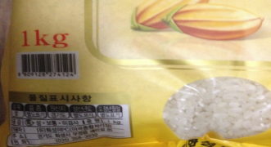
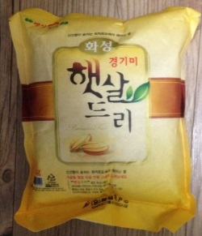
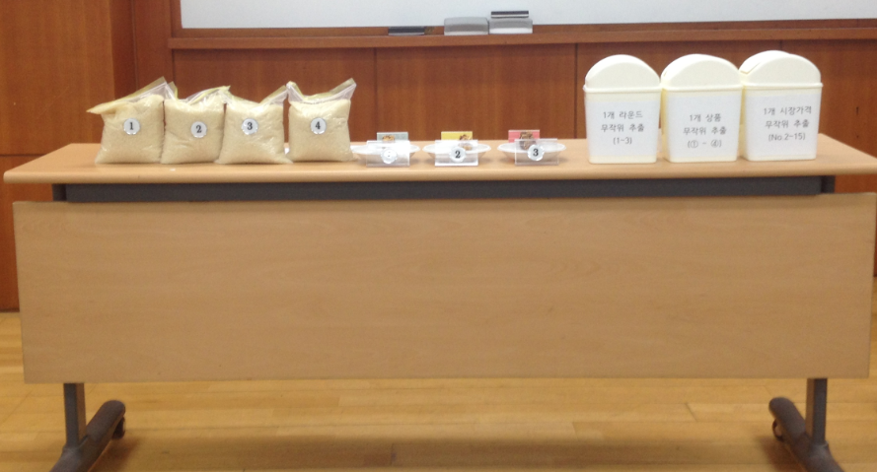
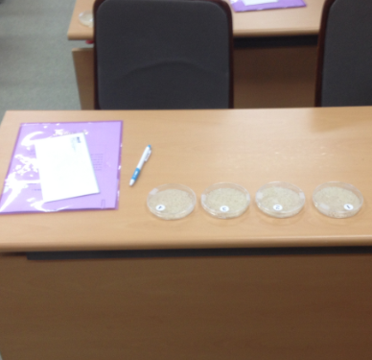
• Rice product (1kg) for experimental auctions
- Four grades of rice: Super, Good, Normal, No Test
- A rice brand in Hwaseong, Gyeonggi province
- Participation Compensation: 15,000 won (USD $15)
• Experiment Setting
<Table>
<Desk>
<Bid paper>
Sealed Bid Auction: 1) No grade information, 2) Grade label only, 3) Detailed grade info
ID(seat number)#
Round# |  | 1 / 2/ 3
Product 1 | Product 2 | Product 3 | Product 4
BID \_______ | BID \_______ | BID \_______ | BID\_________

Slide 18
• Information treatments at experimental auctions
Three bidding rounds that differed in the amount of information
about the rice quality grades provided to subjects
Information provided | 1st Round | 2nd Round | 3rd Round
Only visual, touch, and smell are allowed | ○ | ○ | ○
Labeling Information (“super”, “good”, “normal”, or “no grade test”) | × | ○ | ○
Detailed information about rice grading criteria | × | × | ○

Slide 19
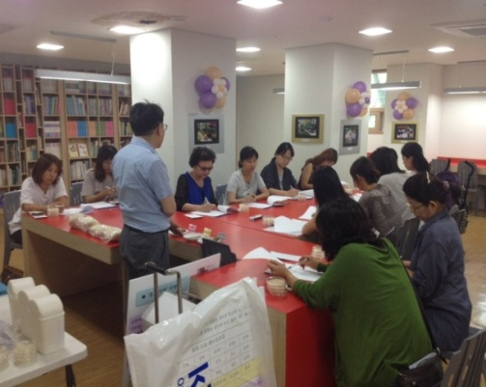
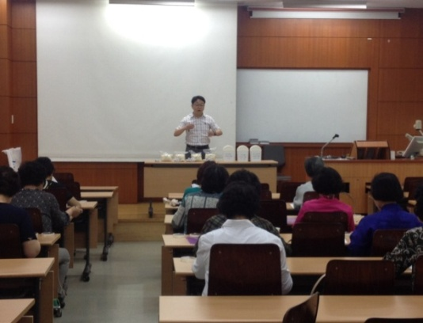




• Experimental auction of this study
Apartment Library
Social Welfare Center
Local Church
Agricultural Cooperatives
Invited Subjects to Korea University

Slide 20
2. Empirical Methods
Assumptions of Empirical Framework
We assumed that consumers correctly expressed their demand after receiving information
After receiving the new information on rice grade, consumers can change their rice purchasing decision before rice grade information.
We can measure the correct value of information only if consumers change their purchasing rice grade after grade information.

Slide 21
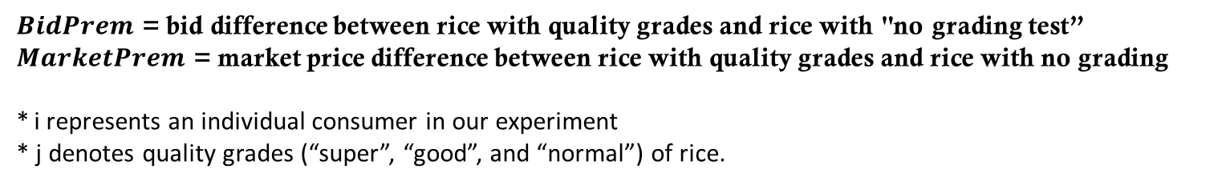
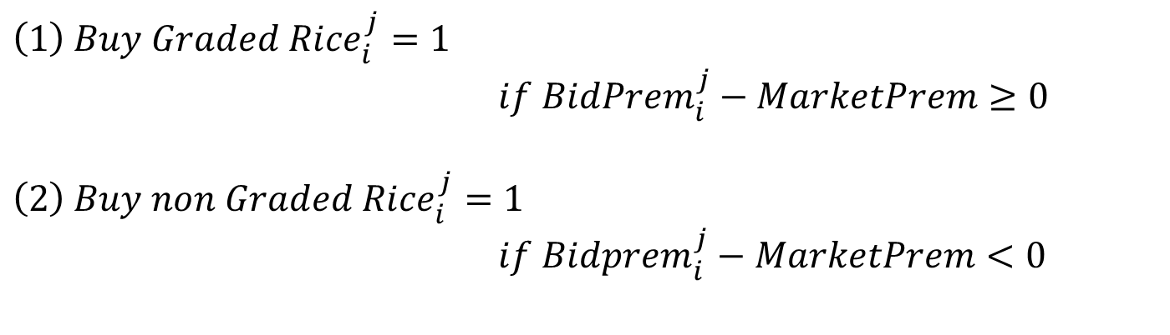
2. Empirical Methods
Following the auction market, we assumed that all consumers purchase either one of graded or non-graded rice
${\left(1\right) Buy Graded Rice}_{i}^{j}=1$
$if {BidPrem}_{i}^{j}−MarketPrem≥0$
$${\left(2\right) Buy non Graded Rice}_{i}^{j}=1$$
$if {Bidprem}_{i}^{j}−MarketPrem<0$
$BidPrem$ = bid difference between rice with quality grades and rice with "no grading test”
$MarketPrem$ = market price difference between rice with quality grades and rice with no grading
* i represents an individual consumer in our experiment
* j denotes quality grades (“super”, “good”, and “normal”) of rice.

Slide 22
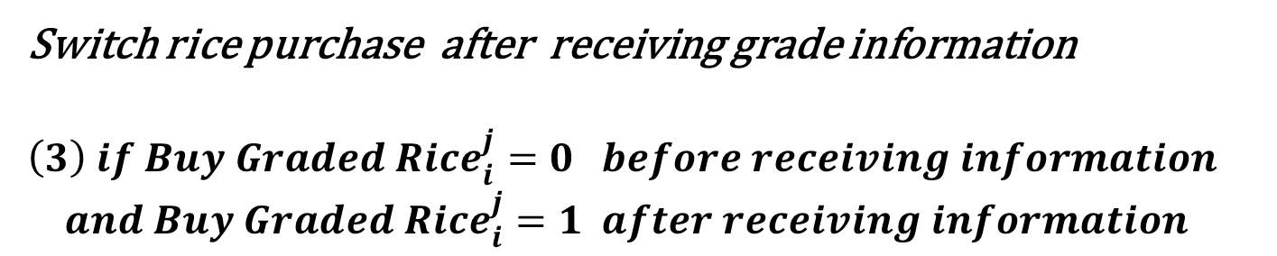
2. Empirical Methods
Given our assumption that consumers obtain value from the provided information when they change their decision, we only included the participants who switched their decision
Switching rice purchase after receiving grade information → Estimating the value of grade labeling information
Switch rice purchase after receiving grade information
${\left(3\right) if Buy Graded Rice}_{i}^{j}=0 before receiving information$ ${and Buy Graded Rice}_{i}^{j}=1 after receiving information$

Slide 23
2. Empirical Methods
The relative consumer surplus for rice labeled with quality grades is calculated as the difference between individual i’s bid premium and the market premium
This consumer surplus represents the value of information when a consumer switches products after receiving labeling information
$${\left(5\right) Consumer Surplus}_{i}^{j}={Bidprem}_{i}^{j}−MarketPrem$$

Slide 24
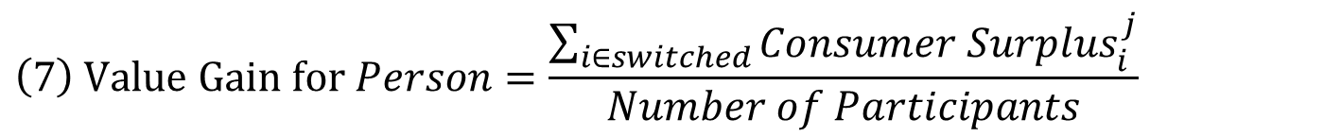
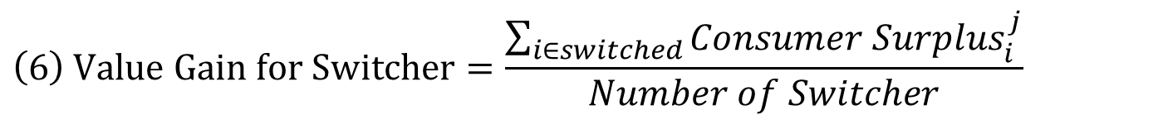
2. Empirical Methods
The total value of grade labeling information is the sum of the value of information for all individuals who switched their purchasing decisions after receiving labeling information
Given this, we could measure two different measures of welfare gains
$$\left(6\right) Value Gain for Switcher=\frac{\sum_{i∈switched}{{Consumer Surplus}_{i}^{j}}}{Number of Switcher}$$
$$\left(7\right) Value Gain for Person=\frac{\sum_{i∈switched}{{Consumer Surplus}_{i}^{j}}}{Number of Participants}$$

Slide 25
3. Experimental Results
Table 3. Participants’ Socioeconomic Characteristics (N=212)
Variable | Categories | Mean | Std. Dev.
Age | Years | 45.8 | 13.4
Household size | Persons | 3.3 | 1.2
Frequency¹ | Times/year | 8.2 | 5.9
Need² | 1: Strongly disagree–5: Strongly agree | 4.1 | 0.8
Awareness³ | 1: Not at all–4: A great deal | 1.8 | 0.7
Family income (Monthly, Unit:1,000 KRW) | Less than 1,000 | 2.9%
 | 1,000-1,990 | 4.3%
 | 2,000-2,990 | 10.0%
 | 3,000-3,990 | 15.3%
 | 4,000-4,990 | 21.1%
 | 5,000-5,990 | 17.7%
 | 6,000-6,990 | 9.1%
 | 7,000-7,990 | 8.6%
 | More than 8,000 | 11.00%
Education level | High school graduate | 35.4%
 | College graduate | 59.9%
 | Graduate degree | 4.7%
¹ Frequency of purchasing rice per year
² Rice grading is needed for rice consumers’ right to information
³ The level of prior awareness of rice grading

Slide 26
3. Experimental Results
Table 4. Number of Participants who “Switched” Purchases with only Grade Information
Grade | Description | Number of Participants | Percentage of Participants
“Super” | Buy “Super” graded rice before information provision | 32 | 15.1%
 | Buy rice labeled with “Super” after information provision | 126 | 59.4%
 | Switched to rice labeled with “Super” after information provision | 94 | 44.3%
“Good” | Buy “Good” graded rice before information provision | 28 | 13.2%
 | Buy rice labeled with “Good” after information provision | 100 | 47.2%
 | Switched to rice labeled with “Good” after information provision | 72 | 33.9%
“Normal” | Buy “Normal” graded rice before information provision | 48 | 22.6%
 | Buy rice labeled with “Normal” after information provision | 107 | 50.5%
 | Switched to rice labeled with “Normal” after information provision | 59 | 27.8%
Information on quality grade labeling influences consumers’ rice purchasing decisions
The quality labeling of “super” has the biggest impact on consumer decisions, followed by the “good” and “normal” grades

Slide 27
3. Experimental Results
Table 5. Number of Participants who “Switched” Purchases with Detailed Grade Information
Grade | Description | Number of Participants | Percentage of Participants
“Super” | Buy “Super” graded rice before information provision | 30 | 14.2%
 | Buy rice labeled with “Super” after information provision | 126 | 59.4%
 | Switched to rice labeled with “Super” after information provision | 96 | 45.3%
“Good” | Buy “Good” graded rice before information provision | 21 | 9.9%
 | Buy rice labeled with “Good” after information provision | 96 | 45.3%
 | Switched to rice labeled with “Good” after information provision | 75 | 35.4%
“Normal” | Buy “Normal” graded rice before information provision | 45 | 21.2%
 | Buy rice labeled with “Normal” after information provision | 110 | 51.9%
 | Switched to rice labeled with “Normal” after information provision | 65 | 30.7%
The percentages of switchers after the provision of additional detailed grade information are similar to those in Table 4
Providing additional detailed grade information does not change consumers’ rice purchasing decisions

Slide 28
3. Experimental Results
Table 6. The Value of Grade Labeling Information (KRW/kg, $1=1,000 KRW)
Value of Only Grade Labeling Information (KRW/kg)
Grade | Average Value Per Switcher | Average Value Per Person
“Super” | 848.7*** | 376.3***
“Good | 729.9*** | 247.9***
“Normal” | 512.1*** | 142.5***
Value of Detailed Grade Labeling Information (KRW/kg)
Grade | Average Value Per Switcher | Average Value Per Person
“Super” | 857.5*** | 388.3***
“Good | 736.7*** | 260.6***
“Normal” | 536.5*** | 164.5***
Note : *** denotes statistical significance at 1% level
Average value for rice grade labeling information: the mean values of grade information are about 697 KRW (70 cents) per switcher and 256 KRW (26 cents/kg) per person. (Super grade rice/kg = 2,168 KRW/kg, $22/kg)
The value of rice grade is higher in higher grade rice than lower grade rice
Given grade labeling information, consumers do not give more value on detailed grade information than simple grade information.

Slide 29
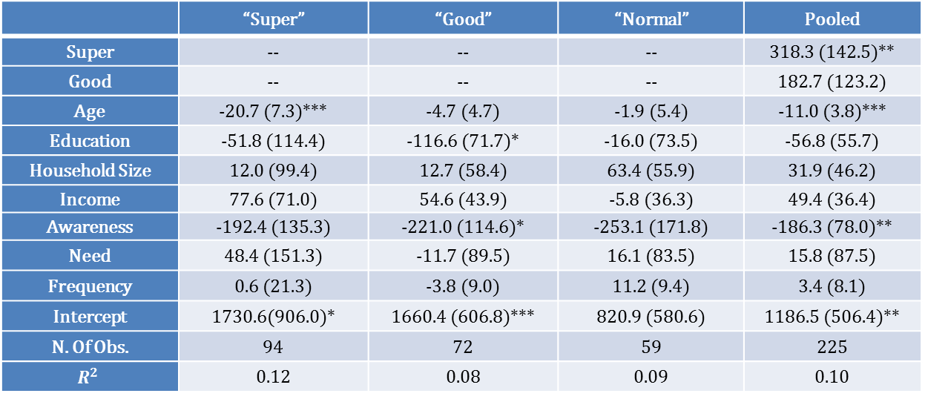
3. Experimental Results
Table 7. Factor Affecting Value of Grade Labeling Information
 | “Super” | “Good” | “Normal” | Pooled
Super | -- | -- | -- | 318.3 (142.5)**
Good | -- | -- | -- | 182.7 (123.2)
Age | -20.7 (7.3)*** | -4.7 (4.7) | -1.9 (5.4) | -11.0 (3.8)***
Education | -51.8 (114.4) | -116.6 (71.7)* | -16.0 (73.5) | -56.8 (55.7)
Household Size | 12.0 (99.4) | 12.7 (58.4) | 63.4 (55.9) | 31.9 (46.2)
Income | 77.6 (71.0) | 54.6 (43.9) | -5.8 (36.3) | 49.4 (36.4)
Awareness | -192.4 (135.3) | -221.0 (114.6)* | -253.1 (171.8) | -186.3 (78.0)**
Need | 48.4 (151.3) | -11.7 (89.5) | 16.1 (83.5) | 15.8 (87.5)
Frequency | 0.6 (21.3) | -3.8 (9.0) | 11.2 (9.4) | 3.4 (8.1)
Intercept | 1730.6(906.0)* | 1660.4 (606.8)*** | 820.9 (580.6) | 1186.5 (506.4)**
N. Of Obs. | 94 | 72 | 59 | 225
$$R^{2}$$ | 0.12 | 0.08 | 0.09 | 0.10
Note : Standard error for each coefficient shown in parentheses. *, **, and *** denote statistical significance at 10%, 5%, and 1% levels, respectively
From the pooled model, we confirm our observation that the “super” grade has the largest value, followed by “good” and “normal”
An incentive for rice producers and processors to improve the quality of rice

Slide 30
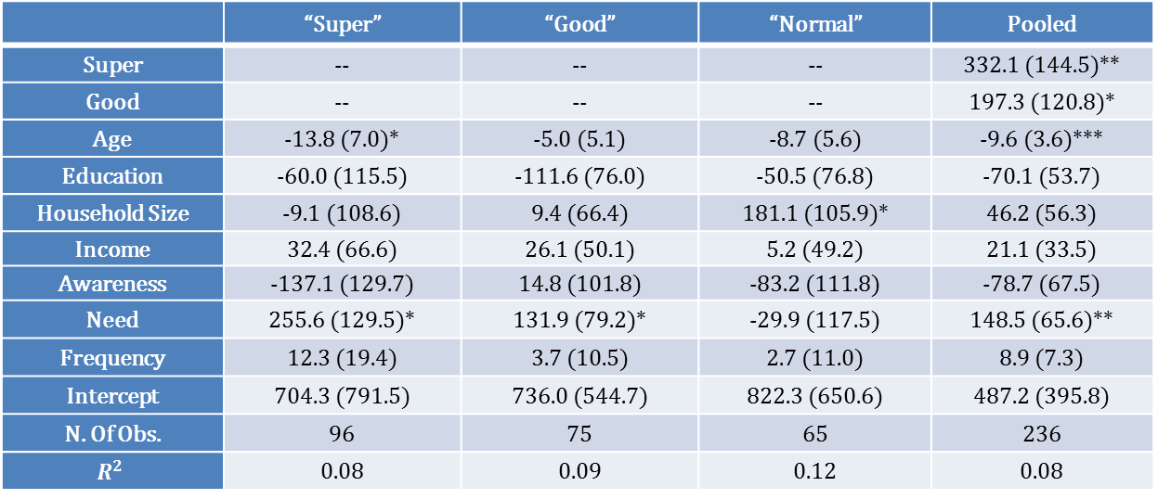
3. Experimental Results
Table 8. Factor Affecting Value of Detailed Grade Labeling Information
 | “Super” | “Good” | “Normal” | Pooled
Super | -- | -- | -- | 332.1 (144.5)**
Good | -- | -- | -- | 197.3 (120.8)*
Age | -13.8 (7.0)* | -5.0 (5.1) | -8.7 (5.6) | -9.6 (3.6)***
Education | -60.0 (115.5) | -111.6 (76.0) | -50.5 (76.8) | -70.1 (53.7)
Household Size | -9.1 (108.6) | 9.4 (66.4) | 181.1 (105.9)* | 46.2 (56.3)
Income | 32.4 (66.6) | 26.1 (50.1) | 5.2 (49.2) | 21.1 (33.5)
Awareness | -137.1 (129.7) | 14.8 (101.8) | -83.2 (111.8) | -78.7 (67.5)
Need | 255.6 (129.5)* | 131.9 (79.2)* | -29.9 (117.5) | 148.5 (65.6)**
Frequency | 12.3 (19.4) | 3.7 (10.5) | 2.7 (11.0) | 8.9 (7.3)
Intercept | 704.3 (791.5) | 736.0 (544.7) | 822.3 (650.6) | 487.2 (395.8)
N. Of Obs. | 96 | 75 | 65 | 236
$$R^{2}$$ | 0.08 | 0.09 | 0.12 | 0.08
Note : Standard error for each coefficient shown in parentheses. *, **, and *** denote statistical significance at 10%, 5%, and 1% levels, respectively
Rice consumers obtain welfare gain from rice grade labeling
Values of information differ across the quality grades. The highest is the super grade of rice. Rice-grading information is the important factor to differentiate domestic rice

Slide 31
4. Conclusions
This study examined the economic value of rice-grade information to assess the effectiveness of the new rice-grading system
Information on rice grade labeling influences consumers’ rice purchasing decisions
Given rice grade labeling information, the detailed rice grade information does affect consumers’ purchasing decisions

Slide 32
4. Conclusions
The rice grade labeling under the mandatory grading system would provide rice consumers credible information on rice quality to make better purchasing decisions
For rice producers, the mandatory grading system could provide an incentive to improve the quality of rice
Given consumers’ small welfare gain from providing the detailed grade-labeling information, policy makers may minimize the cost of grade labeling by only posting grade information instead of detailed grade information.

Slide 33
Thank you

