Slide 1
Bacon decomposition for understanding differences-in-differences with variation in treatment timing (bacondecomp)
July 11, 2019
Stata Conference
Andrew Goodman-Bacon (Vanderbilt University)
Austin Nichols (Abt Associates)
Thomas Goldring (University of Michigan)
@agoodmanbacon

Slide 2
Overview
In canonical difference-in-differences (DD), the regression version = function of pre/post and treat/control means.
When treatment turns on at different times, the regression DD coefficient is a weighted average of canonical “2x2” DDs (Goodman-Bacon 2018)
Shows where such DDs “come from”
This command calculates the component DDs and their weights, plots them (ie. shows variation), compares specifications
Future: conducts balance tests, analyzes estimand,

Slide 3
What is Difference-in-Differences?
$${\overline{y}}_{POST}^{TREAT}$$
$$\left({\overline{y}}_{POST}^{TREAT}−{\overline{y}}_{PRE}^{TREAT}\right)$$
$${\overline{y}}_{PRE}^{TREAT}$$
${\hat{β}}^{DD}=\left({\overline{y}}_{POST}^{TREAT}−{\overline{y}}_{PRE}^{TREAT}\right)$- $\left({\overline{y}}_{POST}^{CONTROL}−{\overline{y}}_{PRE}^{CONTROL}\right)$
$${\overline{y}}_{POST}^{CONTROL}$$
$$\left({\overline{y}}_{POST}^{CONTROL}−{\overline{y}}_{PRE}^{CONTROL}\right)$$
$${\overline{y}}_{PRE}^{CONTROL}$$

Slide 4
What is Difference-in-Differences?
Wooldridge (2002):

Slide 5
What is Difference-in-Differences?
Cameron and Trivedi (2007):

Slide 6
What is Difference-in-Differences?
Angrist and Pischke (2009):

Slide 7
What is Difference-in-Differences?
Imbens and Wooldridge (2007):

Slide 8
What is Difference-in-Differences?
Angrist and Krueger (1999):

Slide 9
What is Difference-in-Differences?
Heckman, LaLonde and Smith (1999):

Slide 10
What is Difference-in-Differences?
Meyer (1995):

Slide 11
What is Difference-in-Differences?
Abadie (2005):

Slide 12
What is Difference-in-Differences?
Athey and Imbens (2006):

Slide 13
What is Difference-in-Differences?
DiNardo and Lee (2011):

Slide 14
Keywords in NBER Papers Since 2012
2014/2015 AER/QJE/JPE/ReStud/JHE/JDE published 93 DD papers:
49% had timing variation
Snow (1855)
Fisher (1926)
Thistlewaite
And Campbell
(1960)
Wright (1928),
Wald (1940),
Durbin (1954)
"difference-in-differences" | "differences-in-differences" |
"diff-in-diff"
("randomization"|"randomize") & "experiment" & "trial"
"regression discontinuity" | "regression kink"
"instrumental variables" & "instrument"

Slide 15
Variation in Timing
$D_{it}$ turns on at different times $t^{∗}$
(Federalism, judicial enforcement, sub-federal
funding process, natural disasters, mass layoffs…)

Slide 16
Two-Way Fixed Effects Estimator
$$y_{it}=α_{i}+α_{t}+{\hat{β}}^{DD}D_{it}+u_{it}$$
Unit fixed effects
Time fixed effects
Treatment dummy
What is ${\hat{β}}^{DD}$?

Slide 17
${\hat{β}}^{DD}$?
This has been unclear, but we do have good
intuition for subsamples here where one group’s
treatment changes and another’s does not.

Slide 18
$${\hat{β}}_{kU}^{2x2}$$
$${\hat{β}}_{kU}^{2x2}=\left({\overline{y}}_{k}^{POST(k)}−{\overline{y}}_{k}^{PRE(k)}\right)−\left({\overline{y}}_{U}^{POST(k)}−{\overline{y}}_{U}^{PRE(k)}\right)$$

Slide 19
$${\hat{β}}_{ℓU}^{2x2}$$
$${\hat{β}}_{ℓU}^{2x2}=\left({\overline{y}}_{ℓ}^{POST(ℓ)}−{\overline{y}}_{ℓ}^{PRE(ℓ)}\right)−\left({\overline{y}}_{U}^{POST(ℓ)}−{\overline{y}}_{U}^{PRE(ℓ)}\right)$$

Slide 20
${\hat{β}}_{kℓ}^{2x2,k}$
$${\hat{β}}_{kℓ}^{2x2,k}=\left({\overline{y}}_{k}^{MID(k,ℓ)}−{\overline{y}}_{k}^{PRE(k)}\right)−\left({\overline{y}}_{ℓ}^{MID(k,ℓ)}−{\overline{y}}_{ℓ}^{PRE(k)}\right)$$
Treatment
Control

Slide 21
${\hat{β}}_{kℓ}^{2x2,ℓ}$
$${\hat{β}}_{kℓ}^{2x2,ℓ}=\left({\overline{y}}_{ℓ}^{POST(ℓ)}−{\overline{y}}_{ℓ}^{MID(k,ℓ)}\right)−\left({\overline{y}}_{k}^{POST(ℓ)}−{\overline{y}}_{k}^{MID(k,ℓ)}\right)$$
Control
Treatment

Slide 22
Difference-in-Differences Decomposition Theorem (3 Group Case)
$$y_{it}=α_{i}+α_{t}+{\hat{β}}^{DD}D_{it}+u_{it}$$
For three groups:
$${\hat{β}}^{DD}=s_{kU}{\hat{β}}_{kU}^{2x2}+s_{ℓU}{\hat{β}}_{ℓU}^{2x2}+s_{kℓ}^{k}{\hat{β}}_{kℓ}^{2x2,k}+s_{kℓ}^{k}{\hat{β}}_{kℓ}^{2x2,ℓ}$$
2x2 DDs: subsamples with two groups (treat/control) and two periods (pre/post)

Slide 23
What do we learn from the 2x2 DDs?
1. We didn’t know what comparisons were being made:
“switchers vs untreated”?
“early vs late”?
“late vs early” (this is less obvious)?
It’s all of those.
2. “What is the control group?”
Every group acts as a control (sometimes).
3. Clarifies theory
We understand the estimand (ATET) and ID assumption (common trends) for each 2x2; late vs. early comparisons are biased if effects vary over time.

Slide 24




Difference-in-Differences Decomposition Theorem (3 Group Case)
$$y_{it}=α_{i}+α_{t}+{\hat{β}}^{DD}D_{it}+u_{it}$$
For three groups:
$${\hat{β}}^{DD}=s_{kU}{\hat{β}}_{kU}^{2x2}+s_{ℓU}{\hat{β}}_{ℓU}^{2x2}+s_{kℓ}^{k}{\hat{β}}_{kℓ}^{2x2,k}+s_{kℓ}^{ℓ}{\hat{β}}_{kℓ}^{2x2,ℓ}$$
Size:
$${\left(n_{k}+n_{U}\right)}^{2}$$
$$×$$
Variance:
$n_{kU}(1−n_{kU}){\overline{D}}_{k}(1−{\overline{D}}_{k})$
Size:
$${\left(n_{ℓ}+n_{U}\right)}^{2}$$
$$×$$
Variance:
$n_{ℓU}(1−n_{ℓU}){\overline{D}}_{ℓ}(1−{\overline{D}}_{ℓ})$
Size:
${\left(\left(n_{k}+n_{ℓ}\right)\left(1−{\overline{D}}_{𝓵}\right)\right)}^{2}$
$$×$$
Variance:
$$n_{kℓ}(1−n_{kℓ})\frac{{\overline{D}}_{k}−{\overline{D}}_{𝓵}}{1−{\overline{D}}_{𝓵}}\frac{1−{\overline{D}}_{k}}{1−{\overline{D}}_{𝓵}}$$
Size:
${\left(\left(n_{k}+n_{ℓ}\right){\overline{D}}_{k}\right)}^{2}$
$$×$$
Variance:
$$n_{kℓ}(1−n_{kℓ})\frac{{\overline{D}}_{𝓵}}{{\overline{D}}_{k}}\frac{{\overline{D}}_{k}−{\overline{D}}_{𝓵}}{{\overline{D}}_{k}}$$
Weights: $\frac{{\left(subsample share\right)}^{2}(subsample variance of FE−adjusted D)}{total variance of FE−adjusted D}$

Slide 25
What do we learn from the weights?
1. Relative importance of each kind of comparison.
“switchers vs untreated”?
“early vs late”?
“late vs early” (this is less obvious)?
More important if big group (bigger sample size) or treated closer to middle of the panel (bigger variance).
“How much” comes from timing vs comparisons to untreated.
2. Importance of specific 2x2 DDs.
Sometimes a few terms dominate.
3. Clarifies theory
The estimand and ID assumption are “variance weighted”; can compare estimand to “parameters of interest” and conduct a proper balance test

Slide 26
What does the bacondecomp command do?
Describe where the DD “comes from”
Which 2x2s matter most? (sources of variation)
How different are the 2x2 DDs? (heterogeneity)

Slide 27
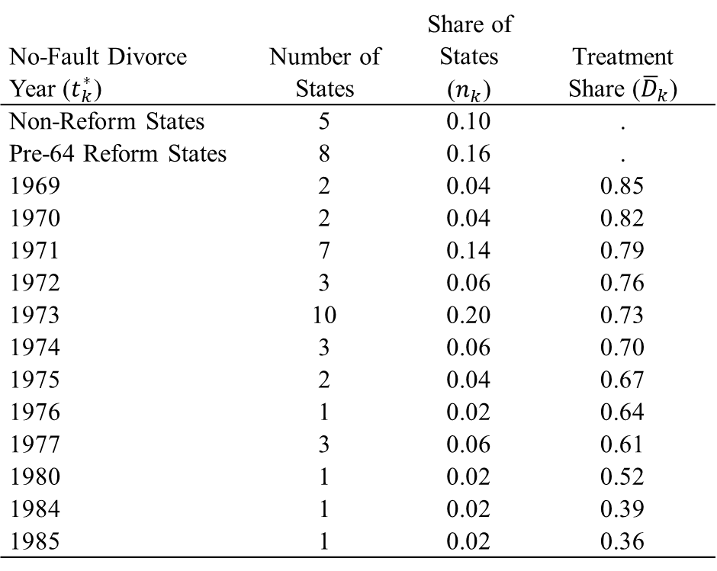
Replication: The Effect of Unilateral Divorce on Suicide (Stevenson and Wolfers 2006)
State-year panel of female suicide rates 1964-1996
12 timing groups vs Non-reform: 12 2x2 DDs
12 timing groups vs Pre-64 reform: 12 2x2 DDs
12 timing groups vs 12 timing groups: 12x11 = 132 2x2 DDs
No-Fault Divorce Year ($t_{k}^{∗}$) | Number of States | Share of States ($n_{k}$) | Treatment Share (${\overline{D}}_{k}$)
Non-Reform States | 5 | 0.10 | .
Pre-64 Reform States | 8 | 0.16 | .
1969 | 2 | 0.04 | 0.85
1970 | 2 | 0.04 | 0.82
1971 | 7 | 0.14 | 0.79
1972 | 3 | 0.06 | 0.76
1973 | 10 | 0.20 | 0.73
1974 | 3 | 0.06 | 0.70
1975 | 2 | 0.04 | 0.67
1976 | 1 | 0.02 | 0.64
1977 | 3 | 0.06 | 0.61
1980 | 1 | 0.02 | 0.52
1984 | 1 | 0.02 | 0.39
1985 | 1 | 0.02 | 0.36

Slide 28
Graphing the Decomposition: Divorce Example

Slide 29
What does the bacondecomp command do?
Describe where the DD “comes from”
Which 2x2s matter most? (sources of variation)
How different are the 2x2 DDs? (heterogeneity)
Calculate why estimates differ across specifications:
Is it the weights, the 2x2 DDs, or both?

Slide 30
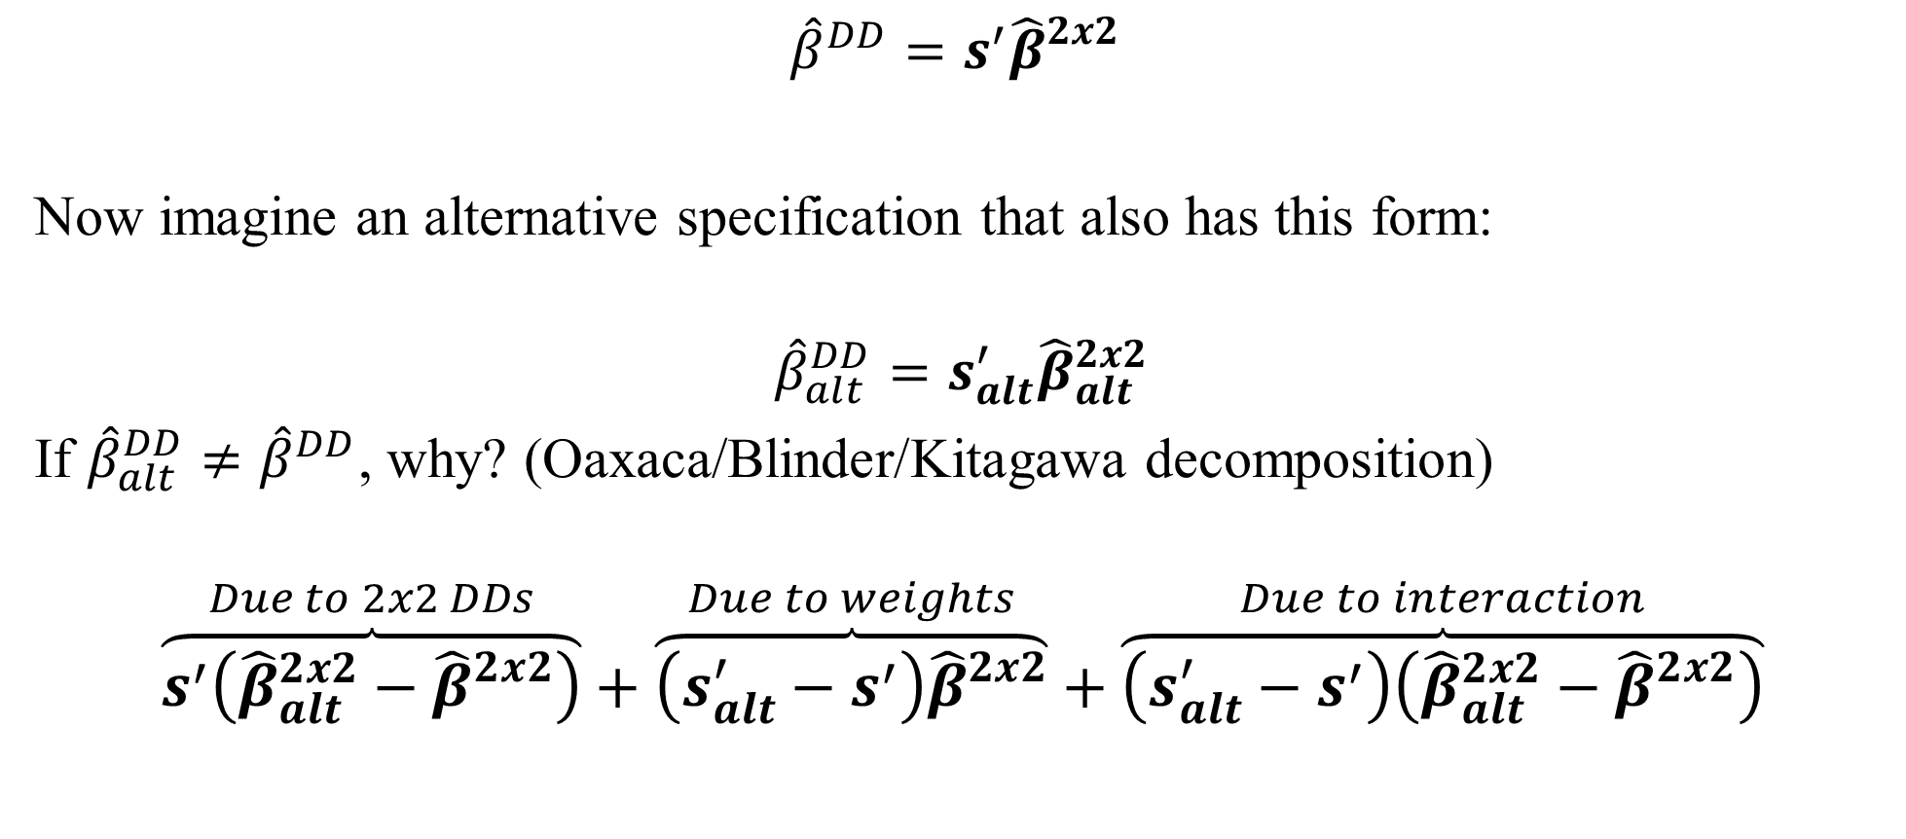
Comparing two weighted averages
$${\hat{β}}^{DD}=s^{′}{\hat{β}}_{}^{2x2}$$
Now imagine an alternative specification that also has this form:
$${\hat{β}}_{alt}^{DD}=s_{alt}^{′}{\hat{β}}_{alt}^{2x2}$$
If ${\hat{β}}_{alt}^{DD}≠{\hat{β}}^{DD}$, why? (Oaxaca/Blinder/Kitagawa decomposition)
$$\overset{Due to 2x2 DDs}{\overbrace{s^{′}\left({\hat{β}}_{alt}^{2x2}−{\hat{β}}_{}^{2x2}\right)}}+\overset{Due to weights}{\overbrace{\left(s_{alt}^{′}−s^{′}\right){\hat{β}}_{}^{2x2}}}+\overset{Due to interaction}{\overbrace{\left(s_{alt}^{′}−s^{′}\right)\left({\hat{β}}_{alt}^{2x2}−{\hat{β}}_{}^{2x2}\right)}}$$
Note (not for today): Goodman-Bacon (2018) now analyzes models with (any) controls, with an additional important nuance.

Slide 31
Plotting components: WLS vs. OLS
53% from 2x2 DDs
38% from weights
9% from interaction
Why does WLS affect the 1970 states so much?
Only two states did no-fault divorce in 1970:
Iowa and California.
CA has a huge downward trend and it matters
a lot more in WLS than OLS.

Slide 32
Conclusion
When treatment timing varies, the (two-way fixed effects) regression DD coefficient is a weighted average of simple 2x2 DDs (Goodman-Bacon 2018)
bacondecomp to be released on SSC next week will plot the 2x2 DDs against their weight to highlight where identification comes from and how heterogeneous are the 2x2 DDs.
“How much” variation comes from timing?
What is “the” control group?
Weights do NOT rely on outcome data (can apply to it to samples you don’t yet have)
bacondecomp also will allow users to analyze why estimates change under different specifications (e.g. weights, controls, triple-diff)
Planned enhancements: test covariate balance (accounting for timing), compare estimand to other parameters of interest, adjust for bias from time-varying effects.

Slide 33
References
Goodman-Bacon, Andrew. 2018. "Difference-in-Differences with Variation in Treatment Timing." National Bureau of Economic Research Working Paper Series No. 25018. doi: 10.3386/w25018.
Stevenson, Betsey, and Justin Wolfers. 2006. "Bargaining in the Shadow of the Law: Divorce Laws and Family Distress." The Quarterly Journal of Economics 121 (1):267-288.
Textbooks and Survey Articles that describe 2x2 DD:
Angrist, Joshua D., and Alan B. Krueger. 1999. "Chapter 23 - Empirical Strategies in Labor Economics." In Handbook of Labor Economics, edited by Orley C. Ashenfelter and David Card, 1277-1366. Elsevier.
Angrist, Joshua David, and Jörn-Steffen Pischke. 2009. Mostly harmless econometrics : an empiricist's companion. Princeton: Princeton University Press.
Angrist, Joshua David, and Jörn-Steffen Pischke. 2015. Mastering 'metrics : the path from cause to effect. Princeton ; Oxford: Princeton University Press.
Cameron, Adrian Colin, and P. K. Trivedi. 2005. Microeconometrics : methods and applications. Cambridge ; New York: Cambridge University Press.
Heckman, James J., Robert J. Lalonde, and Jeffrey A. Smith. 1999. "Chapter 31 - The Economics and Econometrics of Active Labor Market Programs." In Handbook of Labor Economics, edited by Orley C. Ashenfelter and David Card, 1865-2097. Elsevier.
Meyer, Bruce D. 1995. "Natural and Quasi-Experiments in Economics." Journal of Business & Economic Statistics 13 (2):151-161. doi: 10.2307/1392369.
Wooldridge, Jeffrey M. 2010. Econometric analysis of cross section and panel data. 2nd ed. Cambridge, Mass.: MIT Press.

Slide 34
Recent Research on DD with Timing
Abraham, Sarah, and Liyang Sun. 2018. "Estimating Dynamic Treatment Effects in Event Studies with Heterogeneous Treatment Effects." Working Paper.
Athey, Susan, and Guido W. Imbens. 2018. "Design-based Analysis in Difference-in-Differences Settings with Staggered Adoption." Working Paper.
Bitler, Marianne P., Jonah B. Gelbach, and Hilary W. Hoynes. 2003. "Some Evidence on Race, Welfare Reform, and Household Income." The American Economic Review 93 (2):293-298. doi: 10.2307/3132242.
Borusyak, Kirill, and Xavier Jaravel. 2017. "Revisiting Event Study Designs." Harvard University Working Paper.
Callaway, Brantly, and Pedro Sant'Anna. 2018. "Difference-in-Differences With Multiple Time Periods and an Application on the Minimum Wage and Employment." Working Paper.
Chernozhukov, Victor, Iván Fernández‐Val, Jinyong Hahn, and Whitney Newey. 2013. "Average and Quantile Effects in Nonseparable Panel Models." Econometrica 81 (2):535-580. doi: 10.3982/ECTA8405.
de Chaisemartin, C., and X. D’HaultfŒuille. 2018a. "Fuzzy Differences-in-Differences." The Review of Economic Studies 85 (2):999-1028. doi: 10.1093/restud/rdx049.
de Chaisemartin, C.;, and X. D’HaultfŒuille. 2018b. "Two-way fixed effects estimators with heterogeneous treatment effects." Working Paper.
Freyaldenhoven, Simon, Christian Hansen, and Jesse M. Shapiro. 2018. "Pre-event Trends in the Panel Event-study Design." National Bureau of Economic Research Working Paper Series No. 24565. doi: 10.3386/w24565.
Gibbons, Charles, E., Juan Carlos Suárez Serrato, and Michael Urbancic, B. 2018. Broken or Fixed Effects? In Journal of Econometric Methods.
Imai, Kosuke, In Song Kim, and Erik Wang. 2018. "Matching Methods for Causal Inference with Time-Series Cross-Section Data." Working Paper.
Krolikowski, Pawel. 2017. "Choosing a Control Group for Displaced Workers." ILR Review:0019793917743707. doi: 10.1177/0019793917743707.
Sloczynski, Tymon. 2017. "A General Weighted Average Representation of the Ordinary and Two-Stage Least Squares Estimands." Working Paper.
Strezhnev, Anton. 2018. "Semiparametric Weighting Estimators for Multi-Period Difference-in-Differences Designs." Working Paper.
Wooldridge, Jeffrey M. 2005. "Fixed-Effects and Related Estimators for Correlated Random-Coefficient and Treatment-Effect Panel Data Models." The Review of Economics and Statistics 87 (2):385-390.

