Slide 1
Extending Stata graphics via SVG manipulation commands

Slide 2
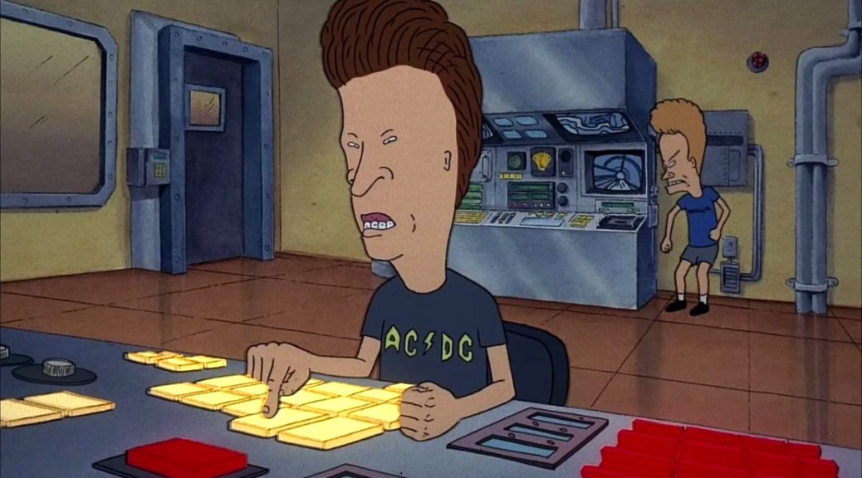
Robert Grant, BayesCamp
Tim Morris, MRC Clinical Trials Unit at UCL

Slide 3
Stata 14’s best feature
On upgrading Stata, one of the pieces of housekeeping I do is change stuff in graph set. Things like:
. graph set print logo off
On submitting ‘graph set’, I spotted something unfamiliar…

Slide 4
Stata 14’s best feature

Slide 5
Stata 14’s best feature

Slide 6
What is SVG?

Slide 7
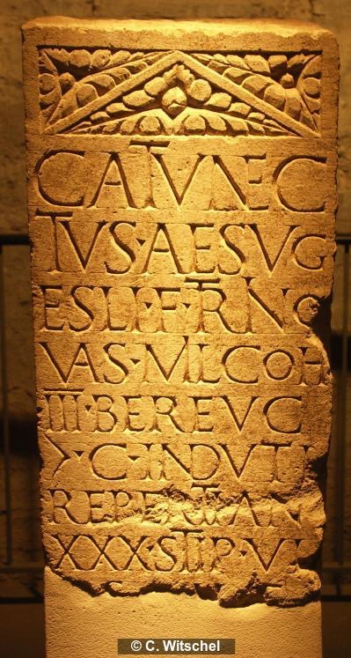

Slide 8
Raster graphics
119 KB .png

Slide 9
Vector graphics
12 KB .svg

Slide 10
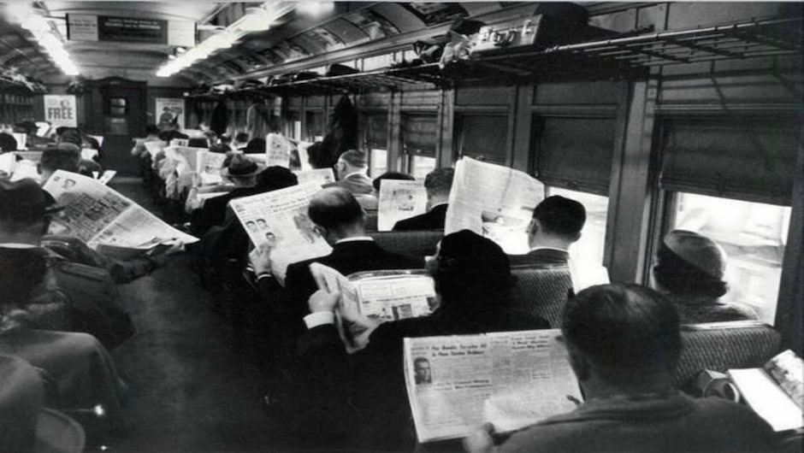
Read it

Slide 11
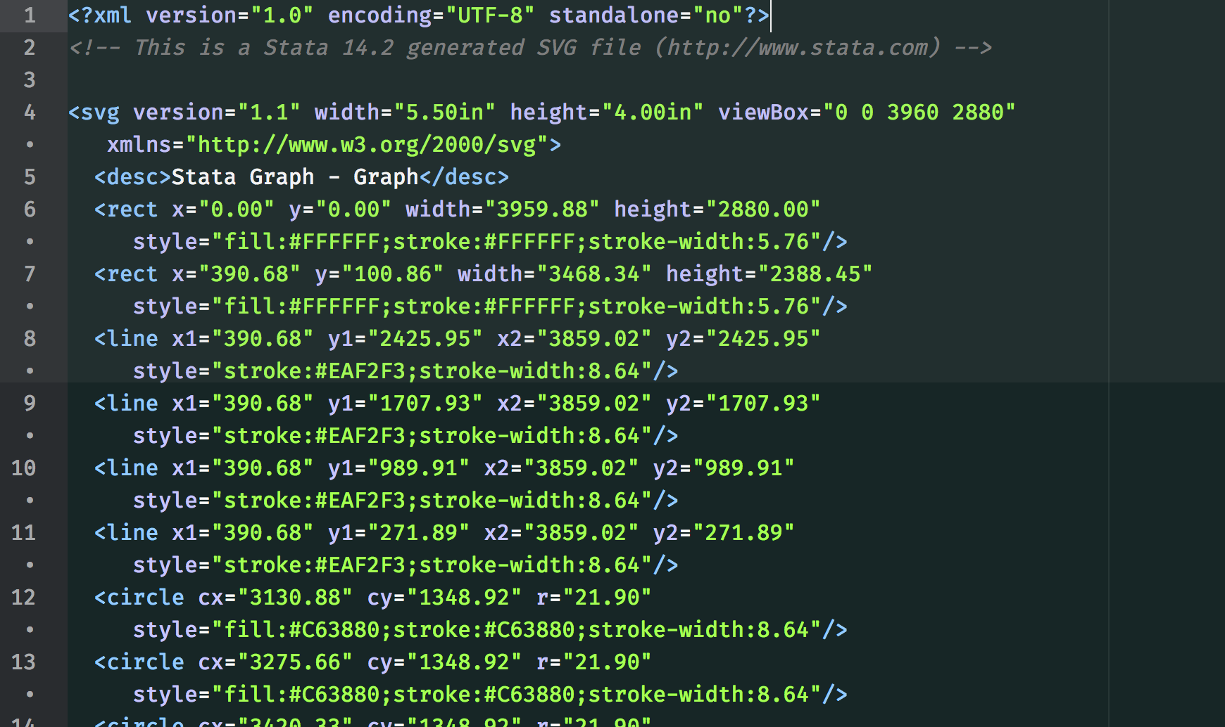

Slide 12
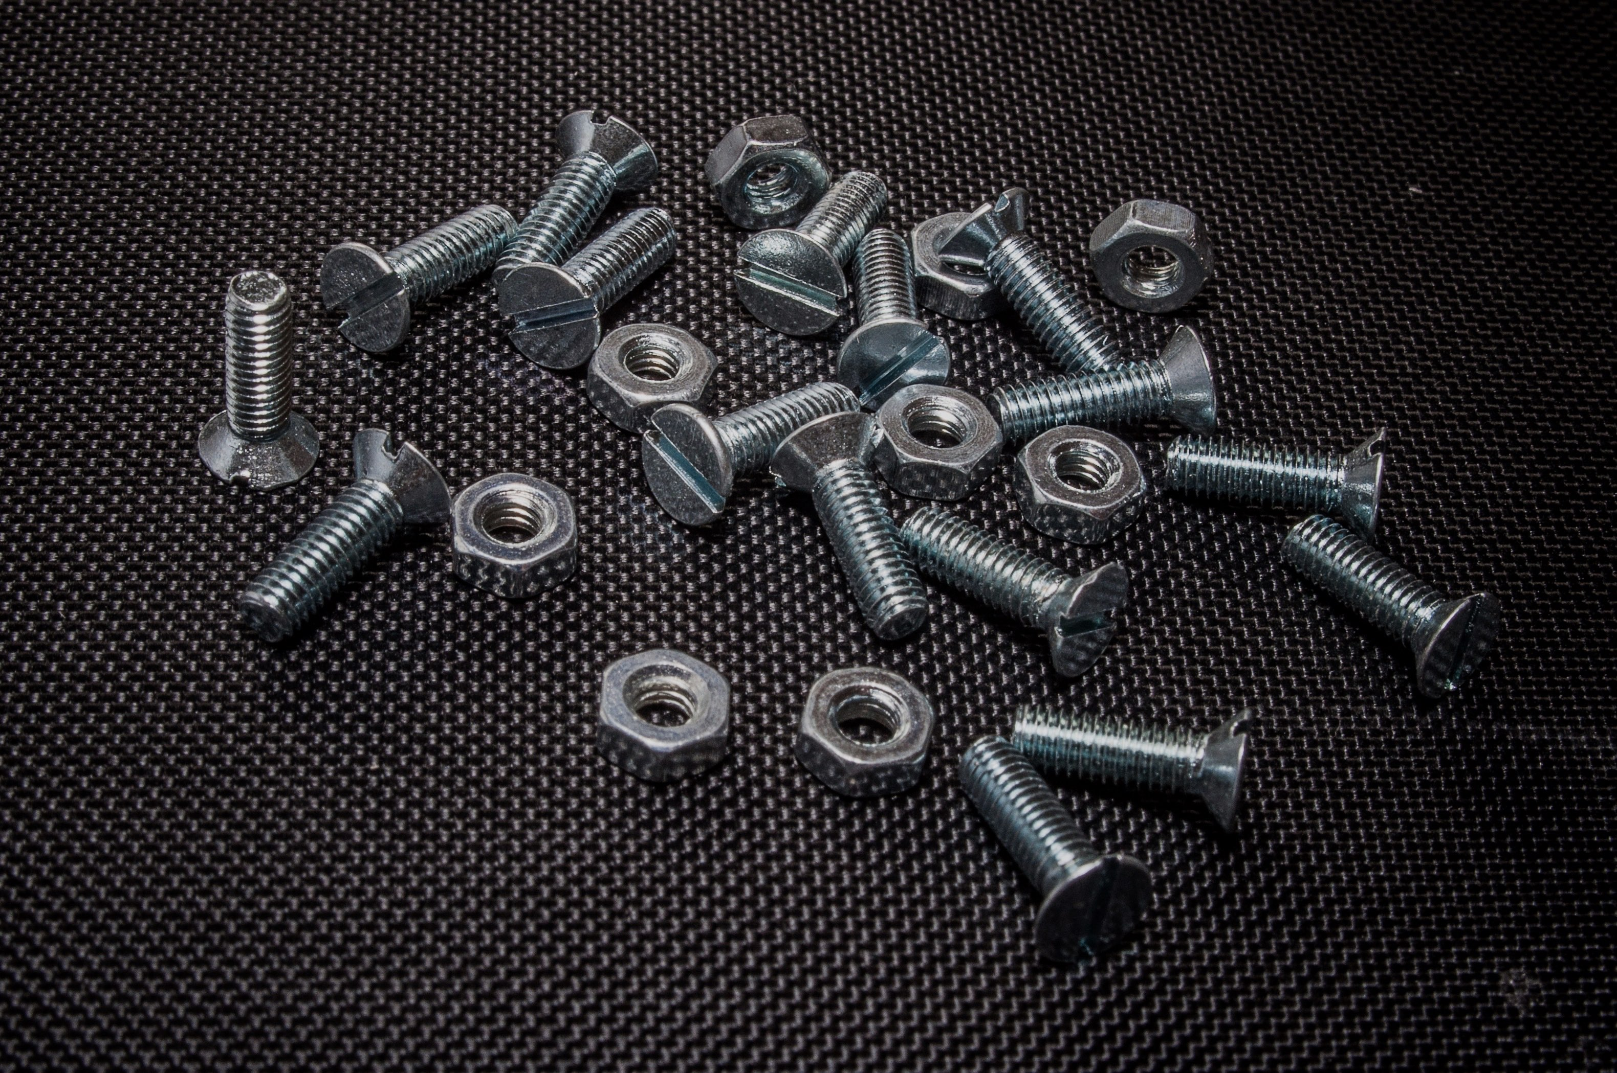
Build it

Slide 13
General principle
Get an SVG file out of Stata (14+)
Open it up and make it even cooler
Receive the accolades of your peers

Slide 14
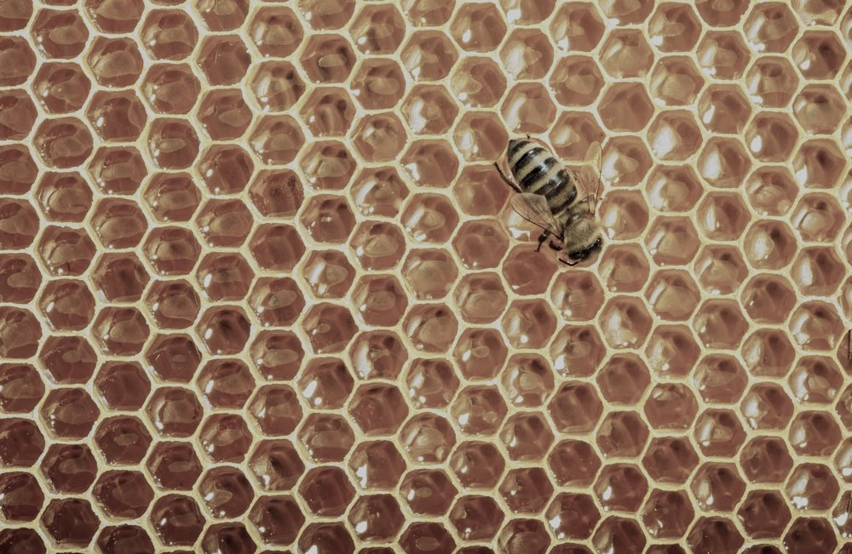
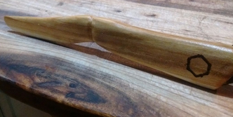
WIN!

Slide 15
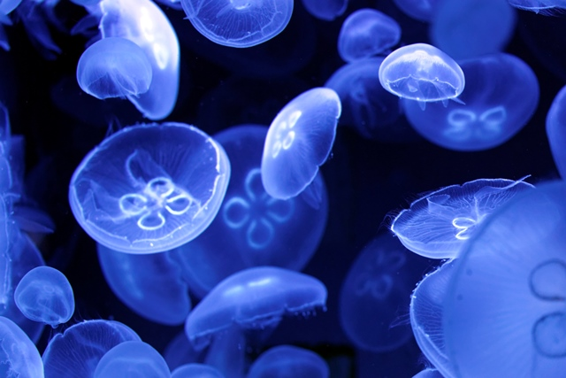
SVG permits ‘opacity=#’

Slide 16
Semi-transparency
or semi-opacity, or translucency
Add to the style information of objects
stroke-opacity, fill-opacity, etc.
Job done!

Slide 17
Semi-transparency
But Tim, I can just do this with mcol(%60) in Stata 15
Yes! …sort of

Slide 18
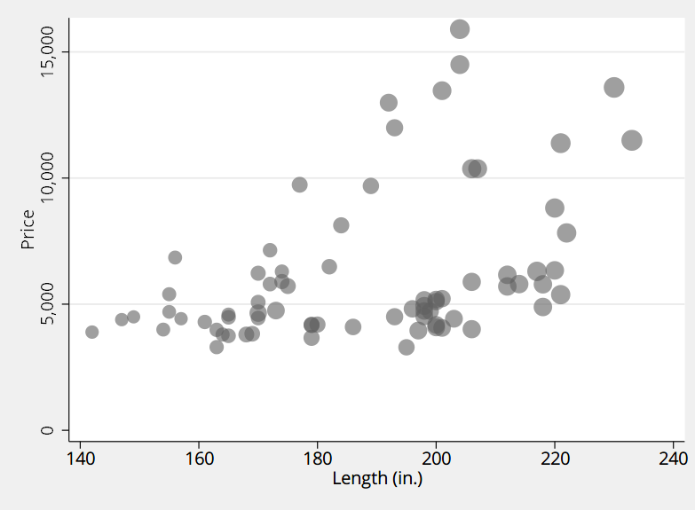
Translucency is easyish (filefilter)

Slide 19
Stata 15 made it so simple: mcol(%60)

Slide 20
Let me break it down
By hand
Stata 15 ‘%’ syntax

Slide 21
BUT… StataCorp?
In Stata 14, a circle was written as:
In Stata 15 a circle is now written as:
This is a problem of general graphics rendering. mlalign(center) fixes it. (thx Chinh Nguyen)

Slide 22
If you care (I do)
Translucency ‘by hand’ is reasonably easy (harder in Stata 15 than in 14)
. tempfile a b
. graph export `a' , as(svg)
. filefilter `a' `b', from(fill:none;stroke:#606060;)
> to(fill:none;stroke:none;)
. filefilter `b' scatter-trans.svg, from(fill:#606060)
> to(fill:#606060;fill-opacity:0.6) replace

Slide 23
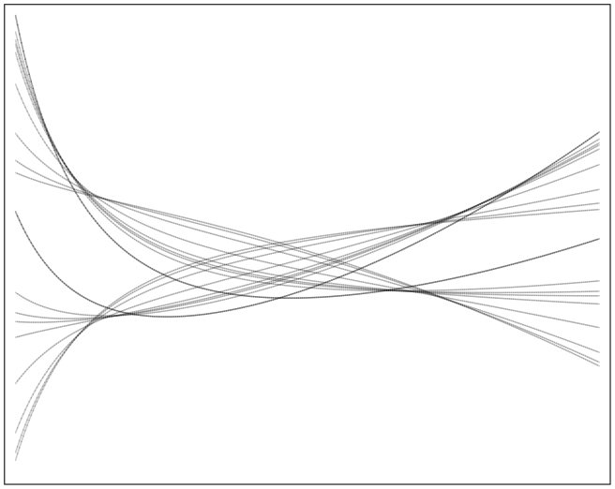
Translucency for lines

Slide 24
Semi-transparency
Now you can add an image (raster), such as a map, in the background

Slide 25
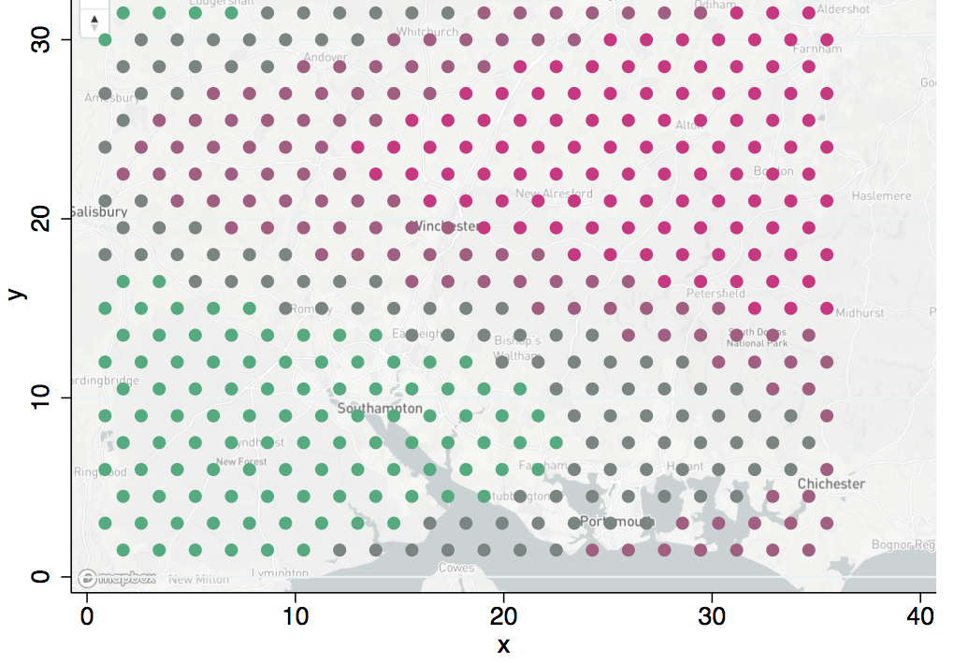

Slide 27
Hexagonal binning
This is different: we don’t start with a Stata SVG file
Count observations in hexagons
Make a scatterplot on a grid -> SVG
Open that and replace circles with hexagon symbols
Job done!

Slide 28
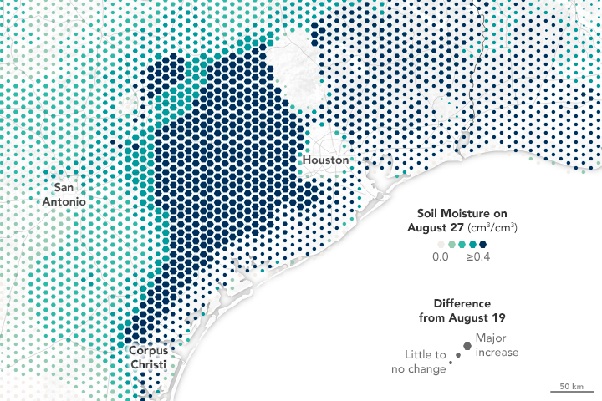

Slide 30
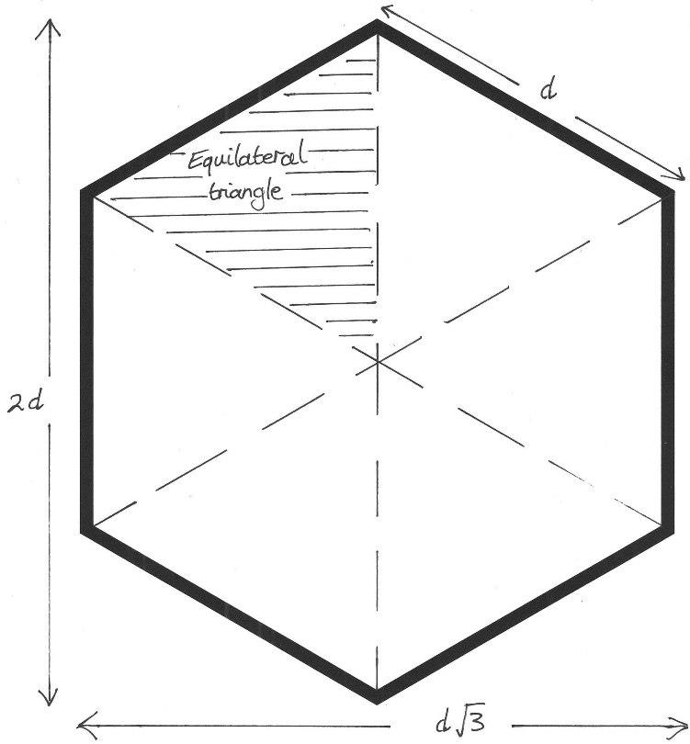
Doing hexbin
We can set up the honeycomb: two grids of rectangles with y and x offset
Get binning!
(0, 1)
(–0.5√3, 0.5)
(0.5√3, 0.5)
(0,0)
(–0.5√3, –0.5)
(0.5√3, –0.5)
(0, –1)

Slide 31
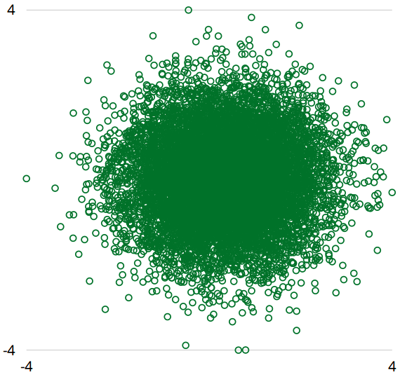
Bivariate normal

Slide 32
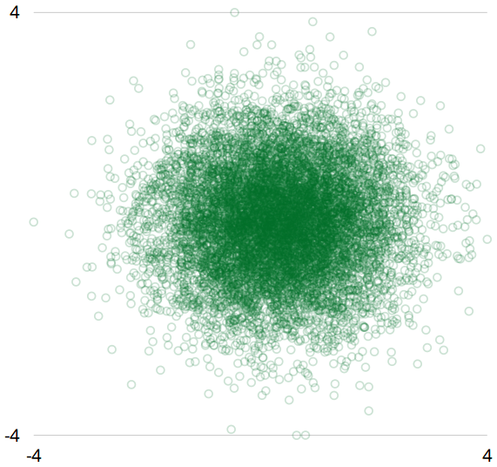
Stata gets us this far

Slide 33
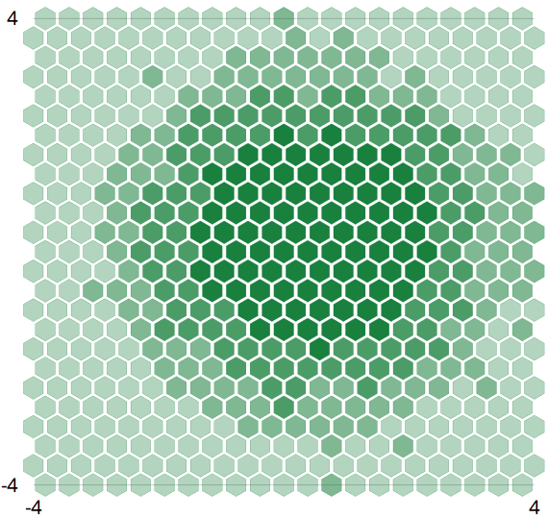
After editing SVG from Stata…

Slide 34
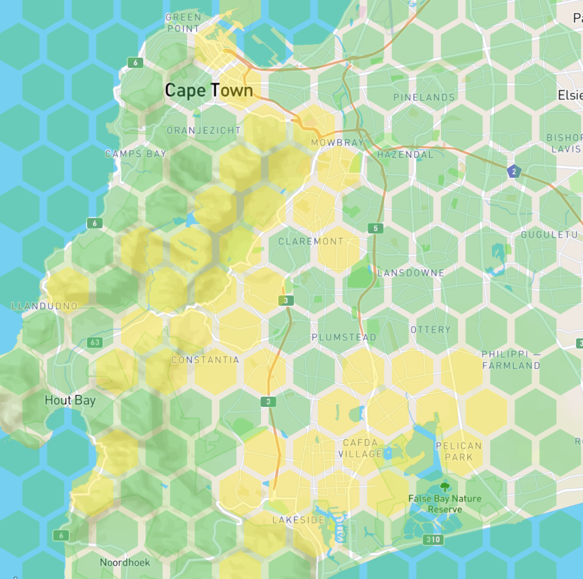
and with a background image

Slide 35
Interactivity
Add basic HTML before & after the SVG
Now you have a web page
Connect objects to controls like sliders, buttons, etc with JavaScript
Job done!

Slide 36
Interactivity
sysuse auto
scatter price mpg
graph export "example.svg", replace
svgwithjs "example.svg", htmlfile("output.html") movar(make) moheading("The make of this car is:")

Slide 37
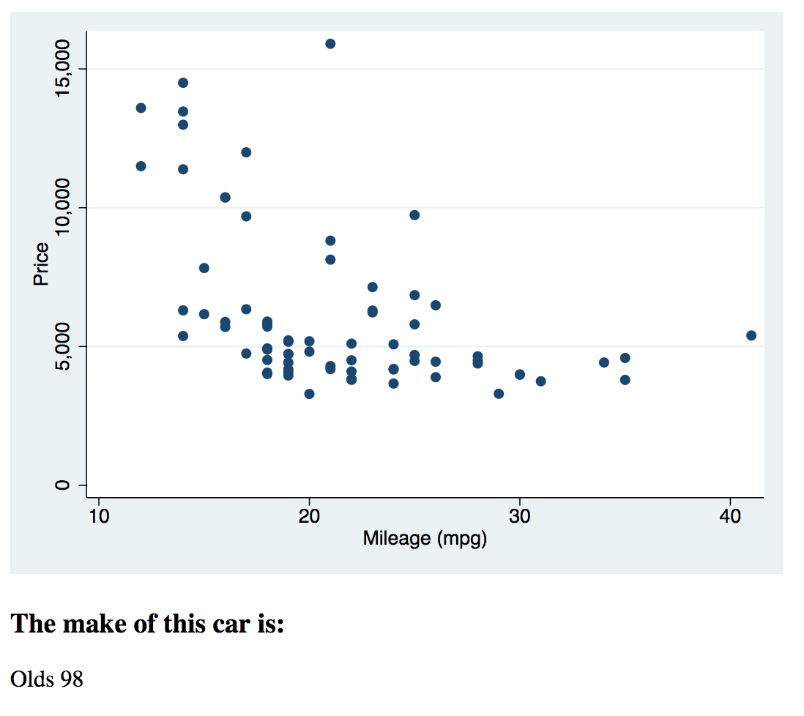

Slide 38
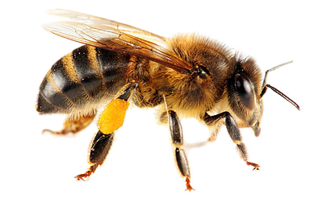
and more…
Colour gradients (see Nadieh Bremer)
Animation (see Sarah Drasner)
What are your ideas?

Slide 39
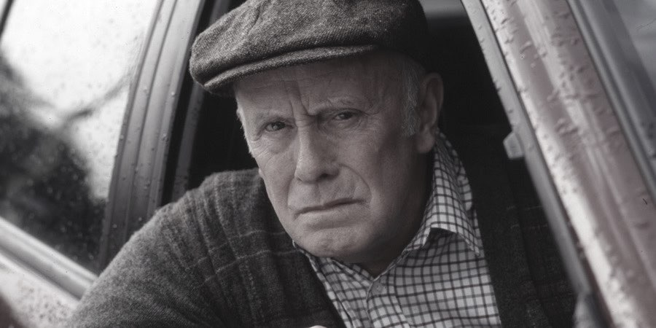
Pre-emptive wishes & grumbles

Slide 40
Why not
Add id and class to objects
Get rid of the double markers in version 15!
Write out the SVG file without “drawing a graph”: SVG file becomes the graph window
. graph gtype -> . svg gtype

Slide 41
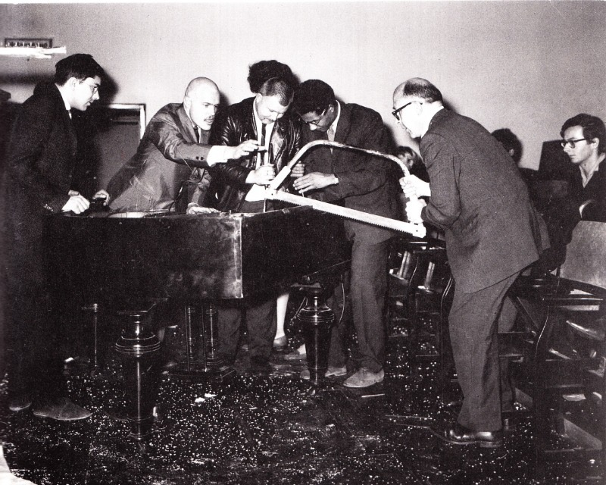
Thanks for listening
github.com/robertgrant/stata-svg

