Slide 1
The Right Way to code simulation studies in Stata
Tim Morris MRC CTU at UCL 25th UK Stata Conference | Michael Crowther University of Leicester

Slide 2
https://github.com/tpmorris/TheRightWay
tldr:
Michael’s way is unambiguously wrong
My way is not unambiguously right
The Right Way is unambiguously right

Slide 3
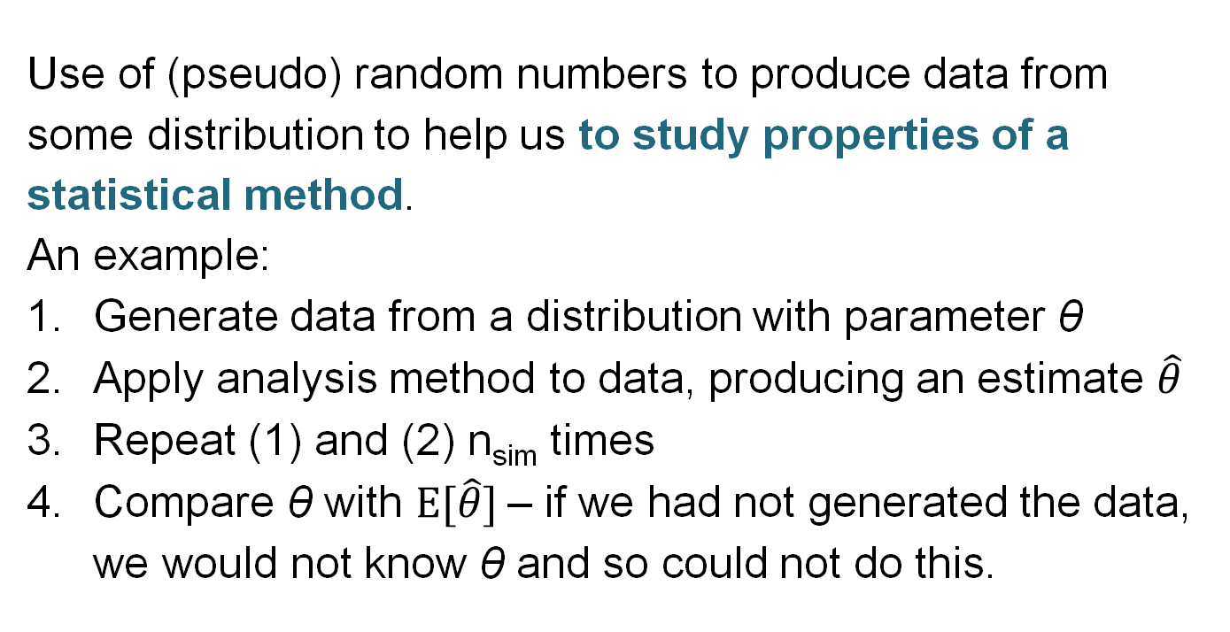
What is a simulation study?
Use of (pseudo) random numbers to produce data from some distribution to help us to study properties of a statistical method.
An example:
Generate data from a distribution with parameter θ
Apply analysis method to data, producing an estimate $\hat{θ}$
Repeat (1) and (2) n_{sim} times
Compare θ with $E[\hat{θ}]$– if we had not generated the data, we would not know θ and so could not do this.

Slide 4
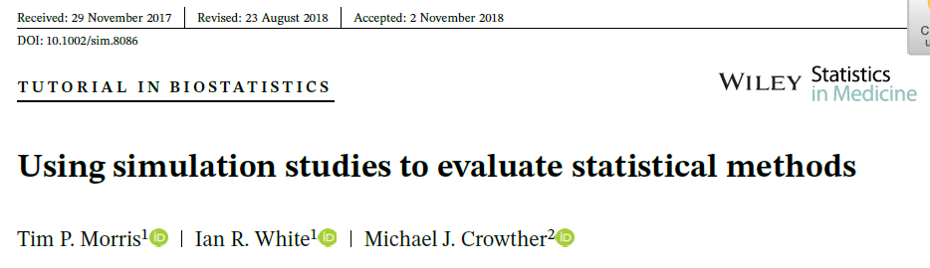
Some background
Consistent terminology with definitions
ADEMP (Aims, Data-generating mechanisms, Estimands, Methods, Performance measures): D, E, M are important in coding simulation studies

Slide 5
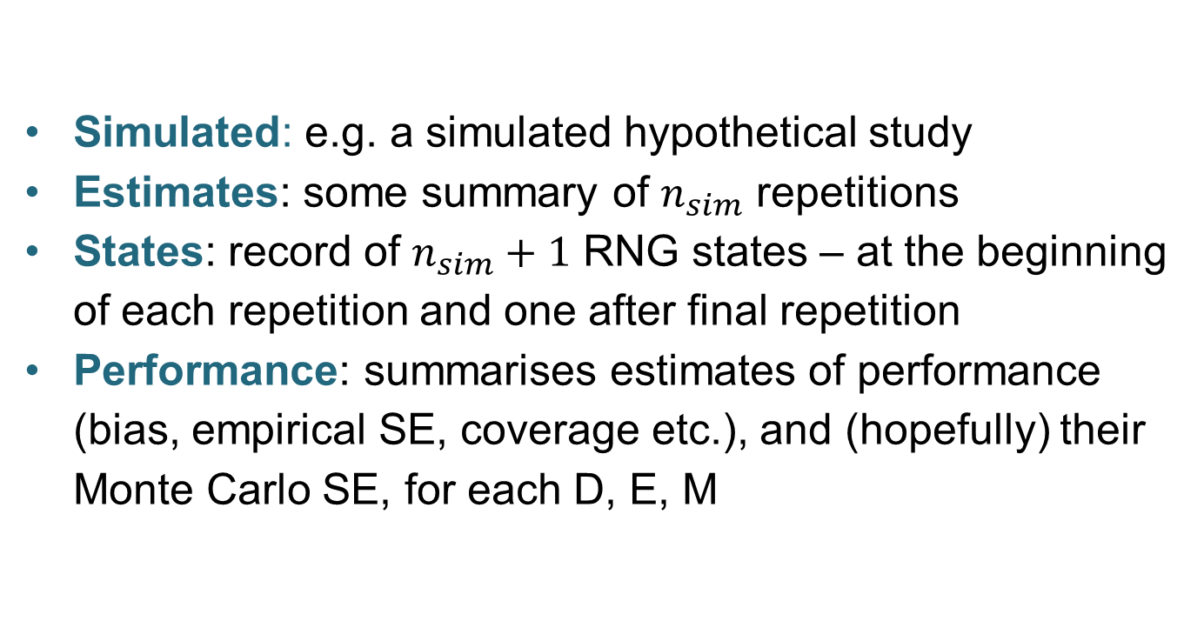
Four datasets (possibly)
Simulated: e.g. a simulated hypothetical study
Estimates: some summary of $n_{sim}$ repetitions
States: record of $n_{sim}+1$ RNG states – at the beginning of each repetition and one after final repetition
Performance: summarises estimates of performance (bias, empirical SE, coverage etc.), and (hopefully) their Monte Carlo SE, for each D, E, M

Slide 6
This talk
This talk focuses on the code that produces a simulated dataset and returns the estimates and states datasets.
I teach simulation studies a lot. Errors in coding occur primarily in generating data in the way you want, and in storing summaries of each repetition (estimates data).

Slide 7
A simple simulation study:
Aims
Suppose we are interested in the analysis of a randomised trial with a survival outcome and unknown baseline hazard function.
Aim to evaluate the impacts of:
misspecifying the baseline hazard function on the estimate of the treatment effect
fitting a more complex model than necessary
avoiding the issue by using a semiparametric model

Slide 8
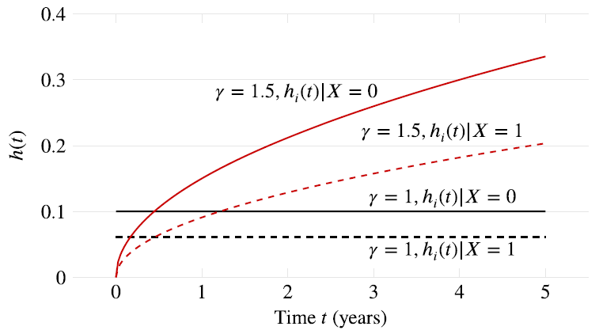

Data generating mechanisms
Simulate n_{obs}=100 and then n_{obs}=500 from a Weibull distribution with $X_{i}\sim Bern(.5)$ and
$$h\left(t\right)= λγt^{γ−1}\exp\left(X_{i}θ\right)\text{where} λ=0.1, θ=−0.5$$
(admin censoring
at 5 years)
Study $γ$ = 1
then $γ$ = 1.5

Slide 9
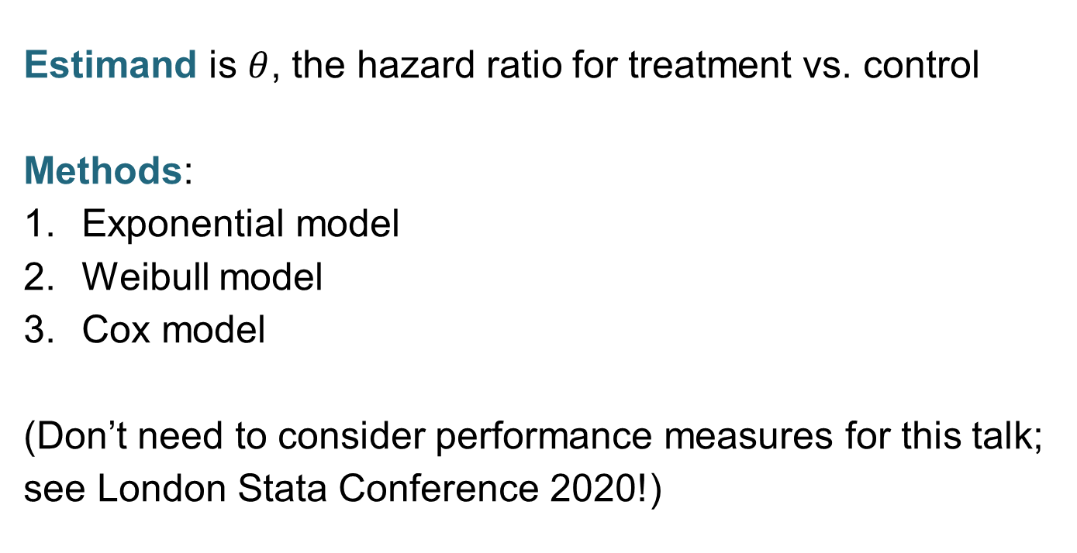
Estimands and Methods
Estimand is $θ$, the hazard ratio for treatment vs. control
Methods:
Exponential model
Weibull model
Cox model
(Don’t need to consider performance measures for this talk; see London Stata Conference 2020!)

Slide 10
Well-structured estimates
Long–long format
rep_id | n_obs | truegamma | method | theta_hat | se
1 | 100 | γ=1 | Exponential | -1.690183 | .5477225
1 | 100 | γ=1 | Weibull | -1.712495 | .54808
1 | 100 | γ=1 | Cox | -1.688541 | .5481199
1 | 100 | γ=1.5 | Exponential | -.5390697 | .2495417
1 | 100 | γ=1.5 | Weibull | -.6375546 | .2504361
1 | 100 | γ=1.5 | Cox | -.6162164 | .2510851
1 | 500 | γ=1 | Exponential | -.5785365 | .1548867
1 | 500 | γ=1 | Weibull | -.5820988 | .1549543
1 | 500 | γ=1 | Cox | -.5867053 | .1550035
1 | 500 | γ=1.5 | Exponential | -.4040936 | .1188226
1 | 500 | γ=1.5 | Weibull | -.4308287 | .1189563
1 | 500 | γ=1.5 | Cox | -.4335943 | .1190354
Inputs
Results

Slide 11
Well-structured estimates
Wide–long format
rep_id | n_obs | gamma | theta_exp | se_exp | theta_wei | se_wei | theta_cox | se_cox
1 | 100 | γ=1 | -1.690183 | .5477225 | -1.712495 | .54808 | -1.688541 | .5481199
1 | 100 | 1.5 | -.5164924 | .2589072 | -.5594682 | .2595417 | -.5601631 | .2598854
1 | 500 | γ=1 | -.6253604 | .1511858 | -.6269046 | .1512856 | -.6343831 | .1513485
1 | 500 | 1.5 | -.478514 | .1176905 | -.5447887 | .1179448 | -.5460246 | .1180312
2 | 100 | γ=1 | -.377425 | .3562627 | -.3859514 | .3563656 | -.3728753 | .3564457
2 | 100 | 1.5 | -.4841157 | .2456835 | -.5684879 | .2466851 | -.5850977 | .2472228
2 | 500 | γ=1 | -.6477997 | .1615617 | -.6477113 | .161647 | -.6452857 | .1616655
2 | 500 | 1.5 | -.3358569 | .1222584 | -.3609435 | .1223288 | -.3619137 | .1224012
Inputs
Results

Slide 12
The simulate approach
From the help file:
‘simulate eases the programming task of performing Monte Carlo-type simulations’
… ‘questionable’ to ‘no’.

Slide 13
The simulate approach
If you haven’t used it, simulate works as follows:
You write a program (rclass or eclass) that follows standard Stata syntax and returns quantities of interest as scalars.
Your program will generate ≥1 simulated dataset and return estimates for ≥1 estimands obtained by ≥1 methods.
You use simulate to repeatedly call the program.

Slide 14
The simulate approach
I’ve wished-&-grumbled here and on Statalist that simulate:
– Does not allow posting of the repetition number (an oversight?)
– Precludes putting strings into the estimates dataset, meaning non-numerical inputs (D) and contents of c(rngstate) cannot be stored.
– Produces ultra-wide data (if E, M and D vary, the resulting estimates must be stored across a single row!)
Your code is clean; your estimates dataset is a mess.

Slide 15
The post approach
Structure:
tempname tim
postfile `tim' int(rep) str5(dgm estimand) ///
double(theta se) using estimates.dta, replace
forval i = 1/`nsim' {
<1st DGM>
<apply method>
post `tim' (`i') ("thing") ("theta") (_b[trt])
> (_se[trt])
<2nd DGM>
}
postclose `tim'

Slide 16
The post approach
+ No shortcomings of simulate
+ Produces a well-formed estimates dataset
– post commands become entangled in the code for generating and analysing data
– post lines are more error prone. Suppose you are using different n. An efficient way to code this is to generate a dataset (with n observations) and then increase subsets of this data in analysis for the ‘smaller n’ data-generating mechanisms. The code can get inelegant and you mis-post.
Your estimates dataset is clean; your code is a mess.

Slide 17
The right approach
One can mash-up the two!
Write a program, as you would with simulate
Use postfile
Call the program
Post inputs and returned results using post
Use a second postfile for storing rngstates
Why?
1. Appease Michael: Tidy code that is less error-prone.
2. Appease Tim: Tidy estimates (and states) dataset that avoids error-prone reshaping & formatting acrobatics.

Slide 18
A query (grumble?)
None of the options allow for a well-formatted dataset. I want to define a (unique) sort order, label variables & values, use chars… (for value labels, order matters; see below)
I believe this stuff has to be done afterwards (?)
To use 1 "Exponential" 2 "Weibull" and 3 "Cox" (I do), I have to open estimates.dta, label define and label values. Could this be done up-front so you could e.g. fill in DGM codes with “Cox”:method_label rather than number 2?

