Slide 1
Bayesian network meta-analysis
Ian White <ian.white@ucl.ac.uk>
MRC Clinical Trials Unit at UCL
London Stata Conference
6th September 2019
Notes:
Abstract for London Stata Conference 2019
Bayesian network meta-analysis
Ian White, MRC CTU at UCL
Network meta-analysis is a statistical approach to combining evidence from multiple studies comparing multiple treatments. It may be “two-stage”, where treatment effects and their variances are estimated separately for each study and then combined using a Normal approximation; or “one-stage”, where summary statistics at treatment group level (e.g. number of events and number of individuals) are directly analysed.
My ‑network‑ suite currently provides various tools for exploring network meta-analysis data and analysing them in a two-stage frequentist approach [1]. I will describe arguments for preferring a one-stage Bayesian approach, and recent work implementing it.
The one-stage approach amounts to fitting a generalised linear mixed model, but I was unable to achieve adequate mixing using ‑bayes: meglm‑. I will describe my alternative approach of automating the writing and running of a WinBUGS program. This process is implemented in the new ‑network bayes‑ and allows substantial modelling flexibility, including Normal or binomial data; various contrast-based and arm-based models; various heterogeneity structures; and the option to sample from the prior. Features not yet implemented are inconsistency models and meta-regression.
[1] White IR. Network meta-analysis. Stata Journal 2015;15:1-34.
20 mins including questions

Slide 2
Plan
Why network meta-analysis (NMA)?
Why one-stage rather than two-stage NMA?
Why Bayesian rather than frequentist NMA?
NMA as a generalised linear mixed model
bayes: meglm
Calling WinBUGS
Comparison in the smoking data

Slide 3
Network meta-analysis: the smoking data
study | dA | nA | dB | nB | dC | nC | dD | nD
1 | 9 | 140 |  |  | 23 | 140 | 10 | 138
2 |  |  | 11 | 78 | 12 | 85 | 29 | 170
3 | 79 | 702 | 77 | 694
4 | 18 | 671 | 21 | 535
5 | 8 | 116 | 19 | 146
6 | 75 | 731 |  |  | 363 | 714
7 | 2 | 106 |  |  | 9 | 205
8 | 58 | 549 |  |  | 237 | 1561
9 | 0 | 33 |  |  | 9 | 48
10 | 3 | 100 |  |  | 31 | 98
11 | 1 | 31 |  |  | 26 | 95
12 | 6 | 39 |  |  | 17 | 77
13 | 95 | 1107 |  |  | 134 | 1031
14 | 15 | 187 |  |  | 35 | 504
15 | 78 | 584 |  |  | 73 | 675
16 | 69 | 1177 |  |  | 54 | 888
17 | 64 | 642 |  |  | 107 | 761
18 | 5 | 62 |  |  | 8 | 90
19 | 20 | 234 |  |  | 34 | 237
20 | 0 | 20 |  |  |  |  | 9 | 20
21 |  |  | 20 | 49 | 16 | 43
22 |  |  | 7 | 66 |  |  | 32 | 127
23 |  |  |  |  | 12 | 76 | 20 | 74
24 |  |  |  |  | 9 | 55 | 3 | 26
Trials compared 4 different interventions to help smokers quit:
A="No contact"
B="Self help"
C="Individual counselling"
D="Group counselling“
dA = #quit out of nA in group A (etc.)

Slide 4
Indirect comparisons
We have trials of different designs:
  A vs B
  A vs C
  A vs D
  B vs C
  B vs D
  C vs D
  A vs C vs D
  B vs C vs D
  We can use indirect evidence: e.g. combining A vs B trials with B vs C trials gives us more evidence about A vs C (we call the A vs C and A vs C vs D trials “direct evidence” about A vs C)

Slide 5
Estimation approaches to NMA (1)
Much of the literature uses a Bayesian approach rooted in the evidence synthesis literature (Lu & Ades 2006)
I proposed a two-stage frequentist approach (White et al 2012)
  in each study, estimate treatment effects and their standard errors
  combine across studies assuming Normality, using multivariate meta-analysis
  implemented in -network- (& presented here in 2013)
Lu, G., & Ades, A. E. (2006). Assessing evidence inconsistency in mixed treatment comparisons. Journal of the American Statistical Association, 101, 447–459.
White, I. R., Barrett, J. K., Jackson, D., & Higgins, J. P. T. (2012). Consistency and inconsistency in network meta-analysis: model estimation using multivariate meta-regression. Research Synthesis Methods, 3(2), 111–125.

Slide 6
Estimation approaches to NMA (2)
But two-stage analysis involves approximations that are poor in small studies
So let’s look at a one-stage analysis
  modelling #events using a binomial likelihood
  this is a GLMM

Slide 7
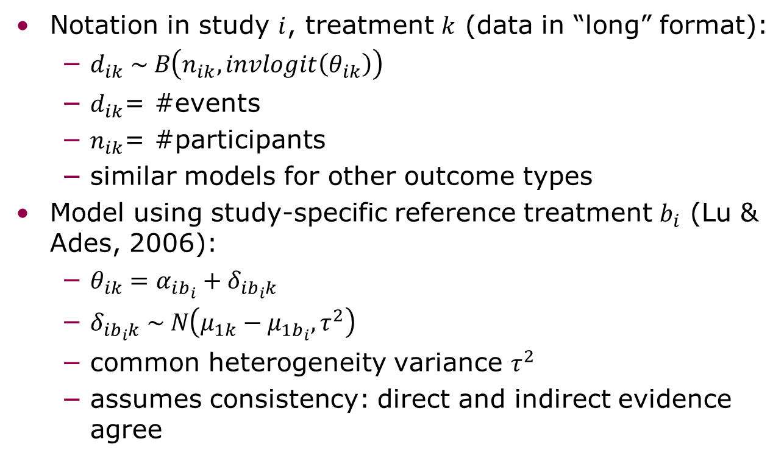
NMA as a generalised linear mixed model
Notation in study $i$, treatment $k$ (data in “long” format):
  $d_{ik} \sim B\left(n_{ik}, invlogit\left(θ_{ik}\right)\right)$
  $d_{ik}$= #events
  $n_{ik}$= #participants
  similar models for other outcome types
Model using study-specific reference treatment $b_{i}$ (Lu & Ades, 2006):
  $θ_{ik}=α_{ib_{i}}+δ_{ib_{i}k}$
  $δ_{ib_{i}k} \sim N\left(μ_{1k}−μ_{1b_{i}},τ^{2}\right)$
  common heterogeneity variance $τ^{2}$
  assumes consistency: direct and indirect evidence agree

Slide 8
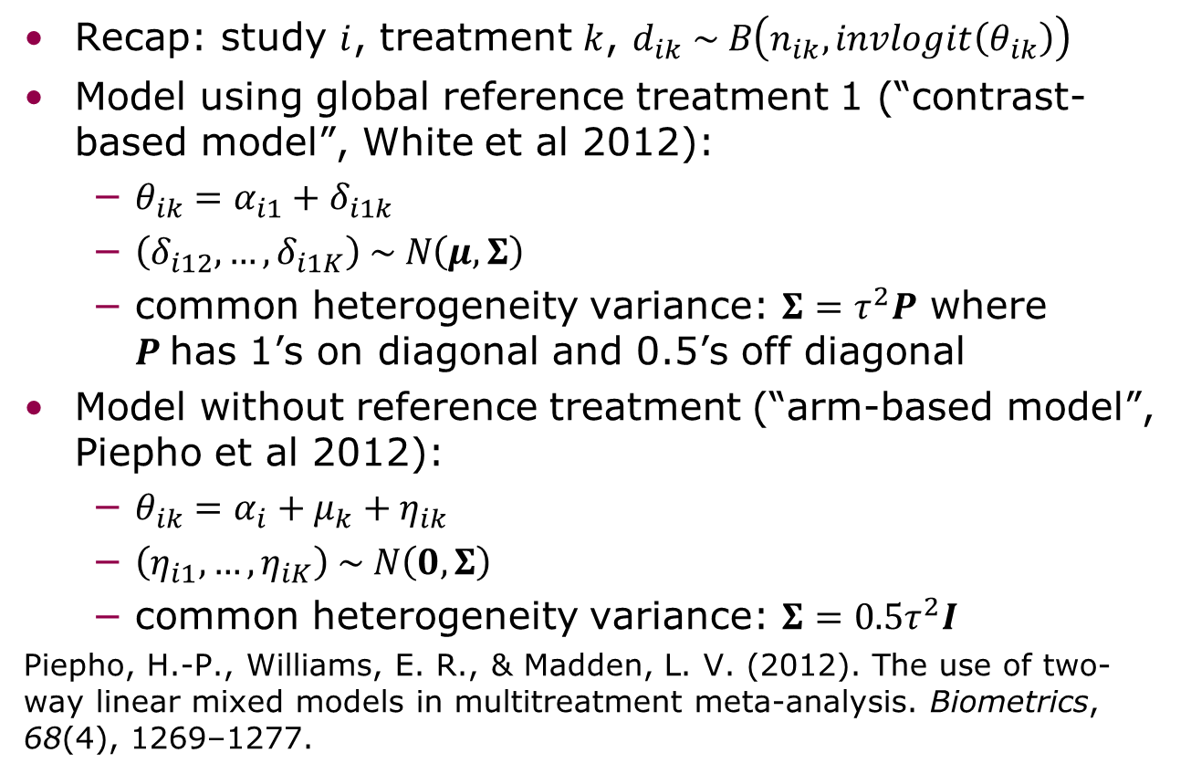
NMA as a generalised linear mixed model
Recap: study $i$, treatment $k$, $d_{ik} \sim B\left(n_{ik}, invlogit\left(θ_{ik}\right)\right)$
Model using global reference treatment 1 (“contrast-based model”, White et al 2012):
  $θ_{ik}=α_{i1}+δ_{i1k}$
  $\left(δ_{i12},…,δ_{i1K}\right) \sim N\left(μ,Σ\right)$
  common heterogeneity variance: $Σ=τ^{2}P$ where $P$has 1’s on diagonal and 0.5’s off diagonal
Model without reference treatment (“arm-based model”, Piepho et al 2012):
  $θ_{ik}=α_{i}+μ_{k}+η_{ik}$
  $\left(η_{i1},…,η_{iK}\right) \sim N\left(0,Σ\right)$
  common heterogeneity variance: $Σ=0.5τ^{2}I$
Piepho, H.-P., Williams, E. R., & Madden, L. V. (2012). The use of two-way linear mixed models in multitreatment meta-analysis. Biometrics, 68(4), 1269–1277.

Slide 9
In Stata
Arm-based model:
  meglm d i.study i.trt || study: R.trt, nocons family(binomial n)
Contrast-based model:
  tab trt, gen(I)
  gen I1not = !I1
  meglm d i.study i.trt || study: I2 I3 I4 I1not, cov(id) nocons family(binomial n)
Results not shown, but for contrast-based model, intpoints(#) needed increasing from default 7 to at least 31 to get accurate parameter estimates
Notes:
C-A contrast was 0.50 (0.08) with intpoints(7), but 0.73 (0.16) with intpoints(31)

Slide 10
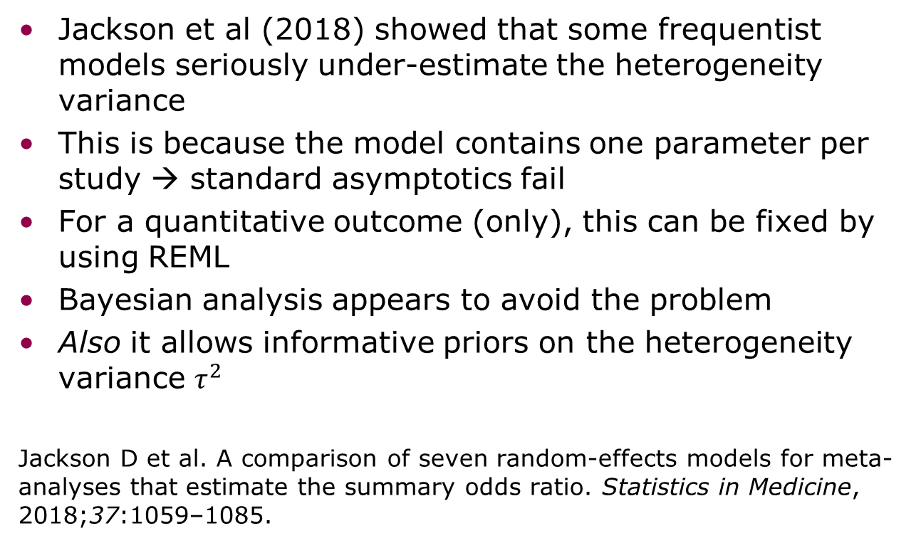
What’s wrong with the frequentist approach?
Jackson et al (2018) showed that some frequentist models seriously under-estimate the heterogeneity variance
This is because the model contains one parameter per study → standard asymptotics fail
For a quantitative outcome (only), this can be fixed by using REML
Bayesian analysis appears to avoid the problem
Also it allows informative priors on the heterogeneity variance $τ^{2}$
Jackson D et al. A comparison of seven random-effects models for meta-analyses that estimate the summary odds ratio. Statistics in Medicine, 2018;37:1059–1085.

Slide 11
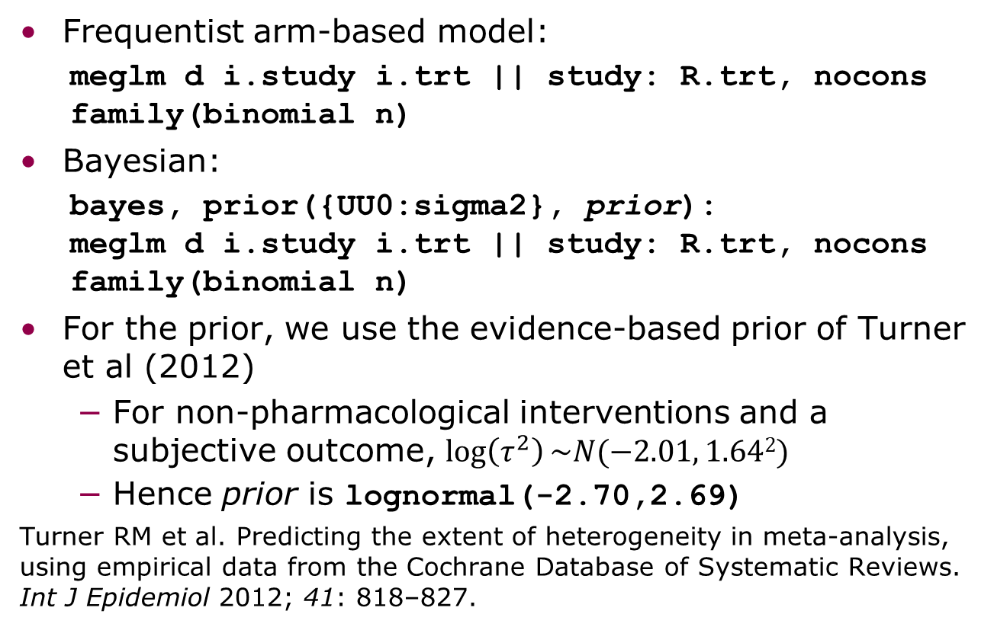
Bayesian approach using bayes: meglm
Frequentist arm-based model:
  meglm d i.study i.trt || study: R.trt, nocons family(binomial n)
Bayesian:
  bayes, prior({UU0:sigma2}, prior):
  meglm d i.study i.trt || study: R.trt, nocons family(binomial n)
For the prior, we use the evidence-based prior of Turner et al (2012)
  For non-pharmacological interventions and a subjective outcome, $\log\left(τ^{2}\right)\sim N(−2.01, 1.642)$
  Hence prior is lognormal(-2.70,2.69)
Turner RM et al. Predicting the extent of heterogeneity in meta-analysis, using empirical data from the Cochrane Database of Systematic Reviews. Int J Epidemiol 2012; 41: 818–827.

Slide 12
Bayesian approach: results
5 million MCMC iterations
thin(1000)
So 5000 samples
2.5 hours on UCL myriad
Effective sample size = 15

Slide 13
Bayesian approach: results
Explorations
  Changed parameterisation of constant term (separate, in study, in treatment) – little difference
  Changed block() as in [R bayesmh] – gets ESS to 1000 in 5 hours
  Can’t separate blocks any further
Notes:
Explorations in the BLOCKER example: compared to the bayesmh code in the manual, bayes:meglm is 2x faster to update and 5x slower to mix, so overall 2.5x less efficient.
Can’t split RE parameters:
block({UU0[study>trt]}, split) → option block() not supported for random-effects parameters

Slide 14
Approach via WinBUGS
(or another gibbs sampler – a run with JAGS seemed slower; I know Stan could be faster)
network bayes
  writes the model, data, initial values, and script
    using file write
  calls winbugs to run the script
  reads output back into Stata and summarises it
    using John Thompson’s winbugs suite
Key variables are already specified by network setup
User specifies
  model type
  priors
  whether to sample from prior or posterior

Slide 15
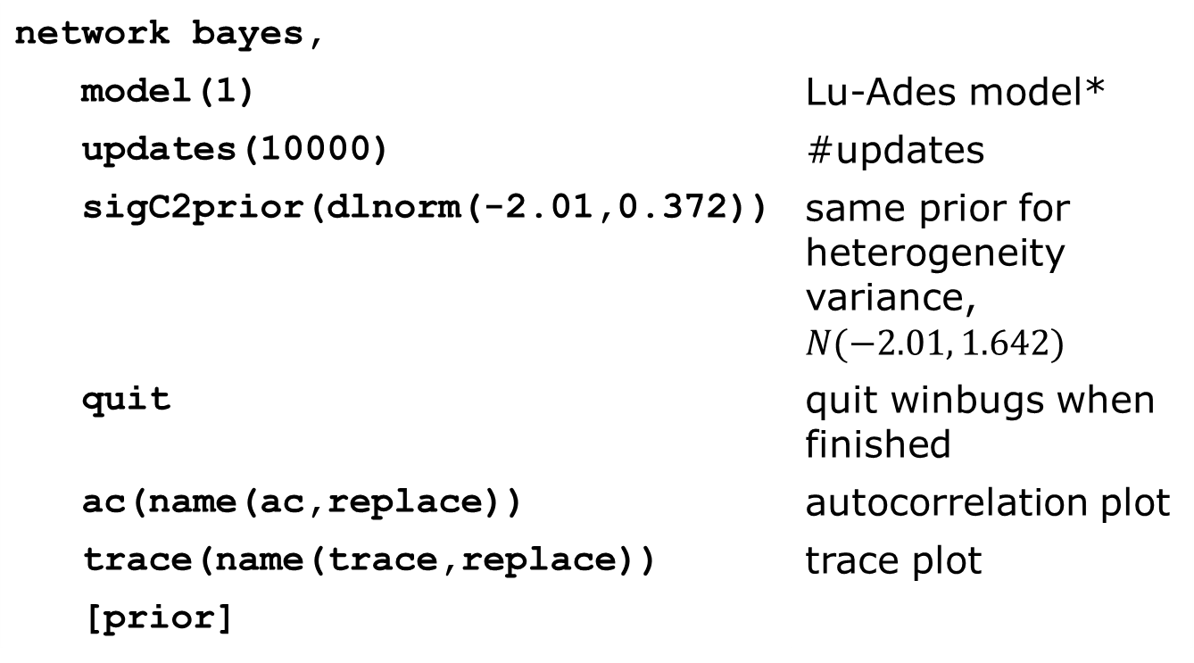
Example
network bayes,
model(1) | Lu-Ades model*
updates(10000) | #updates
sigC2prior(dlnorm(-2.01,0.372)) | same prior for heterogeneity variance, $N(−2.01, 1.642)$
quit | quit winbugs when finished
ac(name(ac,replace)) | autocorrelation plot
trace(name(trace,replace)) | trace plot
[prior]
* Model definitions: White IR et al. A comparison of arm-based and contrast-based models for network meta-analysis. Stat Med, in press

Slide 16
WinBUGS model written
## NMA MODEL 1CB WITH COMMON HETEROGENEITY
## WRITTEN BY NETWORK_BAYES.ADO AT 16:53:49 ON 22 Aug 2019
## In this code:
## Data s[], r[], n[] represent Stata variables study, d, n
## Scalars N=50, NS=24, NT=4 are #arms, #studies, #treatments
model {
## LINK DATA TO THETA
for (o in 1:N) {
r[o] ~ dbin(theta[o],n[o])
}
## MODEL THETA
for (o in 1:N) {
logit(theta[o]) <- alphaA[s[o]] + deltaC[o]*(1-equals(t[o],b[o]))
}
## MODEL STUDY MAIN EFFECTS
for (i in 1:NS) {
alphaA[i] ~ dnorm(0, 0.001)
}
## MODEL OVERALL TREATMENT EFFECTS
muC[1] <- 0
for (k in 2:NT) {
muC[k] ~ dnorm(0, 0.001)
}
## MODEL HETEROGENEITY EFFECTS
for (o in 1:N) {
deltaC[o] ~ dnorm(md[o], taud[o])
md[o] <- muC[t[o]] - muC[b[o]] + offset[o]
taud[o] <- (1/sigC2) * (1 + step(m[o]-3)*(1-2/m[o]))
## includes variance correction for multi-arm studies
}
## mean correction for multi-arm studies
offset[1] <- 0
offset[2] <- 0
for (o in 3:N) {
offset[o] <- step(m[o]-3) * ( (m[o]-2)*offset[o-1] + (deltaC[o-1]-muC[t[o-1]]+muC[b[o-1]]) ) /(m[o]-1)
}
## PRIOR FOR COMMON HETEROGENEITY VARIANCE
sigC2 ~ dlnorm(-2.01,.37180249851279) ## contrast heterogeneity variance
## useful summaries
sigC <- sqrt(sigC2)
}

Slide 17
WinBUGS approach: results
10000 MCMC iterations
No need to thin
13 seconds on laptop
Effective sample size > 2500
Notes:
MCMC samples stored in "N:\Old Home Drives\meta\network\meglm\smoking_network_bayes\network_bayes_sample.dta“
Program in "N:\Old Home Drives\meta\network\meglm\smoking_network_bayes.do“

Slide 18
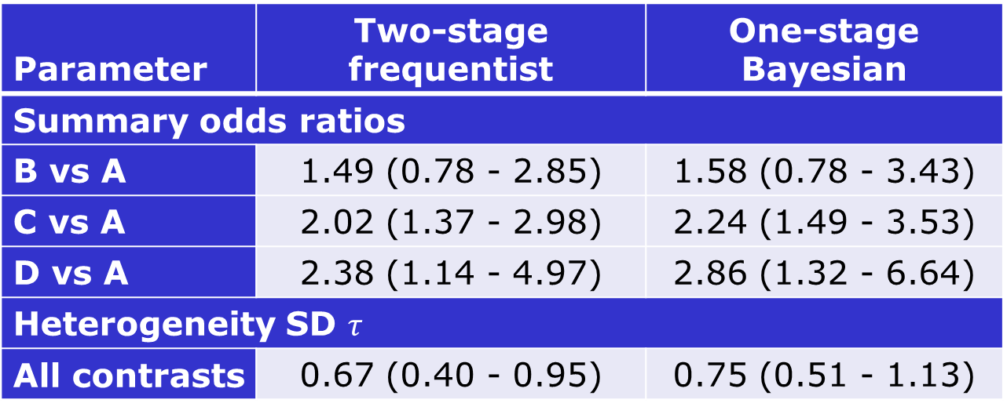
Results for smoking data
Parameter | Two-stage frequentist | One-stage Bayesian
Summary odds ratios
B vs A | 1.49 (0.78 - 2.85) | 1.58 (0.78 - 3.43)
C vs A | 2.02 (1.37 - 2.98) | 2.24 (1.49 - 3.53)
D vs A | 2.38 (1.14 - 4.97) | 2.86 (1.32 - 6.64)
Heterogeneity SD $τ$
All contrasts | 0.67 (0.40 - 0.95) | 0.75 (0.51 - 1.13)
As expected, the one-stage Bayesian approach gives estimates further from the null
Similar results in Lu & Ades 2006

Slide 19
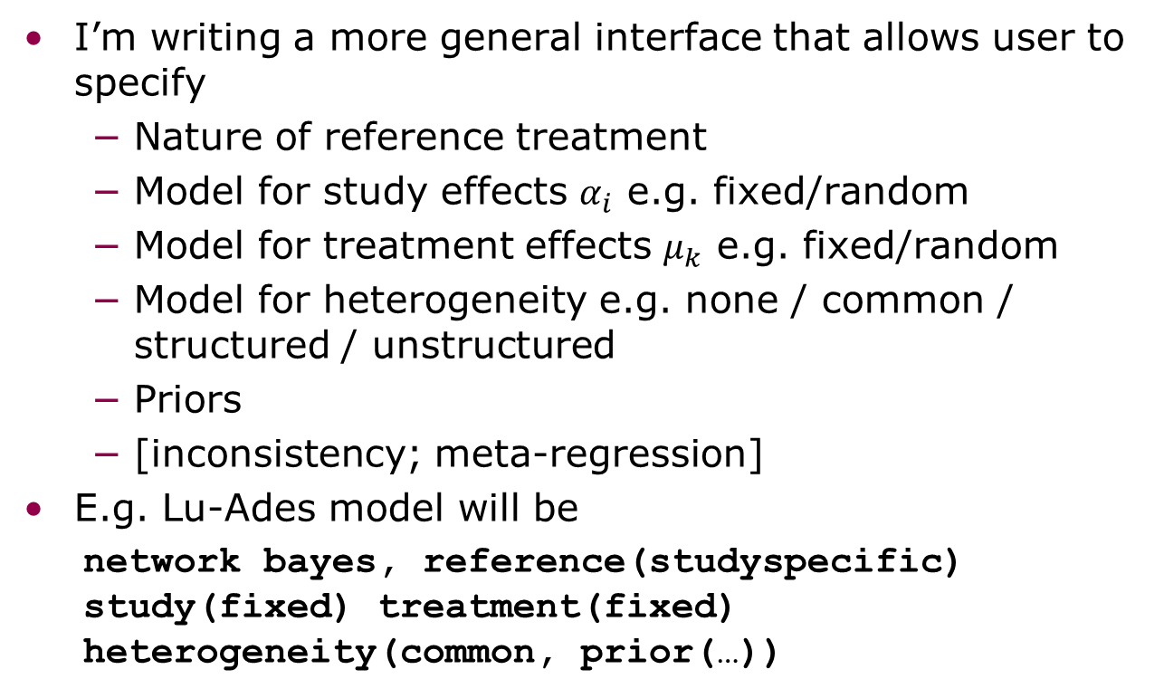
Further work
I’m writing a more general interface that allows user to specify
  Nature of reference treatment
  Model for study effects $α_{i}$ e.g. fixed/random
  Model for treatment effects $μ_{k}$ e.g. fixed/random
  Model for heterogeneity e.g. none / common / structured / unstructured
  Priors
  [inconsistency; meta-regression]
E.g. Lu-Ades model will be
  network bayes, reference(studyspecific) study(fixed) treatment(fixed) heterogeneity(common, prior(…))
Notes:
Planned options:
reference(studyspecific | networkwide | none)
study(fixed | random | none, prior(dist) meanprior(dist) precprior(dist))
treatment(fixed | random)
heterogeneity(none | common | structured | unstructured, prior(dist))

Slide 20
Conclusions / further work
bayes: meglm doesn’t seem a realistic approach: have I missed a trick?
  blocking or other computational trick?
Calling WinBUGS does seem realistic
Acknowledgements
Meta-analysis group at MRC CTU
John Thompson

