Slide 1


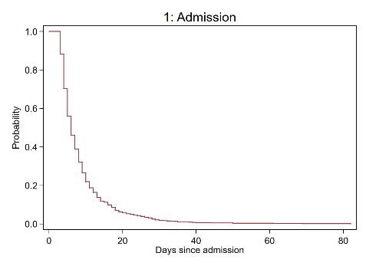
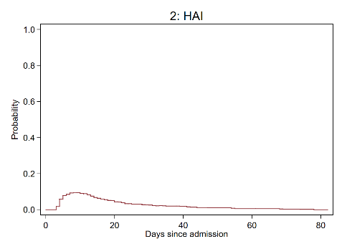
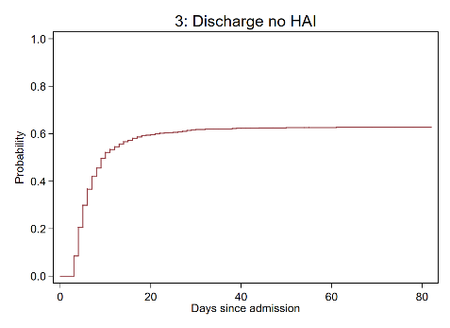
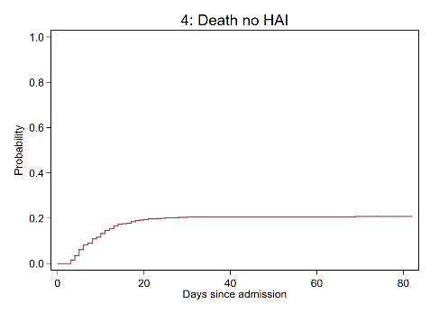
Non-parametric estimation in multi-state survival models: An update to msaj
(Part of the multistate package)
@Micki_Hill
11.09.2020
26th UK Stata Conference 2020
Micki Hill¹
PC Lambert^{1,2} and MJ Crowther^{1,2}
¹University of Leicester; Leicester (UK), ²Karolinska Institutet; Stockholm (Sweden)

Slide 2
Contents
Background
What are multi-state models?
Methods
How do I analyse them?
Software
How will I actually analyse them?
Illustrative example
How do I use msaj in practice?
Conclusion
What should I remember from this talk?

Slide 3





Multi-state models
Standard survival
Competing risks
Boxes = states (6)
Arrows = transitions (5)
State 1:
Admission to hospital
$$h_{1}(t)$$
State 2:
Hospital acquired infection (HAI)
$$h_{2}(t)$$
$$h_{3}(t)$$
$$h_{4}(t)$$
$$h_{5}(t)$$
State 3:
Discharge (no HAI)
State 4:
Death (no HAI)
State 5:
Discharge (HAI)
State 6:
Death (HAI)
10 days after hospital admission, what is the probability a patient is in hospital with a HAI?
At what rate do patients acquire a HAI?
40 days after hospital admission, on average, how many of those days were spent in hospital with a HAI?

Slide 4



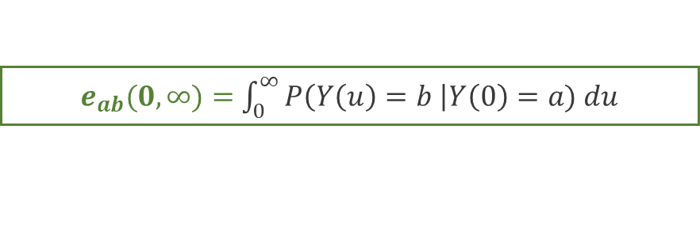
Definitions
Putter, Fiocco & Geskus, 2007 Grand & Putter, 2016
What is the probability a patient is in hospital with a HAI?
Transition probability
$$P(Y\left(t\right)=b|Y\left(s\right)=a, ℋ_{s−})$$
Markov assumption
$$P_{ab}\left(s,t\right)=P(Y\left(t\right)=b|Y\left(s\right)=a)$$
At what rate do patients acquire a HAI?
$$h_{ab}\left(t\right)=\lim_{δt→0}{\frac{P(Y\left(t+δt\right)=b|Y\left(t\right)=a)}{δt}}$$
Transition rates
On average, how long is a patient in hospital with a HAI?
Length of stay
$e_{ab}(0, ∞)=$ $\int_{0}^{∞}{P\left(Y\left(u\right)=b \right|Y\left(0\right)=a) du}$
$e_{ab}(0, t)=$ Restricted LOS
$e_{ab}(s,∞)=$ Residual LOS
4

Slide 5
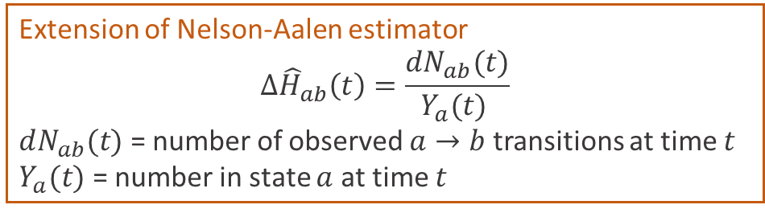
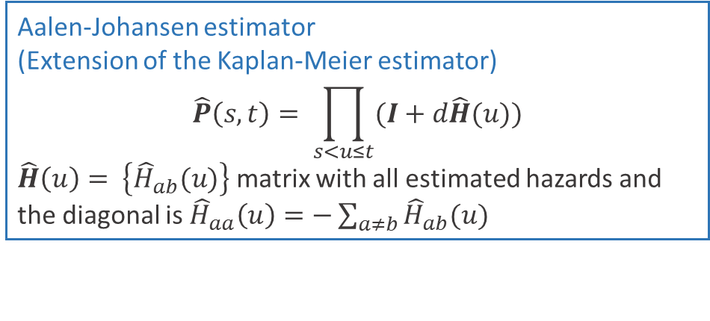
Non-parametric estimators
Aalen & Johansen, 1978
Transition rates
Extension of Nelson-Aalen estimator
$$∆{\hat{H}}_{ab}\left(t\right)=\frac{dN_{ab}(t)}{Y_{a}(t) }$$
$dN_{ab}(t)$ = number of observed $a→b$ transitions at time $t$
$Y_{a}(t)$= number in state $a$ at time $t$
Markov assumption
Transition probability
Aalen-Johansen estimator
(Extension of the Kaplan-Meier estimator)
$$\hat{P}\left(s,t\right)= \prod_{s<u≤t}{(I+d\hat{H}(u)})$$
$\hat{H}\left(u\right)= \left\{{\hat{H}}_{ab}(u)\right\}$ matrix with all estimated hazards and the diagonal is ${\hat{H}}_{aa}\left(u\right)=−\sum_{a≠b}{{\hat{H}}_{ab}(u)}$
Length of stay
Summation of rectangles as the Aalen-Johansen estimator is a step function.

Slide 6
Parametric estimation
Transition rates
Calculate individually for each transition (easy)
Transition probabilities
Calculate using rates for every transition (not easy)
Model
Obtain predictions
Exponential
Analytical solution of FKEs
Assumes Markov property
Any
Numerical solution of FKEs
Any
Via simulation

Slide 7
Software
Crowther & Lambert, 2017
multistate
msset
Transforms the data from wide format to stacked format
msaj
Obtains Aalen-Johansen (empirical) estimates
predictms
Obtains probabilities through simulation from transition rates

Slide 8
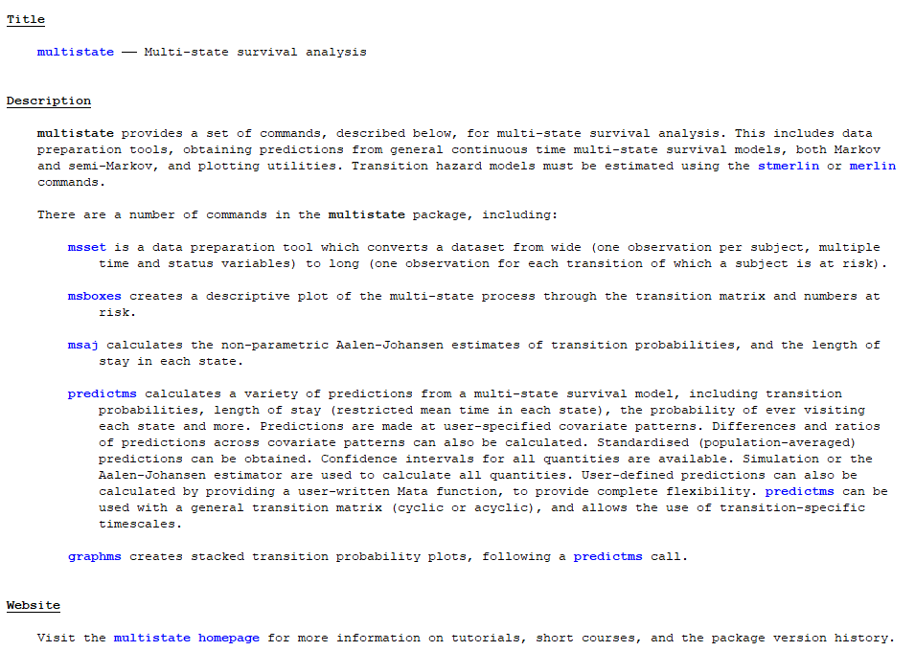
8

Slide 9
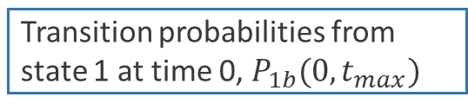
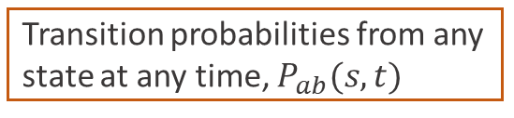
msaj
Why should I use it?
When you have no/few categorical covariates and want to make no assumptions on the transition rates.
As a reference when comparing parametric models.
What does it do?
Calculates Aalen-Johansen estimates of the transition probabilities and stores these in new variables, one for each state.
Before
After
Transition probabilities from state 1 at time 0, $P_{1b}(0,t_{max})$
Transition probabilities from any state at any time, $P_{ab}(s,t)$
Confidence intervals
Length of stay
By option
Bi-directional models

Slide 10
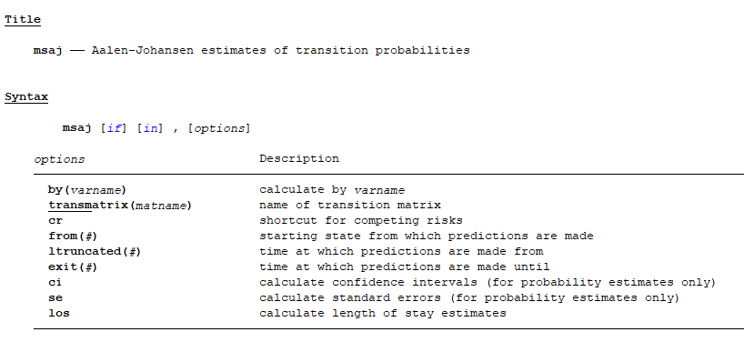
10

Slide 11






HAI Data
Timescale: days since hospital admission
Everyone starts in state 1 at time 0
3 day delay in obtaining a HAI
The last event occurred 82 days since admission
No censoring in this sample
$$N=756$$
State 1:
Admission to hospital
$$124$$
State 2:
Hospital acquired infection (HAI)
$$475$$
$$157$$
$$90$$
$$34$$
State 3:
Discharge (no HAI)
State 4:
Death (no HAI)
State 5:
Discharge (HAI)
State 6:
Death (HAI)
Beyersmann et al, 2006

Slide 12
Data set up 1
net install multistate, from(https://www.mjcrowther.co.uk/code/multistate)
1
State 1
State 2
2
3
4
5
State 3
State 4
State 5
State 6

Slide 13
Data set up 2

Slide 14
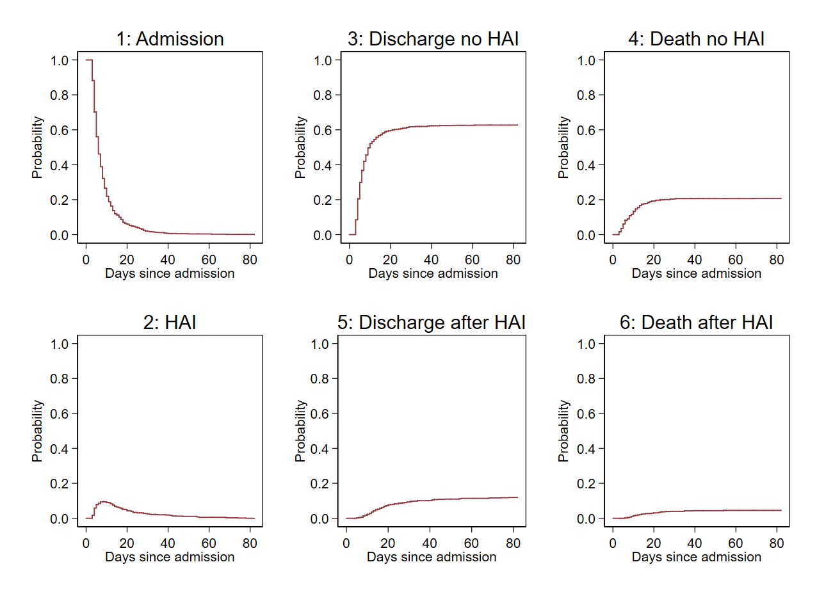
Transition probabilities
msaj, transmatrix(tmat)

Slide 15
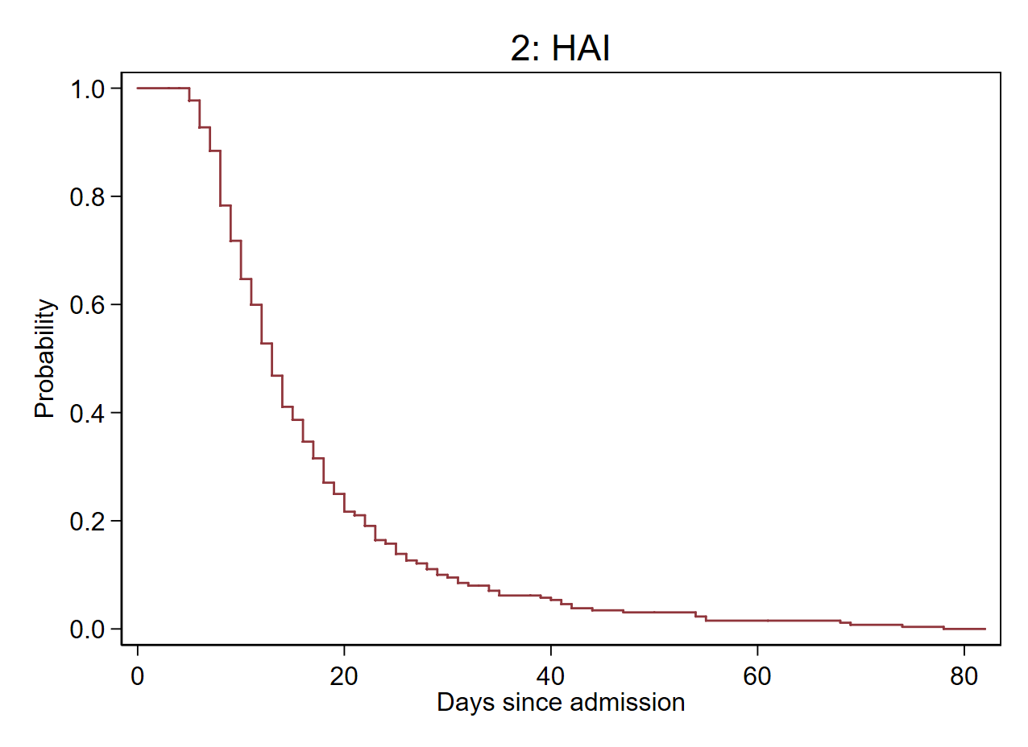
Transition probabilities - from
msaj, transmatrix(tmat) from(2)

Slide 16
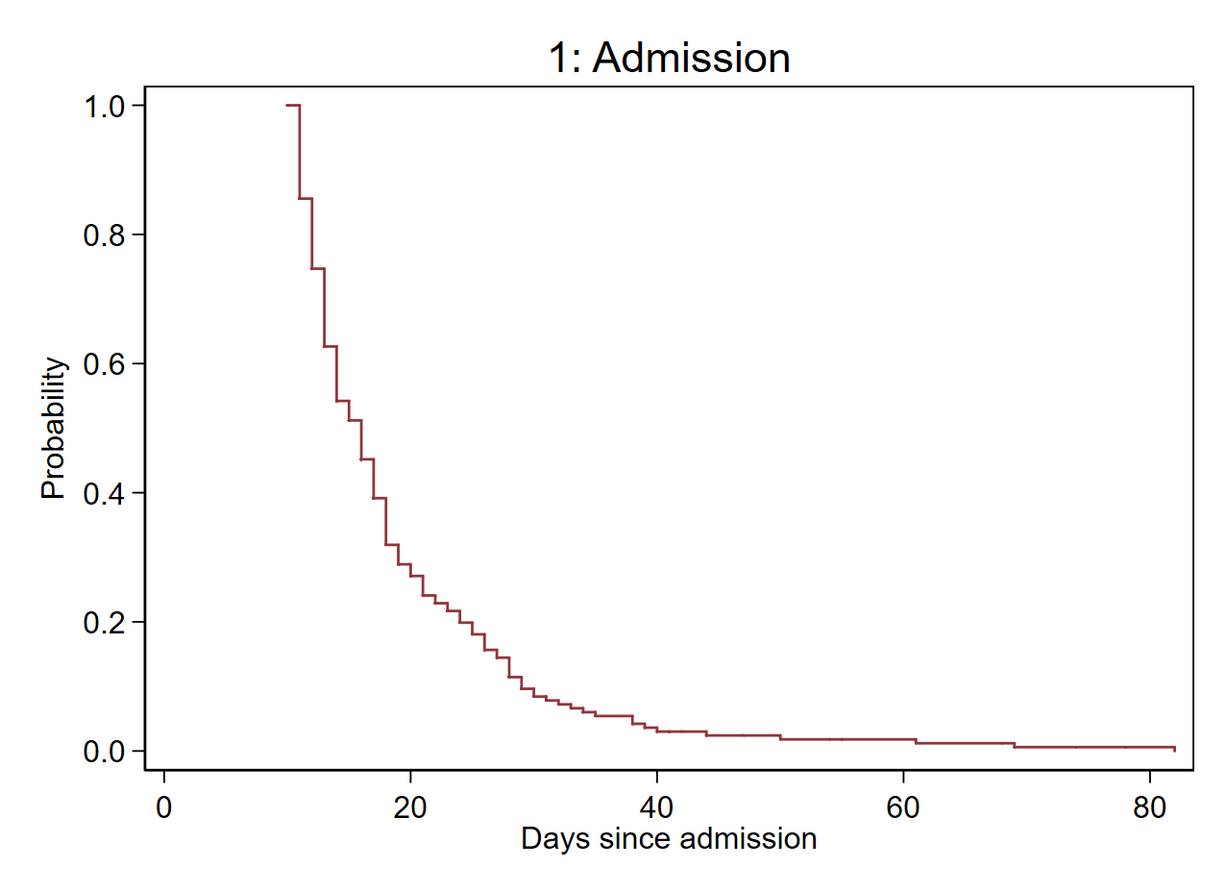
Transition probabilities - ltruncated
msaj, transmatrix(tmat) ltruncated(10)

Slide 17
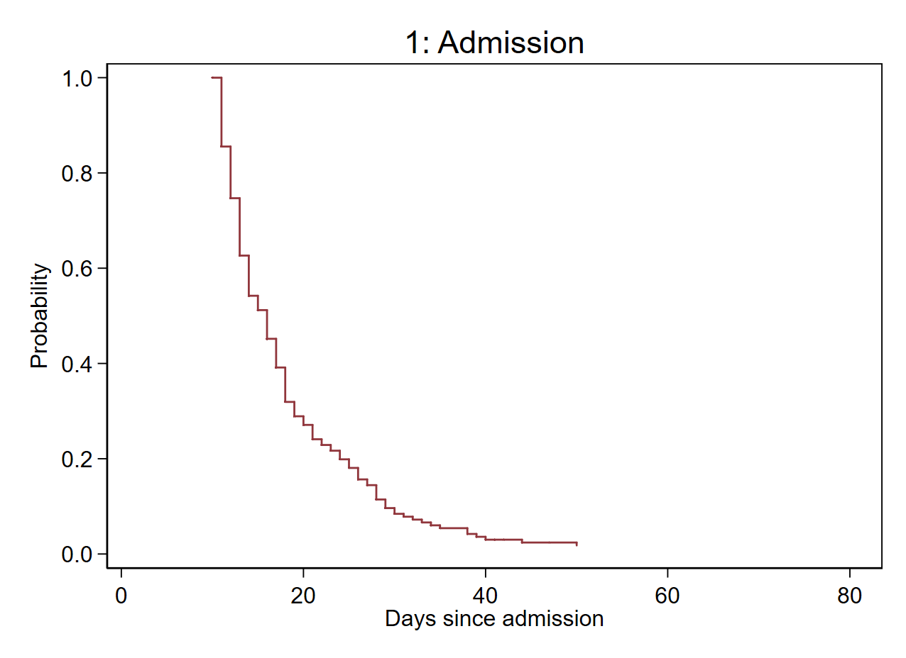
Transition probabilities - exit
msaj, transmatrix(tmat) ltruncated(10) exit(50)

Slide 18
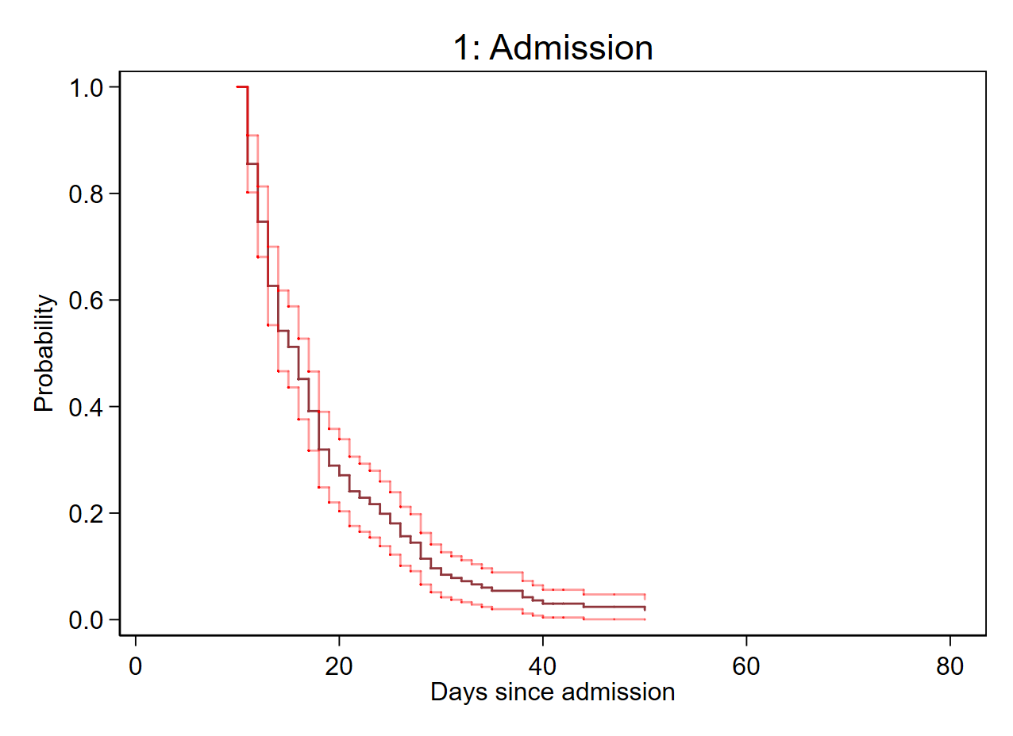
Transition probabilities - ci
msaj, transmatrix(tmat) ltruncated(10) exit(50) ci

Slide 19
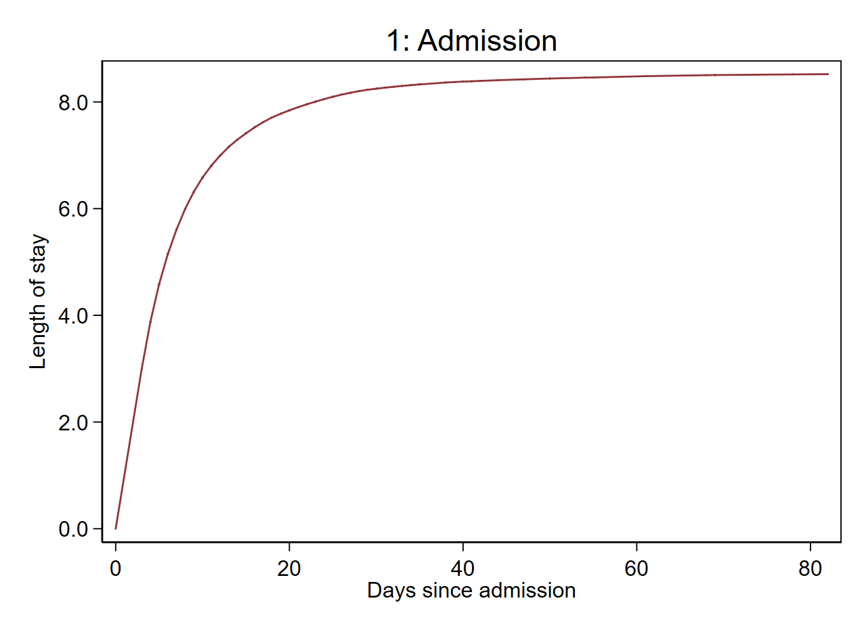
Length of stay
msaj, transmatrix(tmat) los

Slide 20
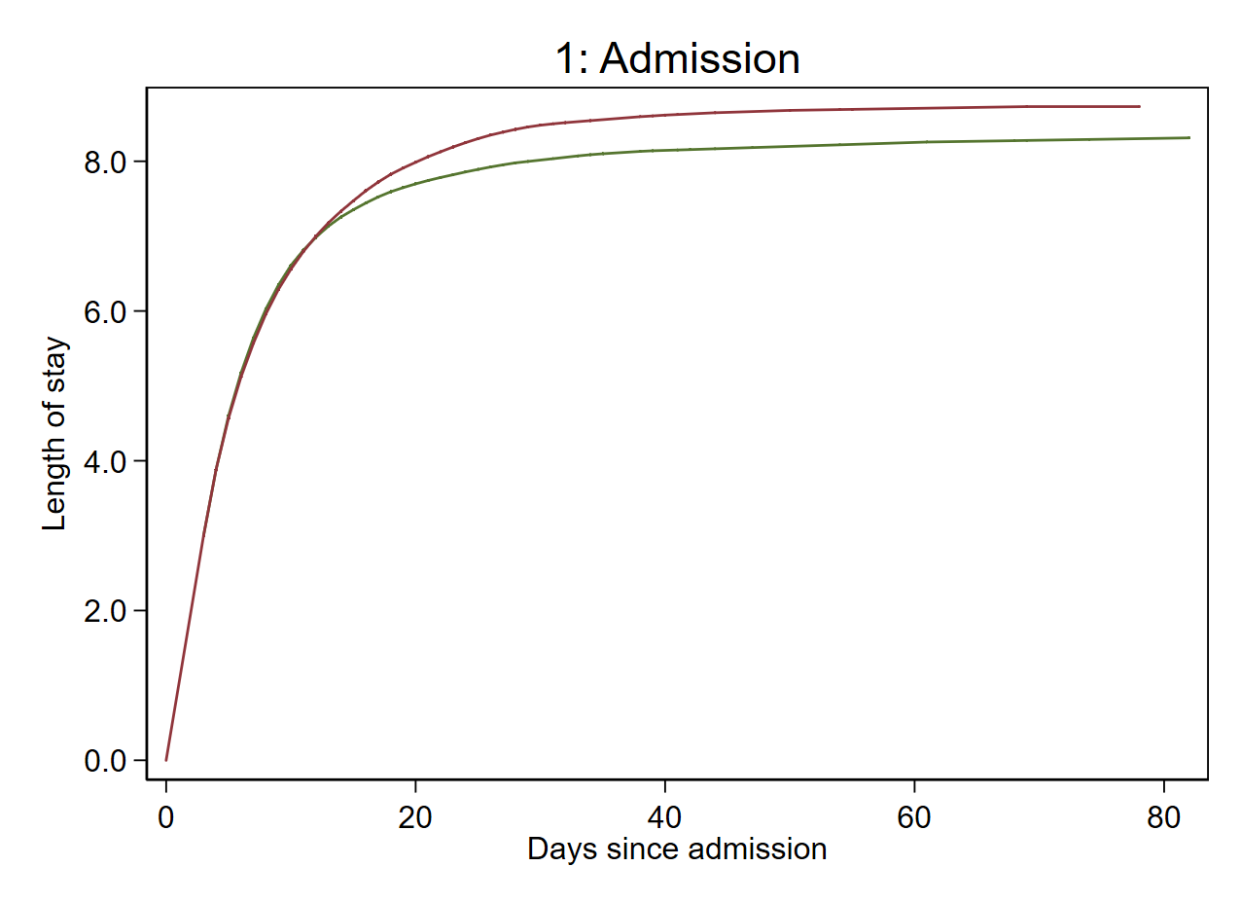
Length of stay - by
msaj, transmatrix(tmat) los by(cov)

Slide 21
Objective
To compare metrics obtained from an exponential model with those obtained from a more flexible model, using non-parametric estimates as a reference.
Metrics of interest
Analysis approaches
predictms
Results
Same HAI data as described before.
Same data preparation as before.

Slide 22
Metrics of interest
Transition probabilities
From state 1 at time 0, $P_{1b}(0,t)$ $b=\{1,2,3,4,5,6\}$
From state 2 at time 3, $P_{2b}(3,t)$ $b=\{2,5,6\}$
Length of stay
From state 1 at time 0, $e_{1b}(0,t)$ $b=\{1,2\}$
From state 2 at time 3, $e_{22}(3,t)$
State 1:
Admission to hospital
(no HAI)
State 2:
In hospital
(HAI)
State 3:
Discharge
(no HAI)
State 4:
Death
(no HAI)
State 5:
Discharge
(HAI)
State 6:
Death
(HAI)

Slide 23
Analysis approaches
Von Cube et al, 2017
Royston P & Parmar MK, 2002
Model
Method for obtaining predictions
Command
Non-parametric
Aalen-Johansen
msaj
AJ
Exponential
Analytical
Exp
Royston-Parmar model, 4 degrees of freedom
Via simulation
predictms
RP (4)

Slide 24
predictms
Crowther & Lambert, 2017
predictms calculates a variety of predictions from a multi-state survival model, including transition probabilities, length of stay and others.
Transition models must be estimated using the stmerlin or merlin commands.
General simulation algorithm is used to obtain the predictions (although other options are now available).
Predictions are made at user-specified covariate patterns.
It is possible to obtain user-defined predictions by providing a user-written Mata function.
https://www.mjcrowther.co.uk/software/multistate/

Slide 25
Set up and model
net install merlin, from(https://www.mjcrowther.co.uk/code/merlin)
Equivalent
Equivalent

Slide 26
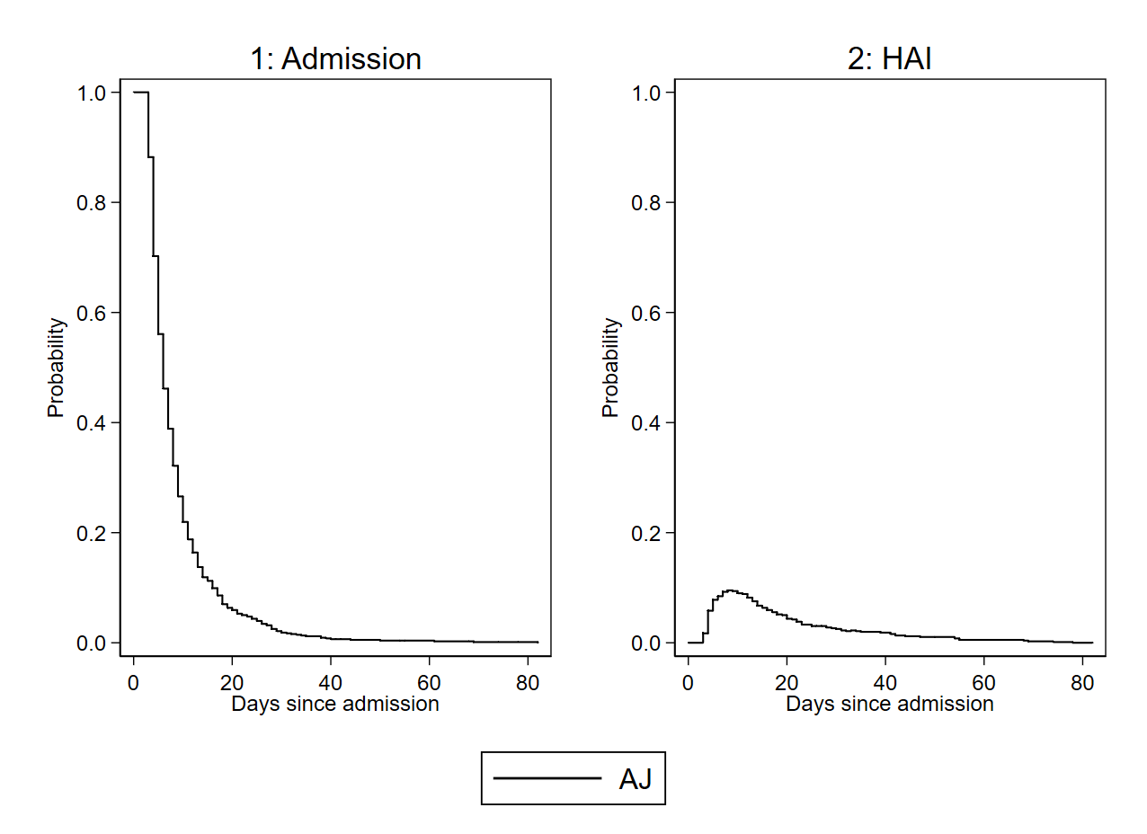
Transition probabilities
msaj, transmatrix(tmat)
predictms, transmatrix(tmat) models(rp1 rp2 rp3 rp4 rp5) timevar(timevar0) seed(3819407) n(1000000) probability

Slide 27
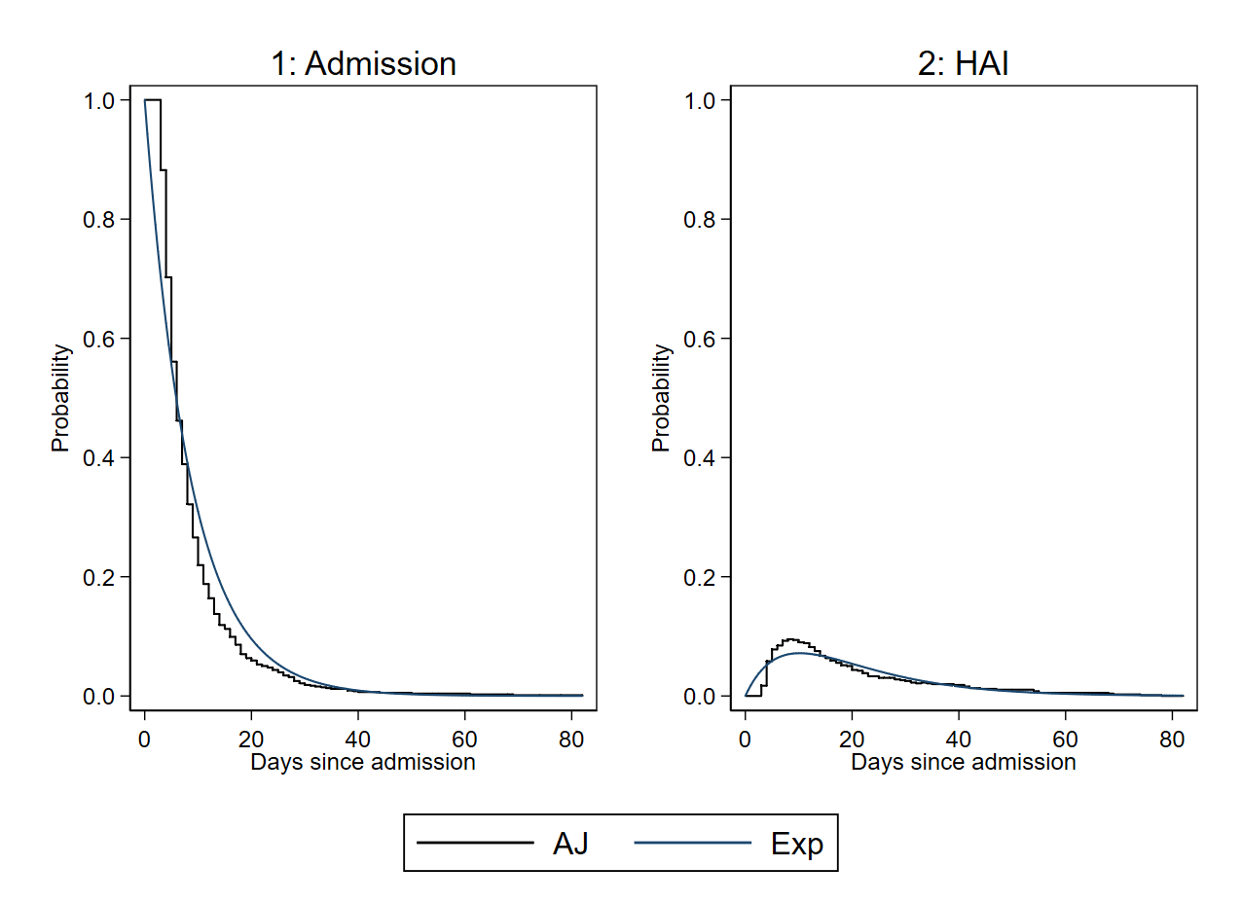
Transition probabilities
msaj, transmatrix(tmat)
predictms, transmatrix(tmat) models(rp1 rp2 rp3 rp4 rp5) timevar(timevar0) seed(3819407) n(1000000) probability

Slide 28
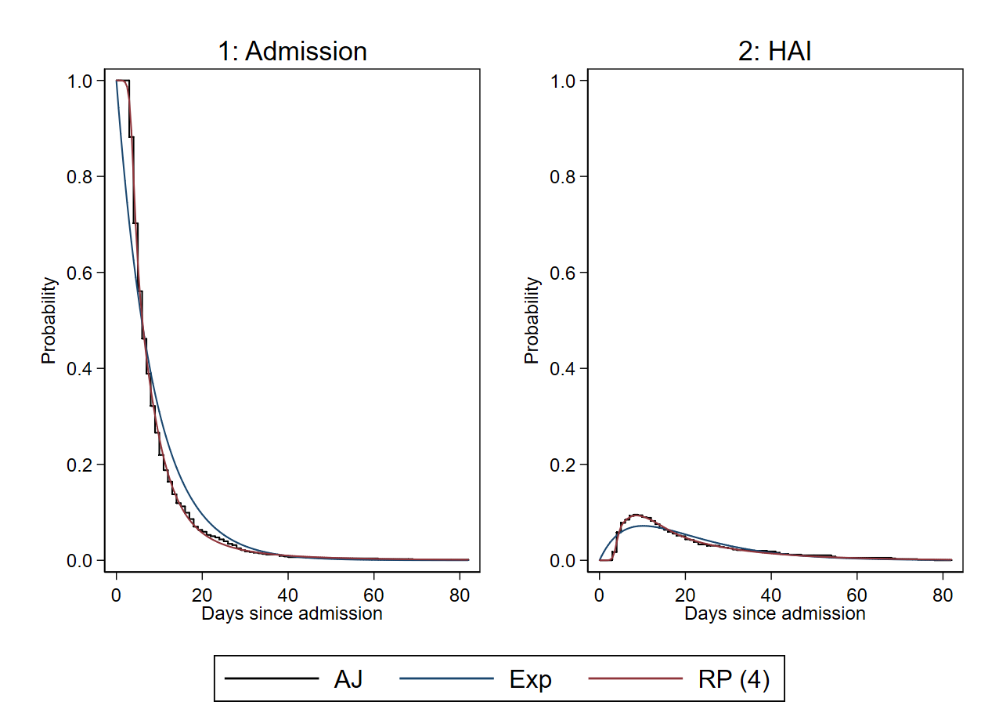
Transition probabilities
msaj, transmatrix(tmat)
predictms, transmatrix(tmat) models(rp1 rp2 rp3 rp4 rp5) timevar(timevar0) seed(3819407) n(1000000) probability

Slide 29
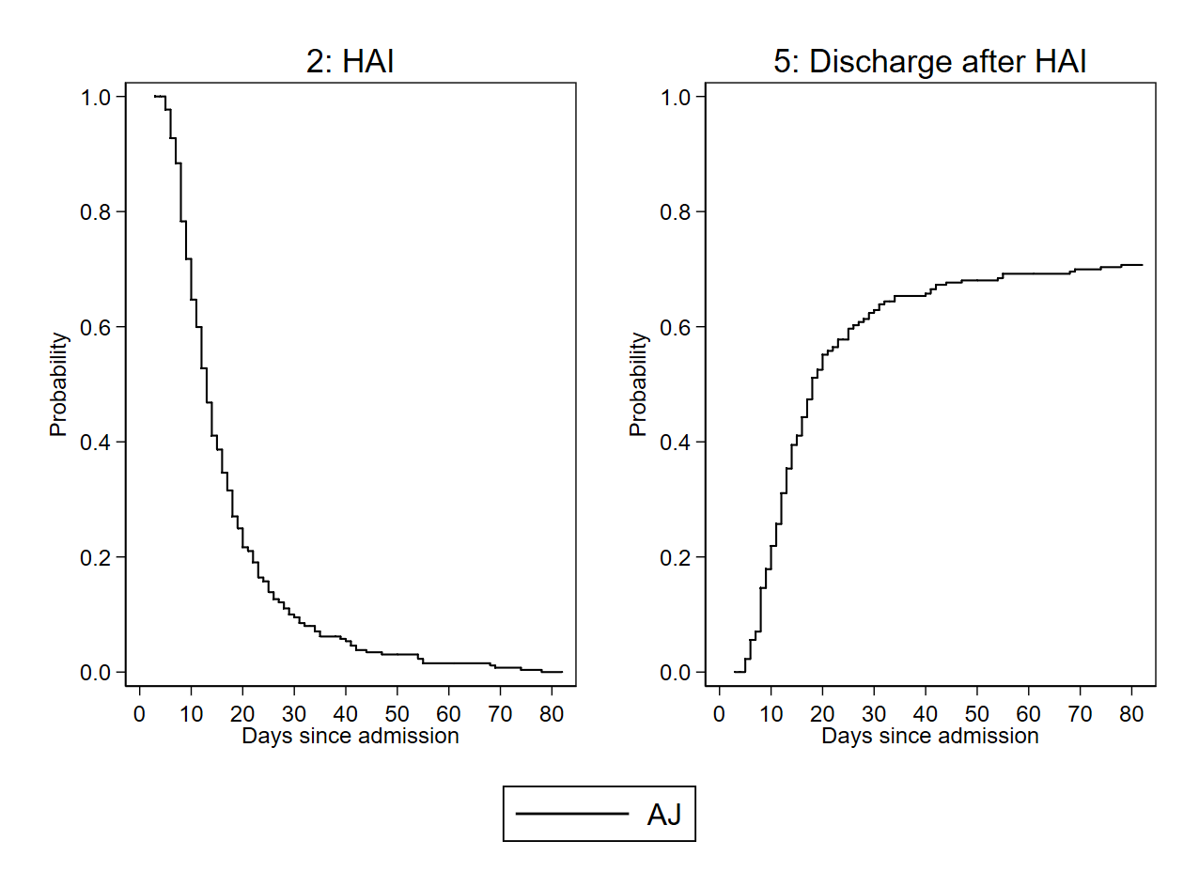
Transition probabilities (from 2: HAI)
msaj, transmatrix(tmat) ltruncated(3) from(2)
predictms, transmatrix(tmat) models(rp1 rp2 rp3 rp4 rp5) timevar(timevar3) seed(3819407) n(1000000) probability from(2)

Slide 30
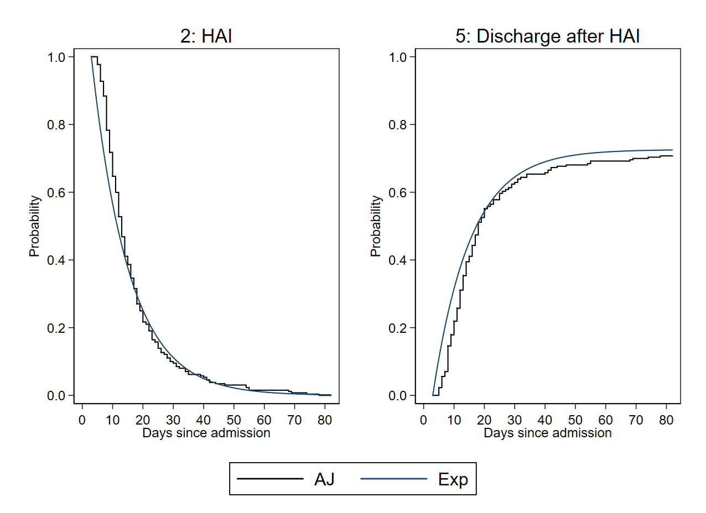
Transition probabilities (from 2: HAI)
msaj, transmatrix(tmat) ltruncated(3) from(2)
predictms, transmatrix(tmat) models(rp1 rp2 rp3 rp4 rp5) timevar(timevar3) seed(3819407) n(1000000) probability from(2)

Slide 31
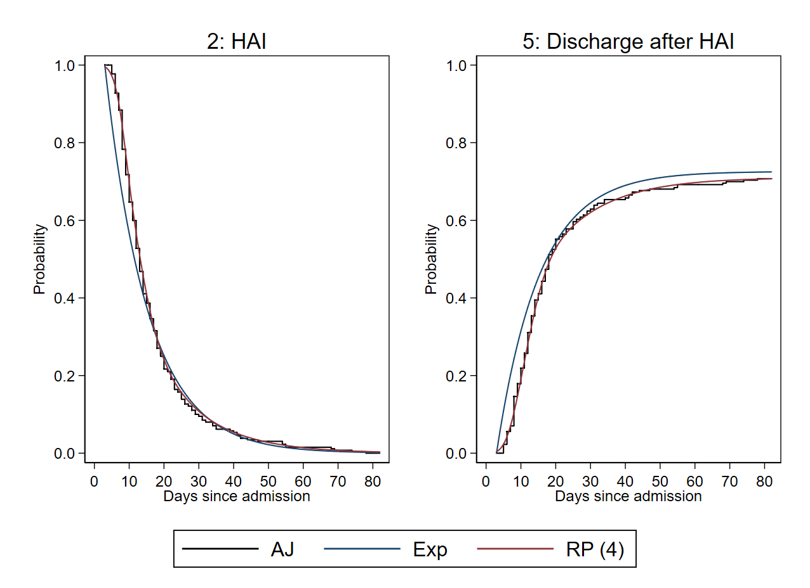
Transition probabilities (from 2: HAI)
msaj, transmatrix(tmat) ltruncated(3) from(2)
predictms, transmatrix(tmat) models(rp1 rp2 rp3 rp4 rp5) timevar(timevar3) seed(3819407) n(1000000) probability from(2)

Slide 32
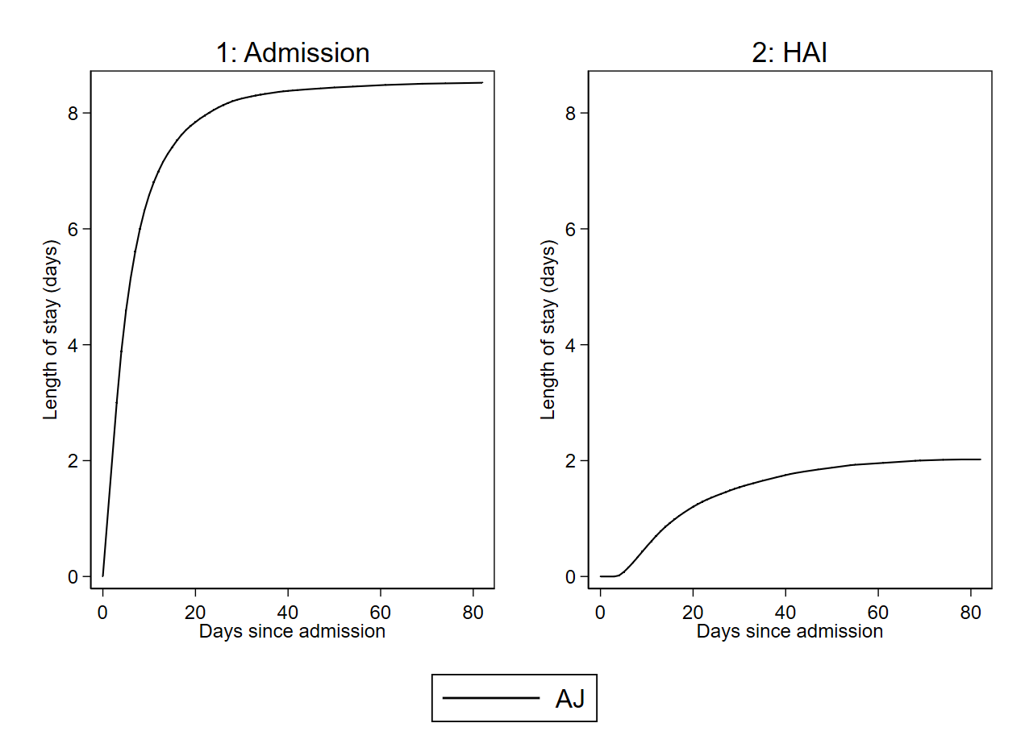
Length of stay
msaj, transmatrix(tmat) los
predictms, transmatrix(tmat) models(rp1 rp2 rp3 rp4 rp5) timevar(timevar0) seed(3819407) n(1000000) los

Slide 33
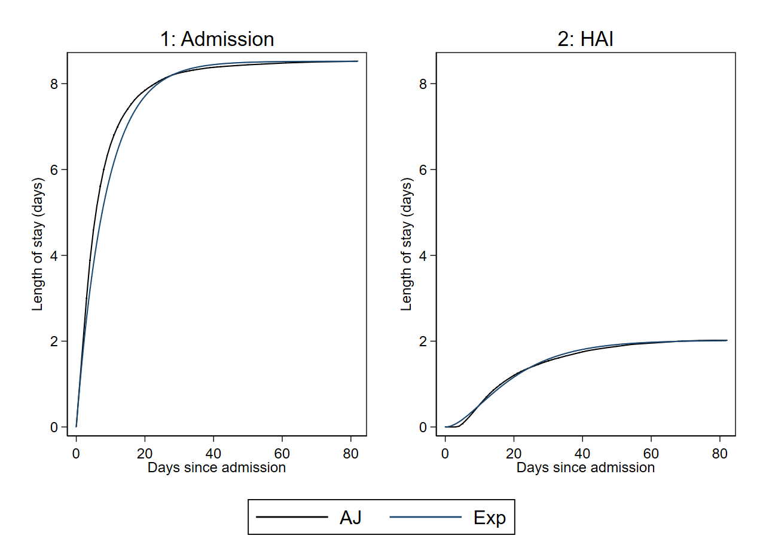
Length of stay
msaj, transmatrix(tmat) los
predictms, transmatrix(tmat) models(rp1 rp2 rp3 rp4 rp5) timevar(timevar0) seed(3819407) n(1000000) los

Slide 34
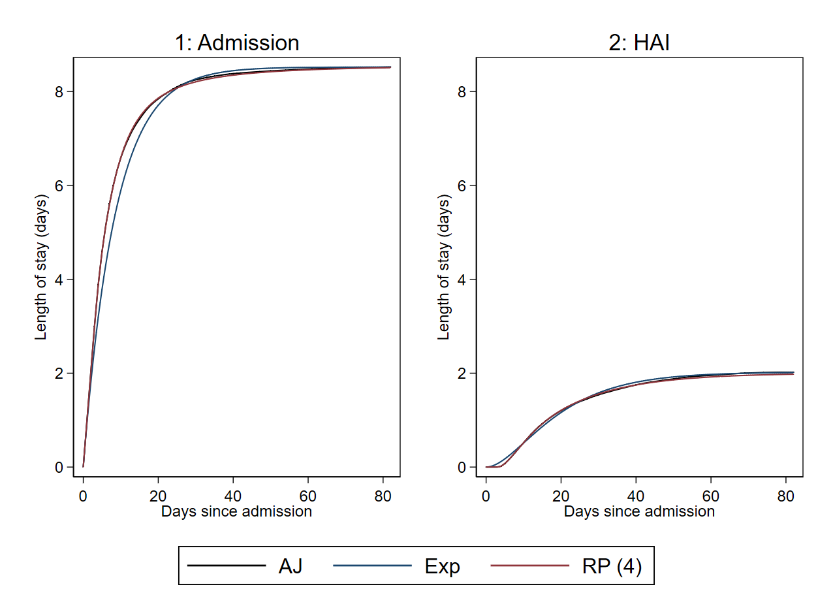
Length of stay
msaj, transmatrix(tmat) los
predictms, transmatrix(tmat) models(rp1 rp2 rp3 rp4 rp5) timevar(timevar0) seed(3819407) n(1000000) los

Slide 35
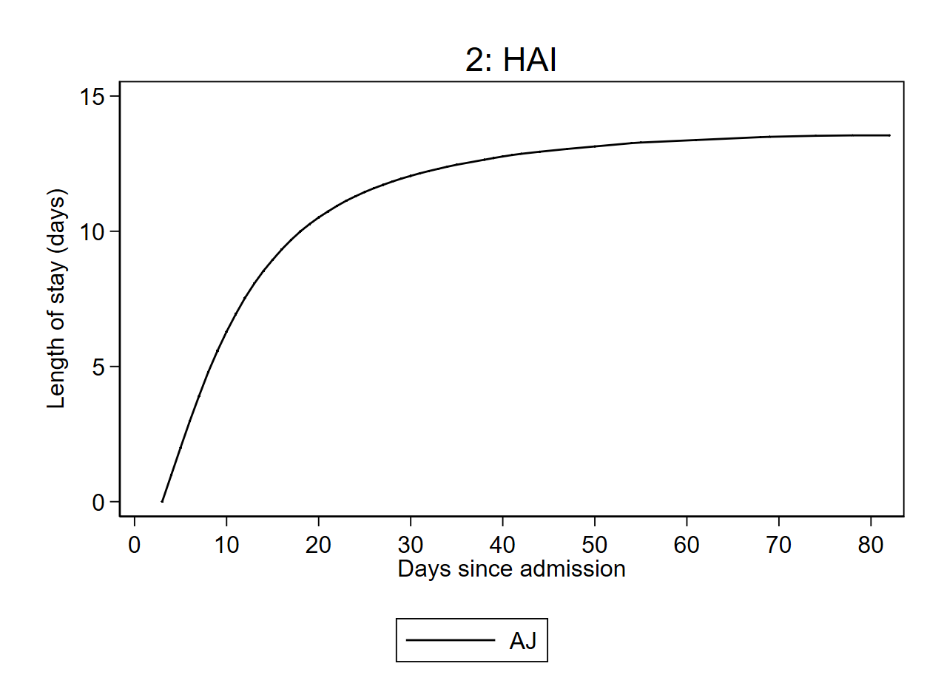
Length of stay (from 2: HAI)
msaj, transmatrix(tmat) los ltruncated(3) from(2)
predictms, transmatrix(tmat) models(rp1 rp2 rp3 rp4 rp5) timevar(timevar3) seed(3819407) n(1000000) los from(2) ltruncated(3)

Slide 36
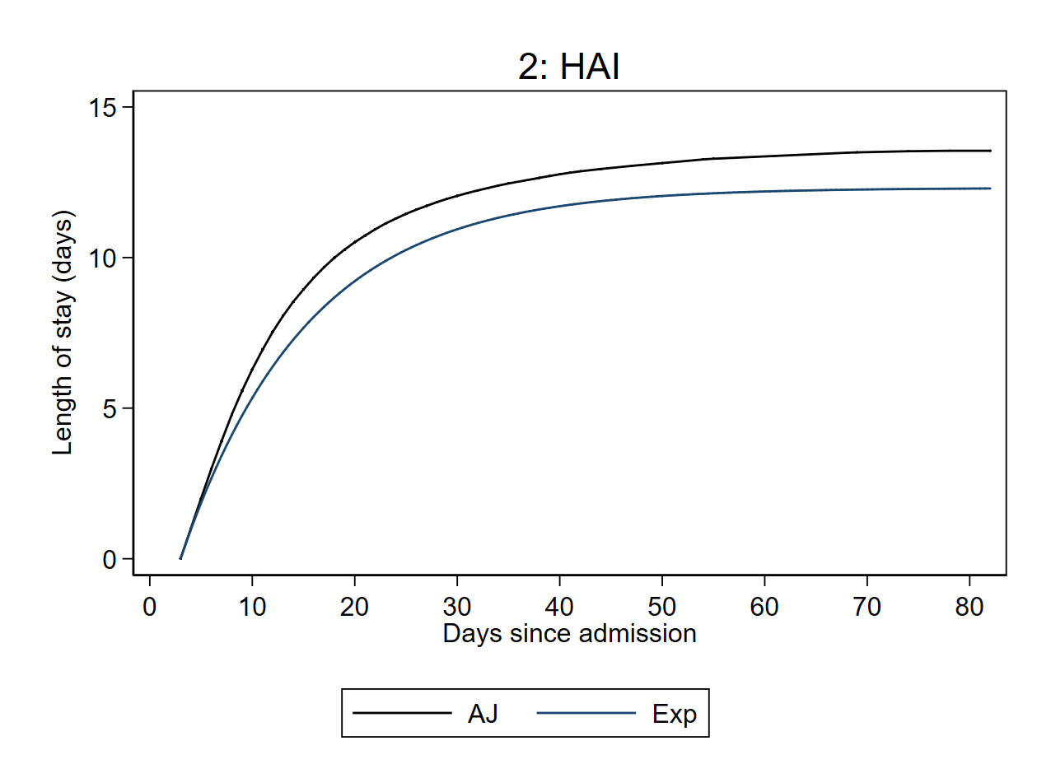
Length of stay (from 2: HAI)
msaj, transmatrix(tmat) los ltruncated(3) from(2)
predictms, transmatrix(tmat) models(rp1 rp2 rp3 rp4 rp5) timevar(timevar3) seed(3819407) n(1000000) los from(2) ltruncated(3)

Slide 37
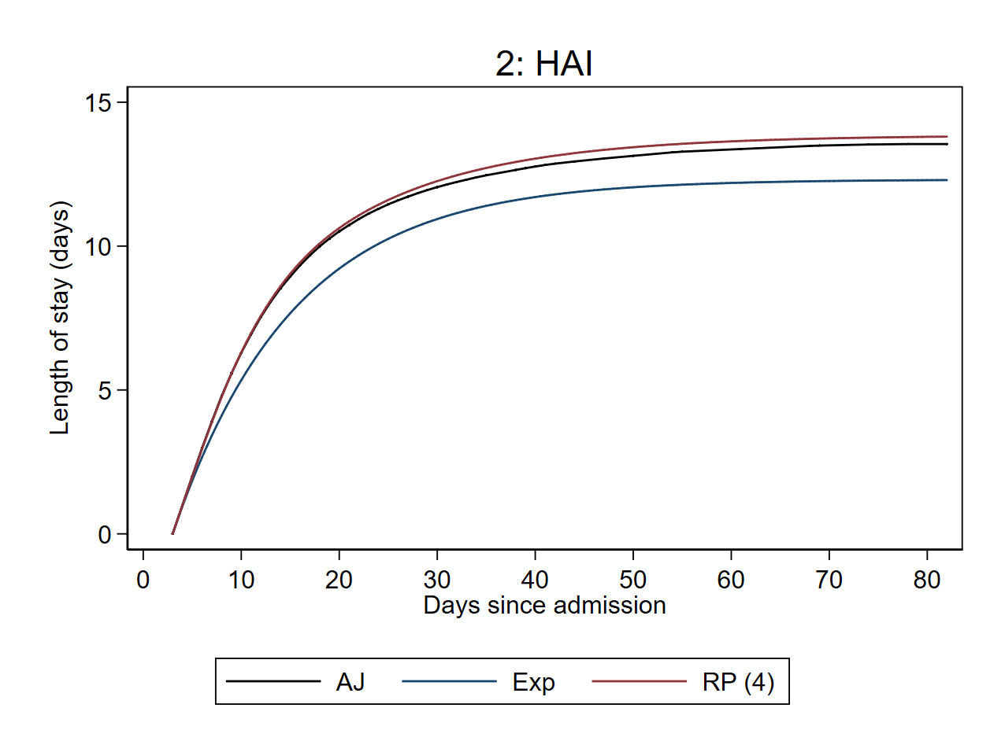
Length of stay (from 2: HAI)
msaj, transmatrix(tmat) los ltruncated(3) from(2)
predictms, transmatrix(tmat) models(rp1 rp2 rp3 rp4 rp5) timevar(timevar3) seed(3819407) n(1000000) los from(2) ltruncated(3)

Slide 38
Conclusion
Metzger & Jones, 2018
The multistate package allows for parametric analyses using predictms with merlin or stmerlin models and non-parametric analyses using msaj. Semi-parametric analyses can be performed using the mstatecox package.
Non-parametric methods may be desired when no assumptions are to be made on the transition rates (in the presence of no/few categorical covariates) and/or to provide a reference for parametric models.
msaj has been updated to provide a comprehensive range of non-parametric transition probability estimates, as well as length of stay.
Extensions to msaj could include fixed horizon predictions and confidence intervals for expected length of stay.
@Micki_Hill
mh594@le.ac.uk

Slide 39
References
Aalen OO, Johansen S. An empirical transition matrix for non-homogeneous Markov chains based on censored observations. Scandinavian J Stat. 1978:141-150.
Beyersmann J, Gastmeier P, Grundmann H, Bärwolff S, Geffers C, Behnke M, et al. Use of Multistate Models to Assess Prolongation of Intensive Care Unit Stay Due to Nosocomial Infection. Infection Control. 2006;27(5):493-499.
Crowther MJ, Lambert PC. Parametric multistate survival models: Flexible modelling allowing transition-specific distributions with application to estimating clinically useful measures of effect differences. Stat Med. 2017;36(29):4719-4742
Grand MK, Putter H. Regression models for expected length of stay. Stat Med. 2016 Mar 30;35(7):1178-92
Metzger SK, Jones BT. mstatecox: A package for simulating transition probabilities from semiparametric multistate survival models. The Stata Journal. 2018;18(3):533-563.
Putter H, Fiocco M, Geskus RB. Tutorial in biostatistics: competing risks and multi-state models. Stat Med. 2007;26(11):2389-2430.
Royston P, Parmar MKB. Flexible parametric proportional‐hazards and proportional‐odds models for censored survival data, with application to prognostic modelling and estimation of treatment effects. Stat Med. 2002;21(15):2175-2197.
Von Cube M, Schumacher M, Wolkewitz M. Basic parametric analysis for a multi-state model in hospital epidemiology. BMC Med Res Methodol. 2017;17(1):111-112.

