Slide 1

Causal
Casual mediation analysis
Aramayis Dallakyan
StataCorp LLC
August 1, 2024

Slide 2

Stata’s mediate command
New in Stata 18: mediate
Performs causal mediation analysis for linear and generalized linear models.

Slide 3
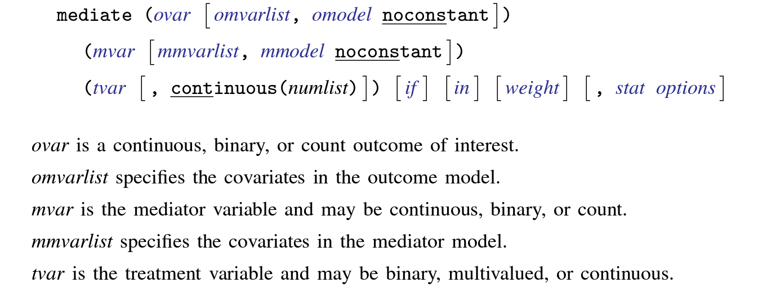
Stata’s mediate command

Slide 4
Stata’s mediate command
Mediator Outcome | linear | logit | probit | Poisson | exp. mean
linear | X | X | X | X | X
logit |  | X | X | X
probit | X | X | X | X | X
Poisson | X | X | X | X | X
exp. mean | X | X | X | X | X
Note: X indicates a supported model combination

Slide 5
Stata’s mediate command
Notes:
Preview of what’s to come

Slide 6
Outline
Basics of causal thinking and inference
  Introduction and motivation
  Potential-outcomes framework and DAGs
  Fundamental steps of causal inference
Causal mediation analysis
  Direct and indirect effects
  Identification
  Demonstration

Slide 7

Causal inference tackles the fundamental questions of cause and effect.
The causal effect aims to compare the outcome when an action T is taken versus the outcome when the action T is withheld.
Causal thinking and causal inference
do(T)
T
Y
T
Y
Notes:
Before delving into the world of mediation analysis, let’s get familiarized with causal thinking and causal inference.
. After third point: If those outcomes are different, then we conclude that action $T$ has a causal effect on

Slide 8
Causal inference tackles the fundamental questions of cause and effect.
The causal effect aims to compare the outcome when an action T is taken versus the outcome when the action T is withheld.
Causal inference
do(T)
T
Y
T
Y
We refer to action T as an intervention, an exposure, or a treatment.
  Effect of a treatment/drug/vaccine on a disease;
  Effect of social media on mental health;
  Effect of genes on a disease, etc.
Notes:
After third point: If those outcomes are different, then we conclude that action $T$ has a causal effect on

Slide 9
Why do we need causality?
Why association or statistical dependence is not enough?
Association does not imply causation!
The amount of association and the amount of causation can be different
Causal inference
Notes:
A fair question at this point is: Why do we need causality?

Slide 10


Causal inference
Suppose we analyze data where the "treatment" is sleeping with shoes on (or not), and the outcome is waking up with a headache (or not) the next day.
We find that most times when someone wears shoes to bed, that person wakes up with a headache.
Question: Can we interpret this relationship as causal?
Causal effect???
Notes:
Start: Let’s consider an example

Slide 11

Causal inference
One possible explanations for association
  Both treatment and outcome are caused by a common cause: drinking the night before.
  Such variables are known as confounders and the association as confounding association.
  Confounding is the main source of differentiating association from causation.
Confounding
Causal effect
_{*Borrowed from Neal (2020)}

Slide 12
Our goal: Learn about causal effects
  Represent the causal structure
  Characterize the causal effect
Notation:
  T ϵ {0,1} denotes treatment assignment: Wearing shoes vs not wearing shoes to bed
  Y denotes the outcome: Headache vs no headache
  X denotes potential confounders that affect both T and Y: Drinking the previous day
Causal inference
Notes:
. We learned that association is not causation. The big question is how to learn causal effects.
. Before we learn causal effect, we need to understand how to represent the causal structure and how to characterize the causal effect?

Slide 13
Directed acyclic graphs (DAGs)
We use DAGs to represent causal relationships and structure.
Arrows indicate a direct causal effect (not mediated) for at least one subject.
Informally, the goal of causal inference is to estimate the causal part of the graph while controlling for the confounding part.
Confounder(s)
X
Confounding
Confounding
T
Y
Causal
Treatment
Outcome
Notes:
For example arrow from (X:drinking the day before -> Y: headache)

Slide 14


Potential-outcomes framework
To characterize the causal effect we use the potential outcomes framework.
Same
person
The potential outcome Y(T = t) = Y(t) is the outcome we would have observed had T = t been assigned.
The causal effect can be measured as Y(1) -Y(0), which is the change due to the treatment keeping everything else the same.
T = 1
T = 0
Placebo
Outcome: Y(1)
Outcome: Y(0)
Notes:
1. We learned how to represent causal relationships.
2. Suppose, $T = 1$ if the patient received a drug and $T = 0$ if received a placebo.
3. For example, $Y(1)$ corresponds to the potential outcome of the subject after receiving treatment $T = 1$. Similarly, $Y(0)$ corresponds to the potential outcome of the subject after receiving treatment $T = 0$.

Slide 15
Potential-outcomes framework
Fundamental Problem of Causal Inference: Only one of {Y(1), Y(0)} is observed.
The observed potential outcome is called factual.
The unobserved potential outcome is called counterfactual.
The causal effect is a contrast between two parallel worlds, which we imagine for the same subject.

Slide 16
Actual, observed world.
In this world everything is the same but T is set to 0.
In this world everything is the same but T is set to 1.
Potential-outcomes framework
X
T
Y
X
T
0
Y(0)
X
T
1
Y(1)
Note that compared to the observed world, in imaginary worlds the causal link between X and treatment T is broken.
Notes:
Let’s see what are those parallel words:
First is the actual word that we leave

Slide 17
Potential-outcomes framework
The observed outcome:
  Y = T*Y(1) + (1 – T)*Y(0)
For the subject with treatment T = 1
Y = 1*Y(1) + 0*Y(0)
Similarly, for T = 0
Y = 0*Y(1) + (1 – 0)*Y(0)
Thus, Y(1) – Y(0) is never observed for subject i.
Subject | T | Y | Y(1) | Y(0) | Y(1) – Y(0)
1 | 0 | 2.1 | ? | 2.1 | ?
2 | 1 | 3.7 | 3.7 | ? | ?
3 | 1 | 4.2 | 4.2 | ? | ?
4 | 0 | 6.2 | ? | 6.2 | ?
… | … | … | … | … | …
Notes:
1.That is our observed data looks like
2. Thus, individual causal effect is never observed
3. A natural measure is Avereage Treatment Effect

Slide 18
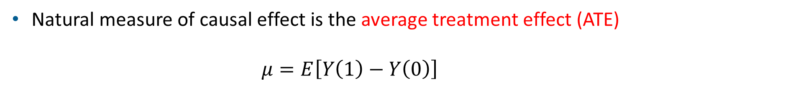
Potential-outcomes framework
The observed outcome:
  Y = T*Y(1) + (1 – T)*Y(0)
For the subject with treatment T = 1
Y = 1*Y(1) + 0*Y(0)
Similarly, for T = 0
Y = 0*Y(1) + (1 – 0)*Y(0)
Thus, Y(1) – Y(0) is never observed for subject i.
Subject | T | Y | Y(1) | Y(0) | Y(1) – Y(0)
1 | 0 | 2.1 | ? | 2.1 | ?
2 | 1 | 3.7 | 3.7 | ? | ?
3 | 1 | 4.2 | 4.2 | ? | ?
4 | 0 | 6.2 | ? | 6.2 | ?
… | … | … | … | … | …
Natural measure of causal effect is the average treatment effect (ATE)
      $$μ=E\left[Y\left(1\right)−Y\left(0\right)\right]$$
Notes:
1.That is our observed data looks like
2. Thus, individual causal effect is never observed
3. A natural measure is Avereage Treatment Effect

Slide 19
Potential-outcomes framework
Important question: Is it possible to estimate the ATE if Y(1) - Y(0) is never observed?
  Yes, but under certain causal assumptions.
Causal inference helps in moving observables {Y, T, X} to the distribution {Y(0), Y(1), T , X}.
Causal Inference is much more than familiar statistical inference
  Statistical inference: from sample to population
  Causal Inference: from sample to counterfactual populations
Notes:
3. This is also known as Pearl’s ladder of causation

Slide 20
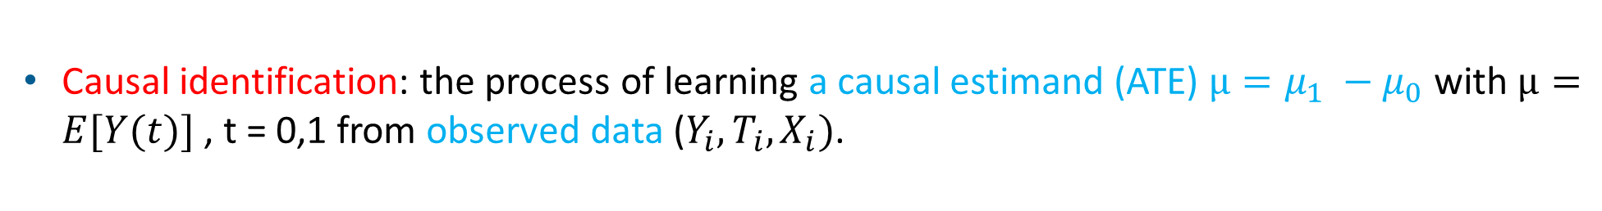
Causal identification
Causal identification: the process of learning a causal estimand (ATE) $μ=μ_{1} −μ_{0}$ with $μ=E[Y(t)]$, t = 0,1 from observed data ($Y_{i},T_{i},X_{i})$.

Slide 21
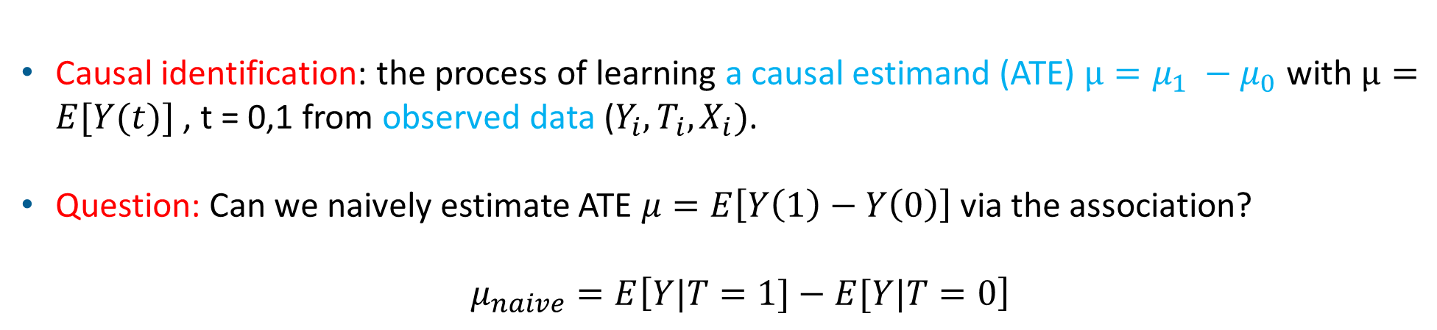
Causal identification
Causal identification: the process of learning a causal estimand (ATE) $μ=μ_{1} −μ_{0}$ with $μ=E[Y(t)]$, t = 0,1 from observed data ($Y_{i},T_{i},X_{i})$.
Question: Can we naively estimate ATE $μ=E\left[Y\left(1\right)−Y\left(0\right)\right]$ via the association?
  $μ_{naive}=E\left[Y|T=1]−E[Y|T=0\right]$
Subject | T | Y | Y(1) | Y(0) | Y(1) – Y(0)
1 | 0 | 2.1 | ? | 2.1 | ?
2 | 1 | 3.7 | 3.7 | ? | ?
3 | 1 | 4.2 | 4.2 | ? | ?
4 | 0 | 6.2 | ? | 6.2 | ?
… | … | … | … | … | …
Notes:
Note that mu_naive can be estimated observable

Slide 22
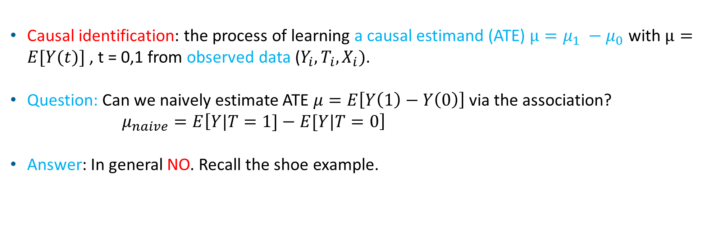
Causal identification
Causal identification: the process of learning a causal estimand (ATE) $μ=μ_{1} −μ_{0}$ with $μ=E[Y(t)]$, t = 0,1 from observed data ($Y_{i},T_{i},X_{i})$.
Question: Can we naively estimate ATE $μ=E\left[Y\left(1\right)−Y\left(0\right)\right]$ via the association? $μ_{naive}=E\left[Y|T=1]−E[Y|T=0\right]$
Answer: In general NO. Recall the shoe example.
Notes:
Note that mu_naive can be estimated observable

Slide 23
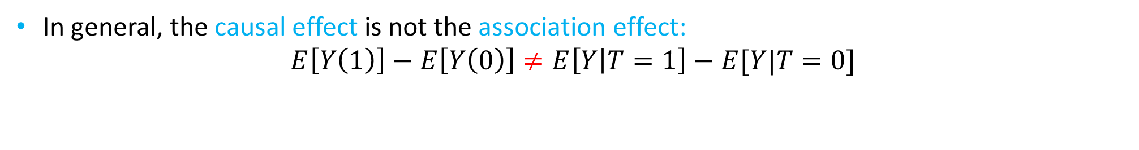
Causal identification
T = 1
T = 0
Causation Association
E[Y(1)]
E[Y(1)] vs
E[Y(0)]
E[Y|T = 1] vs E[Y|T = 0]
In general, the causal effect is not the association effect:
$$E\left[Y\left(1\right)\right]−E\left[Y\left(0\right)\right]≠E\left[Y | T=1\right]−E[Y|T=0]$$
Notes:
Let’s see why using the Big picture of causality

Slide 24
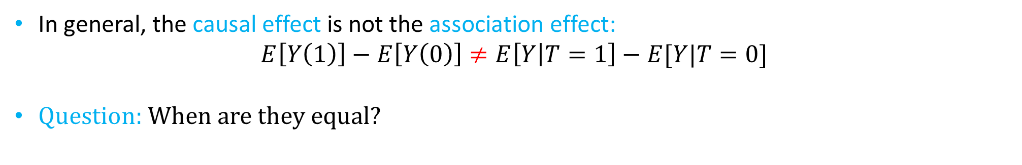
Causal identification
T = 1
T = 0
Causation Association
E[Y(1)]
E[Y(1)] vs
E[Y(0)]
E[Y|T = 1] vs E[Y|T = 0]
In general, the causal effect is not the association effect:
$$E\left[Y\left(1\right)\right]−E\left[Y\left(0\right)\right]≠E\left[Y | T=1\right]−E[Y|T=0]$$
Question: When are they equal?
Notes:
Let’s see why using the Big picture of causality

Slide 25
Randomized control trials (RCTs)
RCTs randomize T, i.e., T is independent of {Y(0),Y(1), X}.
Consequently, it removes any confounding effect.
  E[Y|T = t] = E[Y(t)|T = t] = E[Y(t)]
In other words, in RCTs an observed association between T and Y is a causal
X
T
Y
Notes:
One possible solution is through experiments using randomized control trials:
2. Here we randomized the treatment assignement, thus eliminating the edge from confounders X to T.
Mathematicaly T is independent from Y(0) and Y(1).

Slide 26
Observational data
In observational data, T is not independent of {Y(0),Y(1), X}
Hence, the association between T and Y includes confounding/selection bias.
X
T
Y

Slide 27
Observational data
In observational data, T is not independent of {Y(0),Y(1), X}
Hence, the association between T and Y includes confounding/selection bias.
We need additional causal assumptions that will block/eliminate the bias.
X
T
Y
X
T
Y
Notes:
One possible solution is through experiments using randomized control trials:
2. Here we randomized the treatment assignement, thus eliminating the edge from confounders X to T.
Mathematicaly T is independent from Y(0) and Y(1).

Slide 28
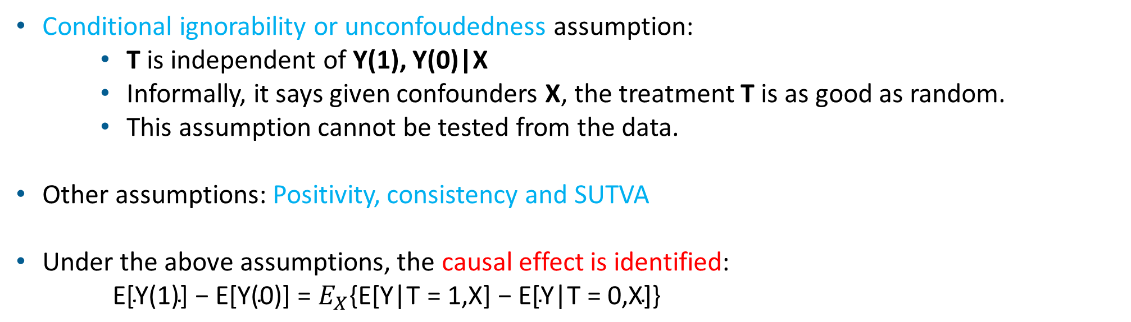
Causal assumptions
Conditional ignorability or unconfoudedness assumption:
    T is independent of Y(1), Y(0)|X
    Informally, it says given confounders X, the treatment T is as good as random.
    This assumption cannot be tested from the data.
Other assumptions: Positivity, consistency and SUTVA
Under the above assumptions, the causal effect is identified:
    $\text{E}\text{[}\text{Y}\text{(1)] − }\text{E}\text{[}\text{Y}\text{(0)] = }E_{X}\text{\{}\text{E}\text{[}\text{Y}\text{|}\text{T}\text{ = 1,}\text{X}\text{] − }\text{E}\text{[}\text{Y}\text{|}\text{T}\text{ = 0,}\text{X}\text{]\}}$
Notes:
Positivity or overlap} assumption: Implies that the treatment assignment should be stochastic, i.e. $$P(T = t | X = x) > 0$$
SUTVA and consistency assumption: States that for a given unit, the treatment of other units does not affect the outcome of the treatment received by that unit.

Slide 29
Summary: Fundamental Steps of Causal Inference
Hypothetical modeling: Researchers make causal assumptions about relationships among variables based on their understanding and expertise.
X
T
Y

Slide 30
Summary: Fundamental Steps of Causal Inference
Hypothetical modeling: Researchers make causal assumptions about relationships among variables based on their understanding and expertise.
Causal identification: Based on the previous assumptions, researchers try to determine whether the causal effect is identified, i.e., bias elimination.
X
T
Y
X
T
Y

Slide 31

Summary: Fundamental Steps of Causal Inference
Hypothetical modeling: Researchers make causal assumptions about relationships among variables based on their understanding and expertise.
Causal identification: Based on the previous assumptions, researchers try to determine whether the causal effect is identified, i.e., bias elimination.
Parameter estimation: If the answer to the second phase is positive, the researcher can then use various estimation techniques, such as teffects or mediate to estimate the causal effect.
X
T
Y
X
T
Y

Slide 32
Causal mediation
Suppose using the Fundamental Steps of Causal Analysis (FSCA), a researcher concluded that exercise, T, has a beneficial causal effect on the perceptions of the well-being of individuals, Y.
X
T
Y
Notes:
Let’s go over the fundamental steps

Slide 33
Causal mediation
Suppose using the Fundamental Steps of Causal Analysis (FSCA), a researcher concluded that exercise, T, has a beneficial causal effect on the perceptions of the well-being of individuals, Y.
Now, the researcher wonders whether the benefit is a consequence of the effect of T on increasing the level of the hormone bonotonin, M, which in turn has a positive effect on subjective well-being, Y.
X
T
Y
X
M
T
Y
Notes:
Let’s go over the fundamental steps

Slide 34
Causal mediation
Suppose using the Fundamental Steps of Causal Analysis (FSCA), a researcher concluded that exercise, T, has a beneficial causal effect on the perceptions of the well-being of individuals, Y.
Now, the researcher wonders whether the benefit is a consequence of the effect of T on increasing the level of the hormone bonotonin, M, which in turn has a positive effect on subjective well-being, Y.
That is, the researcher is interested in decomposing the total effect of T on Y into the indirect causal pathway mediated by M and the direct pathway not mediated by M.
X
T
Y
X
M
T
Y
Notes:
Let’s go over the fundamental steps

Slide 35
Causal mediation: The fundamental steps of causal analysis
Suppose we want to estimate the mediation effect of hormone bonotonin, M, between the effect of exercise, T, on subjective wellbeing, Y.
Notes:
Step1: We start from a simple model where we assume we don’t have any covariate. Letter we will consider more realistic examples.

Slide 36
Causal mediation: The fundamental steps of causal analysis
Suppose we want to estimate the mediation effect of hormone bonotonin, M, between the effect of exercise, T, on subjective wellbeing, Y.
Step 1: Hypothetical modeling
T – exercise
M – bonotonin
Y – well-being
M
T
Y
Notes:
Step1: We start from a simple model where we assume we don’t have any covariate. Letter we will consider more realistic examples.

Slide 37
Causal mediation: The fundamental steps of causal analysis
Suppose we want to estimate the mediation effect of hormone bonotonin, M, between the effect of exercise, T, on subjective wellbeing, Y.
Step 1: Hypothetical modeling
Step 2: Causal identification – more on this later
T – exercise
M – bonotonin
Y – well-being
M
T
Y
Notes:
Step1: We start from a simple model where we assume we don’t have any covariate. Letter we will consider more realistic examples.

Slide 38
Causal mediation: The fundamental steps of causal analysis
Suppose we want to estimate the mediation effect of hormone bonotonin, M, between the effect of exercise, T, on subjective wellbeing, Y.
Step 1: Hypothetical modeling
Step 2: Causal identification – more on this later
Step 3: Estimation in Stata
T – exercise
M – bonotonin
Y – well-being
M
T
Y
Notes:
Step1: We start from a simple model where we assume we don’t have any covariate. Letter we will consider more realistic examples.

Slide 39
Demonstration: The data

Slide 40
Demonstration: Stata’s mediate command

Slide 41
Demonstration: Estimation
Notes:
In the header of the output, we see that mediate fit linear models (the default) for both the outcome and the mediator.
Three treatment-effect estimates are reported in the table.
TE is the total effect of exercise on well-being and is estimated to be 12.7. The interpretation is : if everyone in the population exercised, their well-being would be, on average, 12.7 points higher than
their well-being would be if no one exercised.
The decomposition of the TE into direct and indirect effects is of primary interest. The NIE is estimated to be 9.8, whereas the NDE is estimated to be 2.89. These sum to the total effect of 12.7.
The indirect effect is much larger than the direct effect, indicating that the effect of exercise on well-being is largely due to exercise affecting bonotonin levels, which in turn affect well-being.
The direct effect of 2.89 is the effect of exercise on well-being beyond the effect through bonotonin.

Slide 42
Demonstration: Estimation
mediate uses a method of moments estimator, also known as an estimating equations estimator, to estimate all auxiliary and effect parameters as well as their variance–covariance matrix.
To report the auxiliary parameters:
< output omitted >
Notes:
In addition to the result in the previous slide, we will see

Slide 43
Demonstration: Estimation without interaction
< output omitted >
Notes:
In addition to the result in the previous slide, we will see

Slide 44
Taking a step back: Preparing for causal identification
X
X
Recall that our interest is in the contrast Y(1) - Y(0)
For mediation, the idea is to split the contrast Y(1) - Y(0) into two other contrasts using a third potential outcome M(t).
We introduce a new type of outcome Y(t,m), which corresponds to the potential outcome when we set T = t and M=m.
Note the familiar Y(1) = Y[1, M(1)] and Y(0) = Y[0,M(0)].
T
0
Y(0)
T
1
Y(1)
X
M
M(t)
T
t
Y(t,M(t))
Notes:
On second point: Here, $M(1)$ and $M(0)$ correspond to the values that the mediator would naturally take under the treatment.

Slide 45
Four potential outcomes
X
X
M
M(0)
M
M(1)
T
1
Y(1,M(0))
T
0
Y(0,M(1))
Now, we have two new cross-world potential outcomes Y[t, M(t’)].
Y[1,M(0)] and Y[0,M(1)] are never observed (Fundamental problem of causal inference).
These correspond to the unobserved worlds where treatment is set to t and the mediator is set to the value it would have taken under exposure t’.
We use these four potential outcomes to define total effects, direct effects, and indirect effects
Notes:
Explain Y[1,M(0)] and Y[0,M(1)] :
Y[1,M(0)] are the potential outcomes that we would observe if everybody in the population received treatment, but where the mediator is held at a value that would be observed as though nobody in the population received treatment.
Y[0,M(1)] are the potential outcomes that we would observe if nobody in the population received treatment, but where the mediator is held at a value that would be observed as though everybody in the population received treatment.

Slide 46
Potential-outcome means with mediate
Notes:
We find that the expected effect of exercise on well-being is 12.69, but what is the expected wellbeing when everyone exercises? When no one exercises?
We can estimate four such potential-outcome means by specifying the pomeans option:
Y1M1 is an estimate of the potential-outcome mean E[Y(1,M(1))]. If everyone in the population exercised, we would expect the average well-being to be around 70.
The values labeled Y1M0 and Y0M1 are estimates of the “cross-world” potential-outcome means.
In this case, the Y1M0 estimate tells us the expected average well-being if, everyone exercised but had bonotonin levels as if no-one had exercised.
If we compare the Y1M1 and Y1M0 estimates, we imagine a world where everyone received the treatment, except that the treatment is switched on and off in its effect on the mediator.
For example, the difference between these is 69.804 − 60.00 = 9.8, which is our NIE reported above.

Slide 47
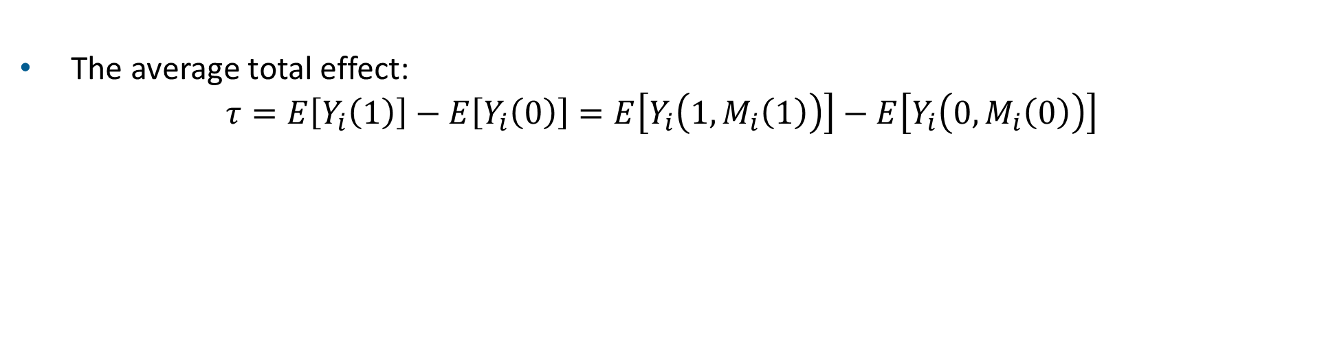
Different treatment effects
The average total effect:
$τ=E\left[Y_{i}\left(1\right)\right]−E\left[Y_{i}\left(0\right)\right]=E\left[Y_{i}\left(1,M_{i}\left(1\right)\right)\right]−E\left[Y_{i}\left(0,M_{i}\left(0\right)\right)\right]$

Slide 48
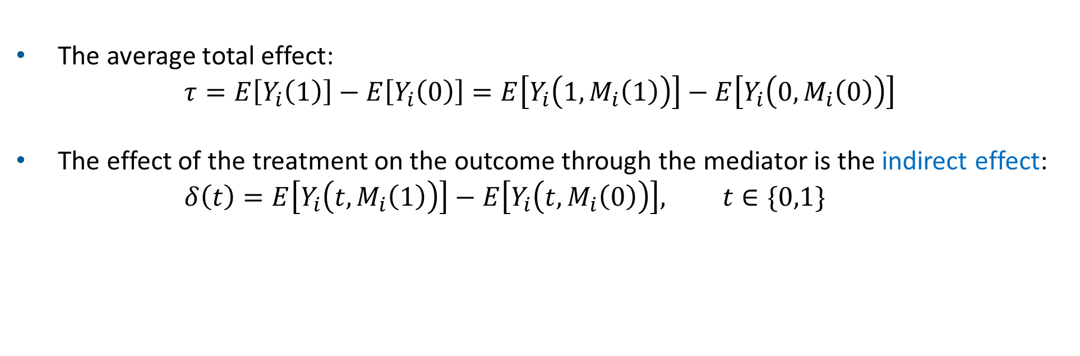
Effect decomposition
The average total effect:
$τ=E\left[Y_{i}\left(1\right)\right]−E\left[Y_{i}\left(0\right)\right]=E\left[Y_{i}\left(1,M_{i}\left(1\right)\right)\right]−E\left[Y_{i}\left(0,M_{i}\left(0\right)\right)\right]$
The effect of the treatment on the outcome through the mediator is the indirect effect:
$δ\left(t\right)=E\left[Y_{i}\left(t,M_{i}\left(1\right)\right)\right]−E\left[Y_{i}\left(t,M_{i}\left(0\right)\right)\right], t∈\{0,1\}$

Slide 49

Effect decomposition
The average total effect:
$τ=E\left[Y_{i}\left(1\right)\right]−E\left[Y_{i}\left(0\right)\right]=E\left[Y_{i}\left(1,M_{i}\left(1\right)\right)\right]−E\left[Y_{i}\left(0,M_{i}\left(0\right)\right)\right]$
The effect of the treatment on the outcome through the mediator is the indirect effect:
$δ\left(t\right)=E\left[Y_{i}\left(t,M_{i}\left(1\right)\right)\right]−E\left[Y_{i}\left(t,M_{i}\left(0\right)\right)\right], t∈\{0,1\}$
The direct effect of the treatment on the outcome
      $ζ\left(t\right)=E\left[Y_{i}\left(1,M_{i}\left(t\right)\right)\right]−E\left[Y_{i}\left(0,M_{i}\left(t\right)\right)\right], t∈\{0,1\}$

Slide 50

Effect decomposition
The average total effect:
$τ=E\left[Y_{i}\left(1\right)\right]−E\left[Y_{i}\left(0\right)\right]=E\left[Y_{i}\left(1,M_{i}\left(1\right)\right)\right]−E\left[Y_{i}\left(0,M_{i}\left(0\right)\right)\right]$
The effect of the treatment on the outcome through the mediator is the indirect effect:
$δ\left(t\right)=E\left[Y_{i}\left(t,M_{i}\left(1\right)\right)\right]−E\left[Y_{i}\left(t,M_{i}\left(0\right)\right)\right], t∈\{0,1\}$
The direct effect of the treatment on the outcome
      $ζ\left(t\right)=E\left[Y_{i}\left(1,M_{i}\left(t\right)\right)\right]−E\left[Y_{i}\left(0,M_{i}\left(t\right)\right)\right], t∈\{0,1\}$
The average total effect can be written as two decomposition of the sum of direct and indirect effect
    $τ=δ\left(1\right)+ζ\left(0\right)=δ\left(0\right)+ζ\left(1\right)$

Slide 51

Three different worlds
The decomposition $τ=δ\left(1\right)+ζ\left(0\right)$ contains 3 different worlds:
X
M(0)
T
0
Y(0,M(0)
X
This difference is
ζ (0)
M
M(0)
T
1
Y(1,M(0))
X
This difference is
δ(1)
M(1)
T
1
Y(1,M(1))
Notes:
Here, delta(1) represent a effect when everybody in the population receive a treatment but we switch on and of the mediator.
Zeta(0) represents a effect when mediator is always off, i.e set to a value that we would naturally observed for a mediator had no one received a treatment but we switch the treatment on and off.

Slide 52
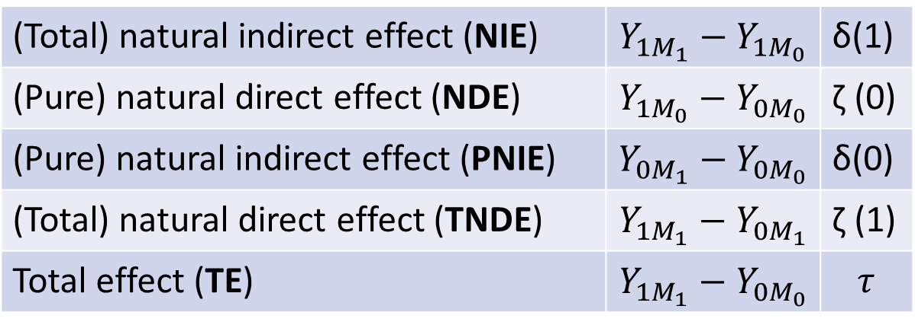
Different treatment effects
Denoting E[Y(t,M(t'))] as $Y_{tM_{t′}}$, we define the following treatment effects of interest:
(Total) natural indirect effect (NIE) | $$Y_{1M_{1}}−Y_{1M_{0}}$$ | δ(1)
(Pure) natural direct effect (NDE) | $$Y_{1M_{0}}−Y_{0M_{0}}$$ | ζ (0)
(Pure) natural indirect effect (PNIE) | $$Y_{0M_{1}}−Y_{0M_{0}}$$ | δ(0)
(Total) natural direct effect (TNDE) | $$Y_{1M_{1}}−Y_{0M_{1}}$$ | ζ (1)
Total effect (TE) | $$Y_{1M_{1}}−Y_{0M_{0}}$$ | $$τ$$

Slide 53
Alternative decompositions with mediate

Slide 54
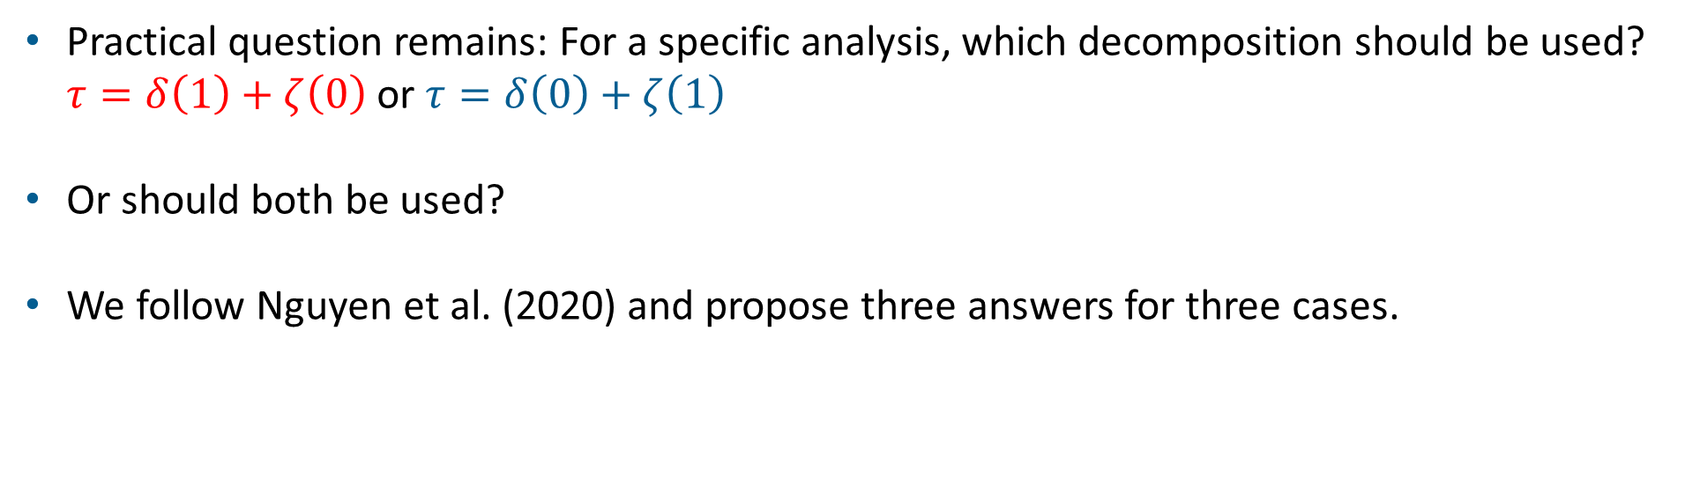
Which decomposition?
Practical question remains: For a specific analysis, which decomposition should be used? $τ=δ\left(1\right)+ζ\left(0\right)$ or $τ=δ\left(0\right)+ζ\left(1\right)$
Or should both be used?
We follow Nguyen et al. (2020) and propose three answers for three cases.

Slide 55
Case 1: Is there a mediated effect? Or, is the causal effect partly mediated by
this mediator?

Slide 56
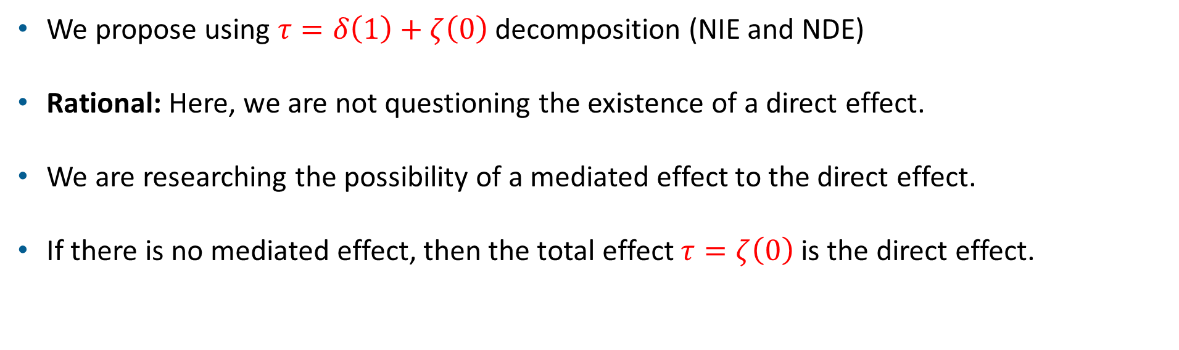
Case 1: Is there a mediated effect? Or, is the causal effect partly mediated by
this mediator?
We propose using $τ=δ\left(1\right)+ζ\left(0\right)$ decomposition (NIE and NDE)
Rational: Here, we are not questioning the existence of a direct effect.
We are researching the possibility of a mediated effect to the direct effect.
If there is no mediated effect, then the total effect $τ=ζ\left(0\right)$ is the direct effect.

Slide 57
Case 2: In addition to the mediated effect, is there a direct effect?

Slide 58

Case 2: In addition to the mediated effect, is there a direct effect?
We propose using $τ=δ\left(0\right)+ζ\left(1\right)$decomposition (PNIE and TNDE).
This is a mirror image of the Case 1.
Rational: Here, we are not questioning the existence of a mediator effect.
We are researching the possibility of treatment affecting the outcome through other mechanisms.
If there is no direct effect, then the total effect $τ=δ\left(0\right)$ is the indirect effect.

Slide 59
Case 3: No prior assumption or preferred question about either direct or
indirect effect

Slide 60
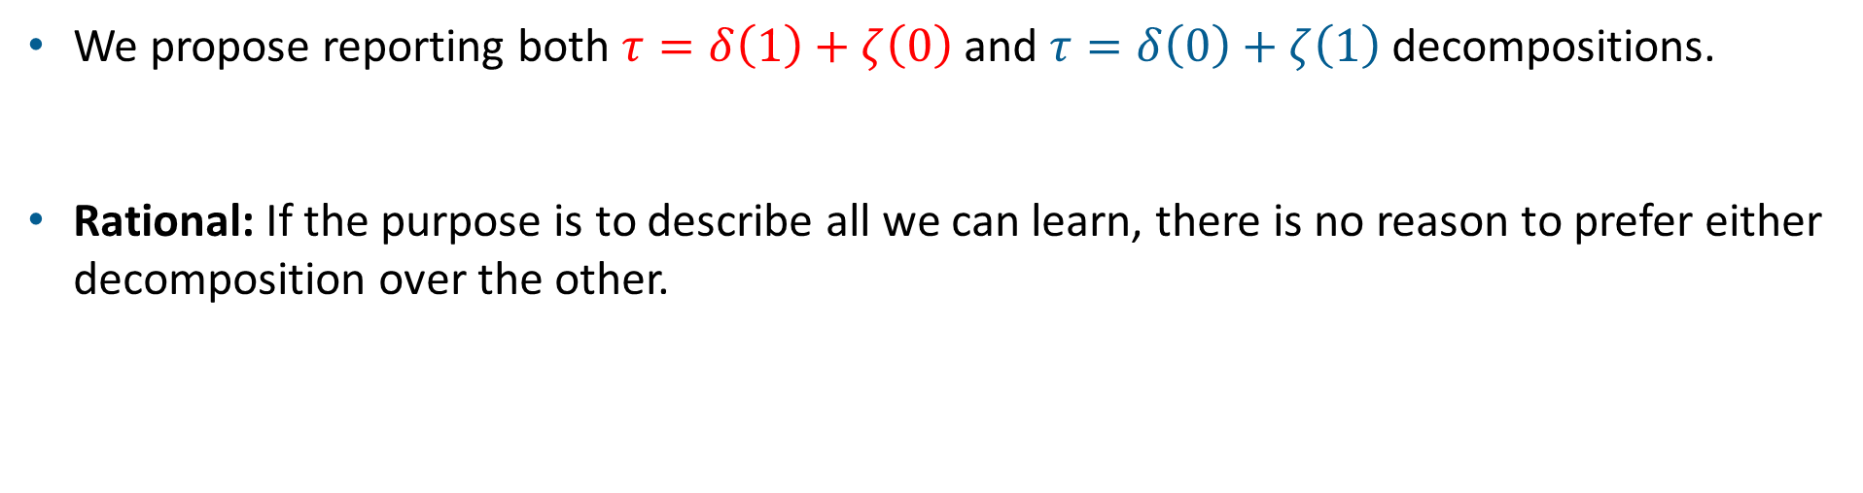
Case 3: No prior assumption or preferred question about either direct or
indirect effect
We propose reporting both $τ=δ\left(1\right)+ζ\left(0\right)$ and $τ=δ\left(0\right)+ζ\left(1\right)$ decompositions.
Rational: If the purpose is to describe all we can learn, there is no reason to prefer either decomposition over the other.

Slide 61

Causal identification
After defining different treatment effects, we are interested in causal assumptions that identify those effects
That is, we are interested in assumptions such that
  $$E_{M}[Y_{i}(t,M_{i}(t^{′})|X_{i}=x]=\int{E{[Y}_{i}\left|M_{i}=m,T_{i}=t,X_{i}=x\right]df[m|T_{i}=t^{′},X_{i}=x]}$$
  LHS is the causal estimand and cannot be estimated from the data
  RHS is a conditional distribution that can be learned from the data
This formula is often referred to as the “mediation formula” and is nonparametric.
Notes:
Now we are ready to discuss the causal identification conditionas.

Slide 62



Causal identification: Assumptions
Sequential ignorabilty
No unobserved confounding in the treatment-outcome relationship.
No unobserved confounding in the mediator-outcome relationship.
No unobserved confounding in the treatment-mediator relationship
No (observed) confounders in the mediator-outcome relationship that are caused by the treatment.
$$X_{2}$$
$$X_{3}$$
M
T
Y
$$X_{1}$$
In addition to sequential ignorability, we need SUTVA and overlap assumptions.
Notes:
Those four assumptions are called sequential ignorability

Slide 63
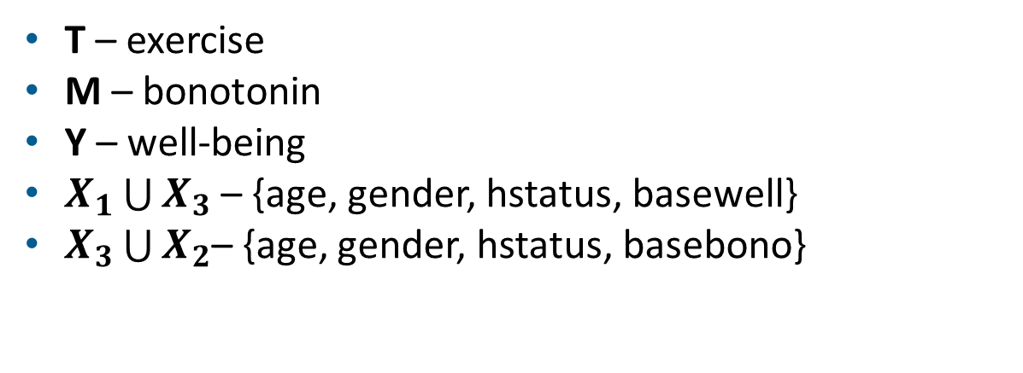

Returning to our example: Adding confounders
Step 1: Hypothetical modeling
Step 2: Causal identification
Step 3: Estimation in Stata
T – exercise
M – bonotonin
Y – well-being
$X_{1}\bigcup{X_{3}}$ – {age, gender, hstatus, basewell}
$X_{3}\bigcup{X_{2}}$– {age, gender, hstatus, basebono}
$$X_{2}$$
$$X_{3}$$
M
T
Y
$$X_{1}$$
Notes:
Step1: We start from a simple model where we assume we don’t have any covariate. Letter we will consider more realistic examples.

Slide 64
Estimation in Stata
Notes:
In the header of the output, we see that mediate fit linear models (the default) for both the outcome and the mediator.
Three treatment-effect estimates are reported in the table. TE is the total effect of exercise on well-being and is estimated to be 13.11. The interpretation is the same as for the ATE
in the nonmediation case: if everyone in the population exercised, their well-being would be, on average, 13.11 points higher than their well-being would be if no one exercised.
The decomposition of the TE into direct and indirect effects is of primary interest. The NIE is estimated to be 10.02, whereas the NDE is estimated to be 3.08. These sum to the total effect of 13.11.
The indirect effect is much larger than the direct effect, indicating that the effect of exercise on well-being is largely due to exercise affecting bonotonin levels, which in turn affect well-being.
The direct effect of 3.08 is the effect of exercise on well-being beyond the effect through bonotonin.

Slide 65
Postestimation in Stata
Notes:
Instead of comparing estimates of the direct and indirect effects, we might ask what proportion of the total effect is due to mediation.
We can answer this question by using estat proportion.
The indirect effect via bonotonin accounts for 76% of the effect of physical activity on well-being, and the remaining 24% is due to other mechanisms.
I will present the list of all postestimation commands later.

Slide 66
Binary outcome and mediator
Notes:
We interpret the effects as expected differences measured on the probability scale, sometimes referred to as risk differences.
The TE of 0.26 indicates that if everyone in the population exercised, we would expect the probability of increased well-being to be 0.26
higher than the probability of increased well-being if no one exercised.
In other words, the chance of experiencing an increase in well-being goes up by 26 percentage points when exposed to the exercise treatment.
We can see that about 0.10 points are due to the indirect path via bonotonin, and about 0.15 points are due to other mechanisms.

Slide 67

Risk ratios
If the outcome is binary, and if the outcome model is either logit or probit, we can express the treatment effects as risk ratios or odds ratios.
The treatment effects on risk-ratio are ratios of potential-outcome means:
    $${NIE}^{RR}=\frac{Y_{1M_{1}}}{Y_{1M_{0}}}$$
    $${NDE}^{RR}=\frac{Y_{1M_{0}}}{Y_{0M_{0}}}$$
    $${PNIE}^{RR}=\frac{Y_{0M_{1}}}{Y_{0M_{0}}}$$
    $${TNDE}^{RR}=\frac{Y_{1M_{1}}}{Y_{0M_{1}}}$$
    $${TE}^{RR}=\frac{Y_{1M_{1}}}{Y_{0M_{0}}}$$

Slide 68
Risk ratios
Notes:
The risk ratio of 1.85 indicates that if everyone in the population exercised, we expect 1.85 as likely to be well-being as the population where nobody excersices.
Note that the total effect is the product of direct and indirect effects, rather than their sum

Slide 69


Odds-ratio
For logit and probit outcome models, $Y_{tM_{t′}}$ are probabilities, and so the treatment effects on the odds-ratio scale are
$${NIE}^{OR}=\frac{Y_{1M_{1}}/(1−Y_{1M_{1}})}{Y_{1M_{0}}/(1−Y_{1M_{0}})}$$
    $${NDE}^{OR}=\frac{Y_{1M_{0}}(1−Y_{1M_{0}})}{Y_{0M_{0}}(1−Y_{0M_{0}})}$$
    $${PNIE}^{OR}=\frac{Y_{0M_{1}}(1−Y_{0M_{1}})}{Y_{0M_{0}}(1−Y_{0M_{0}})}$$
    $${TNDE}^{OR}=\frac{Y_{1M_{1}}(1−Y_{1M_{1}})}{Y_{0M_{1}}(1−Y_{0M_{1}})}$$
    $${TE}^{OR}=\frac{Y_{1M_{1}}(1−Y_{1M_{1}})}{Y_{0M_{0}}(1−Y_{0M_{0}})}$$
Similar to risk-ratio, the total effect is the product of direct and indirect effect.

Slide 70
Odds-ratio
Notes:
The odds of the population where everyone is exercising to have well-being is 2.93 times greater than the odds of the population where nobody exercising.

Slide 71
Multivalued treatment
Notes:
Mexercise – minutes of exercise, has three categories
We now have two effects per estimand because we compare the two treated groups to the control group.
We interpret the effects as expected differences measured on the probability scale, sometimes referred to as risk differences.
The TE of 0.25 indicates that if everyone in the population exercised for 90 minutes, we would expect the probability of increased well-being to be 0.25
higher than the probability of increased well-being if no one exercised.
In other words, the chance of experiencing an increase in well-being goes up by 25 percentage points when exposed to the exercise treatment for 90 minutes.
We can see that about 0.11 points are due to the indirect path via bonotonin, and about 0.14 points are due to other mechanisms.
The results for the 45-minute treatment arm, though expectedly smaller in magnitude, are interpreted similarly.

Slide 72
Continuous treatment
Notes:
With continuous treatments, we have to specify at least two values, one to be the treatment and another to be the control.
We include the continuous() option within the third set of parentheses where we define the treatment.
This option tells mediate to treat the variable as continuous and to use the values specified within the option as
the control and treatment points. The first value is the control, and the remaining values are treatments that are compared
with the control.
Even though we used a continuous treatment variable, we interpret the results as before

Slide 73
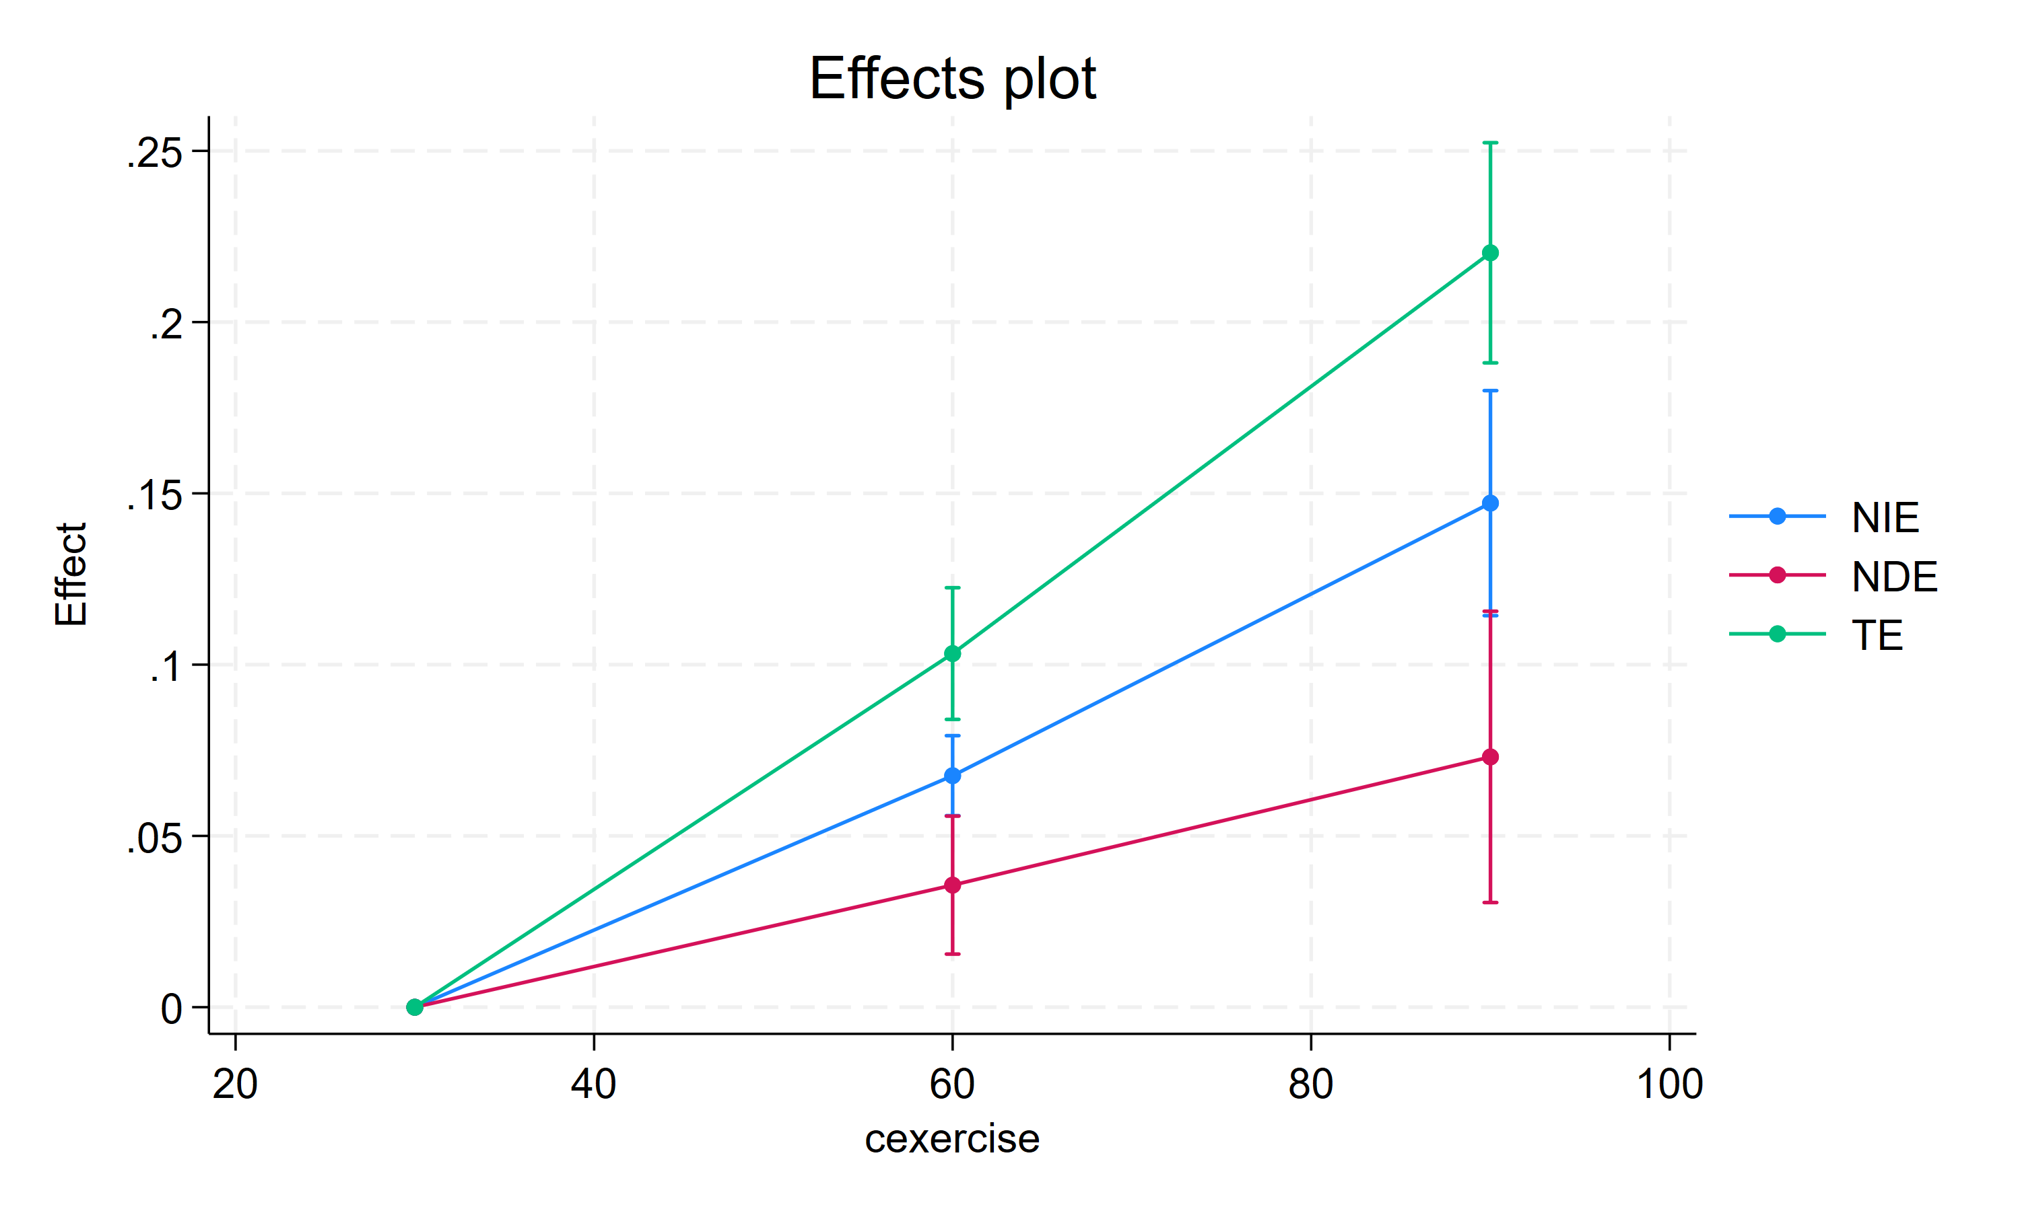
Continuous treatment
Notes:
We now get three effect estimates for each treatment effect, which capture the expected differences in the outcome with respect to
the control point. With multiple effect estimates, it can be convenient to plot the results. We use the postestimation command estat effectsplot

Slide 74
Count mediator
We consider the sample that includes women who gave birth to a child.
We wish to find out whether the socioeconomic status and education of the mother affect the child’s health.
  Y - the birthweight of the baby (bweight)
  T - whether or not the mother has a college degree (college).
  M -the number of cigarettes smoked per day during pregnancy (ncigs).
  X – social economic status of parents (sespar)
The hypothesis is that women with a higher educational degree are likely to smoke fewer cigarettes and that smoking during pregnancy has negative effects on birthweight.
Notes:
The odds of the population where everyone is exercising to have well-being is 2.93 times greater than the odds of the population where nobody exercising.

Slide 75
Count mediator
Notes:
Bweight – infant birthweight(grams)
Ncigs - # of cigarets per day during pregnancy
College – college degree
Ses – sociaoeconomic status
Sespar – ses of parents

Slide 76
Count mediator
Notes:
As before, the type of model we use for the mediator does not affect the interpretation of the estimated treatment effects.
We do not assume that the adverse effects of smoking are different between women with a college degree and women without a college degree. Therefore, we use the nointeraction option
Effects are expected differences on the scale of the outcome variable.
The TE indicates that if all women had a college degree, the average birthweight of newborn babies would be almost 519 grams higher than the average birthweight if no woman had a college degree.
Of this weight increase, around 199 grams are due to women with higher educational degrees smoking less, while 320 grams are due to other mechanisms.

Slide 77
Incidence-rate-ratio
The same formula as risk-ratio.
Allowed when the outcome model is Poisson/exponential mean.
Notes:
The same formula as risk-ratio, and are allowed when the outcome model is Poisson/exponential mean.

Slide 78

Controlled direct effects (CDE)
X
CDE is the effect of the treatment if the mediator were controlled, i.e., set to a specific level (M =m) for everyone.
CDE may vary across individuals, and within an individual may vary depending on the mediator control value m.
For binary treatment
    $$CDE\left(m\right)=Y_{1m}−Y_{10}$$
    $${CDE\left(m\right)}^{RR}=\frac{Y_{1m}}{Y_{0m}}$$
    $${CDE\left(m\right)}^{IRR}=\frac{Y_{1m}}{Y_{0m}}$$
    $${ CDE\left(m\right)}^{OR}=\frac{Y_{1m}/(1 −Y_{1m})}{Y_{0m}/(1 −Y_{0m})}$$
M
m
T
1
Y(1,m)
X
M
m
T
0
Y(0,m)
Notes:
1. SDEs are the oldest among all direct and indirect effcts. CDES are effects of the treatment if the mediator were controlled, i.e., set to a specific
Level for everyone.
2. It is the contrast between the potential outcomes for individual i if their exposure is respectively set to the exposed and unexposed conditions and their mediator is set to m.

Slide 79
Controlled direct effects (CDE)
Notes:
This CDE for ncigs = 0 is 342.
The increase of baby’s birthweight whenever one has college degree is 342 higher than the baby’s birthweight when the mother does not have degree.
If we switch the mediater to ncigs = 1, the CDE is lower by around 9 grams.

Slide 80
Controlled direct effects (CDE)
Notes:
We could also estimate this difference directly bu using contrast option

Slide 81
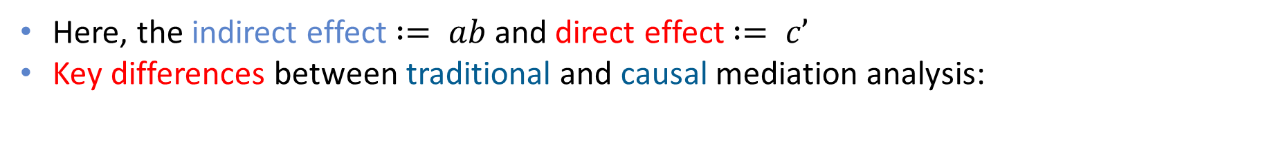

Final remarks: Traditional vs Causal Mediation Analysis
Traditional approach uses a model-based definition
    $Y_{i}=α_{1}+c^{′}T_{i}+bM_{i}+ε_{Y_{i}}$
    $M_{i}=α_{2}+aT_{i}+ε_{M_{i}}$
X
a
M
b
T
c’
Y
Here, the indirect effect $:= ab$and direct effect $:= c’$
Key differences between traditional and causal mediation analysis:
Traditional | Causal
Indirect and direct effects are mathematical objects that do not exist without the model | Effects are defined in a model-free manner, based on reasoning about what fits the notion of causal effect
No separation of the definition of an effect and its estimation method | Separates the definition of an effect, and its identification from estimation

Slide 82
Learn more:
    https://www.stata.com/manuals/causalmediate.pdf
Notes:
Mexercise – minutes of exercise, has three categories
We now have two effects per estimand because we compare the two treated groups to the control group.
Starting with the TE, we expect nearly a 13-point increase in well-being if everyone in the population exercised for 90 minutes.
Of these 13 points, around 10 points are due to the increase in bonotonin levels and 3 points are due to other mechanisms.
The results for the 45-minute treatment arm, though expectedly smaller in magnitude, are interpreted similarly.

Slide 83

Course materials
All the materials are available at: https://adallak.github.io/misc/

Slide 84
References
Neal, B. (2020). Introduction to causal inference.
Nguyen, T., Schmid, I., and Stuart, E. (2020). Clarifying causal mediation
analysis for the applied researcher: Defining effects based on what we want to learn. Psychological Methods, 26.
Nguyen, Trang Quynh, Schmid, Ian, Ogburn, Elizabeth L. and Stuart, Elizabeth A.. "Clarifying causal mediation analysis: Effect identification via three assumptions and five potential outcomes" Journal of Causal Inference, vol. 10, no. 1, 2022, pp. 246-279.
VanderWeele, T. and Shpitser, I. (2013). On the definition of a confounder. The Annals of Statistics, 41.
Notes:
Mexercise – minutes of exercise, has three categories
We now have two effects per estimand because we compare the two treated groups to the control group.
Starting with the TE, we expect nearly a 13-point increase in well-being if everyone in the population exercised for 90 minutes.
Of these 13 points, around 10 points are due to the increase in bonotonin levels and 3 points are due to other mechanisms.
The results for the 45-minute treatment arm, though expectedly smaller in magnitude, are interpreted similarly.

Slide 85


