Slide 1
Statistical consulting with Stata: Lessons learned
2022 Stata Biostatistics and Epidemiology Virtual Symposium
By
Joni Ricks-Oddie, PhD MPH
Director, UCI Center for Statistical Consulting | Department of Statistics
Director, Biostatistics, Epidemiology & Research Design Unit | ICTS

Slide 2
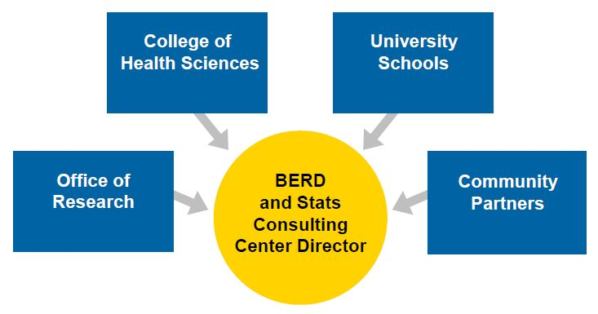
Who are we?

Slide 3
What’s so great about Stata
Software we use
Why Stata
Stata
R
SAS
SPSS
Mplus
Prism
Ease of use
Syntax Consistency
Flexibility
Documentation

Slide 4
Example 1– Where Are Students with Autism and Intellectual Disability Learning?: Placement Trends in California. Inclusion

Slide 5
Project Overview
Project Goal
Specific Research Questions:
To examine variability in placement of students with autism and intellectual disability in order to explore factors associated with placement into regular classroom settings
What are the trends in placement of students
with autism and ID over a 5-year period?
What is the relationship between placement
of students with autism and ID and selected
demographic factors:
percentage of students receiving free or reduced-price lunch
(district socioeconomic status)
number of K-12 students in the district (district size)
district per pupil expenditure (district
expenditure)
percentage of students with disabilities in each district by race/ ethnicity ?

Slide 6
Methodology
Data
Complications
Data were obtained from the California Department of Education (CADOE) via a formal data request.
2 level data – School and School District
All data were from the CADOE, but clearly not all from the same sources.
CA Dept of Educations data was organized in multiple spread sheets with out a clear linking variable
We had to build an analyzable dataset from multiple excel sheets
Changes in the reported methods across time

Slide 7
Analysis
Outcome – Proportion of students placed in a specific classroom setting
Chose a Logistic regressions that clustered by school district
Other options:
  Poisson with an offset
  Multilevel model
Data Visualization
  Used margins and margins plot
  Estimate and graph predicting probability of placement across time

Slide 8
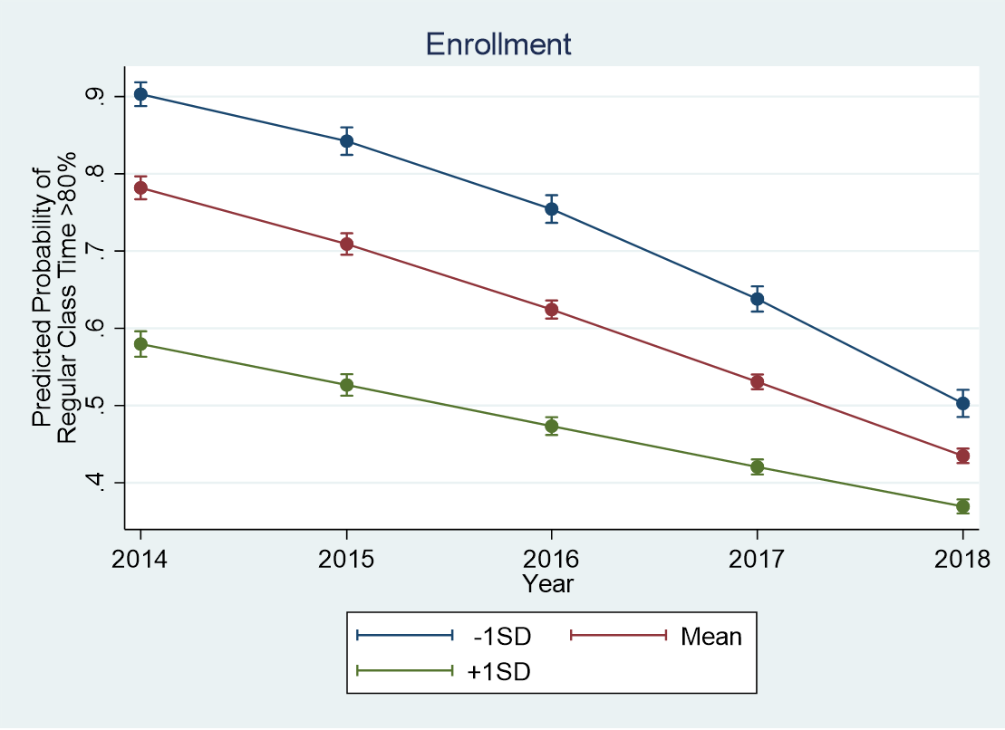
Why You should always graph your results

Slide 9
Comparing graphs side by side
Note the downward shift in predicted probabilities when moving from 2016 to 2017
This could be indicative of some sort of policy change and/or change in reporting standards

Slide 10
Example 2 – Comparison of NSQIP-SRC, TRISS, and ASA-PS to Predict Operative Trauma Mortality in Elderly Patients

Slide 11
Project Overview
Project Goal
Specific Research Questions:
Evaluate the utility of several trauma-specific risk calculators in an elderly population
Explore the predictive ability of NSQIP-SRC, TRISS, and ASA-PS scoring systems in elderly operative trauma patients.

Slide 12
Methodology
Data
Complications
Observational data
Multicenter study, data
Adult trauma patients requiring surgery within 24 hours of admission
Planned subgroup analysis of elderly patients 65 years or older
External validation on a small sample
Large number of comorbidities used in risk calculators

Slide 13
Analysis
Outcomes – Mortality (binary), Length of Stay (count) and Number of Complications (count)
Chose to use a Firth Logit, Linear Regression and Negative Binomial
Other options: Binary Logistic (separation issues), Poisson (over dispersed)
We used a series of commands in Stata to assess the prediction quality of each risk calculator

Slide 14
Data Visualization
Used the roccomp to test the equality of ROC areas
Quick and easy way to make the comparisons you want with the correct number of degrees of freedom
You can specify your own set of matrices to tailor the comparison you want to make between ROC area

Slide 15
Brier Score
Definition- Proper score function or strictly proper scoring rule that measures the accuracy of probabilistic prediction
Command = brier
  Computes the Yates, Sanders, and Murphy decompositions of the Brier mean probability score.
The Brier score is a measure of disagreement between the observed outcome and a forecast (prediction).
Documentation provides a nice explanation of the metrics provided and their appropriate use

Slide 16
Calibration plot of prediction model performance
Command = pmcalplot (user-written)
Works with Binary, Survival and linear regression models
Produces a calibration plot of observed against expected probabilities for assessment of prediction model performance
Primarily useful for assessment of model performance in an external validation of an existing model.

Slide 17
Example 3 - Cognitive Function during the Prodromal Stage of Alzheimer's Disease in Down Syndrome: Comparing Models

Slide 18
Project Overview
Project Goal
Specific Research Questions:
Explore how the sequence of cognitive decline in adults with Down Syndrome (DS) and early stage Alzheimer's Disease (AD)
Complicating early detection of AD progression and diagnostic accuracy is the large variability in baseline cognitive ability among people with DS
Examine AD-related clinical status is associated with multiple measures of cognitive impairment

Slide 19
Methodology
Data
Complications
144 adults with Down Syndrome
Subgroup of larger study cohort examining biomarkers of AD in adults with DS.
Examined 2 groups:
Cognitively Stable (CS(, AD-related impairment was absent
MCI-DS, indicating that there was some indication of cognitive and/or functional decline
Small sample
Twenty-two measures from 13 instruments were hypothesized a priori to measure four cognitive domains: (1) executive function, (2) language, (3) memory, and (4) visuomotor:
17 measures cognitive impairment derived from 10 tests of cognition

Slide 20
Analysis
Twenty-two measures from 13 instruments were hypothesized a priori to measure four cognitive domains: (1) executive function, (2) language, (3) memory, and (4) visuomotor:
Considered other methods for evaluating domains
  Composite Scores
  CFA
  SEM
EFA using all 22 measures to assess the hypothesized domain structure
The resulting structure was then used in a Structural Equations Model

Slide 21
Exploratory Factor Analysis
Command = efa
An initial set of analyses considered 22 scores, but results revealed problems with the five variables ranging from weak loadings, to high uniqueness or significant cross-loadings that did make theoretical sense.
These 5 variables were not included in the overall SEM.
The original four cognitive domains: (1) executive function, (2) language, (3) memory, and (4) visuomotor:
We ended up 3 factors representing (1) language/executive function, (2) memory, and (3) visuomotor that made theoretical sense to the researcher

Slide 22
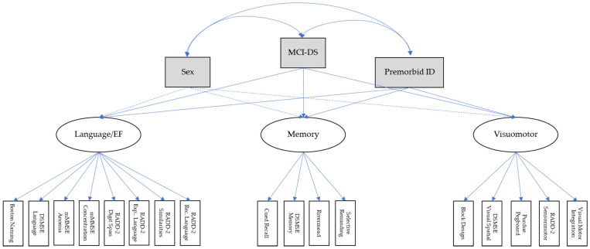
Final Model: SEM

Slide 23
Client and Staff Training
Command = sem
Well documented and includes a good amount of theory
Syntax is clear and straightforward
Stata is a great tool for learning to perform SEM
The staff member I had working on this project has never performed SEM
The clinical we were working with all had no experience with SEM
I used the project as a training tool for both
Difficult software or syntax can make training on the theory difficult

Slide 24
Conclusions
While we use a variety of software, Stata is a main work horse for our units
The syntax consistency make it easy for new staff to pick up
Offers data management and analytic methods that cover a hosts of disciplines
It is often a recommendation I make to research transitioning out of SPSS
There is a lot of interest

