Slide 1
:
Topic: Impact Of Pre-transplant Hemodynamics On Survival After Heart Transplantation
Abstract: The outcome of 429 isolated heart transplants performed at a single institution and followed up to 10 years was analysed for the impact of pre-transplant hemodynamics on long-term survival using STATA 18 with its capabilities in generating Kaplan Meir survival curves, logistic regression, cox regression forest plots and the various graphic capabilities including Margins plots and tables. The advantages of STATA and the comparison with other software including R and MATLAB will be discussed.
Presented By
Dr K R BALAKRISHNAN
Director
INSTITUTE OF HEART AND LUNG TRANSPLANT AND MECHANICAL CIRCULATORY SUPPORT
MGM HOSPITALS ,CHENNAI

Slide 2
PRE TRANSPLANT HEMODYNAMICS AND SURVIVAL AFTER HEART TRANSPLANTATION
LESSONS LEARNED OVER THE PAST DECADE
K R BALAKRISHNAN
Director
INSTITUTE OF HEART AND LUNG TRANSPLANT AND MECHANICAL CIRCULATORY SUPPORT MGM HOSPITALS ,CHENNAI
PROFESSOR OF PRACTICE
DEPT OF ENGINEERING DESIGN AND MEDICAL SCIENCES AND TECHNOLOGY IIT MADRAS
INDIA

Slide 3
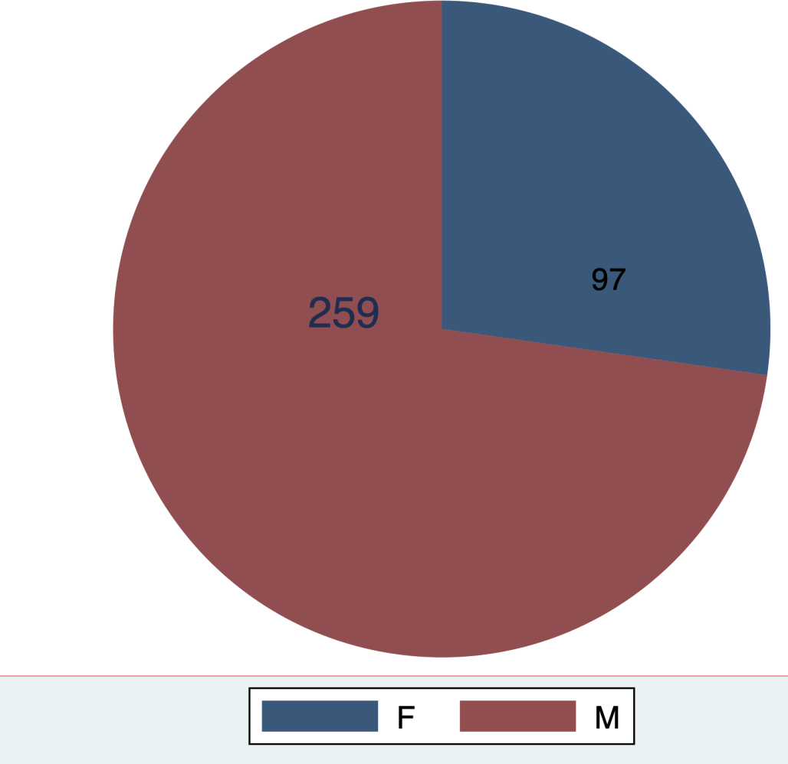
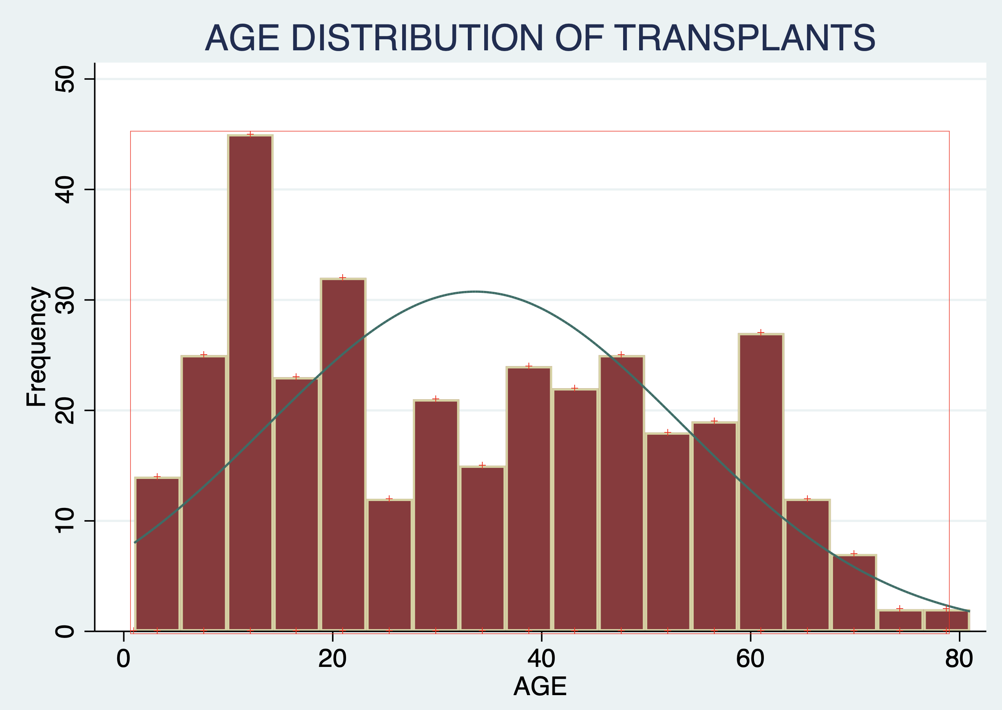
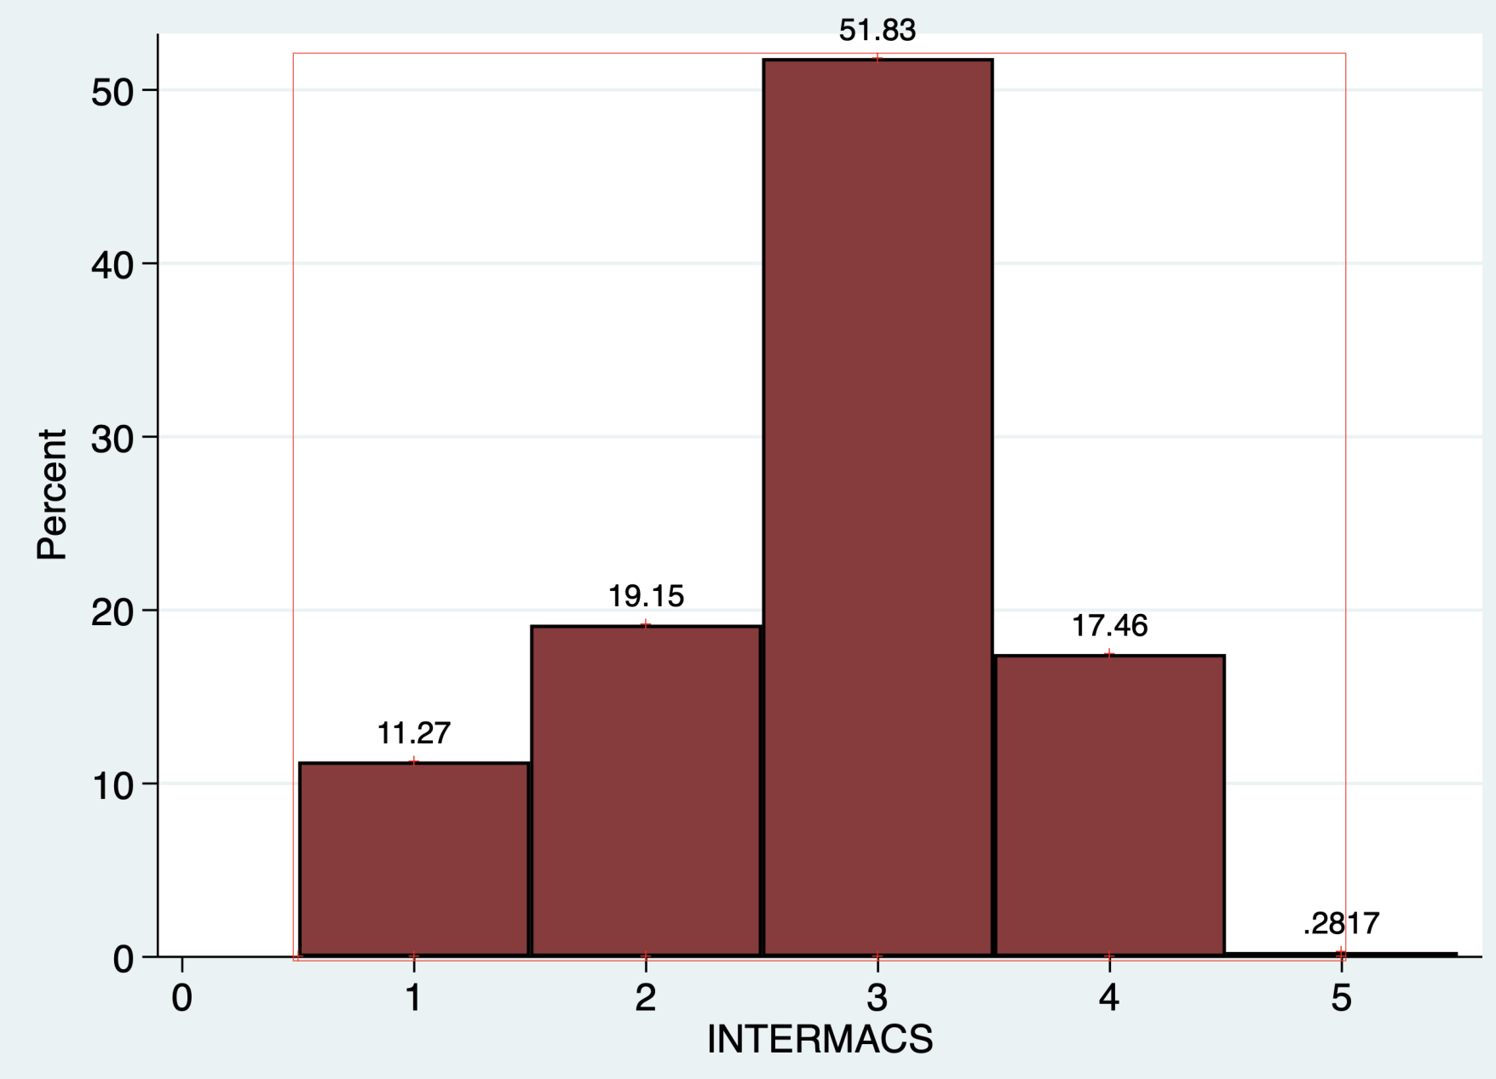
( N = 429)
ISOLATED HEART TRANSPLANTS FROM OCTOBER 2012 TO JULY 2023
AGE < 18 = 129
OVER 30 % of the patients were in INTERMACS category 1 or 2.

Slide 4
ALL PATIENTS HAD A HEMODYNAMIC STUDY PRIOR TO TRANSPLANT
EXCEPT INTERMACS 1,SHIFTED ON ECMO OR CENTRIMAG
The transplants were done within three months of the hemodynamic
study.
Hospital mortality was defined as death within 90 days of the transplant.
Patients were followed for a maximum of 10 years. The statistical tests were done using STATA 18 (Stata corps, Texas).
Logistic regression results are reported as an odds ratio. Pearson’s correlation coefficient was used to compare continuous variables, and Pearson’s chi-squared test was used to compare categorical variables. Kaplan-Meier survival curves were generated in STATA 18.

Slide 5
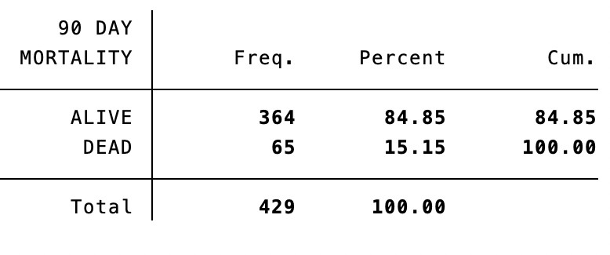
90 DAY SURVIVAL

Slide 6
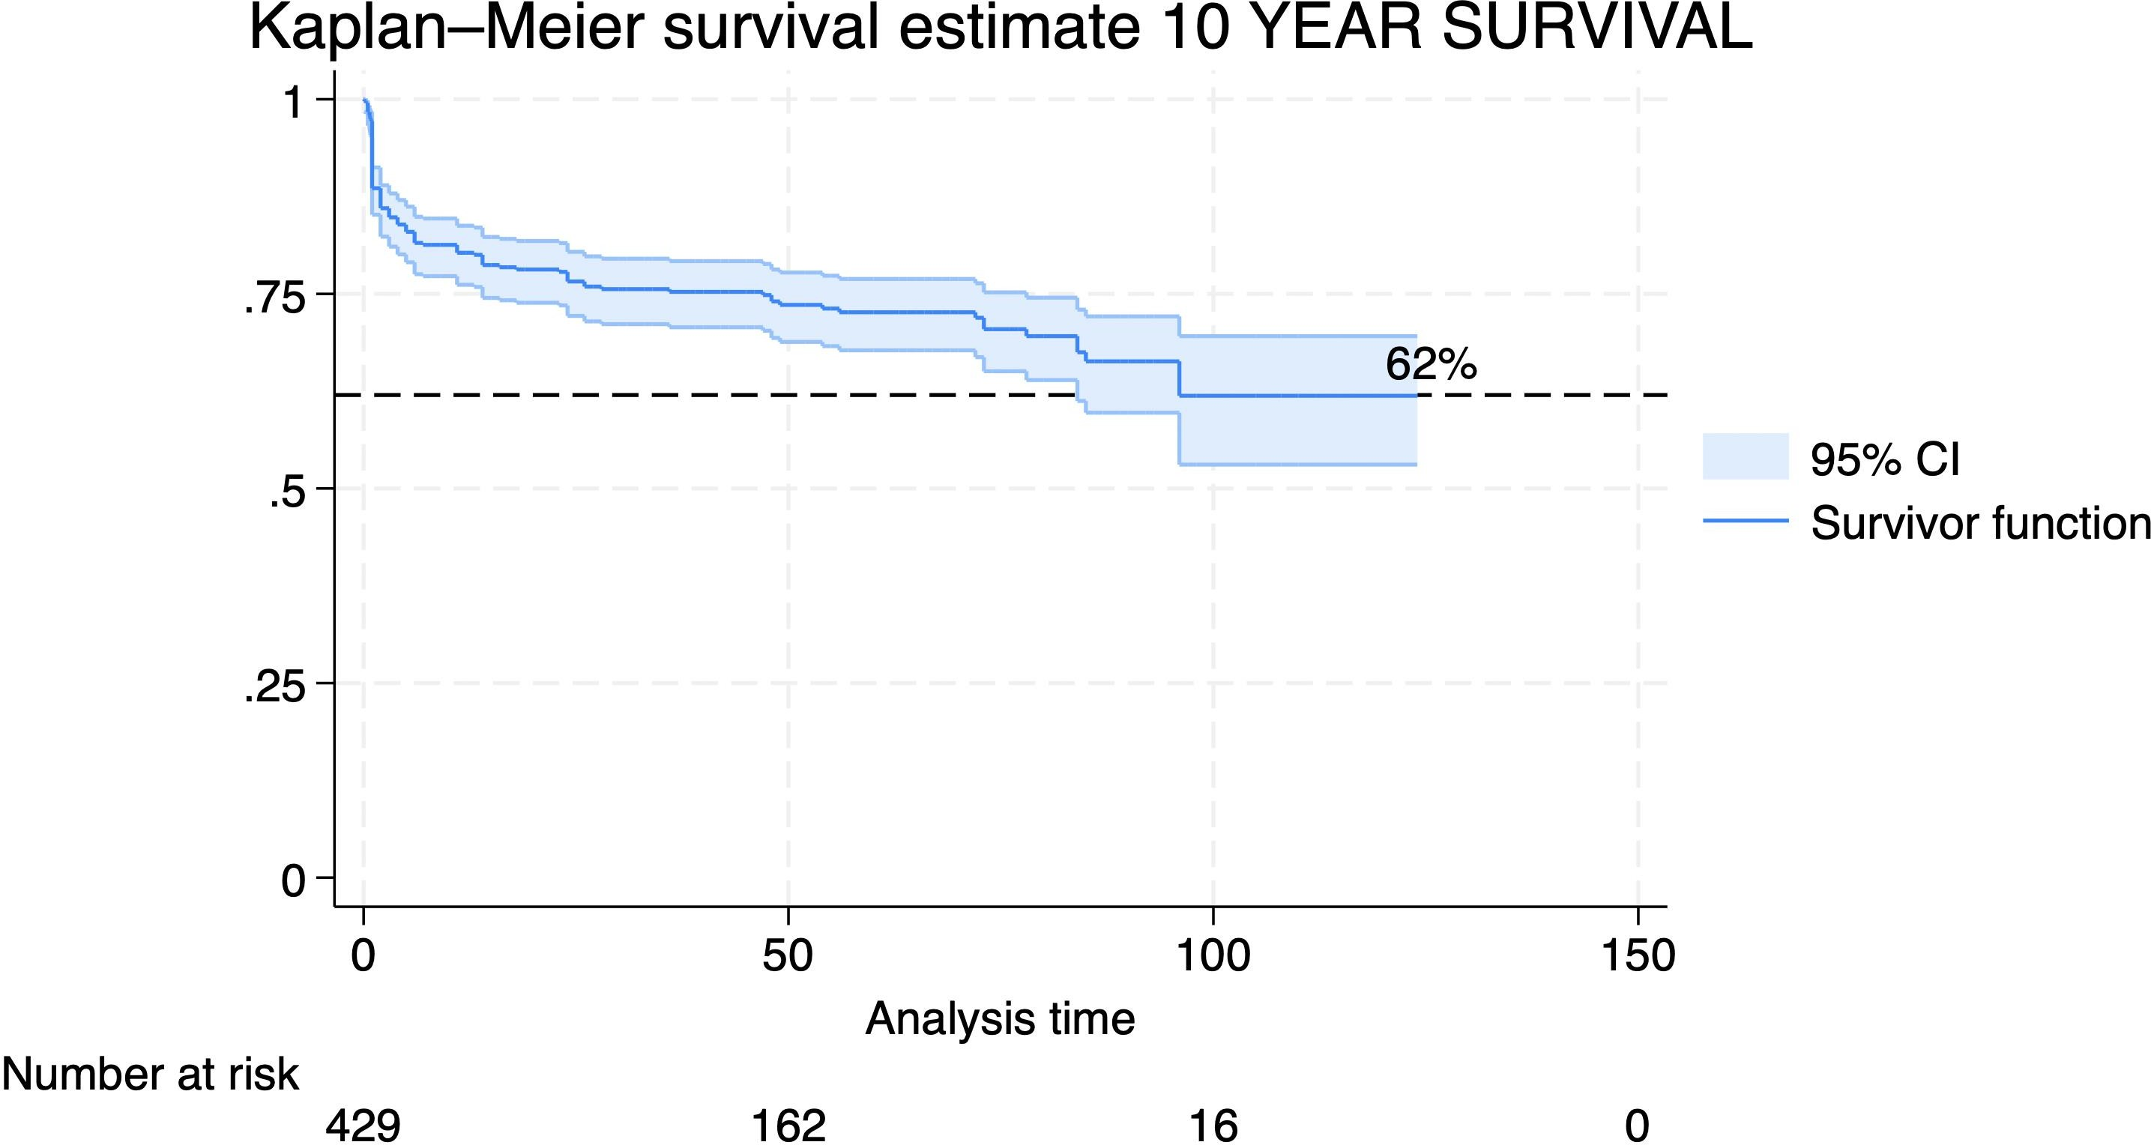

Slide 7
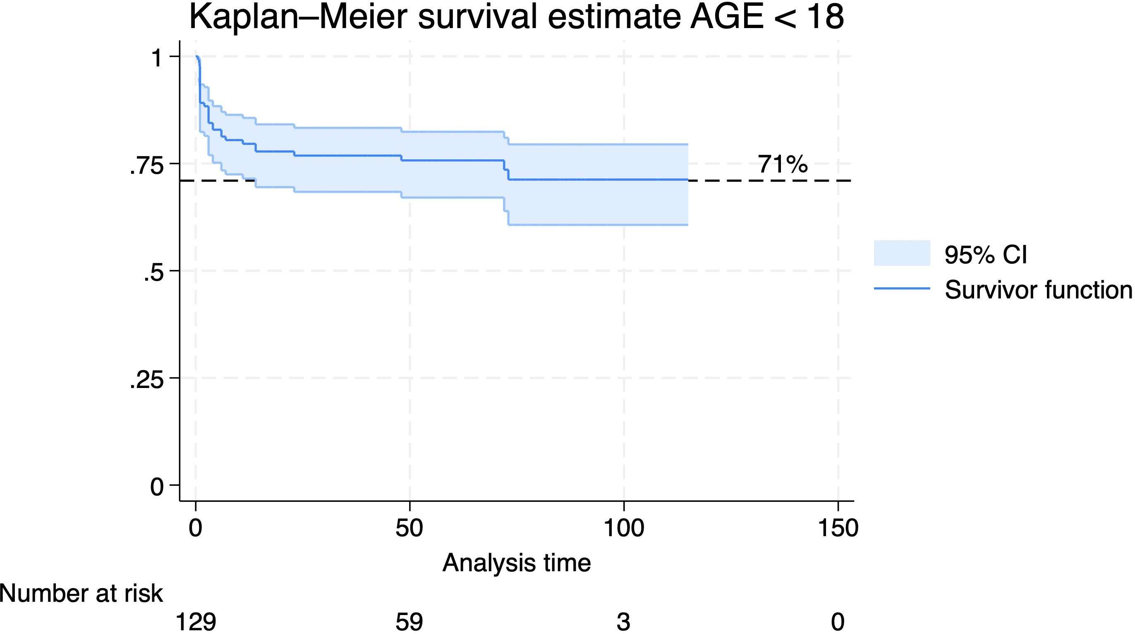

Slide 8
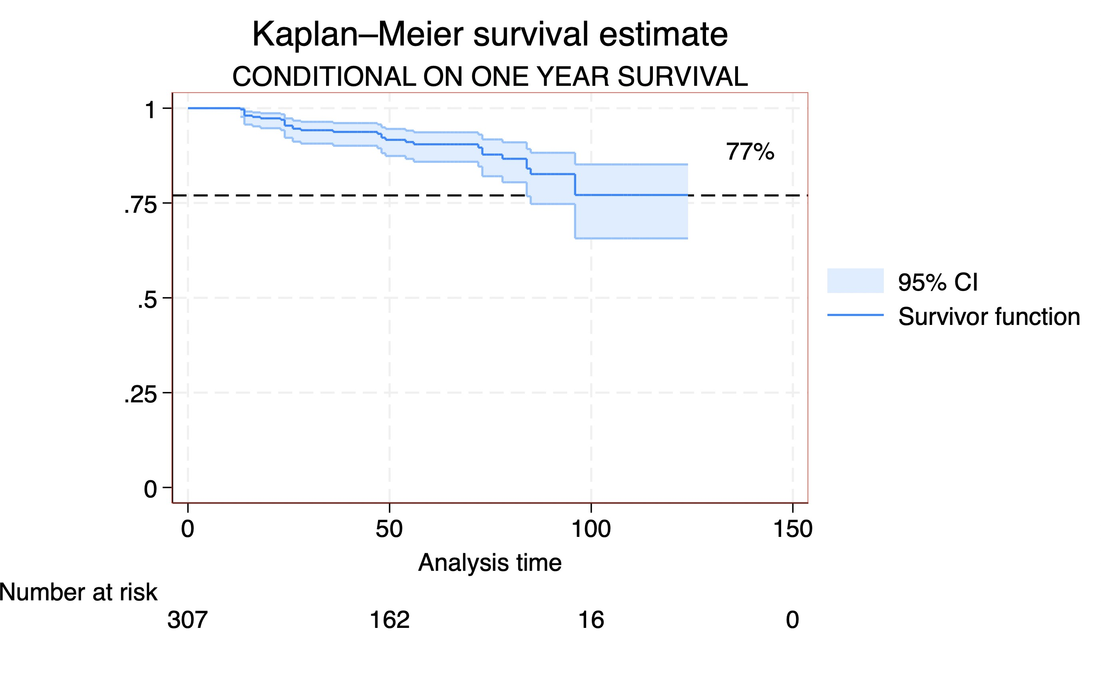

Slide 9
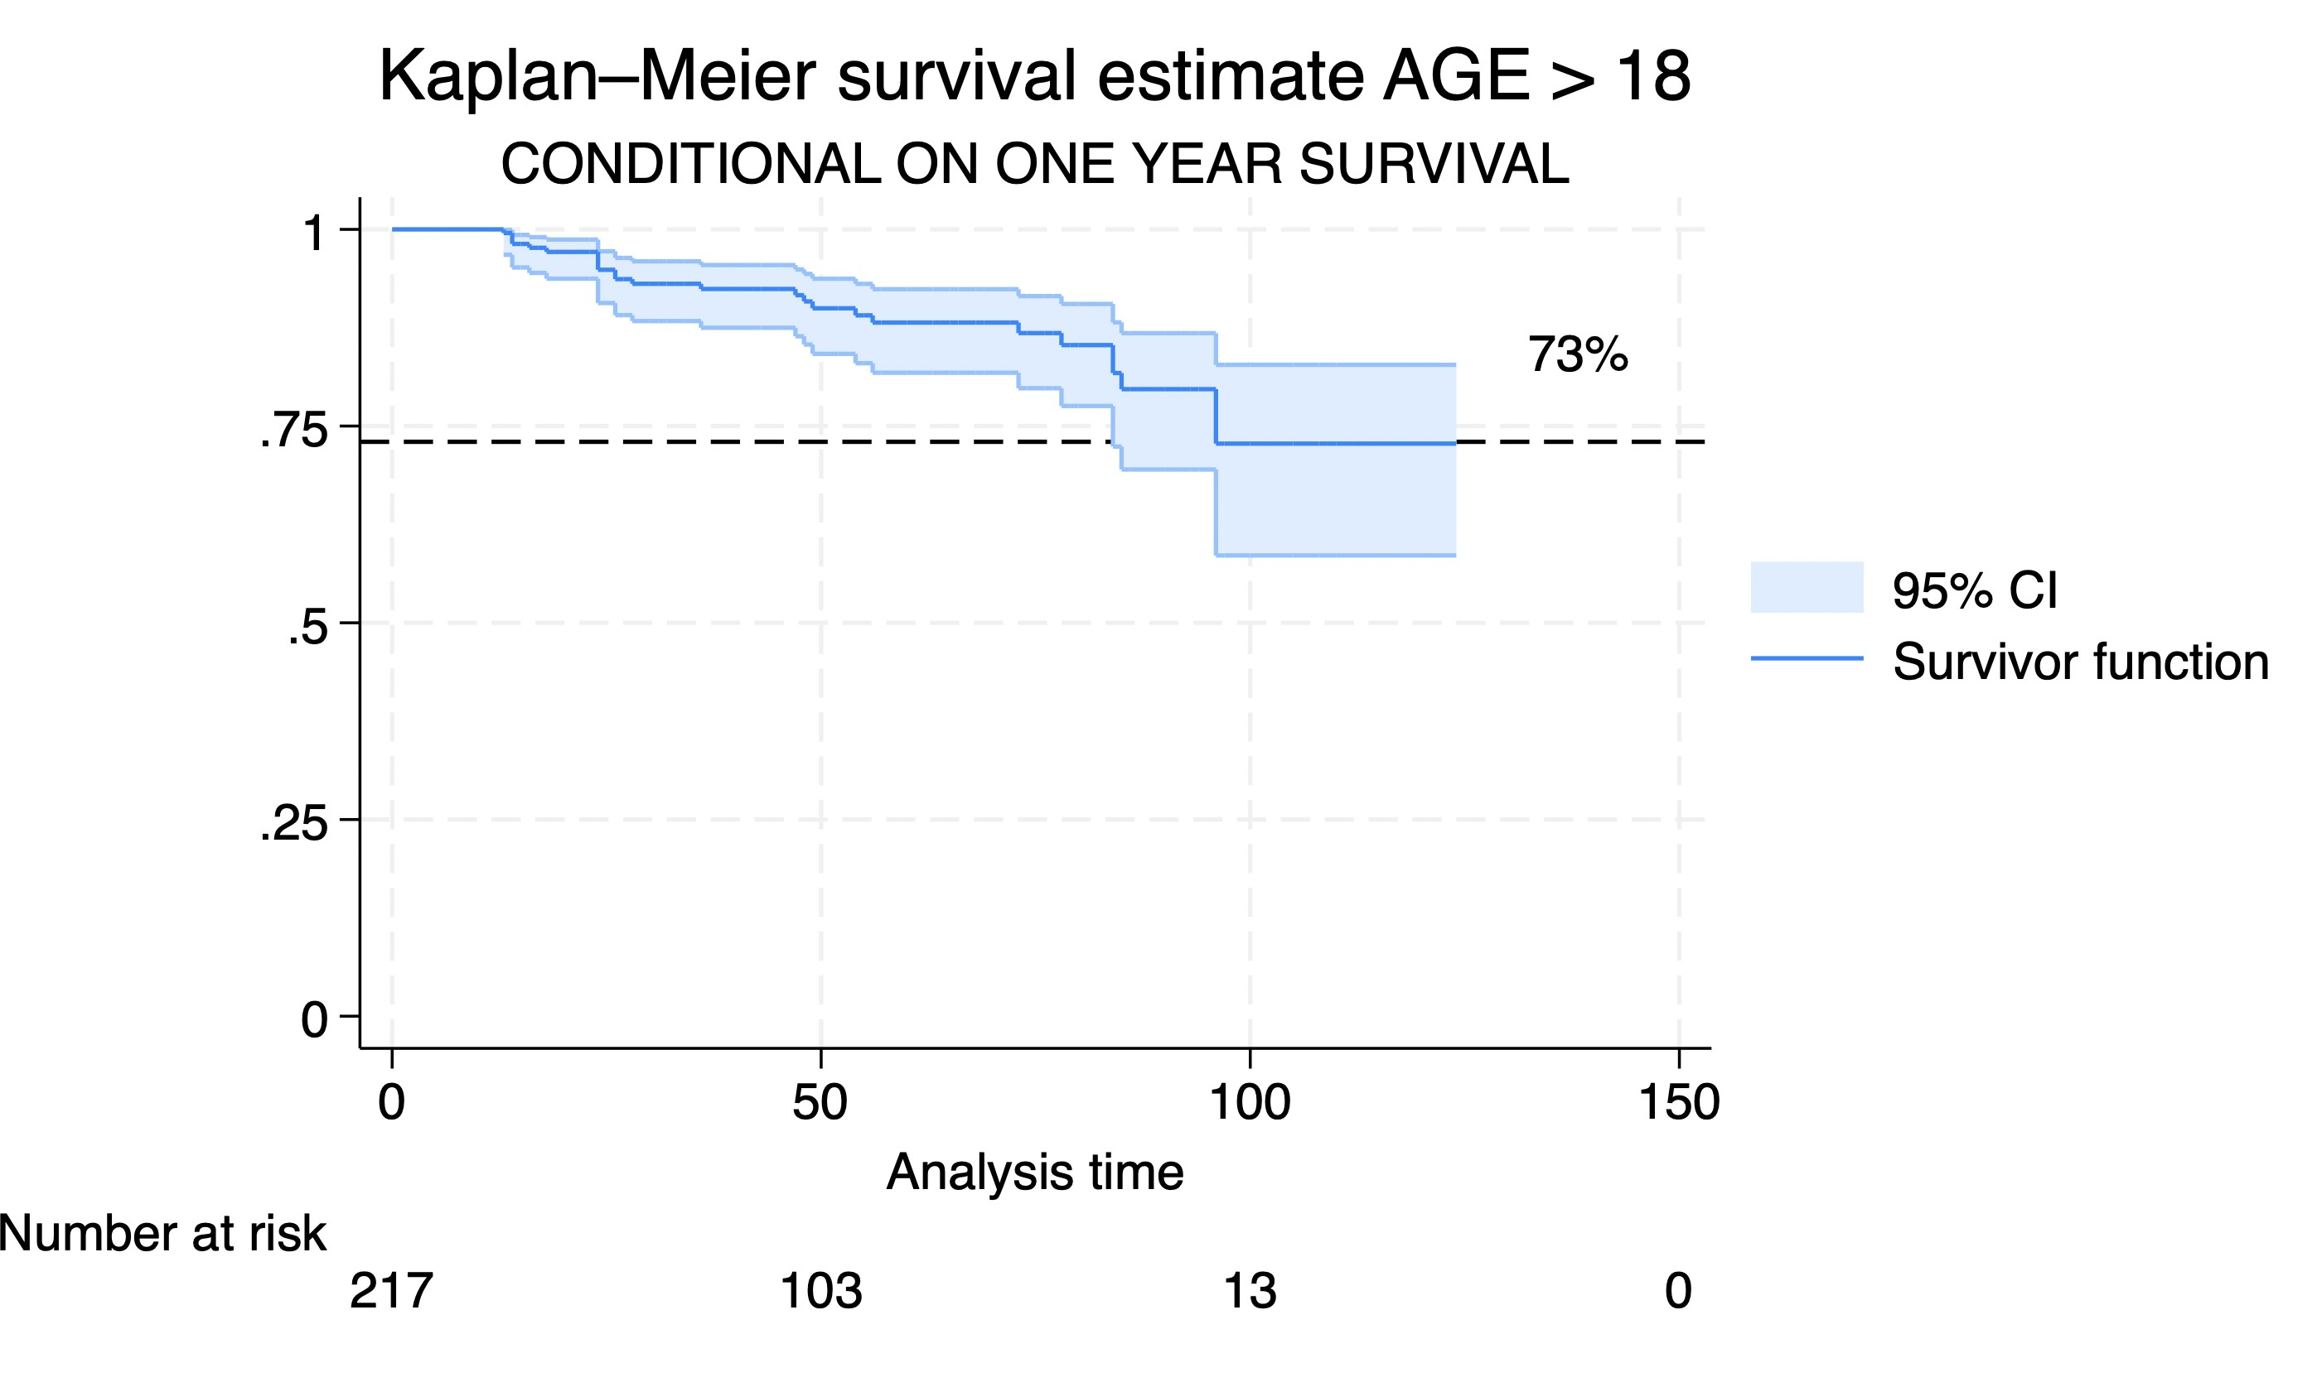

Slide 10
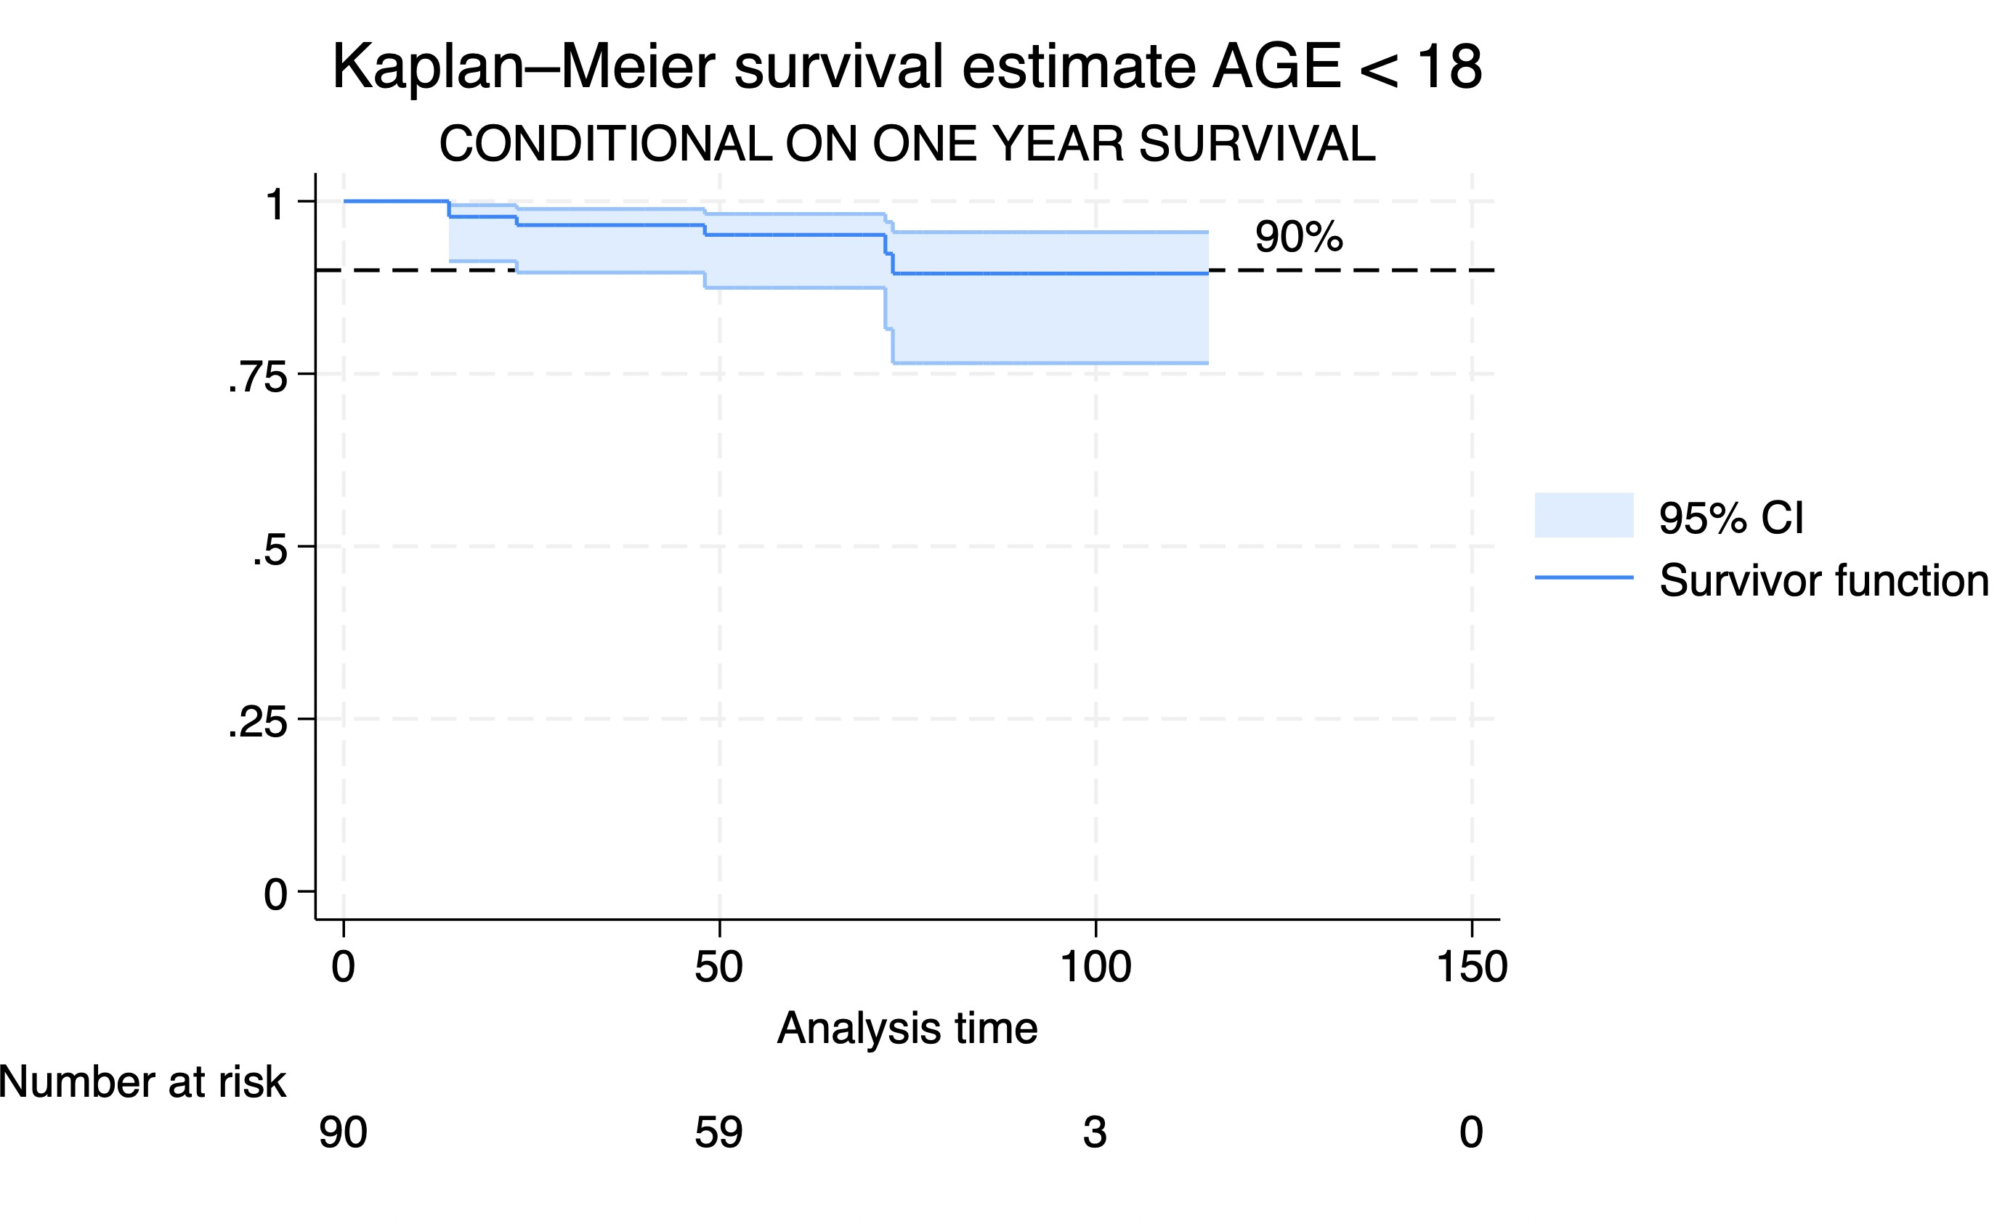

Slide 11
WHAT ARE THE HEMODYNAMIC FACTORS WHICH AFFECT OUTCOMES
?

Slide 12
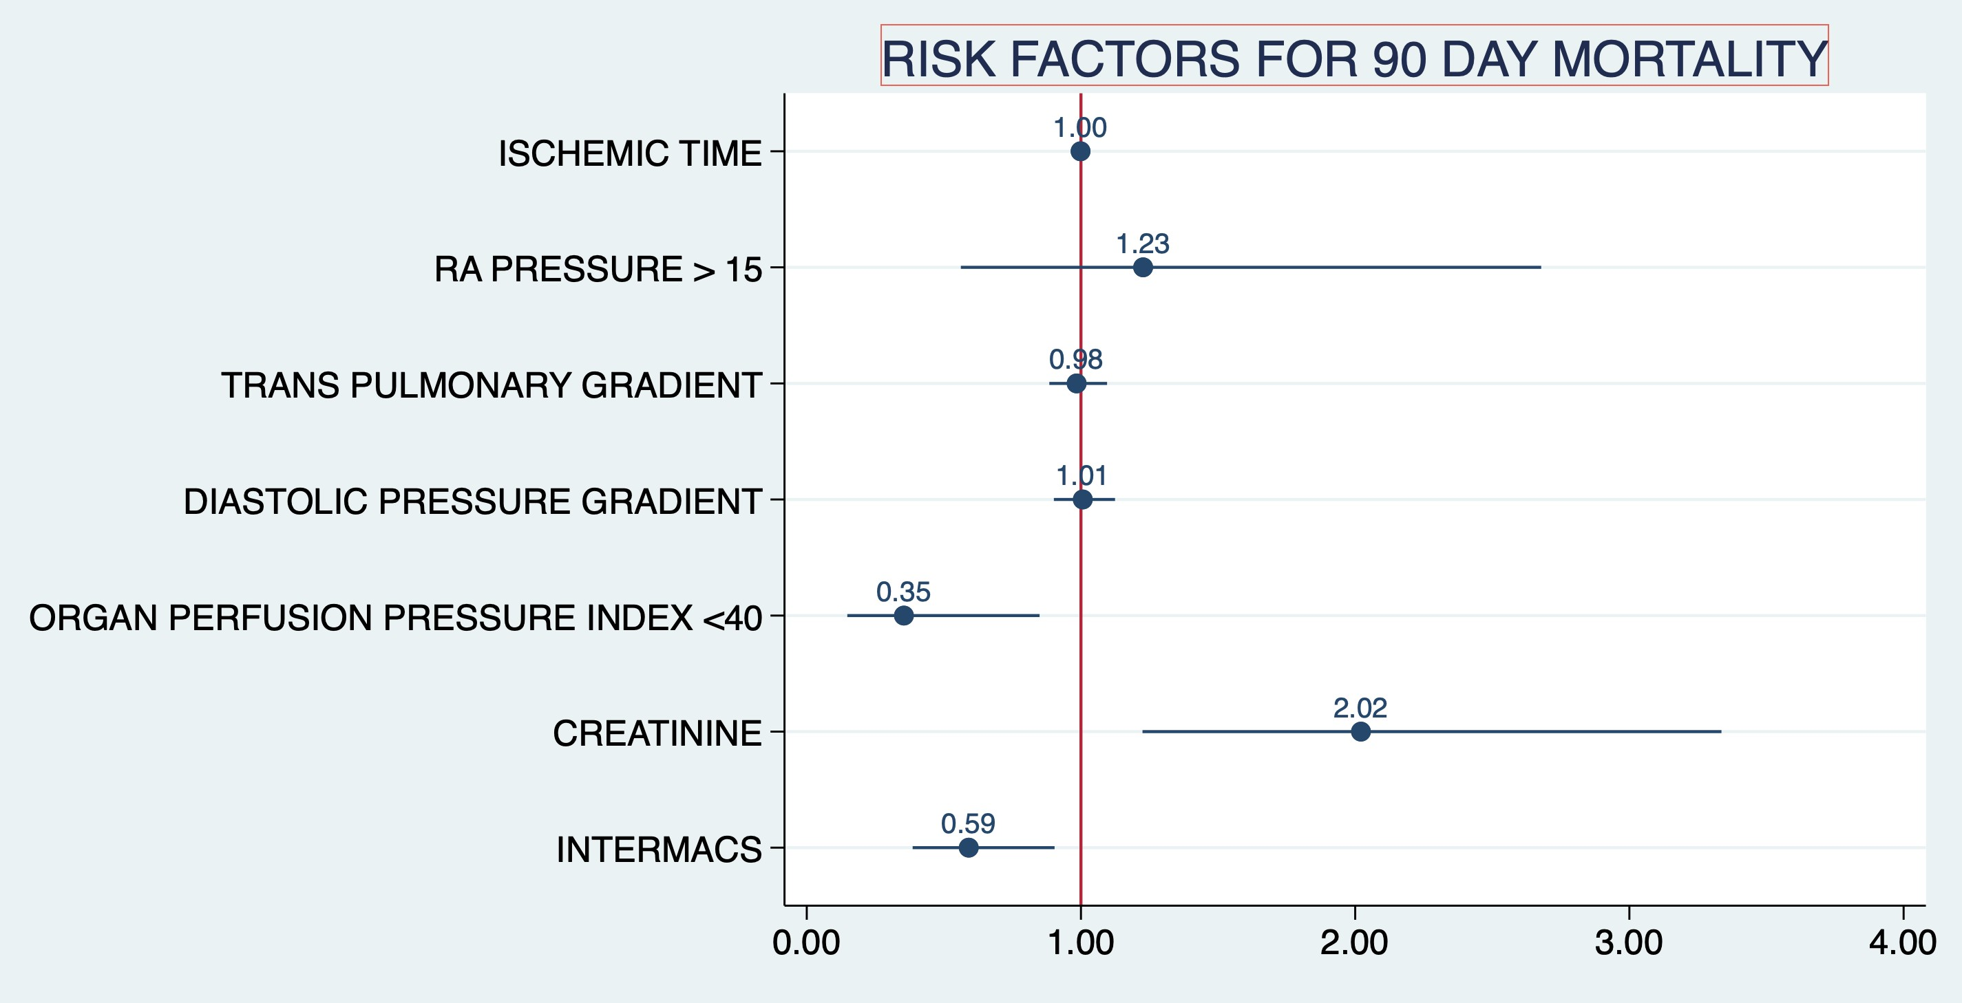

Slide 13
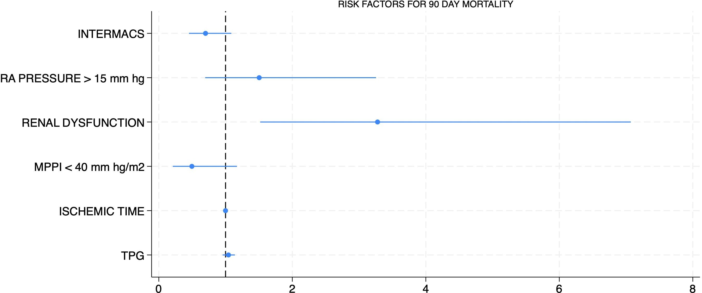
95 % CI P~0.000
OR 0.7003
OR 1.505
OR 3.27
OR 0.49
OR 0.99
OR 1.04

Slide 14
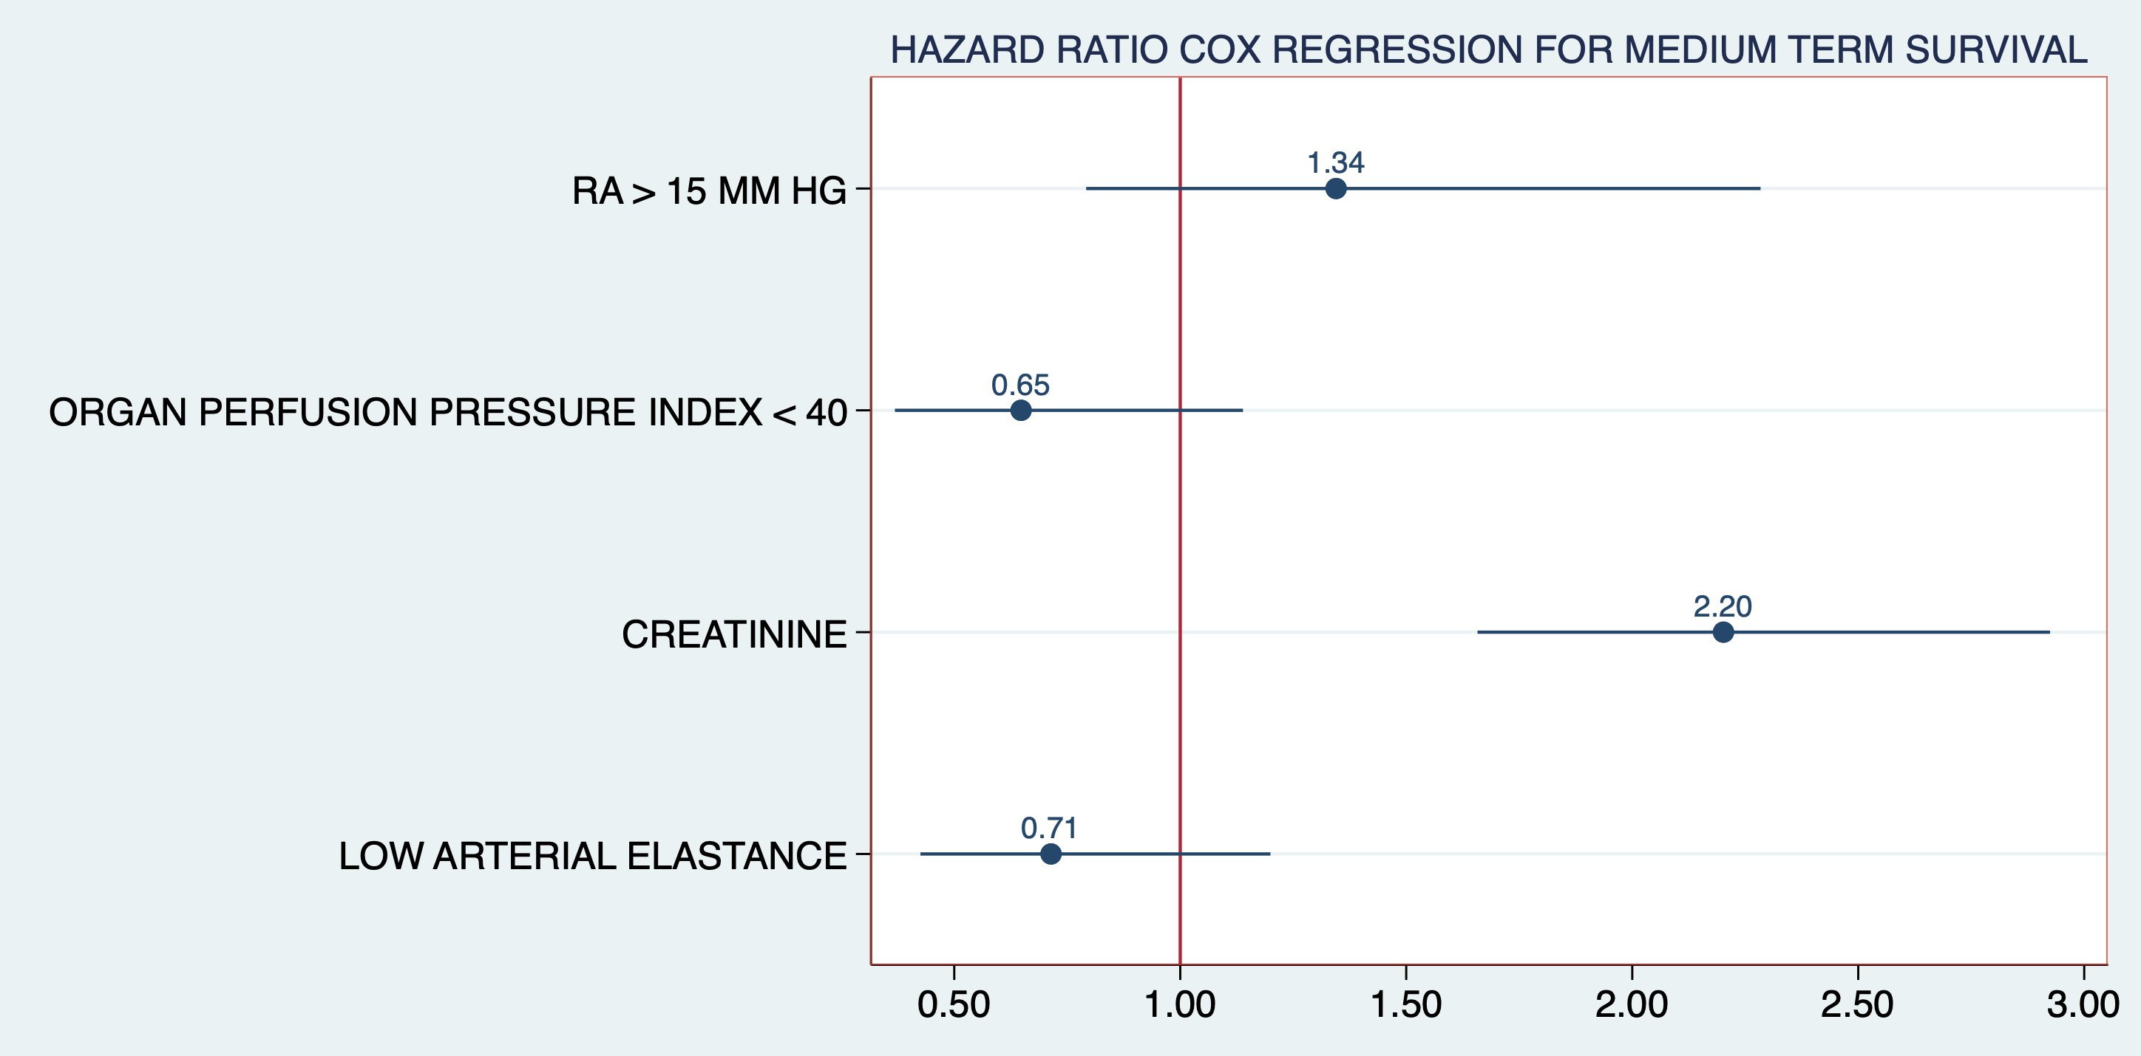

Slide 15
WHY IS A HIGH PRE TRANSPLANT RA PRESSURE A RISK FACTOR ?

Slide 16
Chronically elevated venous pressure in patients with profound right ventricular or
biventricular dysfunction is associated with renal and hepatic dysfunction, volume overload and increased mortality
Mean perfusion pressure (MPP) is important in outcomes of critically ill patients with high venous pressure
significant vasodilation in the setting of high venous pressure could lead to decreased MPP with consequent end-organ dysfunction and poor outcomes of transplantation.
There are important physiological reasons for these patients to be vasodilator , and the most
important is the medical treatment of heart failure.

Slide 17
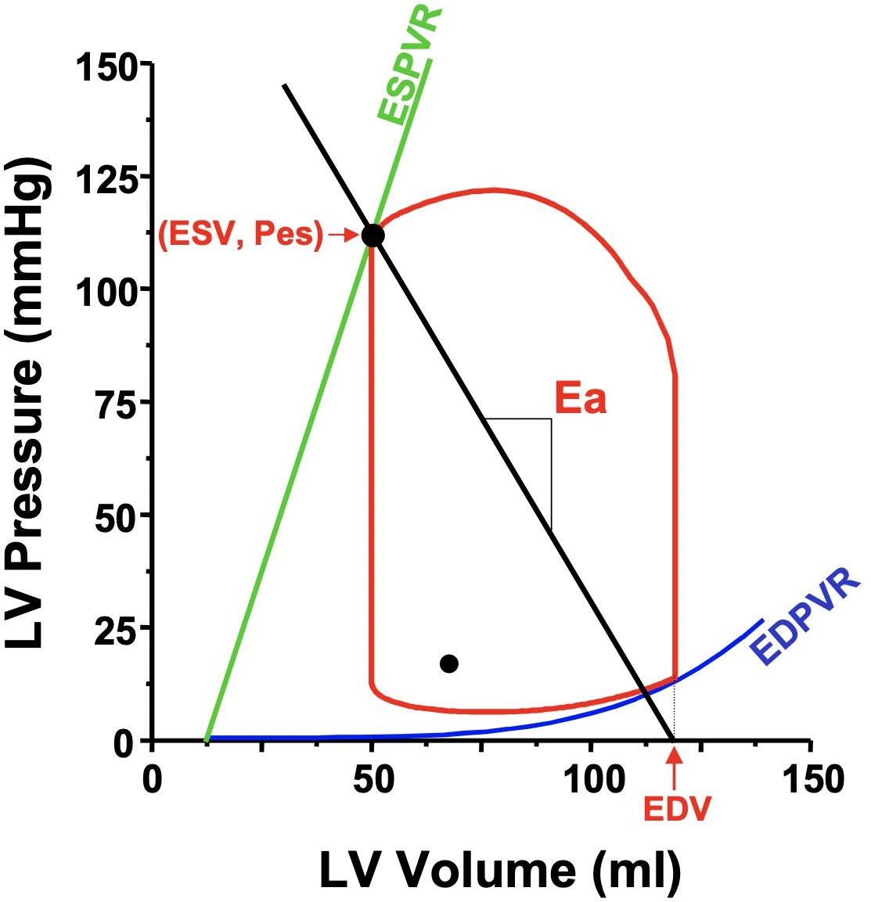
MEDICAL THERAPY OF HEART FAILURE IS BASED ON SOUND PHYSIOLOGICAL PRINCIPLES
PRESSURE VOLUME LOOPS MEASURED BY CONDUCTANCE CATHETERS CAPTURE THE RELATIONSHIP BETWEEN
LEFT VENTRICULAR CONTRACTILITY (end systolic elastance (Ees)) AND ARTERIAL AFTERLOAD (arterial elastance (Ea))
THE RATIO Ea / Ees IS NORMALLY LESS THAN OR EQUAL TO 1 AND IS ELEVATED SIGNIFICANTLY IN HFrEF DUE TO DECREASE IN Ees AND INCREASE IN Ea
Ees
LOWERING Ea WITH ARTERIAL VASODILATORS IS VERY EFFECTIVE IN IMPROVING THE CARDIAC OUTPUT AND FORMS A CRITICAL COMPONENT OF
THE MEDICAL MANAGEMENT OF HFrEF( Chirinos JA, Sweitzer
N. Ventricular–Arterial Coupling in Chronic Heart Failure. Card Fail Rev 2017;3(1):12-18)
Ea

Slide 18
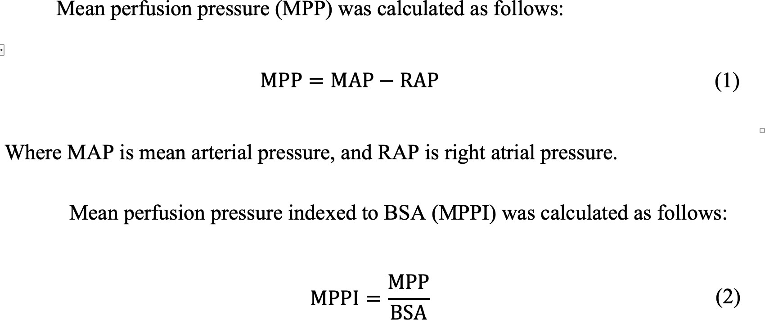

Slide 19
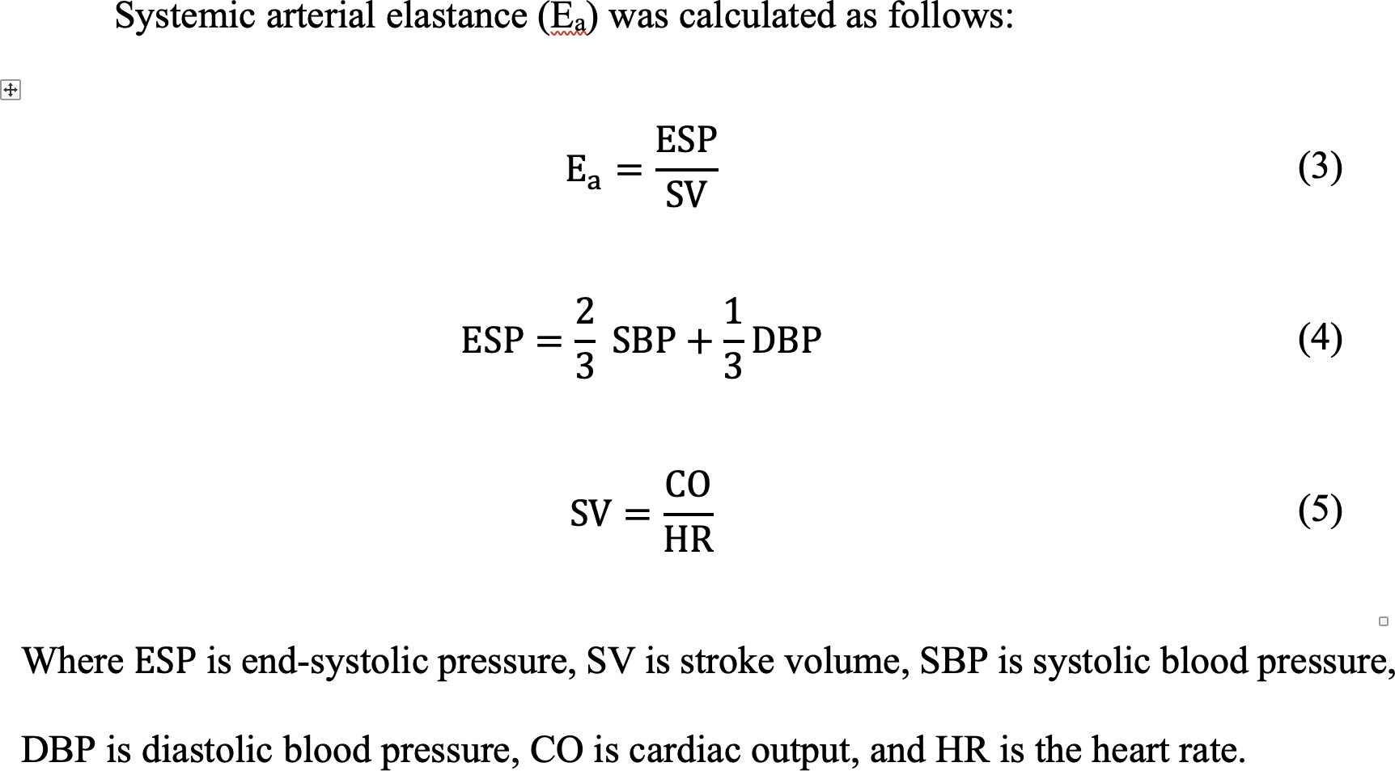

Slide 20
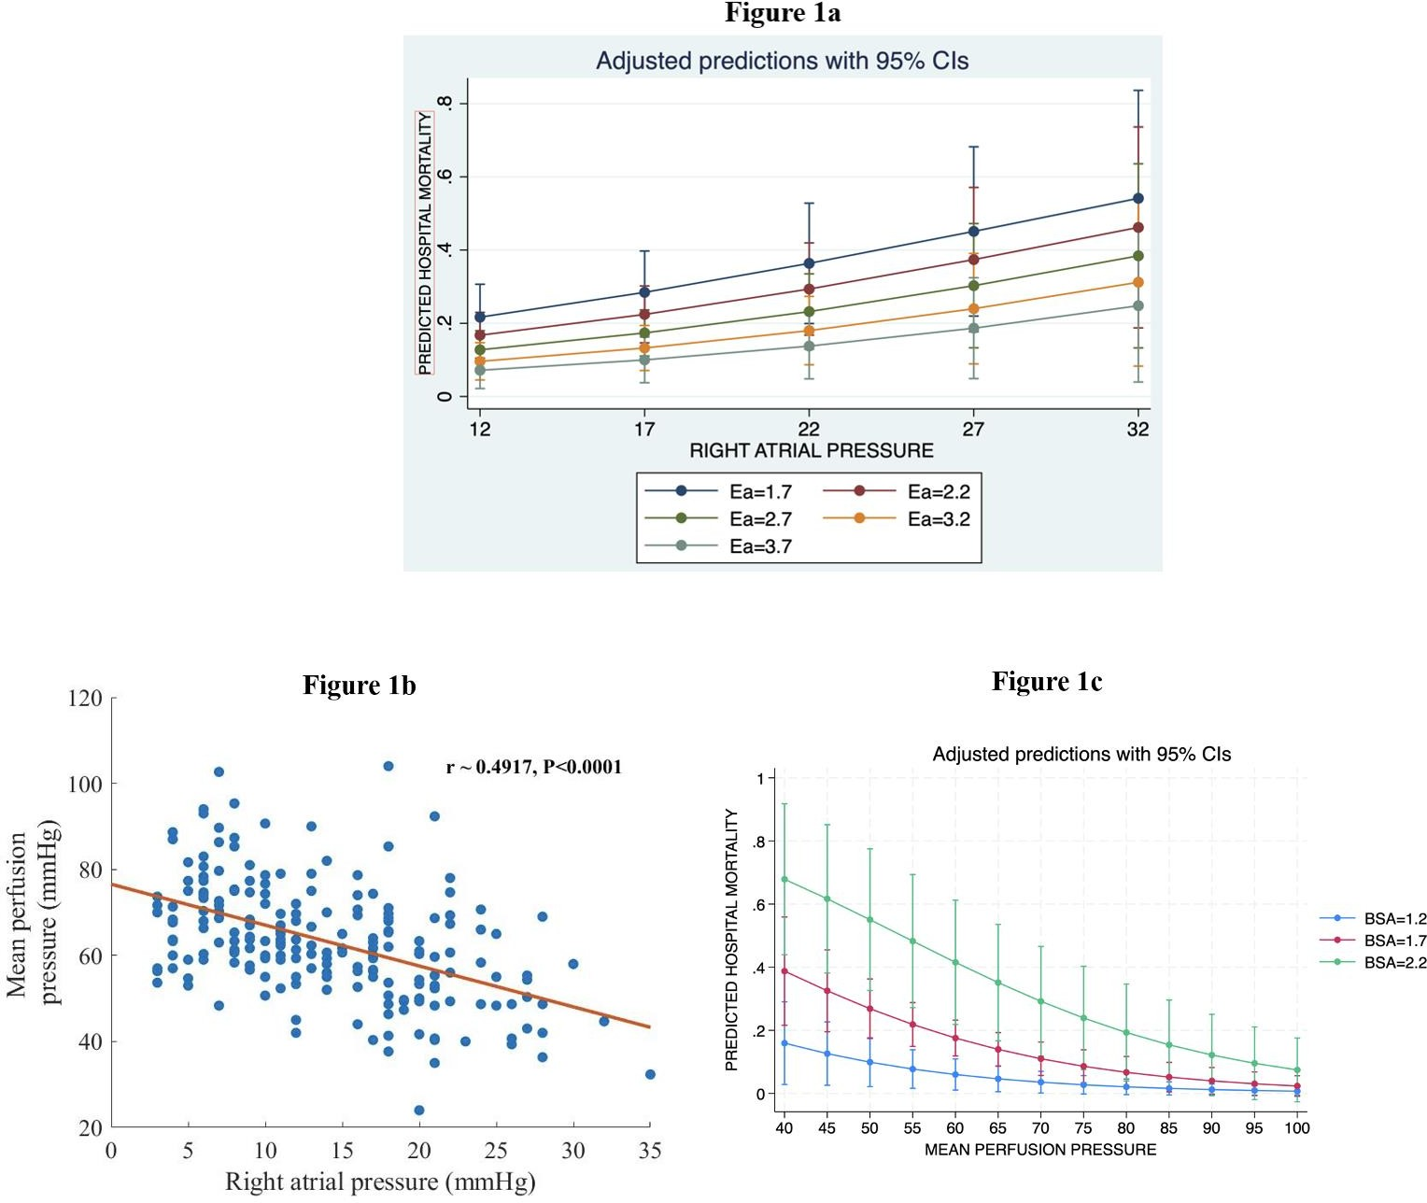

Slide 21
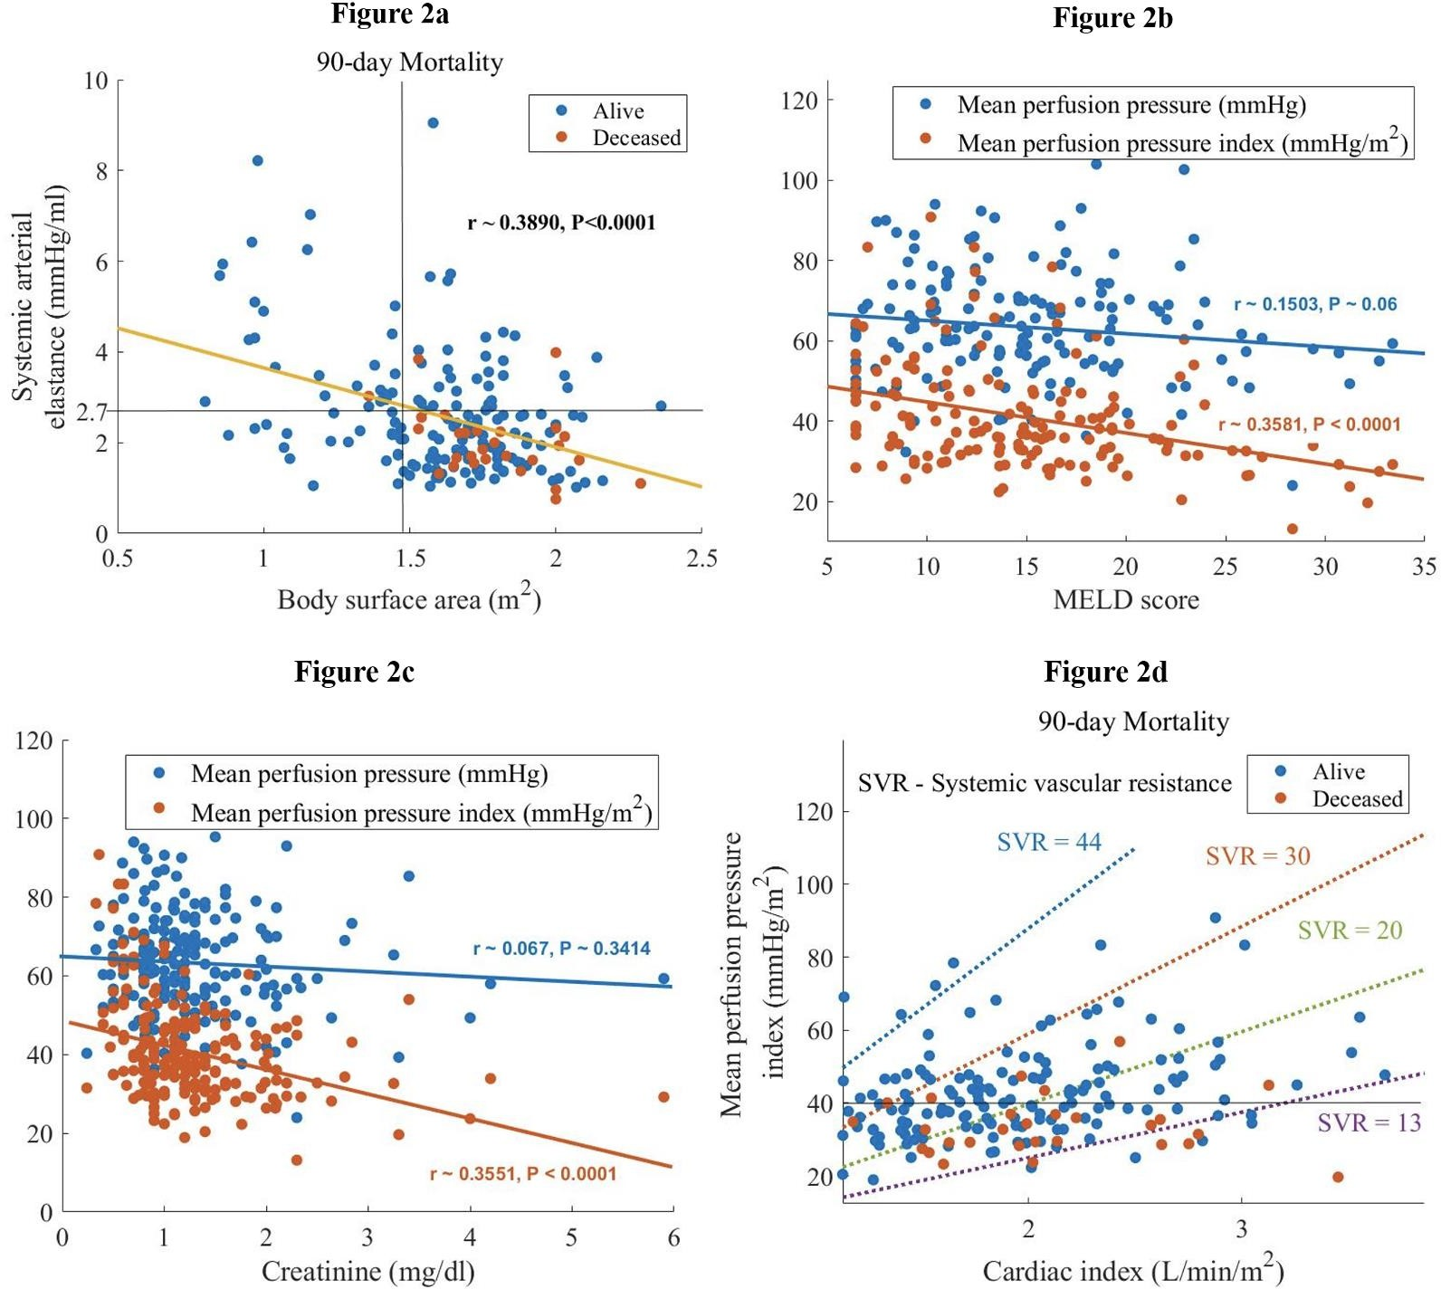

Slide 23
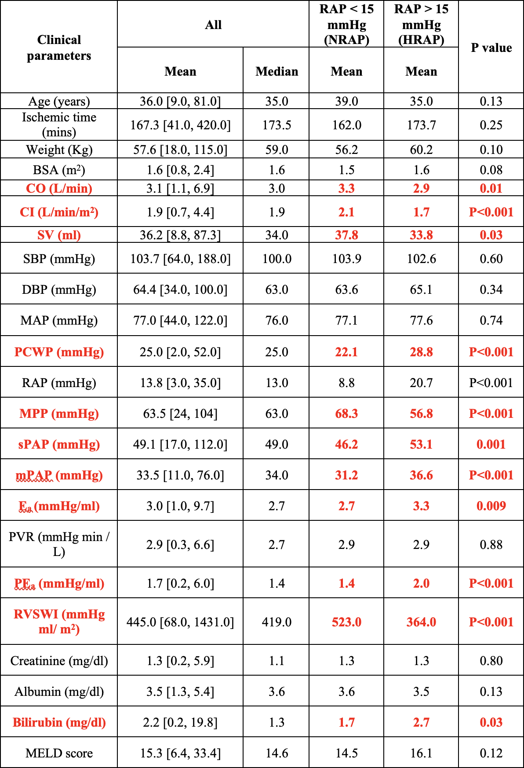

Slide 24
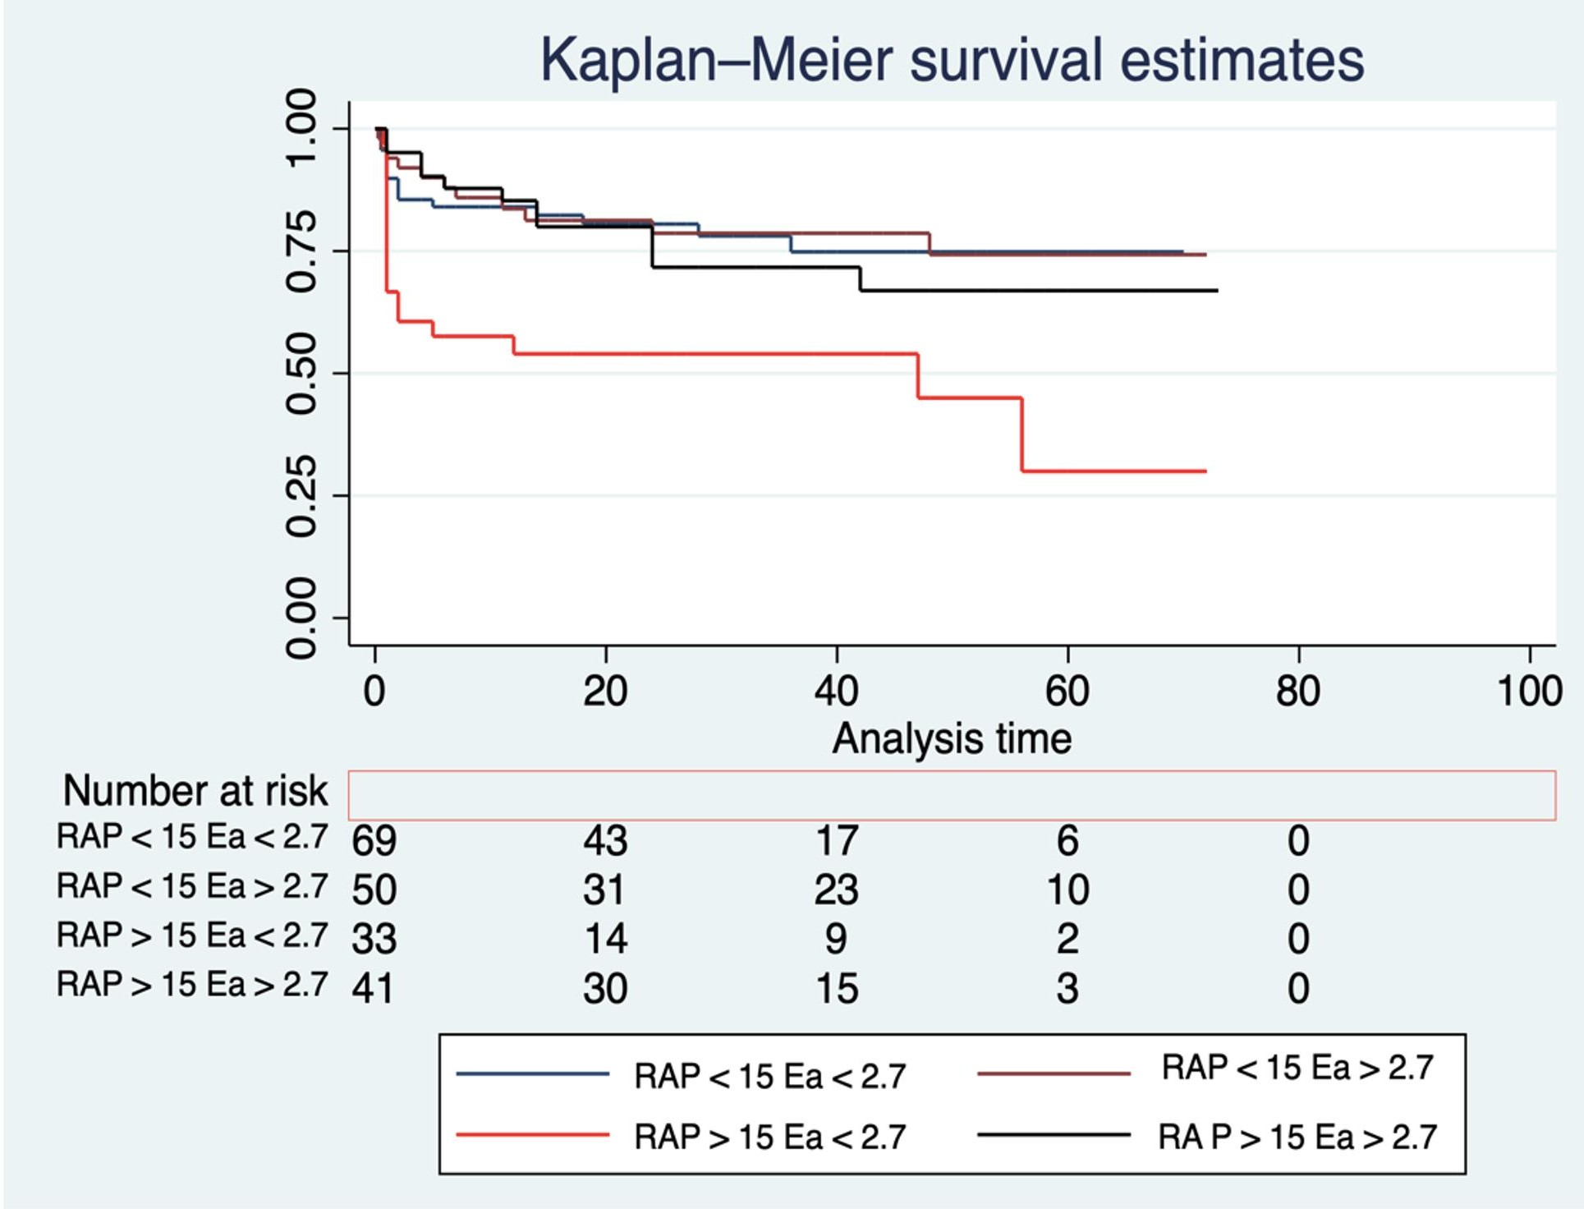
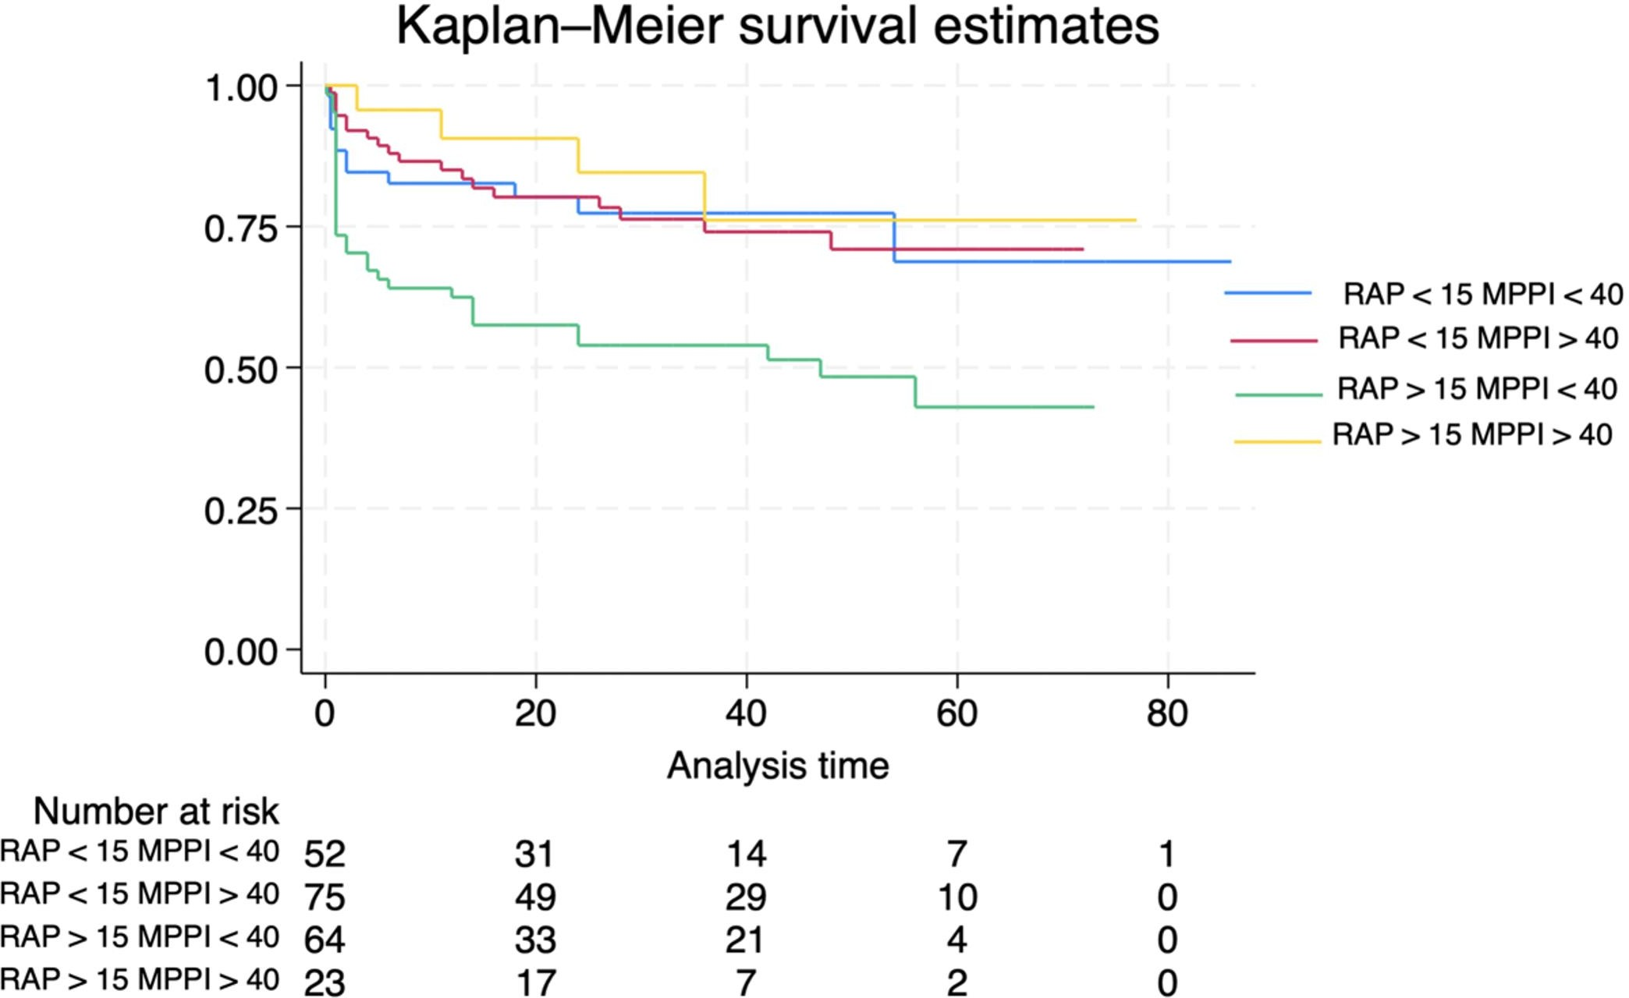

Slide 25
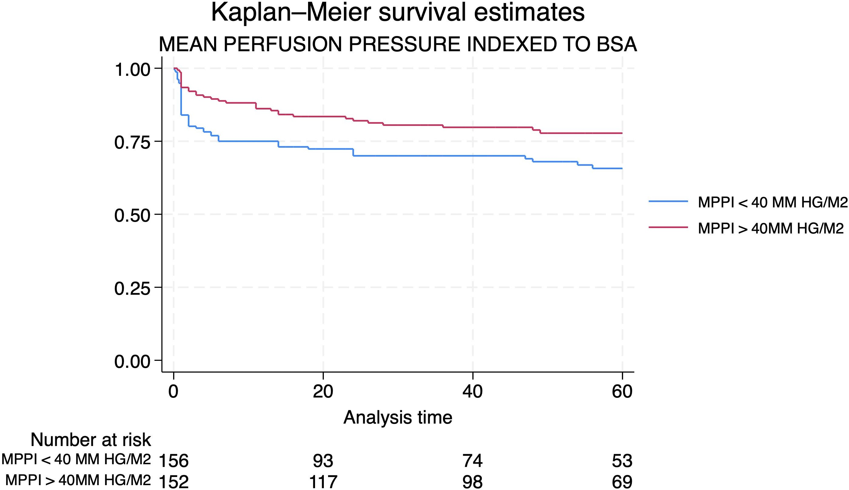
Log rank ~0.02

Slide 26
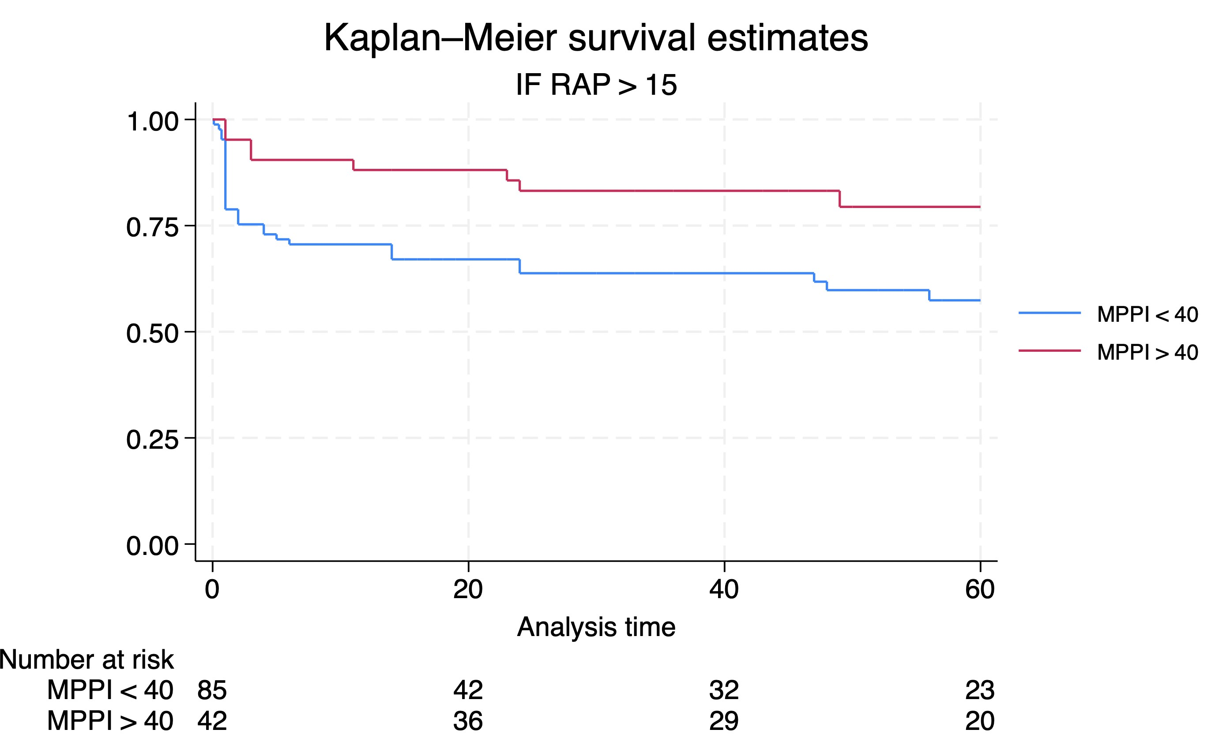
Log rank ~0.02

Slide 27
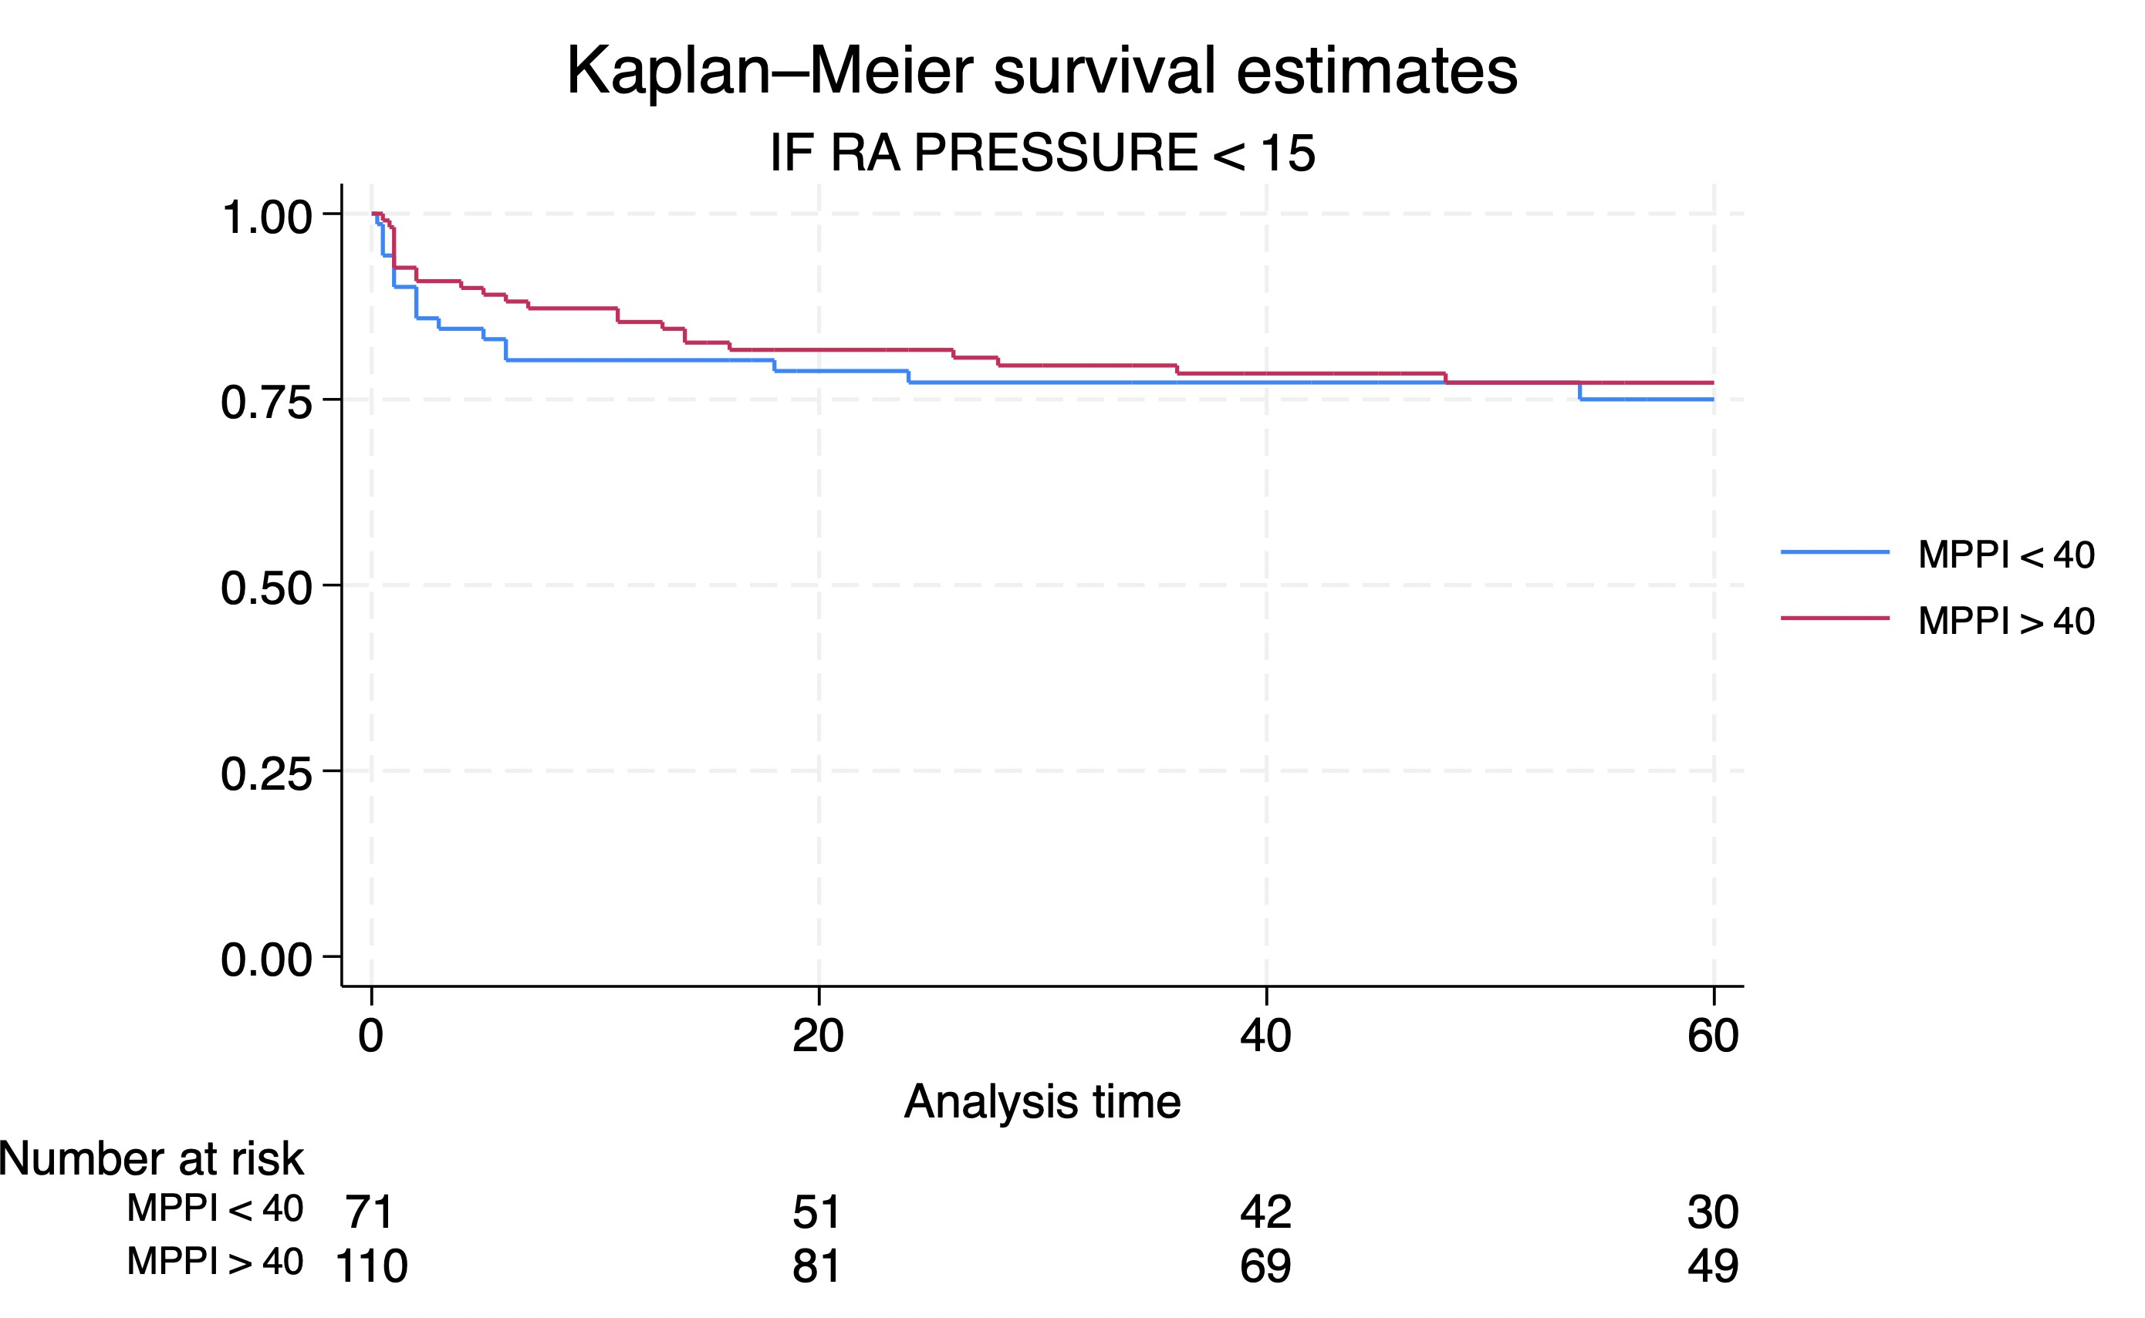

Slide 28
WHY IS BODY SURFACE AREA IMPORTANT IN HIGH PRE TRANSPLANT VENOUS PRESSURE ??

Slide 29
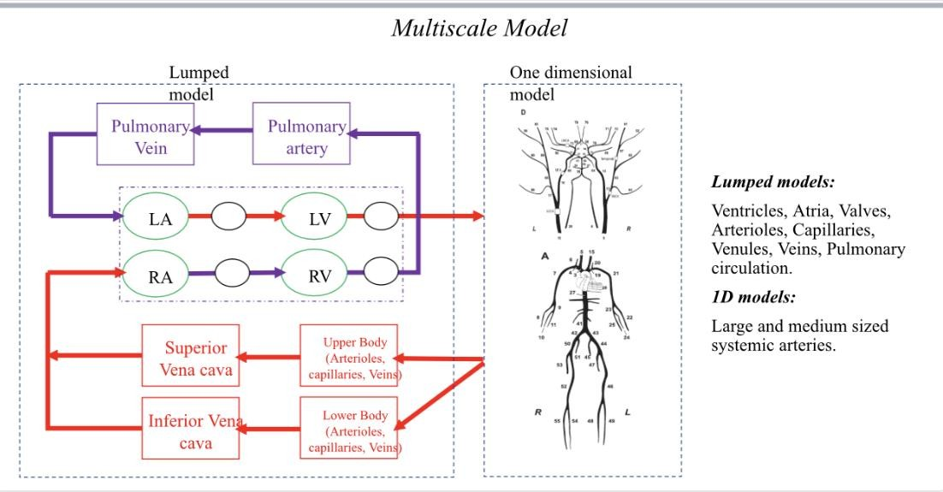
MATHEMATICAL MODEL IN COLLABORATION WITH DEPT. ENGINEERING DESIGN,IIT,MADRAS. PROF KRISHNA KUMAR AND DR G RAJAGOPALAN
TO UNDERSTAND HEMODYNAMICS OF BIVENTRICULAR DYSFUNCTION
A multiscale model of the entire cardiovascular system, including a 1D arterial
tree coupled with a lumped model of the rest of the circulation and baroreceptors, was developed to understand the complex hemodynamics of this subset of patients better. This was also used to generate virtual patients based on the measured clinical data.
Virtual PV loops of the right and left ventricles and respective atrial pressures were generated for the following conditions.
NORMAL LV AND RV FUNCTION
LV DYSFUNCTION
BIVENTRICULAR DYSFUNCTION
EFFECT OF VASODILATATION ON LV AND BIVENTRICULAR DYSFUNCTION
EFFECT OF IABP ON LEFT AND BIVENTRICULAR DYSFUNCTION
COMBINED EFFECT OF VASODILATATION AND IABP ON LEFT AND

Slide 30
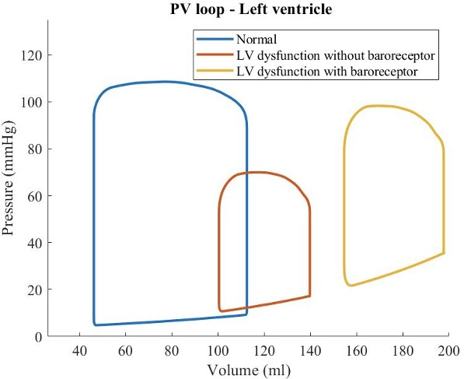
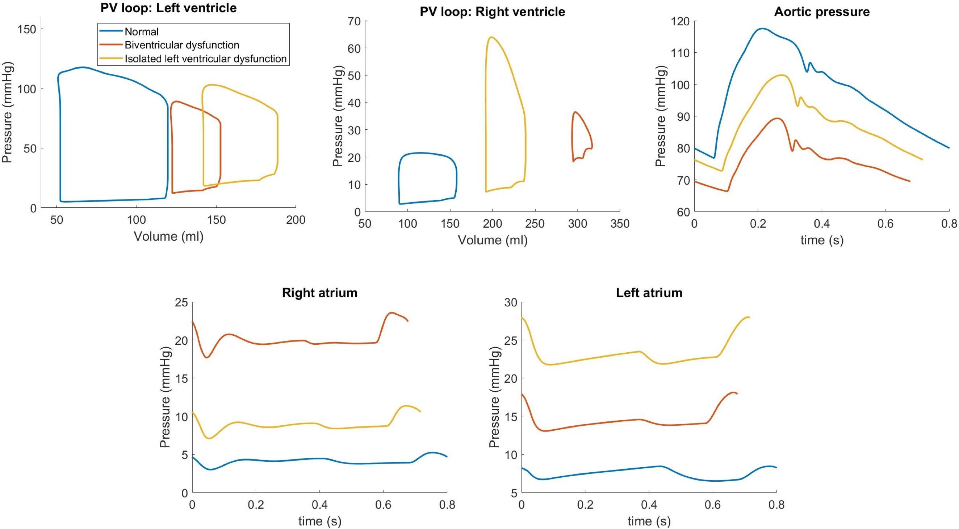
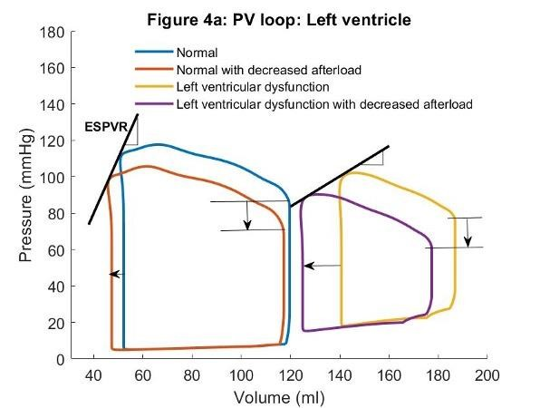
BIVENTRICULAR DYSFUNCTION PATIENTS HAVE WORSE HEMODYNAMICS
EFFECT OF BARORECEPTORS CRUCIAL
VASODILATORS ONLY LOWER THE BLOOD PRESSURE WITH NORMAL LV FUNCTION BUT INCREASE STROKE VOLUME IN LV DYSFUNCTION DUE THE DIFFERENCE IN SLOPE OF ESPVR

Slide 31
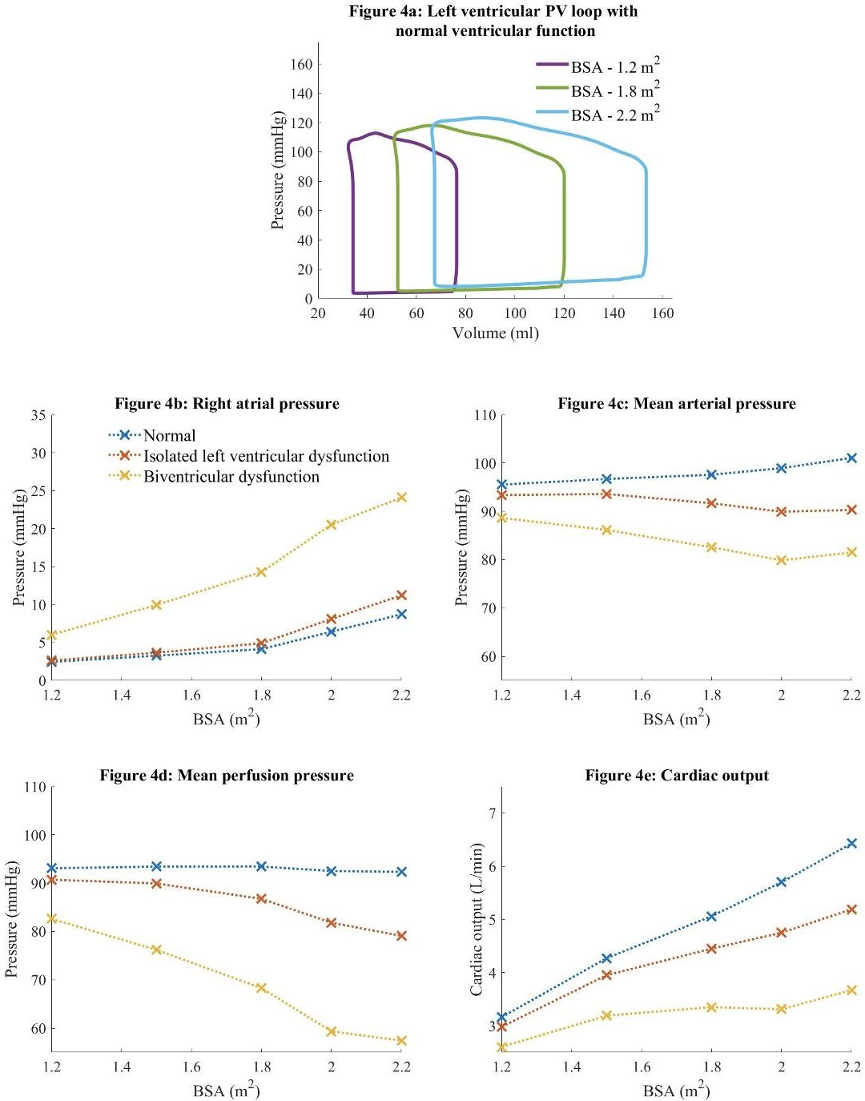

Slide 32
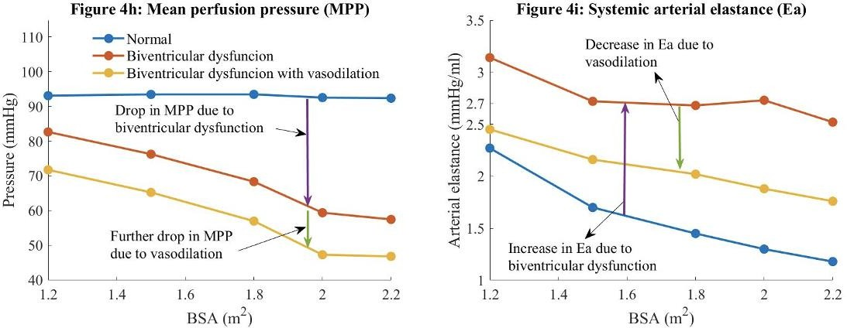

Slide 33
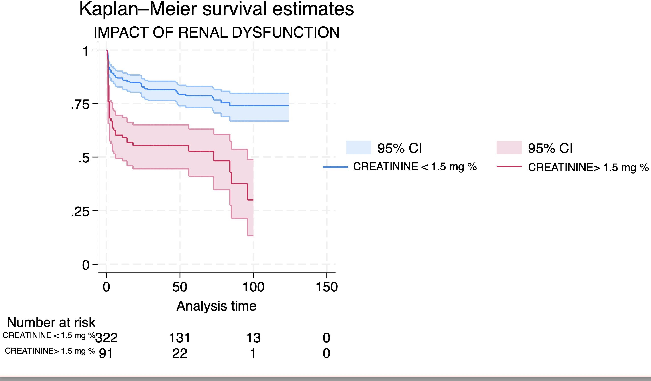
EGFR was less than 70 ml/mt/m2
with a median value of 37.92.
Older age more than 50 (Hazard ratio (HR 2.82)),

Slide 34
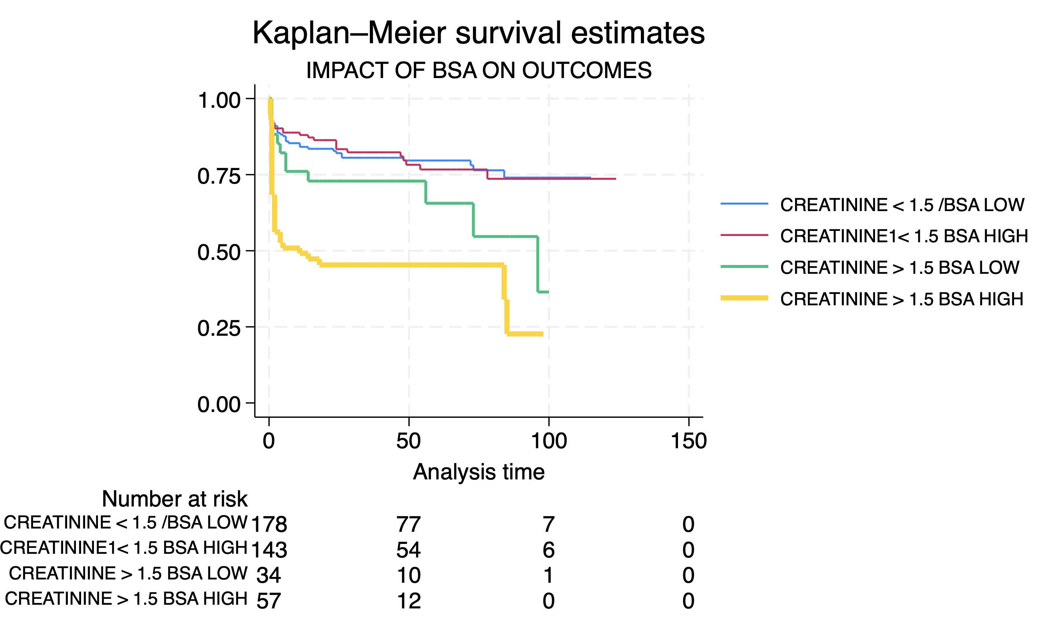

Slide 35
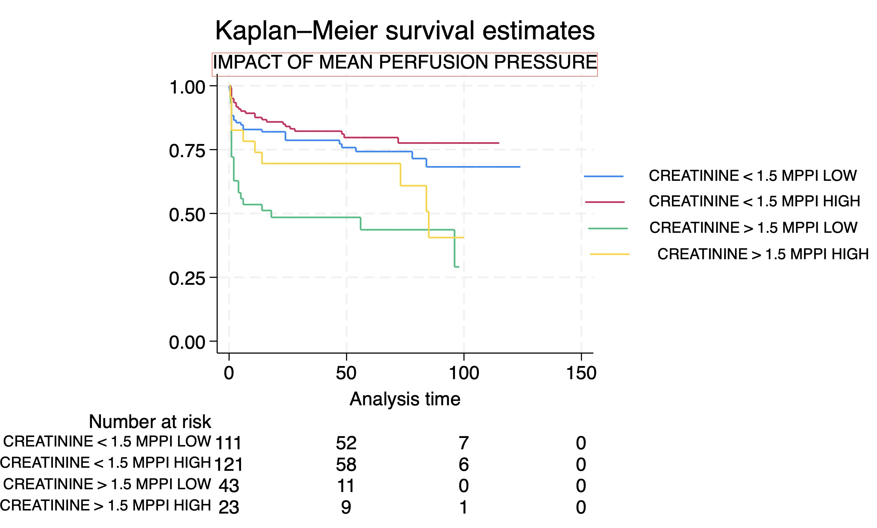

Slide 36
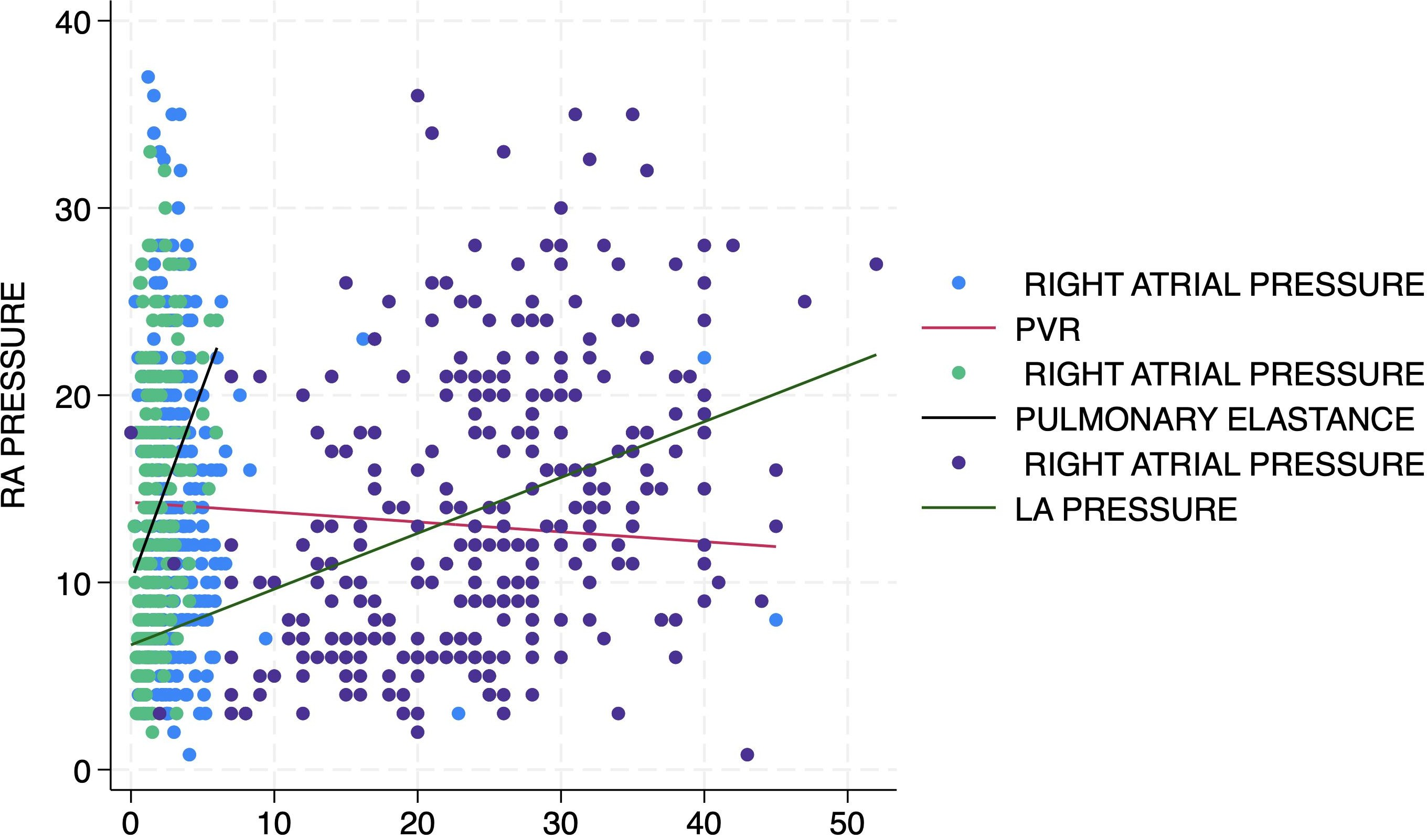
DETERMINANTS OF RV DYSFUNCTION IN PATIENTS WITH LV DYSFUNCTIO
PULMONARY ELASTANCE (PEa)= PA SYSTOLIC PRESSURE / STROKE VOLUME
CAPTURES BOTH PULSATILE AND RESISTIVE LOAD
R2 0.0931p~0.000
R2 0.1313P~0.000
LAP
PEa
PVR
R2 0.0007P~0.6310

Slide 37
IF HIGH PEa LEADS TO HIGH RA PRESSURE AND LOW ARTERIAL ELASTANCE (Ea) IN HIGH RA PRESSURE IS A RISK FACTOR,THEN RATIO OF PEa / Ea SHOULD AFFECT HEMODYNAMICS

Slide 38
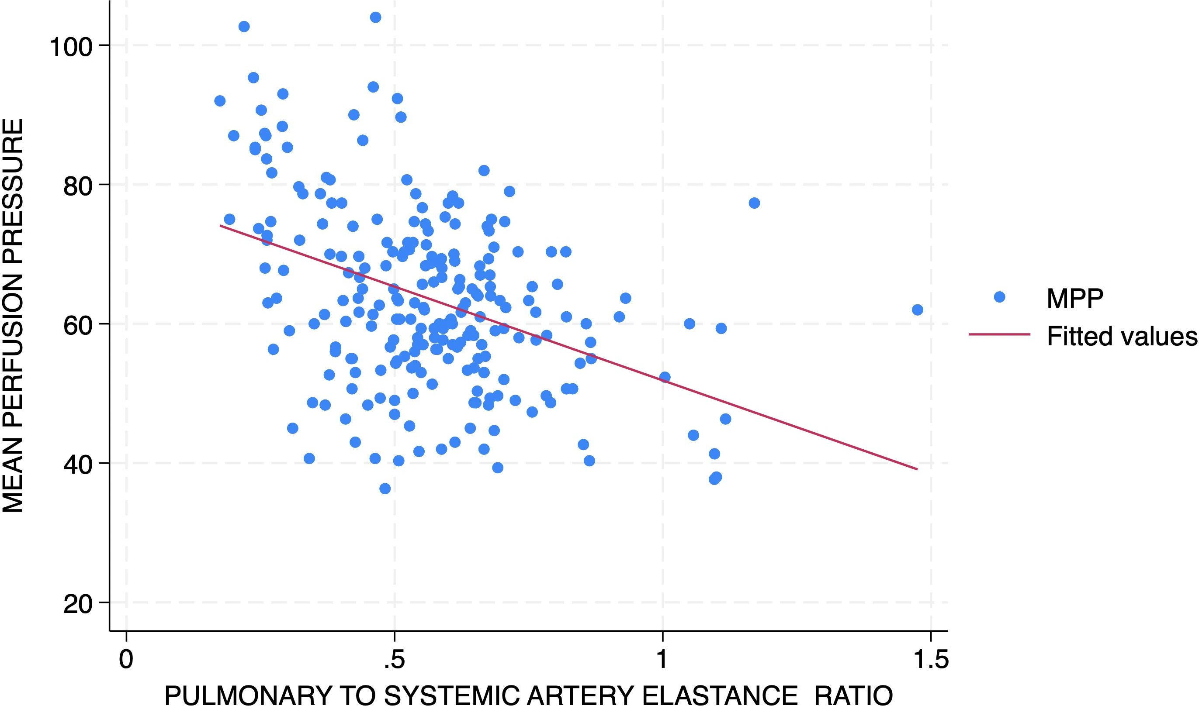

Slide 39
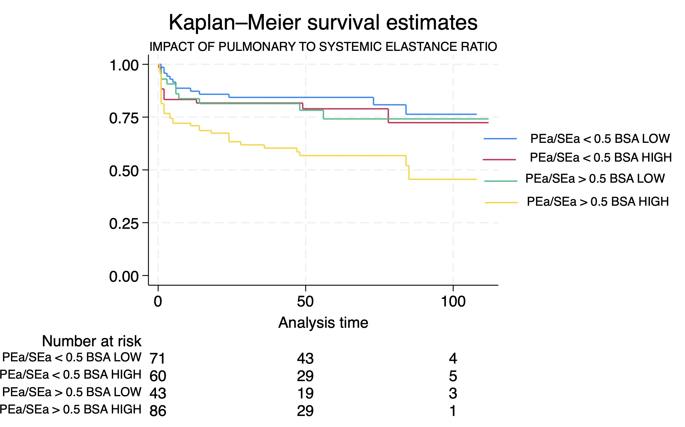

Slide 40
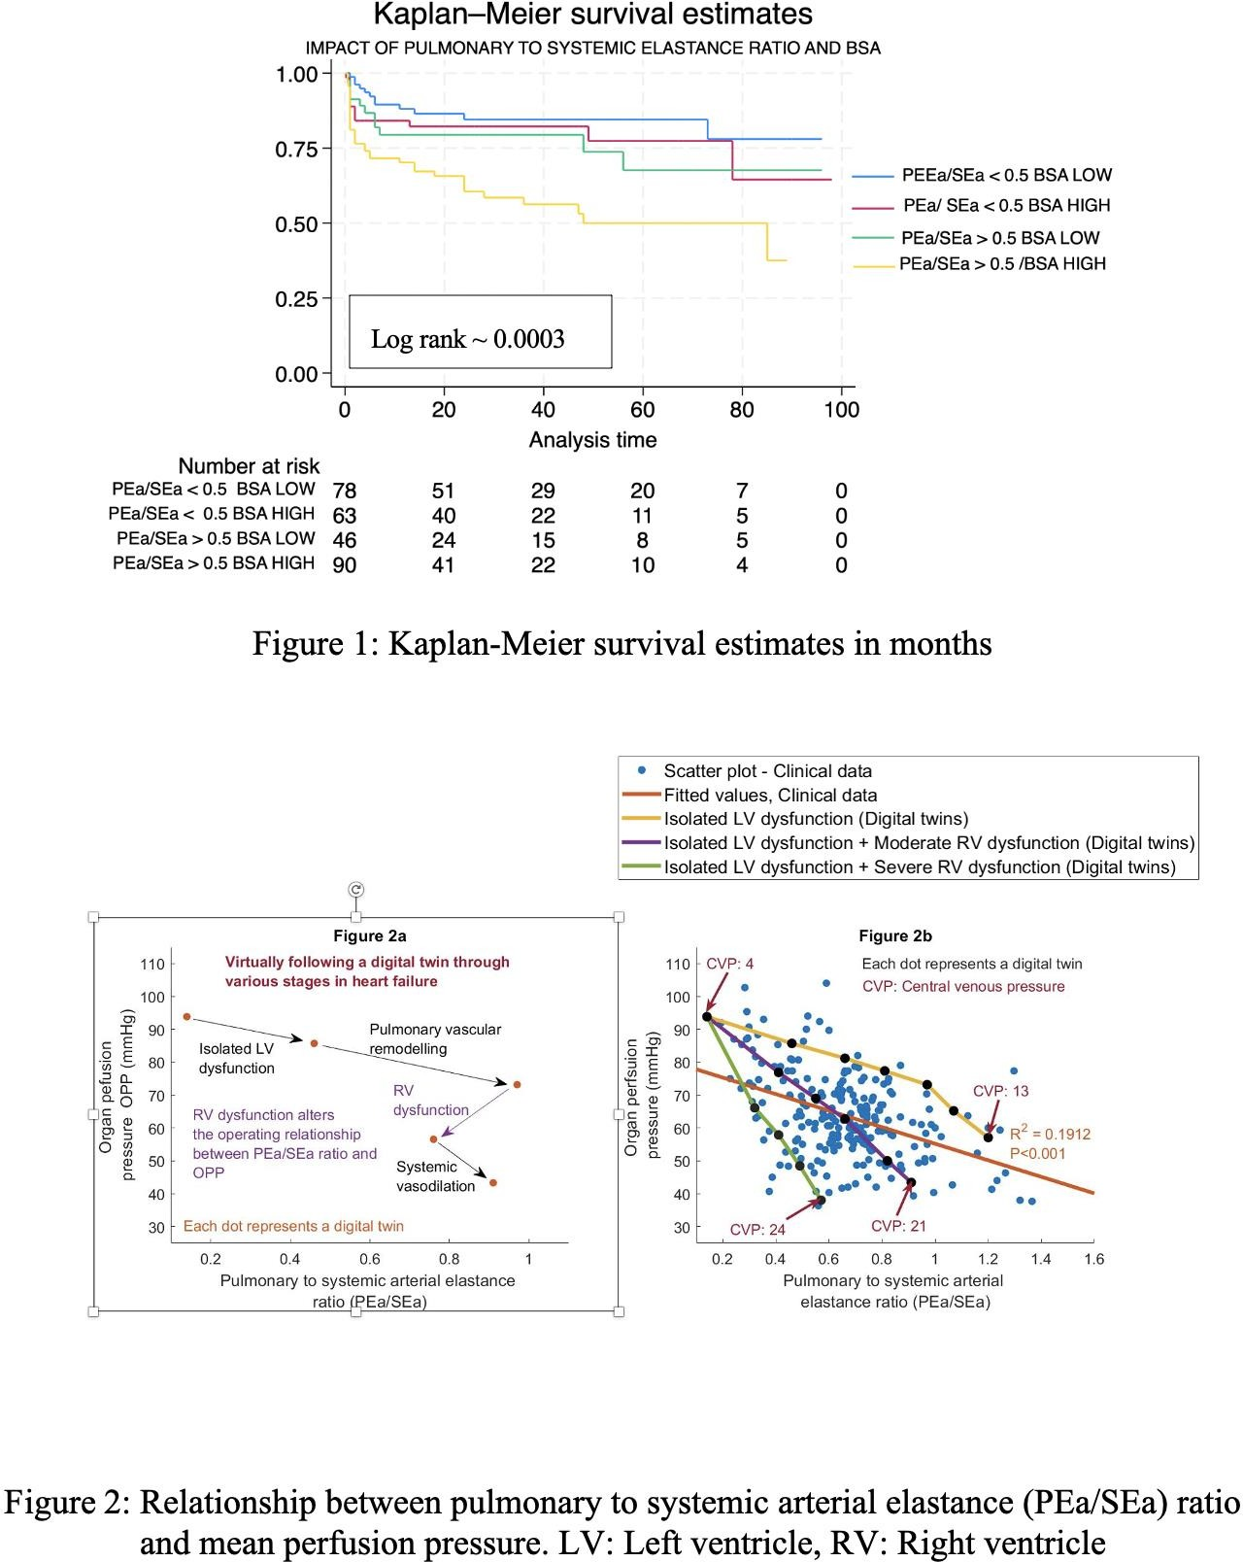
MODEL OF BIVENTRICULAR HEART FAILURE USED TO GENERATE DIGITAL TWINS TO EXPLAIN THE SCATTER

Slide 41
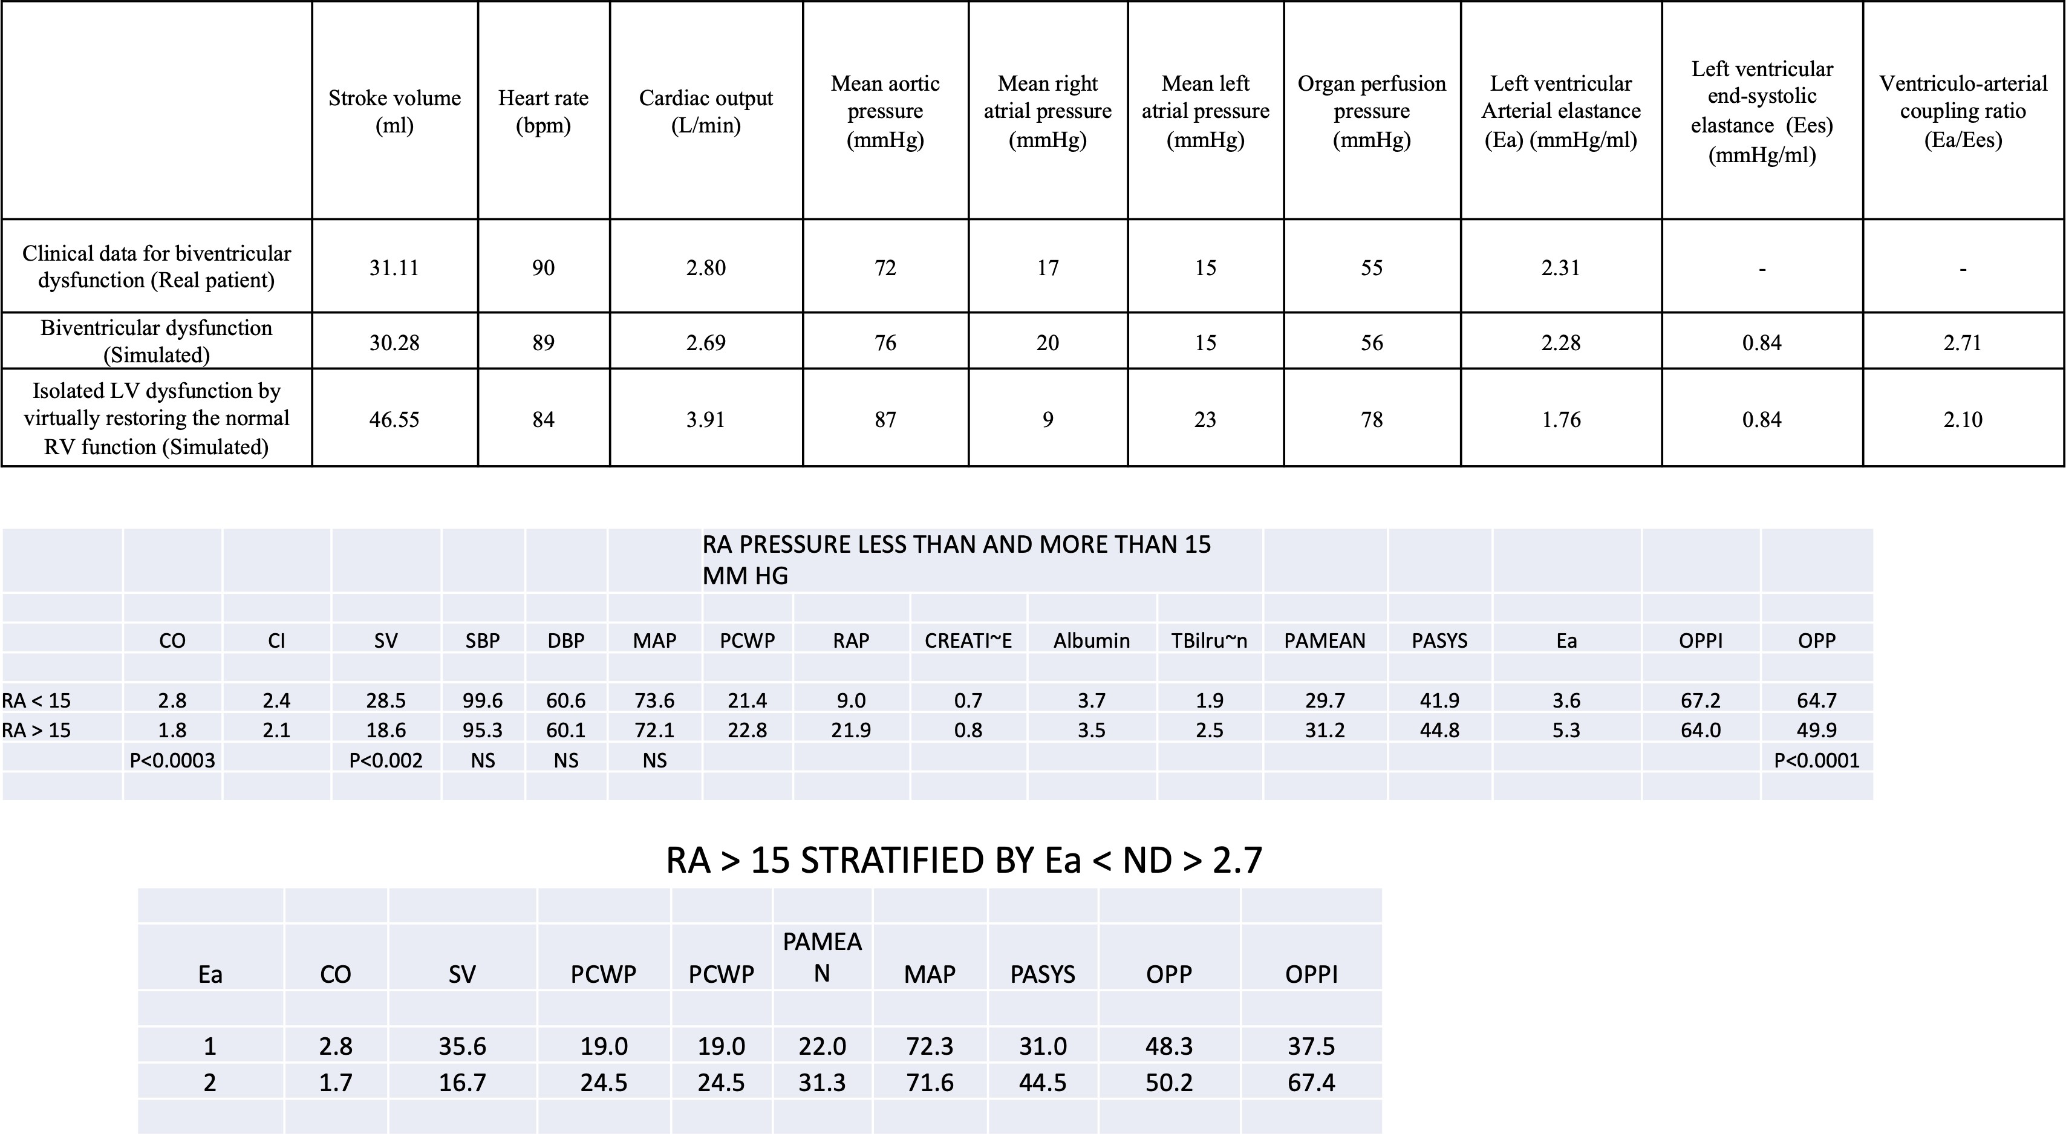
PATIENT WITH BIVENTRICULAR DYSFUNCTION, RV FUNCTION WAS VIRTUALLY RESTORED TO NORMAL TO CONVERT IT INTO AN ISOLATED LV DYSFUNCTION
AND
BIVENTRICULAR DYSFUNCTION PATIENTS ARE SICKER WITH LOWER CO,STROKE VOLUME,OPPI,HIGHER Ea
VASODILATOR THERAPY NEEDS CAREFUL MONITORING

Slide 42
CONCLUSIONS
Low MPP in the presence of high RAP is associated
with worse outcomes after heart transplantation, especially in patients with higher BSA.
In patients with high RAP, the acceptable blood
pressure during vasodilator therapy needs to be higher, especially in patients with higher BSA.
MPPI less than 40 mmHg/m² seems significant across different body sizes.

Slide 43
CONCLUSIONS
PRESERVED RENAL FUNCTION CRUCIAL FOR EXCELLENT LONG TERM RESULTS
RISING PEa / ARTERIAL ELASTANCE RATIO IN PATIENTS WITH LV DYSFUNCTION SHOULD PROMPT REFERAL FOR ADVANCE HEART FAILURE THERAPY
EXCELLENT LONG TERM RESULTS ARE POSSIBLE EVEN IN A RESOURCE CONSTRAINED ENVIRONMENT

