Slide 1

Method-specific reporting for reproducible competing-risk
prediction in Stata
Our thoughts on what can be reported by authors publishing competing risks prognostic models, to ensure smooth external validation?
Aisha Vayani, MSc | Professor Mark Rutherford, PhD
Biostatistics Research Group, University of Leicester
Contact email address: av248@leicester.ac.uk
UK Stata Conference 2026 | London | 3–4 September
Notes:
Aim: create a reporting recommendation, that complements existing guidances like TRIPOD, to advise analysts publishing competing risks prognostic models, on what we think should be released from their work, to ensure that if an external validator was to try and recreate their predictions on their own dataset, they would not need to make large guesses or find it impossible to do without needing to contact the author for further information. These are just our thought processes on how one can ensure competing risk prognostic models can be transparently reported.

Slide 2
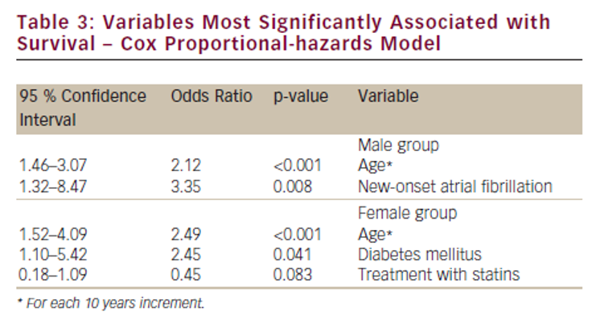
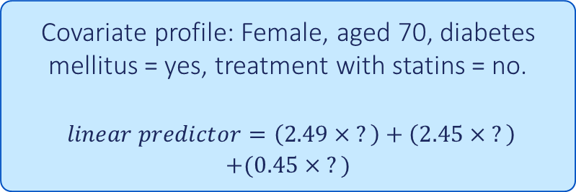
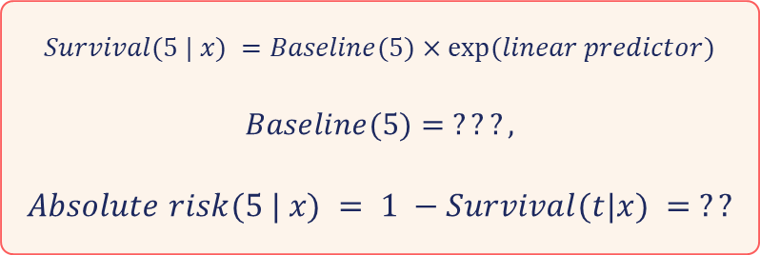
A simple Cox prediction
Under proportional hazards
Worked 5-year example
Covariate profile: Female, aged 70, diabetes mellitus = yes, treatment with statins = no.
$linear predictor=\left(2.49× ?\right)+\left(2.45× ?\right)$
$$+(0.45× ?)$$
$$Survival(5 | x) =Baseline(5)×exp⁡(linear predictor)$$
$$Baseline(5)= ???,$$
$$Absolute risk(5 | x) = 1 −Survival(t|x) = ??$$
Miriam Shteinshnaider, Dorit Almoznino-Sarafian, Sylvia Berman, Irma Tzur, Natan Cohen, Oleg Gorelik, Gender-related Differences in Clinical Variables Associated with Survival of Patients with Atrial Fibrillation, European Cardiology 2012;8(3):152–7
https://doi.org/10.15420/ecr.2012.8.3.152
We need the baseline function, full set of coefficients and the covariate coded values.
A hazard ratio alone cannot recover the absolute risk.
2
A familiar starting point
Notes:
Start with a simple Cox model to show the reporting problem. On the left side is a results table pulled from a paper we found online. This was not a prognostic model, just a descriptive study looking at gender differences in survival. But it shows the problem we are talking about.
If we were interested in recreating and predicting the absolute risk for any patient: eg a 70 year old female with diabetes and no statin treatment, how would we do this?
First we would calculate the linear predictor, which is a combination of the relevant coefficients (in the blue rectangle) and the covariate coded value. But in this case we don’t know what a 70 year old would be coded as: The paper says 10 year increments but we don’t know if that’s from 0 or say 50. We also don’t know what no statin treatment is coded as: is it 0 or some other value?
The survival at 5 years for this patient is calculated as the baseline surv at 5 years times the exp of the linear predictor. While we might be able to guess and calculate the linear predictor, We don’t know what the baseline survival is at 5 years. Hence, the absolute risk, given as 1 – the surv probability, is impossible to estimate with just the hazard ratios. We need to know the baseline function, coefficients and the covariate coded values.

Slide 3

Competing risks
Colorectal
cancer death
The competing event removes the possibility of a later cancer death.
Colorectal cancer
diagnosis
Other-cause
death
Target: a cause-specific cumulative incidence function (CIF)
CIF$ₖ(t|x) = P(T ≤ t, J = k | x)$
Probability of cause k by time t, knowing that another cause could occur first.
Competing risks
3
Notes:
Now we add competing events to the picture. In this example, a person diagnosed with colorectal cancer can have one of 2 outcomes: colorectal cancer death or death due to other causes. If the event of interest is death from colorectal cancer, then death from another cause is considered a competing event because Once a competing death has occurred, a later cancer death is no longer possible.
The prediction target is therefore the cumulative incidence function, or CIF. calculates the probability that a person experiences event k on or before time t, while taking into account that other competing events could happen first. (T is the time until an event occurs).

Slide 4
Reporting needs differ by competing-risks model
CIF based models
Cause-specific hazard models
Fine-Gray models
Flexible parametric models (FPMs)
Models the CIF directly
Fit one cause-specific hazard model for every cause
Under proportional subhazards: coefficients + baseline CIF
Report the fitted components for every model
Separate cause models don’t always form a coherent joint risk
State how the models are combined to obtain the CIF
Time dependent effects makes the reporting more complex
Model-specific reporting
4
Notes:
There are two broad modelling frameworks for competing risks, cif-based and cause specific hazard models, and the information needed for prediction is not identical across them.
Fine-Gray models target the CIF. Under proportional subhazards, Fine-Gray is similar to a cox model, where we combine coefficients with a baseline CIF. If we were interested in more than one cause of death, we would need to fit separate models for each cause. However, this is not ideal as the join risk may not always add up to 1. And if effects change over time, then that transfer becomes more involved.
The cause-specific framework instead fits a model for every cause and then combines them using integration methods. For this presentation I am keeping the focus to flexible parametric models as they’ve been shown to be favoured. They also make the reporting problem clear because of the amount of components one would have to manually report to ensure one can recreate the model. In addition, one would also need to state how the different models come together to predict the CIF.

Slide 5
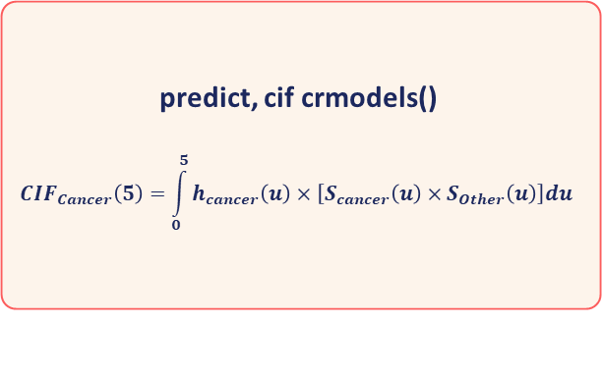
Two cause-specific models produce one cancer-death CIF
Cancer-death model hazard
h₁(t | x)
predict, cif crmodels()
$$CIF_{Cancer}\left(5\right)=\int_{0}^{5}{h_{cancer}\left(u\right)×\left[S_{cancer}\left(u\right)×S_{Other}\left(u\right)\right]du }$$
5-year
cancer-death
CIF
Other-cause model hazard
h₂(t | x)
Cause-specific workflow
5
Notes:
Expanding on that, this is the prediction workflow for an FPM. We first fit a model for each cause of death and then combine them to obtain the CIF..
This done by multiplying The cancer hazard (prob of dying from cancer) by the total survival probability from all causes, integrated from zero to the prediction time.
In Stata, the predict command with cif and crmodels performs this calculation for us behind the scenes.

Slide 6
Fit and save one stpm3 model for each cause
Cause 1: colorectal cancer death in 1975-84 dataset
use "internal.dta", clear
stset surv_yy, failure(status==1) id(id) exit(time 5)
stpm3 i.stage i.sex ///
@rcs(age, df(3) winsor(2.5 97.5)) ///
i.stage#i.sex, ///
df(3) ///
tvc(i.stage @rcs(age, df(3) winsor(2.5 97.5))) dftvc(2) ///
scale(lncumhazard) initvaluesloop
estimates store M_time_cancer
estimates save "M_time_cancer.ster", replace
Repeat for other-cause death
Use the same model form.
Change only:
failure(status==1)
↓
failure(status==2)
Then save M_time_other.ster
Same model structure for simplicity, with different failure definitions.
Fit both causes
6
Notes:
This is the Stata implementation for the first cause. We used a colorectal cancer dataset from 1975-84 to fit a model. We declare survival data using stset, with survival time in years, event of interest as status=1 for colorectal cancer death and set the exit time as 5 years since diagnosis.
The stpm3 command then fits the model on the log cum hazard scale. We allow main effects for stage, sex and age and an interaction term between stage#sex. Age is modelled using restricted cubic splines with 3 df and the effect of age is constant in the upper and lower 2.5th age percentiles. We allow 3df for the baseline hazard and tde for stage and age, with 2df each.
We then store the estimation result as M_time_cancer and save it as a ster file. For other-cause death we run the same model form, changing the failure definition to status=2, and save the second object as M_time_other.ster. Weve fitted the same model for simplicity but these can be changed.
Initvaluesloop allows looping over different initial models.

Slide 7
Restore both models and predict the 5-year CIF
Restore fitted models in 1985-94 colorectal dataset
Predict the 5-year cancer-death CIF
use "external.dta", clear
stset surv_yy, failure(status==1) id(id) exit(time 5)
estimates use "M_time_other.ster"
estimates store M_time_other
estimates use "M_time_cancer.ster"
estimates store M_time_cancer
gen prediction_time = 5
predict cif5, cif ///
crmodels(M_time_cancer M_time_other) ///
crnames(cancer other) ///
timevar(prediction_time) merge
rename cif5_cancer predicted_cif5
rename cif5_other predicted_other_cif5
Predict performs the integration. Matching variable names, covariate coding and compatible Stata versions are assumed.
Predict with crmodels()
7
Notes:
For external validation we use a colorectal dataset from 1985-94 and again recreate the same survival-data structure. Then, we restore both fitted models and store them in Stata memory.
On the right, we use the predict command with the cif option to calculate the 5 year CIFs. Over here, weve told stata the names of the fitted models, and use crnames() to give a variable name to the cif estimates generated.
This is an idealistic scenario which assumes that between the two datasets; Variable names match, reference levels and transformations are identical, and the Stata and commands versions are compatible with the saved objects.

Slide 8
Manual reconstruction requires both cause-specific models
Each fitted model
Combining step
Time scale, units and outcome definition
Formulas to calculate the overall survival and hazards for each cause
Covariate definitions and coding
Integration formula and time grid used to calculate the CIF
Model scale and baseline spline basis and knots
All coefficients, including intercept and baseline terms
Non-linear and TDE predictor basis and knot locations
×2
Minimum for manual reconstruction
8
Notes:
If the fitted objects were not available, this is what manual reconstruction would require.
Everything on the left must be supplied for each cause: the time scale with units and the outcome definition, the exact covariate definitions and how they were coded, the model scale, what baseline spline was used and location of knots, the complete coefficient vector, the basis and knot locations for any non-linear or TDE covariates.
Then we still need the right-hand side: the formula for calculating the overall survival and hazards from the model. and the integration formula and time gid used to calculate the CIF.
The list is quite useful because it shows the reporting problem and explains why releasing an ster file can be a practical aid.

Slide 9
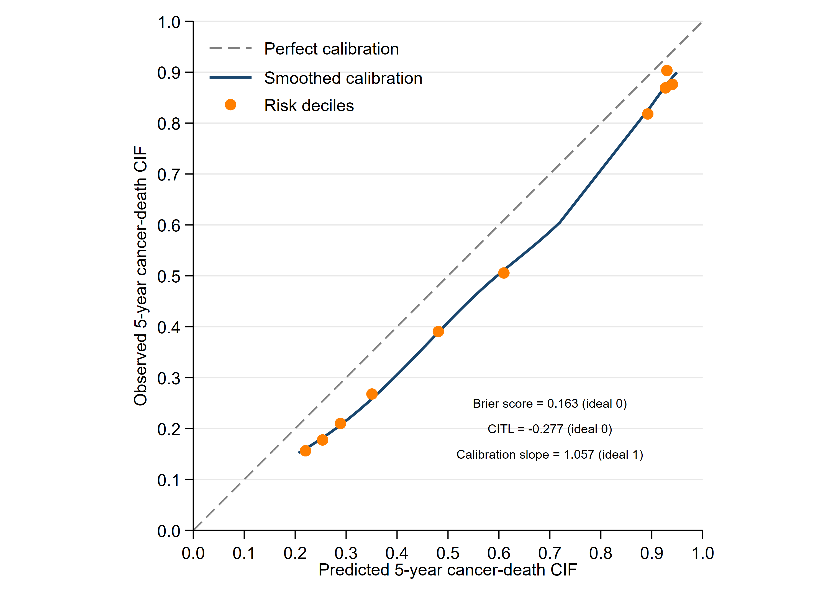
Calibration with calplotcr
Assess calibration in 1985-94 colorectal dataset
Predicted versus observed 5-year CIF
* Predicted-risk groups
xtile rg_cancer = predicted_cif5, nq(10)
xtile rg_other = predicted_other_cif5, nq(10)
gen validation_data = 1
stset surv_yy, failure(status==1 2) id(id) exit(time 5)
calplotcr predicted_cif5 predicted_other_cif5, aj ///
models(M_time_cancer M_time_other) ///
eventvar(status) events(1 2) timepoint(5) ///
riskgroups(rg_cancer rg_other) ///
datavar(validation_data 1) bin(10) ///
rcsrmsknots(5)
Ideal calibration follows the 45° line. Here the curve is mostly below it: the older model overpredicts risk in the later period.
Worked validation example
9
Notes:
And now Once we have patient-level predictions, we can then assess calibration (i.e. measuring agreement between observed and predicted cifs).
We initially split the predicted cifs into 10 equally sized risk groups. The code then uses calplotcr, a user-written Stata command described by Mozumder and colleagues. Here, we tell stata the names of our two CIF variables. We use the aj option for observed cifs to be calculated using the Aalen-Johansen estimator. Models( ) names the two stored models, eventvar(status) events(1 2) identifies and maps the variable and its event code.
riskgroups(rg_cancer rg_other) gives the pre-created risk groups for each cause. bin(10) requests ten grouped calibration points. and rcsrmsknots(5) fits the smooth calibration curve using rcs with 5 knots. This generates the plot on the right.
The horizontal axis is predicted five-year cancer cif. The vertical axis is the corresponding observed cancer cif. Perfect agreement lies on the 45-degree line.
Here, our calibration curve is below the line, which means the earlier model overpredicts in the later cohort. That is plausible because both cancer and other-cause mortality can change and improve over calendar time.
Our focus was on using calplotcr, but other metrics can also be calculated such as brier score or CITL (shown in the graph with their ideal values in brackets)
Rcsknots() used when you want manual control over knot locations
Rcsrmsknots() used when you want stata to automatically assign standard percentiles for a chosen number of knots

Slide 10
A .ster file is one practical Stata-to-Stata route
.ster + prediction code
Still report clearly
Preserves fitted components
Covariate coding
Avoids manual transcription of fitted components
Event definition, prediction time points and units
Easier route for validation within Stata
Software and command versions
The object reduces transcription. It does not replace transparent reporting.
Recommended Stata release
10
Notes:
Our current advised route is therefore to release all ster files in a published prognostic model.
The advantage is convenience. The objects preserve the fitted components and reduces the need to manually report them. This could make external validation much easier, especially when the validator is also working in a compatible Stata environment.
But the object is not self-sufficient. Authors still need to transparently report the covariate coding, event definitions, prediction time points and units, software and command versions. We should also be cautious about long-term portability across Stata and package versions. So this is one practical route, not a claim that ster is a permanent solution.

Slide 11
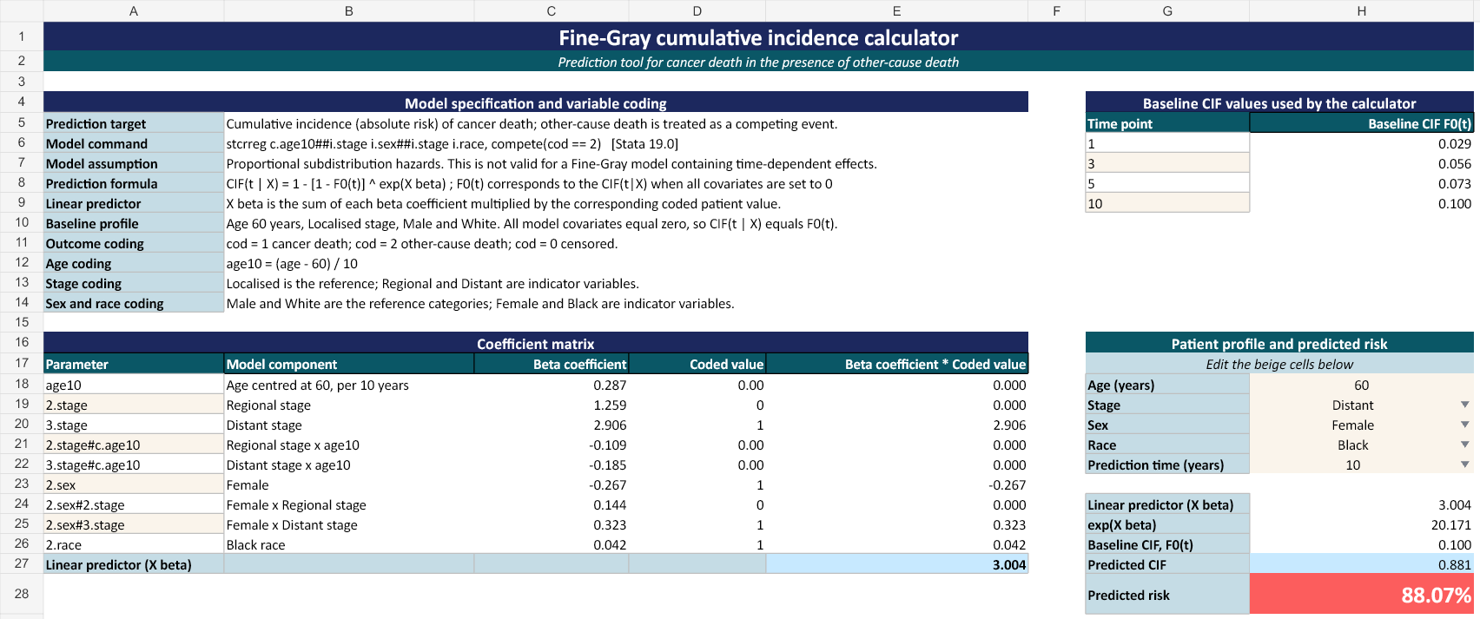
An Excel workbook alternative
Visible coefficients, covariate coding, baseline CIFs and the prediction formula
Notes:
We have also built a software-neutral reconstruction workbook as an alternative illustration.
The workbook makes all the ingredients feeding into the prediction visible. For a Fine-Gray model, it combines a selected covariate pattern with coefficients and a baseline CIF. For FPMs it is more involved to create this because both models must be shown, including the entire integration process over time.
I do not see the workbook as a replacement for the model object when the original Stata implementation is available. Though it is a possible fallback if object formats change or another software environment is used. It also shows how much information manual reconstruction actually requires.

Slide 12
This is what have we learned so far
1
2
3
Competing risks reporting are method-specific
Model objects are a practical reporting aid
Software-neutral tools can be an alternative
Cause-specific models with splines and time-dependent effects increase the reporting requirement.
Useful for validating models in Stata. Doesn’t replace transparent reporting. Limited to users who know and have a Stata licence.
Possible fallback for situations such as changes to the format of an .ster file.
This is work in progress. We welcome any feedback
Conclusions
12
Notes:
We have three lessons we have learnt from this work in progress.
First, the exact reporting requirements for competing risks models are method-specific. Cause-specific prediction is particularly demanding because separate models, spline functions and time-dependent effects all feed into a single CIF.
Second, fitted objects can be a practical aid to reporting and make validation easier in Stata, but they do not replace transparent reporting. They may also be limited to users who know and have a license to use stata.
Lastly, a software-neutral tool may be useful as an additional safeguard for situations such as changes to formats of ster files or even validators using a different platform such as R.
This is work in progress. weve laid out our ideas, but these are not the only possible solutions for transparent reporting. We ofcourse welcome any feedback.

Slide 13
References
Fine JP, Gray RJ. A proportional hazards model for the subdistribution of a competing risk. JASA 1999;94:496–509.
Andersen PK, Klein JP, Rosthøj S. Generalised linear models for correlated pseudo-observations. Biometrika 2003;90:15–27.
Royston P, Parmar MKB. Flexible parametric proportional-hazards and proportional-odds models. Stat Med 2002;21:2175–2197.
Syriopoulou E et al. Regression standardisation with competing events using standsurv. BMC Med Res Methodol 2022;22:226.
van Geloven N et al. Validation of prediction models in the presence of competing risks. BMJ 2022;377:e069249.
Collins GS et al. TRIPOD+AI statement. BMJ 2024;385:e078378.
Royston P, Altman DG. External validation of a Cox prognostic model. BMC Med Res Methodol 2013;13:33.
Booth S et al. Temporal recalibration in competing-risk prediction models. Stat Med 2023;42:5007–5024.
Mozumder SI et al. Calibration of cause-specific absolute risk for external validation. Diagn Progn Res 2025;9:23.
StataCorp. Stata 19 documentation: estimates save/use, stpm3 and postestimation.
Lambert PC. stpm3 resources and Stata conference materials. pclambert.net/software/stpm3/.
Key sources
13

Slide 14

Thank you
Connect on LinkedIn
Questions and discussion
Aisha Vayani
Biostatistics Research Group, University of Leicester
av248@leicester.ac.uk
UK Stata Conference 2026

