Slide 1
Reference based multiple imputation;
for sensitivity analysis of clinical trials with missing data
Suzie Cro
MRC Clinical Trials Unit at UCL
The London School of Hygiene and Tropical Medicine

Slide 2
Outline
Reference based multiple imputation; asthma trial
The mimix command
Sensitivity analysis example 1; asthma trial
Sensitivity analysis example 2; peer review study

Slide 3
Example - asthma trial
Placebo vs. Budesonide for patients with chronic asthma
Forced Expiratory Volume in 1 second (FEV₁) recorded at baseline, 2, 4, 8 and 12 weeks
Primary outcome: mean treatment group difference at 12 weeks adjusted for baseline
Only 38/90 Placebo and 72/90 Budesonide were observed at 12 weeks
Busse et al. (1998)

Slide 4
Example - asthma trial
Any analysis must make an untestable assumption about the unobserved data
Wrong assumption → biased treatment estimate
Primary analysis – Missing-at-Random (MAR)
A set of analyses where the missing data is handled in different ways as compared to the primary analysis should be undertaken

Slide 5
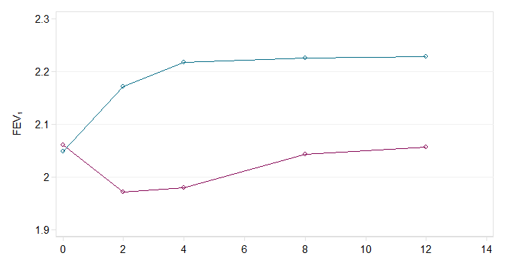
Example - asthma trial - MAR
Time (weeks)
Placebo MAR means
Active MAR means

Slide 6
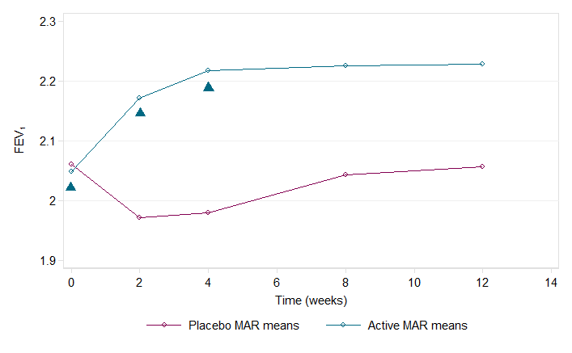
Example - asthma trial - MAR
Time (weeks)
Placebo MAR means
Active MAR means
Observed FEV₁

Slide 7
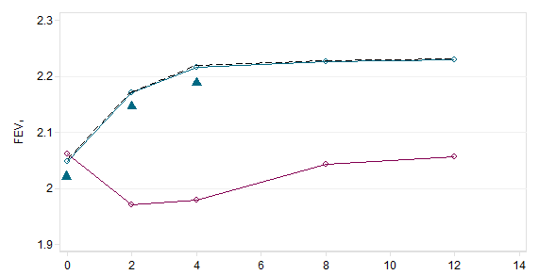
Example - asthma trial - MAR
Time (weeks)
Placebo MAR means
Active MAR means
Observed FEV₁

Slide 8
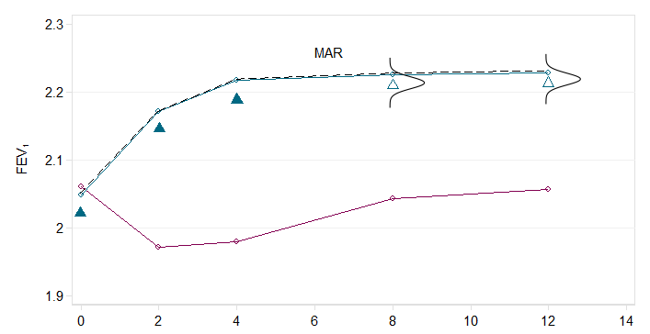
Example - asthma trial - MAR
Time (weeks)
Placebo MAR means
Active MAR means
Observed FEV₁
Imputed FEV₁

Slide 9
Multiple imputation

Slide 10
Multiple imputation

Slide 11
Multiple imputation

Slide 12
Multiple imputation

Slide 13
Multiple imputation

Slide 14
Asthma trial - MAR
Time (weeks)
Placebo MAR means
Active MAR means
Observed FEV₁
Imputed FEV₁

Slide 15
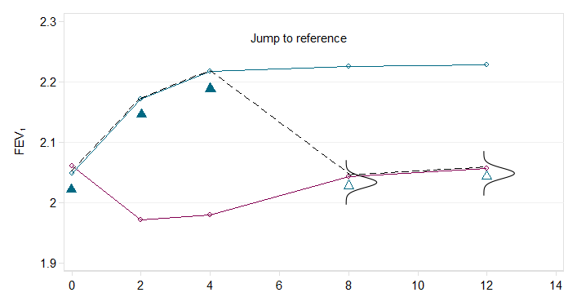
Asthma trial - Jump to reference
Time (weeks)
Placebo MAR means
Active MAR means
Observed FEV₁
Imputed FEV₁

Slide 16
Asthma trial - Copy reference
Time (weeks)
Placebo MAR means
Active MAR means
Observed FEV₁
Imputed FEV₁

Slide 17
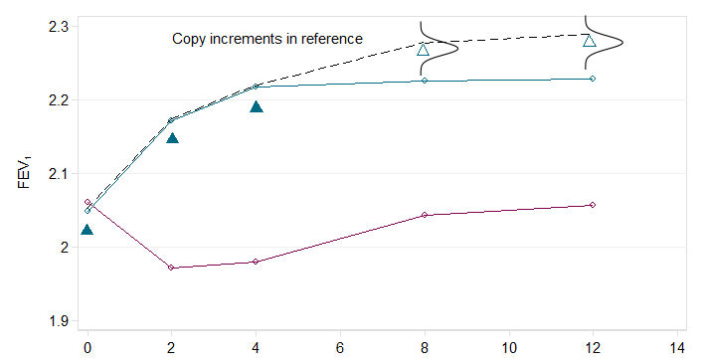
Asthma trial - Copy increments in reference
Time (weeks)
Placebo MAR means
Active MAR means
Observed FEV₁
Imputed FEV₁

Slide 18
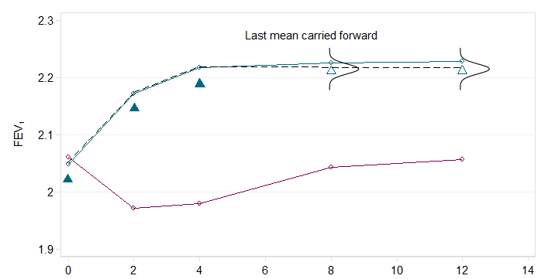
Asthma trial - Last mean carried forward
Time (weeks)
Placebo MAR means
Active MAR means
Observed FEV₁
Imputed FEV₁

Slide 19
Reference based sensitivity analysis
Comparison of results under different reference based assumptions allows us to determine the robustness of results
Interim missing observations may often be imputed under on-treatment MAR, or under one of the outlined assumptions

Slide 20
mimix
The mimix command conducts multiple imputation under the 5 reference based assumptions
Optionally allows users to conduct analysis with two in-built analysis options; regress or mixed
Syntax:

Slide 21
Asthma trial

Slide 22
Asthma trial

Slide 23
Asthma trial

Slide 24
Asthma trial

Slide 25
Asthma trial

Slide 26
Specifying the imputation method - 1
Method | Name to specify in method()
Missing at random (MAR) | mar
Jump to reference | j2r
Last mean carried forward | lmcf
Copy increments in reference | cir or ciir
Copy reference | cr
For j2r, cir or cr also require refgroup() to specify the reference group

Slide 27
Asthma trial - results
Analysis | Treat Est. | Std. Err. | P-value
Primary – MAR | 0.323 | 0.104 | 0.002
Last mean carried forward | 0.296 | 0.096 | 0.003
Copy placebo | 0.289 | 0.101 | 0.005
Copy active | 0.251 | 0.082 | 0.003
Jump to placebo | 0.226 | 0.103 | 0.029
Jump to active | 0.128 | 0.095 | 0.181
Copy increments in placebo | 0.281 | 0.103 | 0.007
Copy increments in active | 0.277 | 0.082 | 0.001

Slide 28
Asthma trial - results
Analysis | Treat Est. | Std. Err. | P-value
Primary – MAR | 0.323 | 0.104 | 0.002
Last mean carried forward | 0.296 | 0.096 | 0.003
Copy placebo | 0.289 | 0.101 | 0.005
Copy active | 0.251 | 0.082 | 0.003
Jump to placebo | 0.226 | 0.103 | 0.029
Jump to active | 0.128 | 0.095 | 0.181
Copy increments in placebo | 0.281 | 0.103 | 0.007
Copy increments in active | 0.277 | 0.082 | 0.001

Slide 29
mimix - behind the scenes…

Slide 30
Example 2 - Reviewer study
Schroter et al. (2004) performed a single blind RCT among BMJ reviewers to compare:
- no training
- self-taught training
Participants sent a baseline paper to review (paper 1)
2-3 months later sent second paper to review
Quality of review measured by the mean (2 raters) Review Quality Instrument, range 1 to 5

Slide 31
Example 2 - Reviewer study
Quality of baseline review:
 | No intervention |  |  | Self training
 | n | mean | SD | n | mean | SD
Returned paper 2 | 162 | 2.65 | 0.81 | 120 | 2.80 | 0.62
Did not return paper 2 | 11 | 3.02 | 0.50 | 46 | 2.55 | 0.75

Slide 32
Example 2 - Reviewer study
Quality of baseline review:
Primary analysis – MAR assumption
What if participants who did not return paper 2 behaved like the no intervention group?
 | No intervention |  |  | Self training
 | n | mean | SD | n | mean | SD
Returned paper 2 | 162 | 2.65 | 0.81 | 120 | 2.80 | 0.62
Did not return paper 2 | 11 | 3.02 | 0.50 | 46 | 2.55 | 0.75

Slide 33
Example 2 - Reviewer study

Slide 34
Example 2 - Reviewer study

Slide 35
Example 2 - Reviewer study

Slide 36
Example 2 - Reviewer study
Analysis | Treat Est. | Std. Err. | P-value
Primary – MAR | 0.239 | 0.070 | 0.001
Copy no intervention | 0.172 | 0.069 | 0.013
The intervention effect is slightly reduced under copy no intervention but it remains statistically significant

Slide 37
Specifying the imputation method - 2
For individual specific imputation methods use methodvar(varname) option
Where varname defines the imputation method for each individual – must be constant over time
refgroupvar(varname) defines individual specific reference group

Slide 38
Acknowledgements
Adaptation of a SAS macro written by James Roger
Thanks to Tim Morris for his comments and editions which helped to improve the programme
James Carpenter, Mike Kenward

Slide 39
Carpenter JR, Roger JH, Kenward MG, Analysis of Longitudinal Trials with protocol deviation: a framework for relevant accessible assumptions and inference via multiple imputation, Journal of Biopharmaceutical Statistics, 23:1352-1371, 2013.
Cro S, Morris TP, Kenward MG, Carpenter JR, Reference-based sensitivity analysis via multiple imputation for longitudinal trials with protocol deviation, Stata Journal, 16:2:443-463, 2016.

