Slide 1
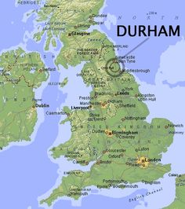
Spaghetti, paella and alternatives:
Graphics for multiple series and groups
Nicholas J. Cox
Department of Geography

Slide 2
Spaghetti is a tangle
Spaghetti plots show many tangled lines
– say for multiple time series or other functional traces –
which can be hard to distinguish and interpret.
We may see broad collective patterns,
but can we tell apart fine structure and mere noise?

Slide 3
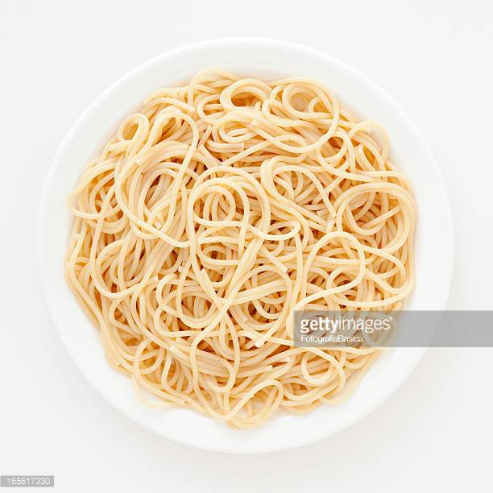
pasta Stata

Slide 4
Paella is problematic
Paella plots show multiple point patterns for many groups, sufficiently mixed up that comparisons are made difficult.

Slide 5
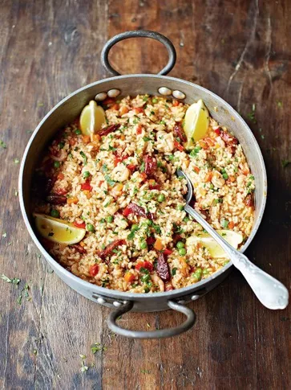
appealing? appalling?

Slide 6
This talk surveys several strategies and tactics for better, friendlier comparisons.
Devices range from showing data several times over to selection, smoothing and transformation.
Headline for those marginally interested: the least standard and possibly most interesting idea here is what are now called front-and-back plots.

Slide 7
Superimpose? Wood for trees…

Slide 8
Arctic sea ice extent
Seasonality is clear: ice melts in summer, freezes in winter
Trend is not so clear from this graph
Source:
ftp://sidads.colorado.edu/DATASETS/NOAA/G02135/north/monthly/data

Slide 9
One graph to summarize

Slide 10
Juxtapose? Trees within the wood…

Slide 11
Superimpose?

Slide 12
Grunfeld data
One version of several is bundled with Stata: webuse grunfeld
Named for Yehuda Grunfeld (1930–1960)
Kleiber, C. and Zeileis, A. 2010.
The Grunfeld Data at 50.
German Economic Review 11: 404-417.
doi:10.1111/j.1468-0475.2010.00513.x

Slide 13
Juxtapose?

Slide 14
Generic grumbles
The previous two graphs came from easy commands:
xtline invest, overlay
xtline invest
Necessarily the results of default choices are often poor –
even with a few panels and few observations in each.
At best, xtline and tsline are starting points.

Slide 15
Transform the response! Here logarithms

Slide 17
Other transformations
neglog = sign(x) * log(1 + abs(x))
are like logarithms, but for zero and negative values too
Stata 15.1 updated 7 August 2018 plus: easier using
sign(x) * log1p(abs(x))
inverse hyperbolic sine asinh()
square or cube roots
reciprocals
logits

Slide 18
Tiny tips
Lose the default note() with by(): usually groups are best explained outside the graph.
Lose default xtitle()s that are merely year, date or the like: your readers don’t need them!
Stata’s defaults for logarithmic axis labels are often lousy, but for discussion and help see 2018. Logarithmic binning and labeling. Stata Journal 18: 262–286
http://www.stata-journal.com/article.html?article=gr0072

Slide 19
Prominent problems
Do these graphs really work well?
Again, this is the easy end of plotting panel data:
there are only 10 panels in the Grunfeld data.
Improvements on various levels:
Lose the legend! Kill the key! It grabs too much space.
Two or three colours are great, but not ten or twelve.
Front-and-back plots!

Slide 20
Lose the legend: Explanatory marker labels?
Suppress the marker symbol and put an identifier in a marker label in its place.
This works for small integers, US states (MA, TX), ISO country codes (DE, FR), etc.
It can work best if you care mostly about extremes.

Slide 21
Lose the legend: trailing text labels?
Add marker labels as scatter plot elements at the ends of the series. The default marker label position of 3 o’clock is exactly right.
This can be elaborated with starting text labels as well and/or different groups with matched line and marker label colours.

Slide 22
Colours are not so crucial
If we explain each series otherwise
– with self-explanatory labels or trailing text labels –
we can often dispense with the “fruit salad” or “technicolour dreamcoat” effects.
Never use red and green together: use red or orange and blue.

Slide 24
Front-and-back plots
New name (14 June 2018) for a slightly old idea!
https://www.statalist.org/forums/forum/general-stata-discussion/general/270264-subsetplot-available-on-ssc/page2
The current Stata implementation is fabplot (SSC).
Read that alternatively as “foreground and backdrop”.
Names should not matter, but they do.
If now fabplot, can groovyplot be far behind?

Slide 25
The main idea
Superimpose and juxtapose!
Show each group in turn with the others as backdrop.
Contrast line width and line colour (or marker properties).
The Stata machinery
The major trick lies in temporary restructuring of the data. twoway, by() is used to do the hard graphics work.

Slide 26
Going grey is good!
2009. Going gray gracefully: Highlighting subsets and downplaying substrates. Stata Journal 9:499–503
https://www.stata-journal.com/sjpdf.html?articlenum=gr0040
The spelling of this colo[u]r can change mid-Atlantic.

Slide 27
Some references on front-and-back plots I
Wallgren, A., B. Wallgren, R. Persson, U. Jorner, and J.-A. Haaland. 1996. Graphing Statistics and Data: Creating Better Charts. Newbury Park, CA: Sage.
Koenker, R. 2005. Quantile Regression. Cambridge: Cambridge University Press. See pp.12–13.
Carr, D.B. and L.W. Pickle. 2010. Visualizing Data Patterns with Micromaps. Boca Raton, FL: CRC Press. p.85.
Cox, N.J. 2010. Graphing subsets. Stata Journal 10: 670–681.
Rougier, N.P., Droettboom, M. and Bourne, P.E. 2014. Ten simple rules for better figures. PLOS Computational Biology 10(9): e1003833.
Schwabish, J.A. 2014. An economist's guide to visualizing data.
Journal of Economic Perspectives 28: 209–234.

Slide 28
Some references on front-and-back plots II
Knaflic, C.N. 2015. Storytelling with Data: A Data Visualization Guide for Business Professionals. Hoboken, NJ: Wiley.
Unwin, A. 2015. Graphical Data Analysis with R. Boca Raton, FL: CRC Press.
Cairo, A. 2016. The Truthful Art: Data, Charts, and Maps for Communication.
San Francisco, CA: New Riders. p.211
Camões, J. 2016. Data at Work: Best Practices for Creating Effective Charts and Information Graphics in Microsoft Excel. San Francisco, CA: New Riders. See p.354
Wickham, H. 2016. ggplot2: Elegant Graphics for Data Analysis. Cham: Springer. See p.157.
Schwabish, J. 2017. Better Presentations: A Guide for Scholars, Researchers, and Wonks. New York: Columbia University Press. See p.98.

Slide 29
If you know other references, please let the author know.

Slide 30
More strategies: we will see some….
Select. Don’t try to show everything. Focus on what is of greatest interest or importance.
Smooth. Remove minor fluctuations that are likely to be just noise.
Subtract. Remove summaries or model fits and show residuals to see what is idiosyncratic.
Subdivide. Subsets or groups can identified helpfully.

Slide 32
New York Choral Society 1979
Data used in 2007. Turning over a new leaf. Stata Journal 7: 413–433, which in turn gives references.
https://www.stata-journal.com/sjpdf.html?articlenum=gr0028
Quantile plots show ordered values for each singer part against plotting position, so (e.g.) 0.25, 0.5, 0.75 would be plotting positions for lower quartile, median, upper quartile.
Measurements are given in inches. We add a metric axis.

Slide 34
Quantiles can be smoothed
An appropriate smoothing comes from Harrell, F.E. and C.E. Davis. 1982. A new distribution-free quantile estimator. Biometrika 69: 635–640.
There is a Stata implementation in hdquantile (SSC).
These quantile plots are both obtained using fabplot.

Slide 36
Select!
2 × 2, 3 × 3, 4 × 4 and other displays can look good.

Slide 38
Subtract summaries
The recipe here – one of many possible – is
Interpolate a few gaps using piecewise cubic Hermite method (mipolate, SSC).
Calculate mean and SD over months for reference period 1981–2010.
Show selected recent years in standard scores defined by those means and SDs.
Evidently, the more general idea is to look at residuals from any model or summary of interest.

Slide 39
auto data
It would be remiss to ignore the auto data bundled with Stata.

Slide 42
fabplot syntax
fabplot command yvar xvar [if] [in] , by(byvar [, byopts])
[ front(twoway_command)
frontopts(twoway_options) graph_options ]
where command can be scatter, line, connected, etc.

Slide 43
Words from the wise? Stephen M. Kosslyn
To communicate effectively, your display should be understood at a glance and later recalled without effort.
(2006. Graph Design for the Eye and Mind, p.14)
For an incisive review, see https://www.amazon.com/review/RVIIR7L4RMN25

Slide 44
Words from the wise? William S. Cleveland
Many useful graphs require careful, detailed study. (1994. The Elements of Graphing Data, p.115)

Slide 45
Words from the wise
The purpose of computing is insight, not numbers.
Richard Wesley Hamming (1915–1998)
The purpose of computing is insight, not pictures.
Lloyd Nicholas Trefethen (1955–)

Slide 46


Slide 47
All graphs use Stata scheme s1color, which I strongly recommend as a lazy but good default.
This font is Georgia.
This font is Lucida Console.

