Slide 1

mlim – Single and Multiple Imputation with Automated Machine Learning
E. F. Haghish
haghish@uib.no
@haghish

Slide 2
Overview
Motivation
Algorithm
Installation
Synrax
Examples

Slide 3
Motivation
Improving imputation accuracy
Reducing bias and improving fairness
Improving imputation of hierarchical data
Simplifying imputation…

Slide 4
Main idea…
Feature 1 | Feature 2 | Feature 3 | Feature 4 | Feature 5 | Feature 6
Observed |  | Observed |  | Observed
Observed | Observed |  | Observed | Observed
Observed | Observed |  | Observed
Observed | Observed | Observed | Observed |  | Observed
Observed | Observed | Observed | Observed | Observed | Observed
 | Observed | Observed | Observed | Observed | Observed
 |  | Observed | Observed | Observed | Observed
 |  | Observed |  |  | Observed
Train
Predict

Slide 5
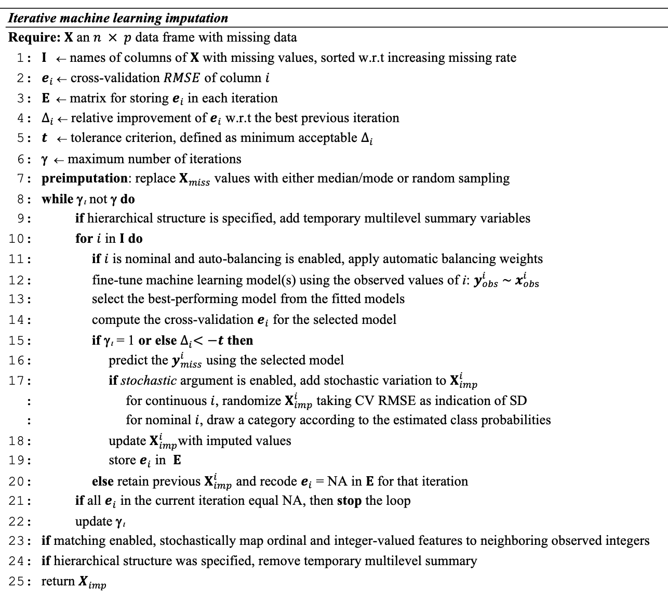

Slide 6
Preimputation
Feature 1 | Feature 2 | Feature 3 | Feature 4 | Feature 5 | Feature 6
Observed | random | Observed | random | Observed | random
Observed | Observed | random | Observed | Observed | random
Observed | Observed | random | Observed | random | random
Observed | Observed | Observed | Observed | random | Observed
Observed | Observed | Observed | Observed | Observed | Observed
random | Observed | Observed | Observed | Observed | Observed
random | random | Observed | Observed | Observed | Observed
random | random | Observed | random | random | Observed
Optimize in each iteration

Slide 7
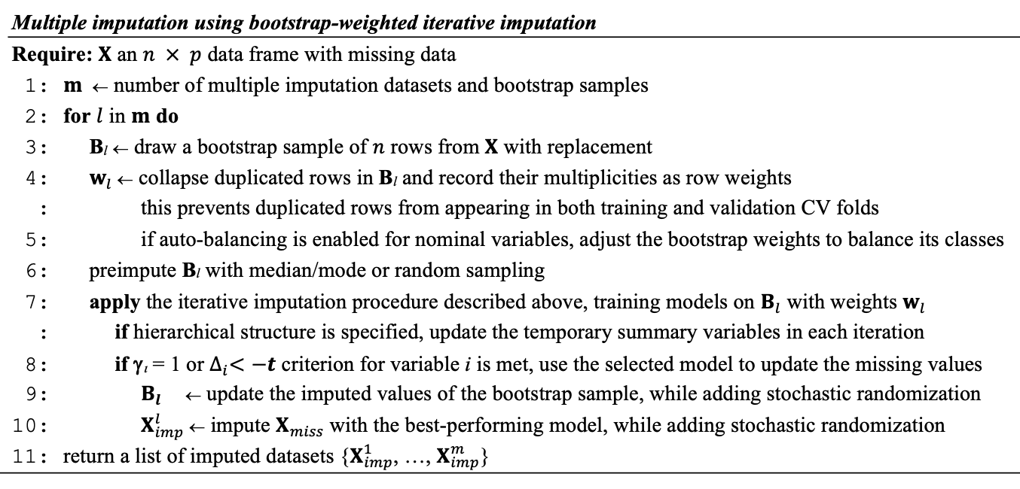

Slide 8
Installation
In addition to Stata, you need R on your system
The rcall Stata package should be installed
  Github.com/haghish/rcall
Install mlim R package and its optional dependencies
Install mlim Stata package

Slide 9
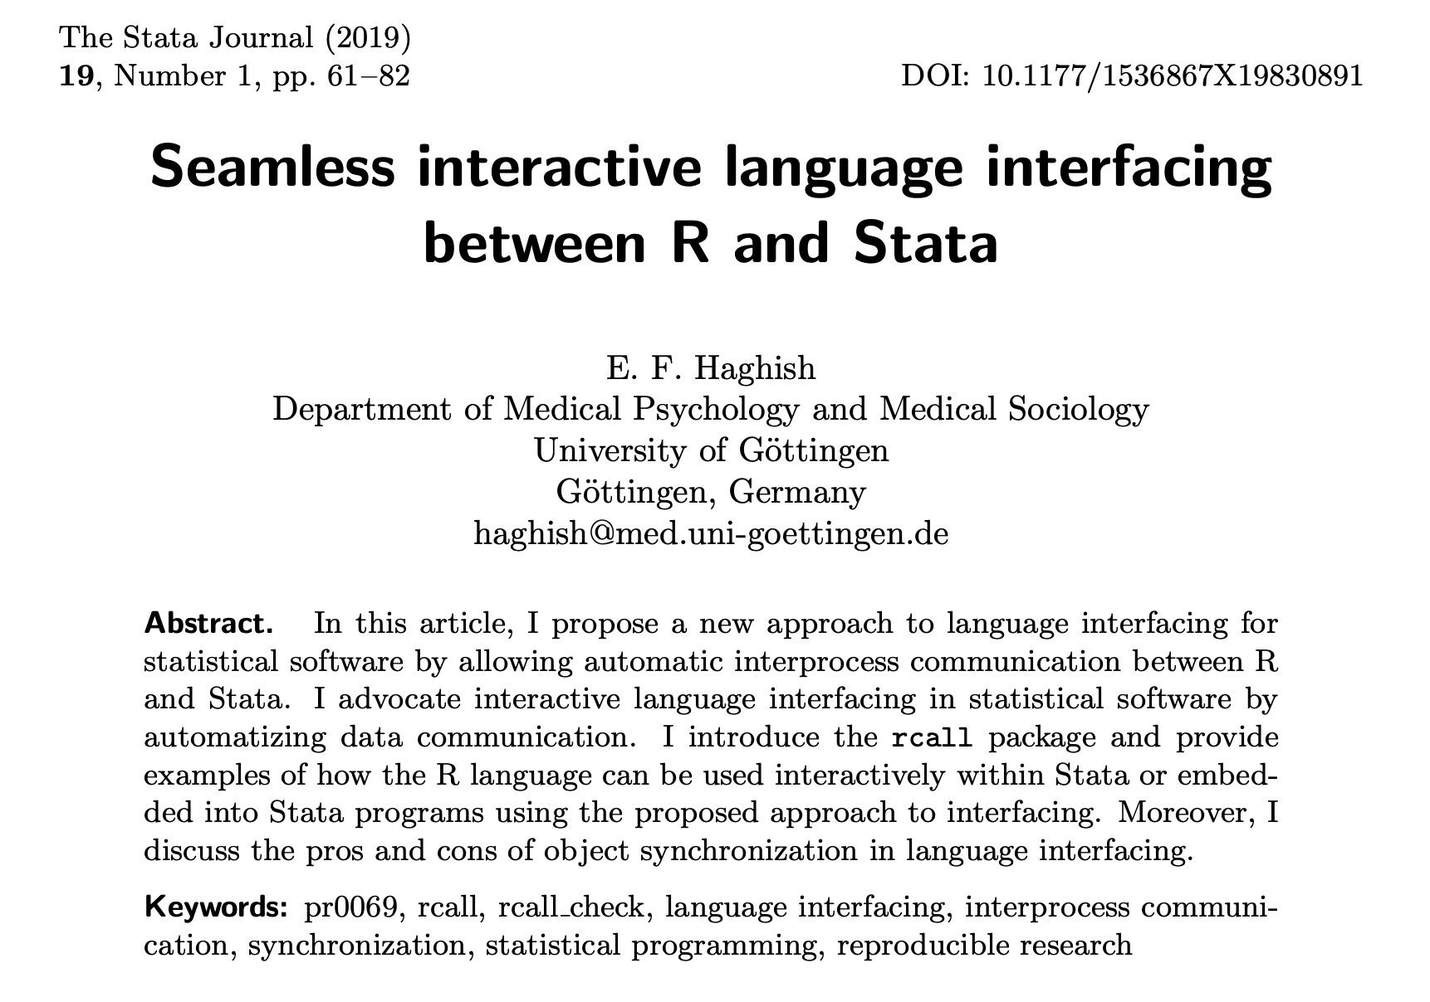


Slide 10

Data communication between Stata & R
Stata
rcall
R Server

Slide 11
Installation
R
install.packages("mlim")
Stata
First, install github command, and then install rcall and mlim from github:
net install github, from("https://haghish.github.io/github/")
github install haghish/rcall
github install haghish/mlim
devtools::install_github("mlim")

Slide 12
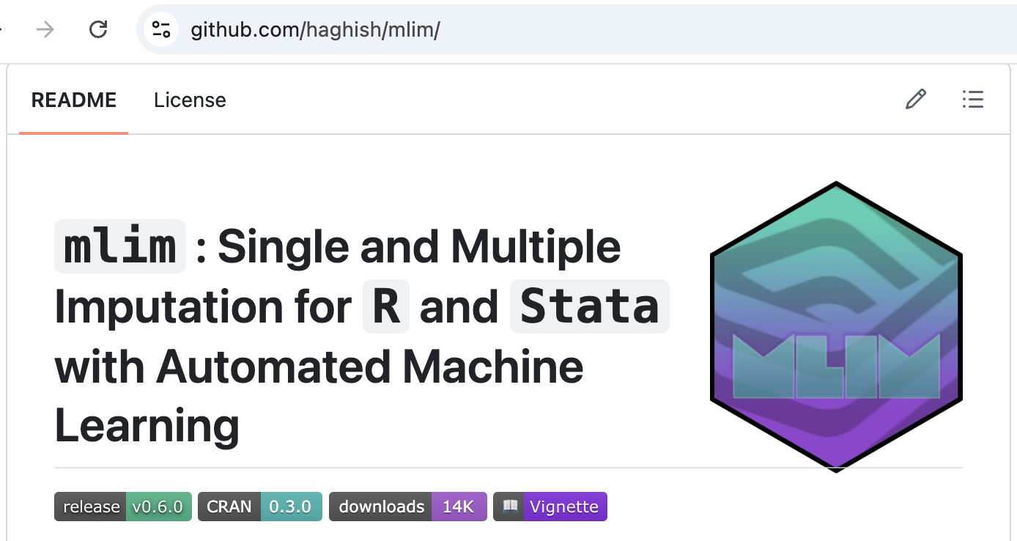

Slide 13
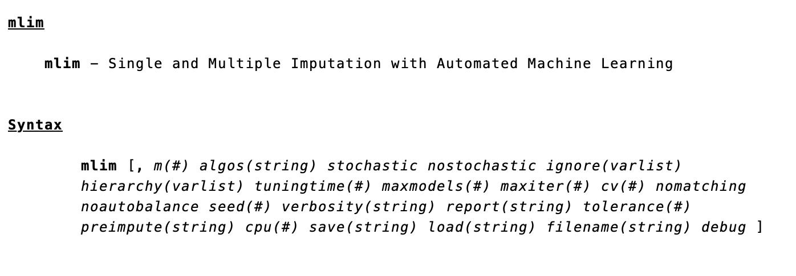
Stata syntax

Slide 14
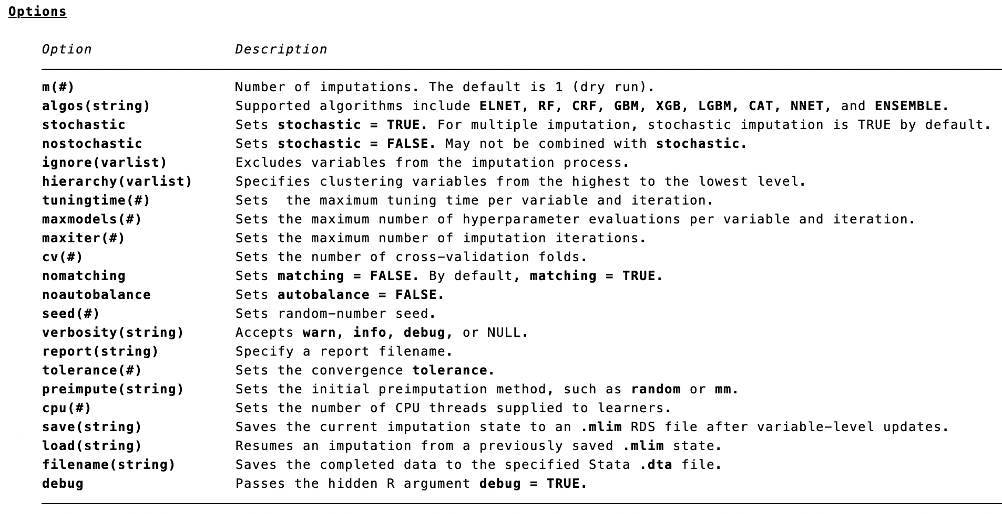
Stata syntax

Slide 15
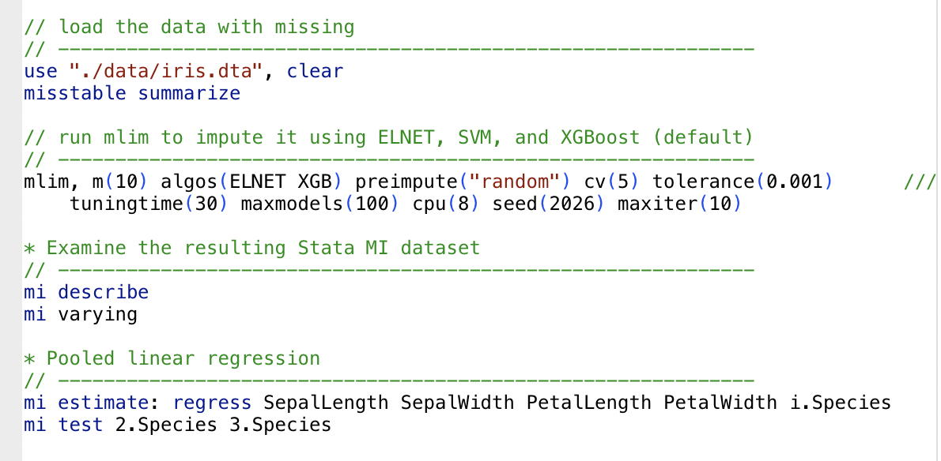

Slide 16
Examples

Slide 17
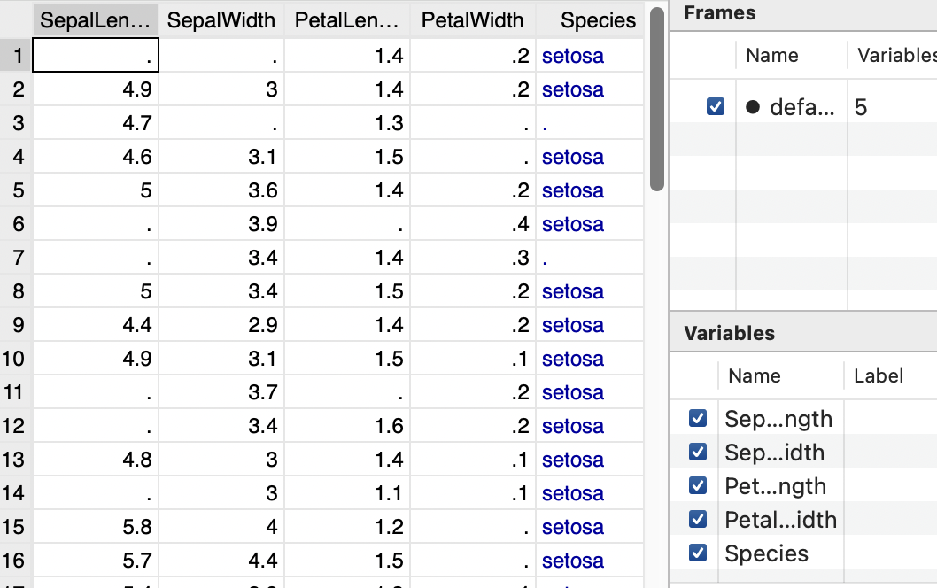
iris dataset

Slide 19
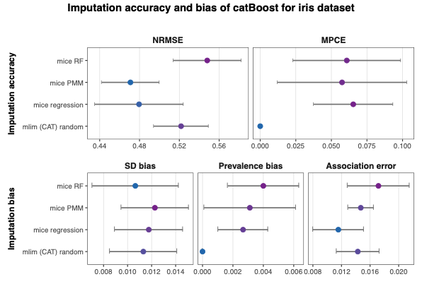
(Sample size = 150, preimpute = "random")

Slide 20
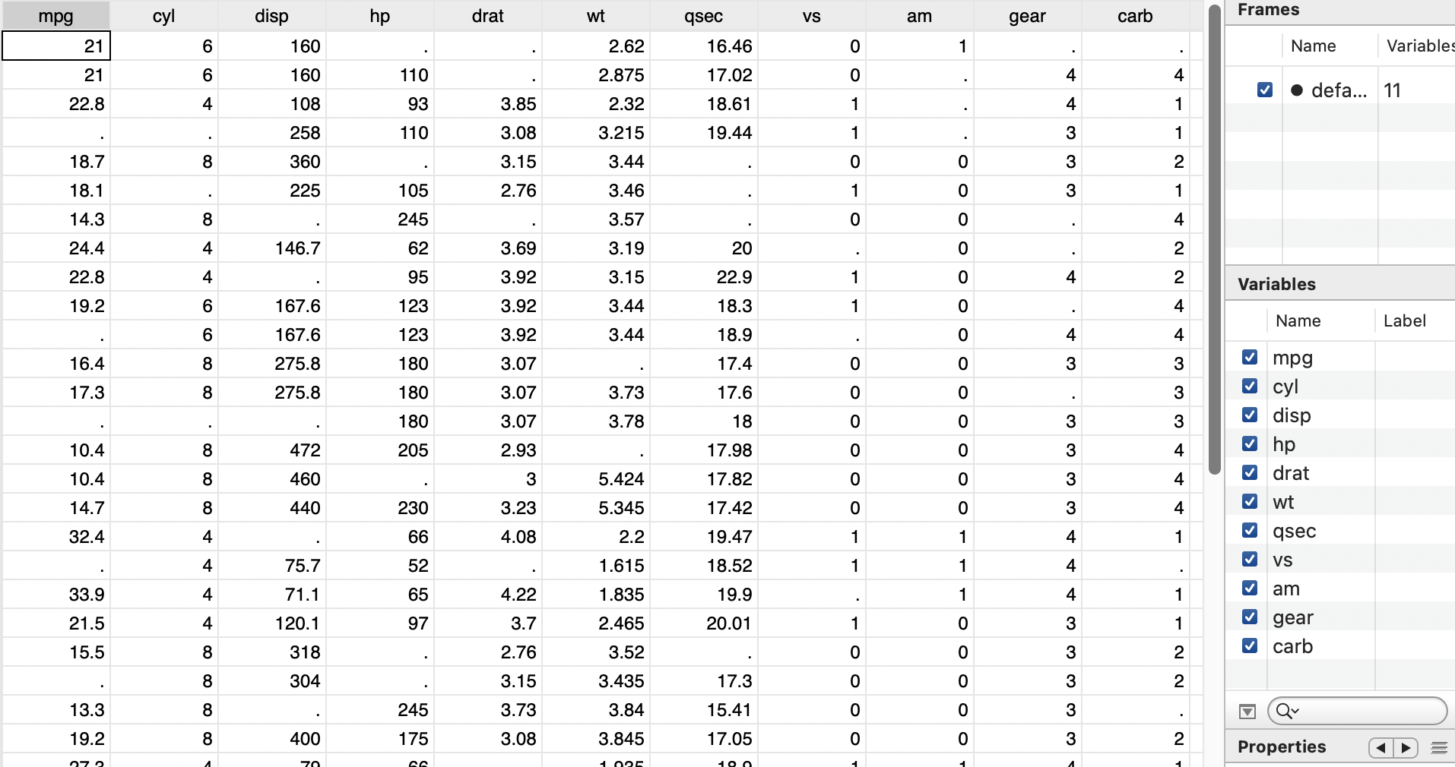
mtcars dataset

Slide 21
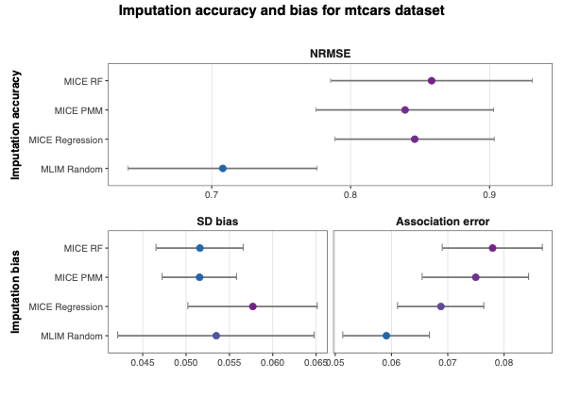
(Sample size = 32, matching = TRUE, preimpute = "random")

Slide 22
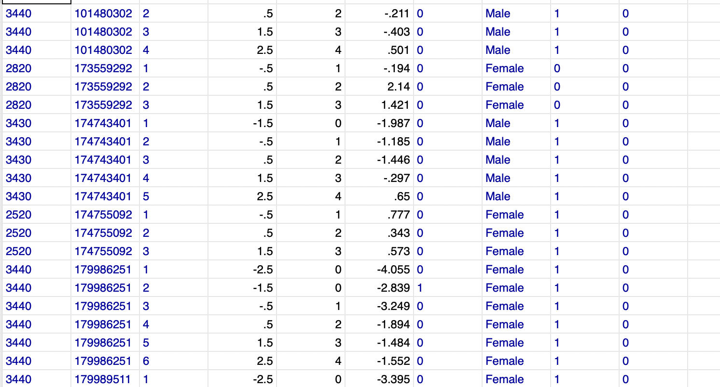

Slide 23
// Impute 10 datasets, while being aware of this nested data structure
mlim, m(10) hierarchy(schoolid childid measurementid)

Slide 24
uib.no

