Slide 1


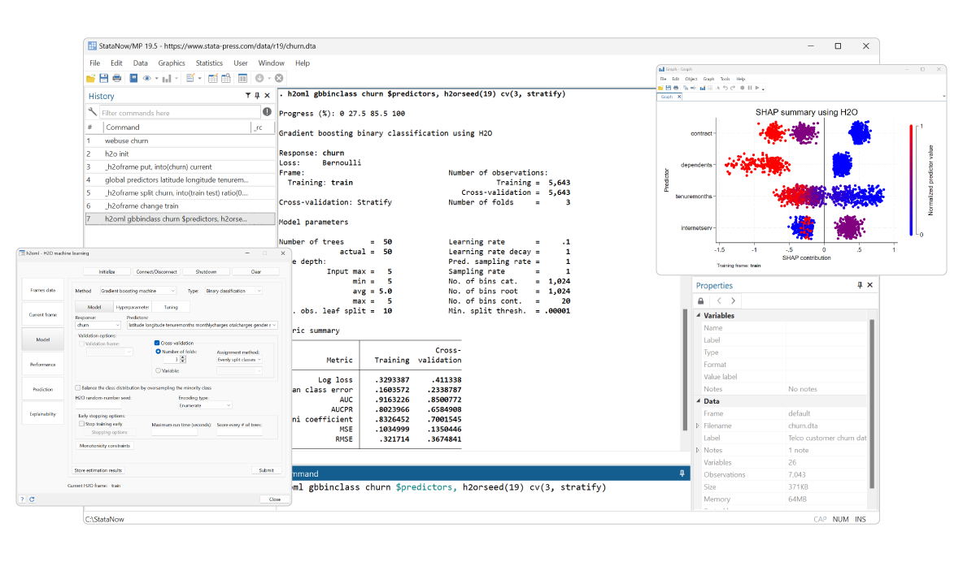
Teaching STATA through real failure
What went wrong, what worked, and what we changed
Presented by
Presented to
George Anyumba, DrPH
Paris Johnson,DrPH
STATA 2026
Notes:
GA: I am Dr. George Anyumba, playing the Analyst, the person who writes the code and believes it.
PJ: And I am Dr. Paris Johnson, playing the Skeptic, the person who asks the simple questions that ruin his day.
GA: Today we are Teaching Stata Through Real Failure: what went wrong in our analysis, what worked to catch it, and what we changed.
PJ: (Points at the orange output.) And hold on to that r(459). By the end, we hope you see it as the most useful error Stata ever gave us.
GA: Everything today is simulated, but every pattern is real. Let's start with a quick question.

Slide 2

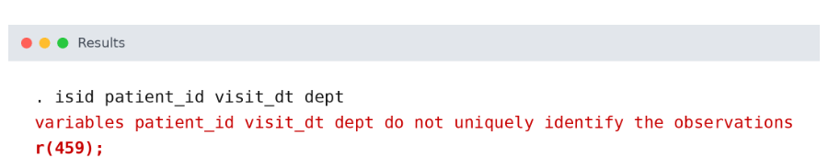
The Error That Changed Our Analysis
Our first analysis ran perfectly: no errors, no warnings, and a strong, significant result. It was also misleading. Then one command stopped us
This message told us our data was not structured the way we believed. One visit was stored as several rows, and our results were built on that mistake.
This presentation will cover:
What went wrong: how a clean-running analysis produced a misleading answer
What worked: the questions and Stata checks that exposed the problem
What we changed: how we rebuilt the workflow and how we teach it now
Notes:
GA: This analysis ran perfectly and gave us a strong result.
PJ: (Points at the error.) Until this. Stata was telling us our data was not what we thought it was. Today we'll show what went wrong, what worked, and what we changed.

Slide 3


CASE ANALYSIS
Anysoma Health Group is a community clinic in Brooklyn with four departments. Leadership launched evening walk-in hours and asked one question: did evening hours improve 30-day follow-up? The answer lived in four data sources:
EHR Encounter Log
Scheduling System
Lab Results Feed
Enrollment Registry
All Data Simulated
Notes:
GA: Let us introduce the case we will work through today. Anysoma Health Group is a community clinic. It is fictional, but we built it to look and behave like the clinics many of you have worked with: several departments, busy front desks, and data coming from many directions at once.
PJ: Like a lot of clinics, Anysoma had a problem with access. Many of its patients work during the day. They cannot leave their jobs for an appointment, so they delay care, miss follow-up, or end up in the emergency department.
GA: So leadership tried something. They launched evening walk-in hours as a pilot. And they asked a very typical question: did evening hours improve 30-day follow-up?
PJ: That question matters. Evening staffing costs money. If the pilot works, leadership wants to expand it. If it does not, they want to put those resources somewhere else. Whatever we report will shape a real decision.
GA: Now, the answer did not live in one clean file. It lived in four systems.
PJ: The EHR encounter log recorded what happened during each visit. The scheduling system managed appointments and walk-ins. The lab feed recorded tests. And the enrollment registry told us who our patients actually were.
GA: Each of those systems was built by different people, for different purposes, at different times. None of them was designed to be analyzed together.
PJ: And here is the part to hold on to: each system had its own idea of who a patient is and what counts as a visit. That detail is going to matter a lot in the next few minutes.
GA: To be honest, I did not think much about it at the time. I had a clear question, I had the data, and I knew exactly which model I wanted to run.
PJ: (Points to the QR code.) Before George shows you what he did, take out your phone and scan this code. It opens Anysoma's site with the same simulated data we are using. As we go, you can look at the actual rows yourself.
PJ: One suggestion while you are in there: open the raw encounter file and ask yourself a simple question. What does one row represent?
GA: Hold that thought. Now let me show you how I ran the analysis.

Slide 4
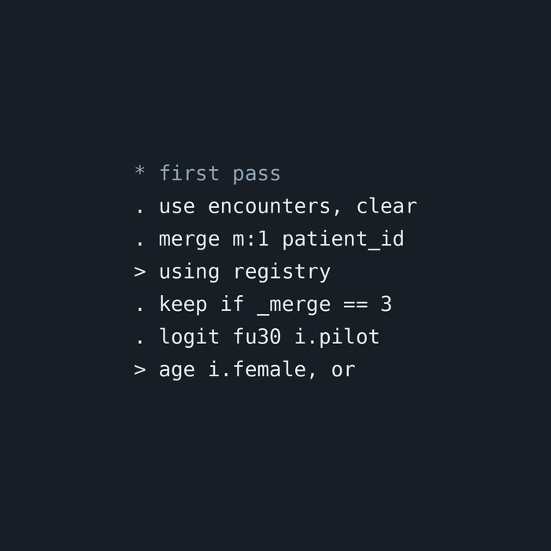
Running the Analysis
With a clear question and four data sources, the path looked simple. Load the visits, add patient information, and model follow-up. The entire analysis took five lines of Stata and ran without a single error or warning. Here is what the first pass did:
Load the Encounter Data
The EHR encounter log became the starting dataset, on the assumption that each row represented one clinic visit.
Merge Patient Demographics
Age and sex were added from the enrollment registry. Records that did not match were dropped, a routine step in most tutorials.
Model 30-Day Follow-Up
A logistic regression estimated whether evening walk-in hours were associated with completing follow-up, adjusting for age and sex.
Notes:
GA: So here is exactly what I did. I want you to watch closely, because every step I take is one you have probably taken yourself.
GA: First, I loaded the encounter log. It was the biggest file and it had the visits, so it felt like the natural starting point. I assumed each row was a visit. That seemed obvious.
GA: Second, I needed age and sex for the model, and those lived in the enrollment registry. So I merged the registry onto the encounters by patient ID. Some records did not match. That happens with administrative data all the time, so I kept the matches and moved on. That is what the tutorial did.
GA: Third, I ran a logistic regression. Did the patient complete follow-up within 30 days, yes or no, with evening walk-in hours as the main predictor, adjusting for age and sex. I asked for odds ratios because leadership understands those.
PJ: And did anything go wrong?
GA: Nothing. No errors. No warnings. Stata ran every line. Five lines of code, and I had my answer.
PJ: I want everyone to notice something. Every one of those steps is defensible on its own. You could find each one in a good textbook.
GA: That is what made me so confident.
PJ: Before George shows you the result, here is a quick challenge. If you have the Anysoma site open, look at the raw encounter file. Scroll through a few rows. Ask yourself: what does one row really represent?
GA: Keep your answer to yourself for now. Let me show you what the model said.

Slide 5

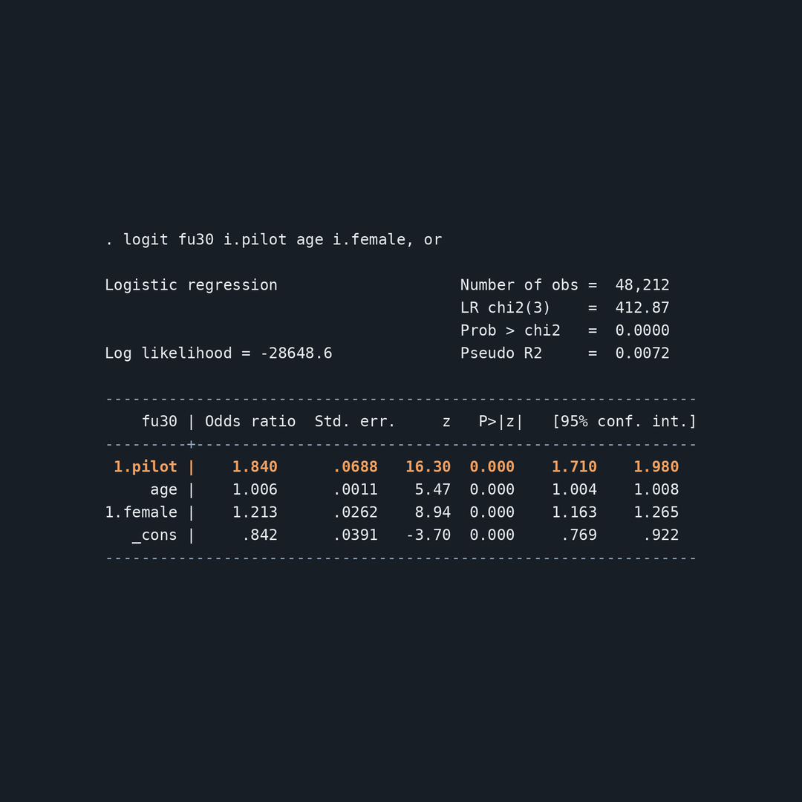
The Results
The model ran cleanly, and the output looked like a success story. Every number pointed in the same direction:
Strong Effect
Evening walk-in hours were linked to 84% higher odds of completing 30-day follow-up (odds ratio 1.84).
High Follow-Up
71.4% of records showed completed follow-up within 30 days.
Highly Significant
p < 0.001, with a tight 95% confidence interval of 1.71 to 1.98.
Large Sample
N = 48,212, a sample big enough to feel trustworthy.
Notes:
GA: And here is what the model told us. Evening walk-in hours were associated with 84% higher odds of completing 30-day follow-up. An odds ratio of 1.84.
GA: 71.4% of records showed completed follow-up. The p-value was less than 0.001. The confidence interval was tight, 1.71 to 1.98. And the sample size was over 48,000.
GA: Clean output. No warnings. A strong, significant effect in a large sample. Honestly, I could have put this in a report to leadership that same afternoon. Evening hours work. Fund them.
PJ: That is a very convincing slide, George.
GA: Thank you.
PJ: So let's test it. Everyone, turn to the person next to you. You have 60 seconds. Before you believed this result, what would you check first?
PJ: Let's hear a few. (Take two or three answers and repeat each one into the microphone. Remember who said what, because you'll call back to them on the next slides.)
PJ: Those are exactly the right instincts. And here's one more question to hold onto. George has 48,212 observations. Does anyone remember how many patients Anysoma actually has enrolled?
GA: (Pause.) About 9,400.
PJ: So how did 9,400 people become 48,000 observations?
GA: That is a very good question.
PJ: Let's find out.
Note to remember: the 9,406 enrolled patients is a number the audience will have seen on the Anysoma website or in our case slide. "Anysoma only has about 9,400 enrolled patients."

Slide 6

Why Clean Output Can Still Be Wrong
Our first analysis of Anysoma Health Group ran without a single error. It produced a strong, significant result that looked ready to report. But clean code is not the same as correct analysis. Five hidden problems shaped our answer before we ever ran the model:
One Visit, Many Rows
One Patient, Several IDs
Merges That Drop Data Silently
The Wrong Unit of Analysis
Confidence Without Checks
Notes:
GA: When we started this project, the question was simple. Anysoma launched evening walk-in hours, and leadership wanted to know whether they improved 30-day follow-up. I loaded the data, merged in demographics, ran a logistic model, and got a strong result. No errors. No warnings. I was ready to write the report.
PJ: And that is exactly the problem. Stata did everything George asked. It just could not tell him that he was asking the wrong question of the wrong data. So let's walk through the five things that were hiding underneath that clean output.
PJ: One visit, many rows. The EHR recorded every step of a visit as its own row: check-in, vitals, provider, checkout. One afternoon at the clinic became four or five rows. In OB/GYN and Neurology, each visit was five rows.
GA: Which means one patient could vote five times in my model. I thought each row was a visit. I never checked.
PJ: One patient, several IDs. Evening walk-ins checked in at a scheduling kiosk that issued its own ID. The lab had a third ID. So the same person could look like three different people.
GA: And the registry only knew one of those IDs.
PJ: Merges that drop data silently. George merged the encounters to the registry and kept only the matches. That feels routine. But the records that did not match were the kiosk IDs, which were almost all evening walk-ins.
GA: So my merge quietly removed the very program we were trying to evaluate. Stata reported it in the merge table. I just didn't read it as a finding.
PJ: The wrong unit of analysis. Leadership asked about people. The model answered a question about rows. Patients who come in often generate most of the rows, and they are also the most likely to complete follow-up, simply because they are already in the building.
GA: So the people who were already doing well got the loudest voice in my results.
PJ: Confidence without checks. None of these problems produced an error on their own. The only thing that finally stopped us was one command, isid, asking Stata to confirm what one row represented.
GA: And that is where r(459) came in. It was the first time the data disagreed with me out loud.
PJ: Over the next few slides, we'll take each of these apart: what went wrong, what worked to catch it, and what we changed, both in the code and in how we teach it.

Slide 7
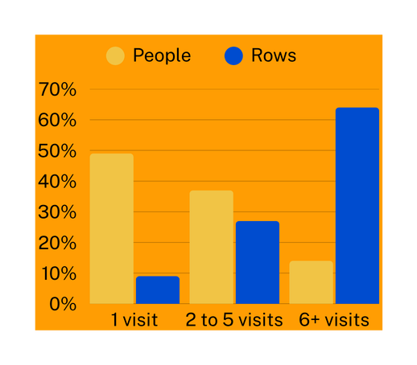
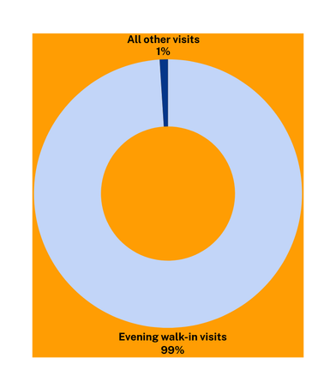
What Was Hiding in the Data
When we stopped trusting the output and looked at the data itself, the problems were visible right away. The numbers told a very different story about who was actually driving our results. Here is what we found:
One Visit, Many Rows
Each workflow step was its own row. A single visit became four or five rows, and every row counted as a vote.
One Patient, Several IDs
Who Is Doing the Voting?
Who the Merge Removed
Evening walk-ins received a kiosk ID the registry did not recognize, so one person could appear as several.
The Merge Removed the Pilot
Keeping only matched records deleted almost every evening walk-in visit, which was the exposure we were trying to study.
What Is N?
48,212 rows, 21,530 visits, 11,237 IDs, 9,406 people. The model used rows; leadership asked about people.
Notes:
PJ: So on the last slide we asked: how did 9,400 people become 48,000 observations? Let's look.
PJ: Earlier, someone in the room said we should check for duplicates. You were right. George, a simple question: what is one row in your dataset?
GA: A visit. I think.
PJ: It was not. The EHR recorded every step of a visit as its own row: check-in, vitals, provider, checkout. In OB/GYN and Neurology there was a fifth step. So one afternoon at Anysoma became four or five rows, and every one of those rows voted "completed follow-up."
GA: Which means some patients voted five times in my model.
PJ: And not just any patients. Look at the bar chart. Patients who visit only once are almost half of our people, but only 9% of the rows. Patients with six or more visits are just 14% of our people, but they produce 64% of the rows.
GA: And those frequent visitors are the ones most likely to complete follow-up, because they are already coming in. So the patients who were already doing well had the loudest voice in my results.
PJ: That is the first problem. Here is the second. Someone mentioned checking the merge. Also right.
PJ: Evening walk-ins checked in at a scheduling kiosk, and the kiosk issued its own ID. The registry had never seen those IDs. So when George merged and kept only the matches, those visits disappeared.
GA: Look at the donut. Almost every record the merge removed was an evening walk-in. My merge deleted the very program we were trying to evaluate.
PJ: And Stata told us. The merge table showed the unmatched records. We just treated it as housekeeping instead of a finding.
GA: Which brings us back to the question Paris asked. What is N? It depends on how you count. 48,212 rows. 21,530 visits. 11,237 IDs. 9,406 people.
PJ: Every one of those is a legitimate number. The failure was never choosing. Leadership asked about people, and the model quietly answered a question about rows.
GA: None of this caused an error. Every number was real. They just were not answering our question.
PJ: So how did we finally catch it? One command.
(Advance to slide 8.)
If nobody in the room mentioned duplicates or the merge during the neighbor exercise, drop the "someone in the room said" lines and start with: "George, a simple question: what is one row in your dataset?"

Slide 8
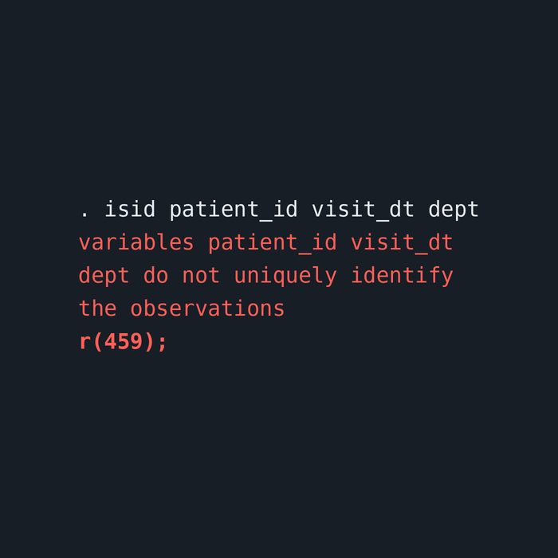
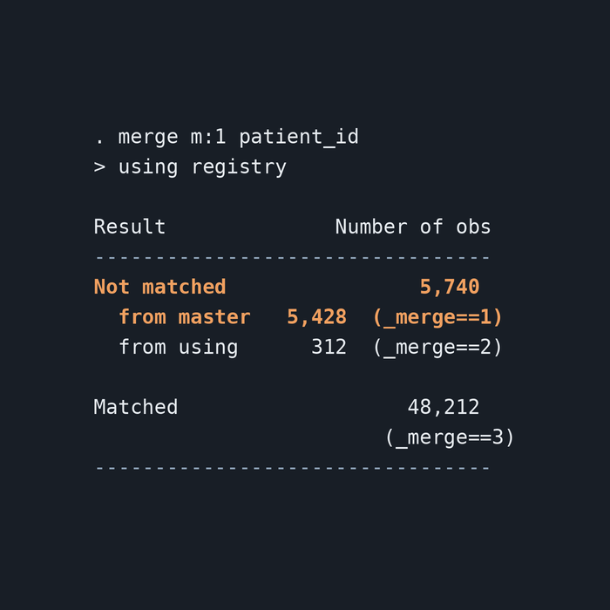
What Worked: Asking Simple Questions
We did not need a new model or a new method. We needed to stop trusting the output and ask the data two simple questions. Both answers had been available in Stata the whole time.
Ask What One Row Is
Read the Merge as a Finding
Before modeling again, we ran duplicates report and found many rows sharing the same patient, date, and department. Then we used isid to test our belief that each row was one visit. Stata answered with r(459): these variables do not uniquely identify the observations. For the first time, the data disagreed with us out loud. A quick count showed that each visit had been split into four or five rows.
The merge table had been telling us something from the start: 5,428 encounter rows never matched the registry. Instead of dropping them, we asked who they were. A simple cross-tab of the pilot flag by merge status showed that almost every unmatched row was an evening walk-in with a kiosk ID. The records we treated as housekeeping were the heart of the evaluation.
Notes:
PJ: So how did we finally catch it? Not with a better model. With better questions.
PJ: The first question was the one I kept asking George: what is one row? So instead of running another regression, we ran duplicates report on patient, date, and department. Lots of duplicates.
GA: Then I ran isid. I was telling Stata: I believe each combination of patient, date, and department is one visit. Confirm it.
PJ: (Points to the left circle.) And Stata said no. r(459). These variables do not uniquely identify the observations.
PJ: Remember the error from the very beginning of our talk? Here it is. Most of us were taught to treat this as a problem to get rid of. But look at what it just did: it caught a false belief before we published it.
GA: A quick count by visit showed each one had been split into four or five rows. That told us exactly how to fix it.
PJ: The second question was about the merge. (Points to the right circle.) This table appears every time you merge in Stata. George saw it. Most of us see it every day.
GA: 5,428 rows from my encounter data did not match the registry. I did what the tutorial did. I kept the matches and moved on.
PJ: So this time we asked who they were. One cross-tab: pilot flag by merge status. Almost every unmatched row was an evening walk-in.
GA: Those were the kiosk IDs. The registry had never seen them. The merge table was reporting the most important finding in the project, and I treated it as housekeeping.
PJ: Neither of these checks is advanced. duplicates, isid, and reading the merge table. They are all in the first weeks of any Stata course.
GA: The difference was when we used them. Before the model, not after.
PJ: So once we knew what was wrong, what did we change?
(Advance to slide 9.)
The merge table uses 48,212 as the matched count, so it matches the N on your results slide. It also means the encounter log started with 53,640 rows before the merge. If anyone asks, that's the right total.

Slide 9
Fix the Structure First
We started by linking every ID to one person. A crosswalk connected EHR, kiosk, and lab IDs to a single person_id, and merge ..., assert(match using) stopped the do-file if any encounter failed to link. Then we used collapse to turn four or five workflow rows into one row per visit, and confirmed it with isid person_id visit_dt dept. No record was dropped without an explanation.
What We Changed: Rebuilding the Workflow
Once we knew what was wrong, we rebuilt the analysis in the order the data required, not the order the tutorial suggested. Structure came first. The model came last. Every step now states what one row represents and checks it before moving on.
Answer the Question That Was Asked
Leadership asked about people, so we analyzed people. We kept each patient's first visit, which defines whether they were exposed to evening hours, and confirmed one row per person with isid person_id. Only then did we run the same logistic model as before. We also tested the alternative: keeping every visit and using vce(cluster person_id) so repeat visits were not treated as independent.
Notes:
PJ: So what did we change? Not the question. Not the model. The order.
GA: My first pass went straight from loading data to running a regression. The rebuild starts somewhere else: with the structure of the data.
GA: The first fix was identity. We built a crosswalk that connected every ID, from the EHR, the kiosk, and the lab, to one person. And this time, when I merged, I added assert(match using).
PJ: Explain what that does.
GA: It tells Stata: every encounter must link to a person. If even one does not, stop the do-file. So instead of silently dropping 5,428 rows, the code now refuses to continue until I explain them.
PJ: Silent data loss becomes a loud failure. That is the whole idea.
GA: The second fix was the visit. Each visit was four or five rows, one per workflow step. We used collapse to combine them into one row per visit. Then we ran isid again.
PJ: And this time?
GA: No error. Each combination of person, date, and department now uniquely identified one visit. The same command that stopped us before now confirmed we had fixed it.
PJ: Then we had to make a decision we had skipped the first time. What is our unit of analysis?
GA: Leadership asked whether evening hours helped patients complete follow-up. That is a question about people. So we kept one row per person, their first visit, because that is when they were either exposed to evening hours or not.
PJ: Some of you might be thinking: why throw away the later visits?
GA: Good question, and there is a defensible alternative. You can keep every visit and use vce(cluster person_id), so Stata knows repeat visits come from the same person. That answers a slightly different question: about visits instead of people.
PJ: Both approaches are reasonable. The difference from the first pass is that now it is a decision, written in the do-file, instead of an accident.
GA: And only after all of that did I run the same model I ran the first time. Same outcome. Same predictors. Same command.
PJ: But before we show you the new result, there is one more thing we changed, and it is the one we most want you to take home.

Slide 10
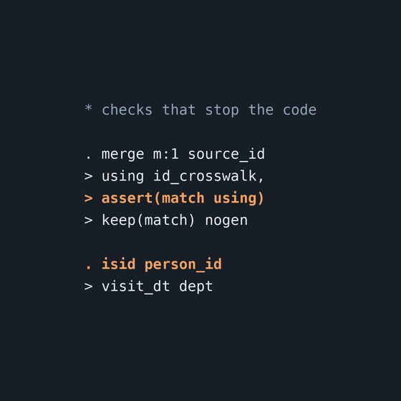
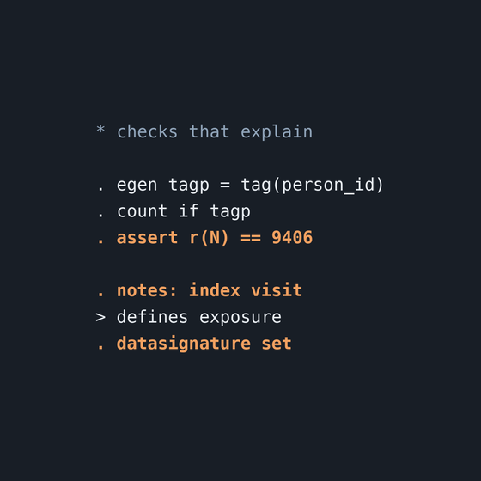
Quality Checks Built into the Code
Our first analysis depended on someone noticing a problem. The rebuilt do-file does not. We added checks directly into the code, so the data is tested every time the analysis runs. If something changes, whether new data, a new analyst, or a new extract, the do-file catches it before the model does. These checks turn skepticism into a habit that runs automatically, even when no reviewer is in the room.
Checks That Stop the Code
Checks That Explain the Code
Every time the unit of analysis changes, isid confirms what one row represents. Every merge uses assert(match using), so unmatched records stop the do-file instead of disappearing. If a check fails, the analysis stops until someone explains why.
We count people and use assert to compare the result with a number we trust, the 9,406 enrolled patients. notes records each decision inside the dataset, and datasignature confirms the file we modeled is the file we checked.
Notes:
PJ: Here is my confession. For most of this project, I was the quality check. I was the one asking what one row is and who the merge dropped.
GA: And she was right every time. Which is a little annoying.
PJ: But a person is not a system. I will not be in the room for every analysis. And neither will you. So we asked: what if the do-file could be skeptical on our behalf?
GA: So we built the checks into the code. There are two kinds.
GA: The first kind stops the code. (Points to the left circle.) Every time the unit of analysis changes, we run isid. If each row is not what we think it is, Stata stops. And every merge now includes assert(match using). If any record fails to link, the do-file refuses to continue.
PJ: Think about what that means. On our first pass, 5,428 rows vanished without a sound. With this one option, that same situation stops the analysis and demands an explanation.
GA: The second kind explains the code. (Points to the right circle.) We count the number of unique people and assert that it equals 9,406, the number in the enrollment registry. That is a number we trust from outside the dataset.
PJ: If you remember only one habit from today, make it this one: check your N against a number you trust from outside your data. It catches more errors per keystroke than anything else we know.
GA: Then notes. It records our decisions inside the dataset itself: why we used the first visit, how we linked IDs. Anyone who opens the file later can see our reasoning, not just our results.
PJ: And datasignature confirms that the file we modeled is the same file we checked. If someone replaces or edits it, Stata will tell us.
GA: None of these commands are advanced. They are short, they are fast, and they are available in every version of Stata.
PJ: What changes is where they live. Not in the analyst's head. In the do-file.
GA: So now, with the structure fixed and the checks in place, we ran the same model one more time.
PJ: Same data. Same model. Let's see what changed.

Slide 11
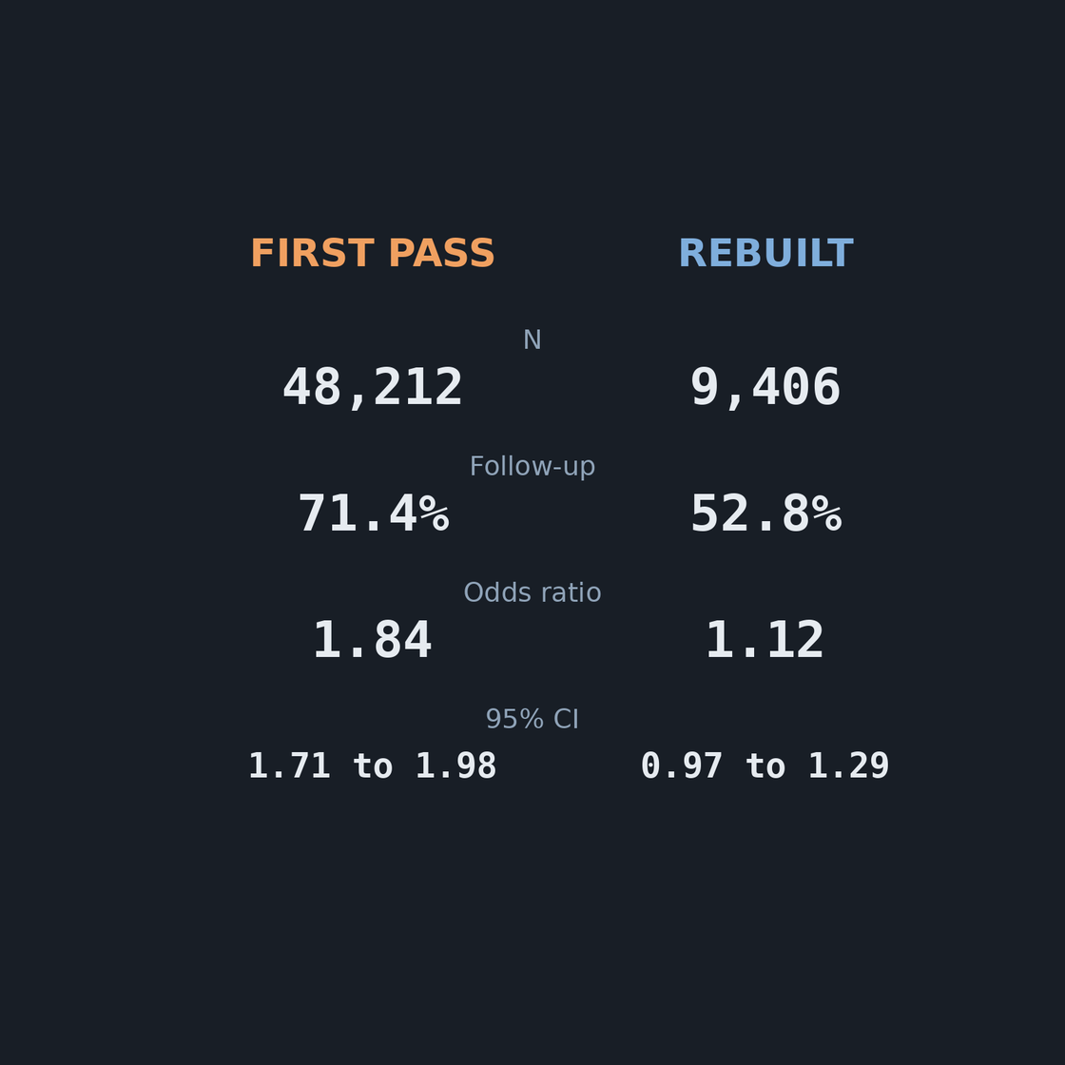
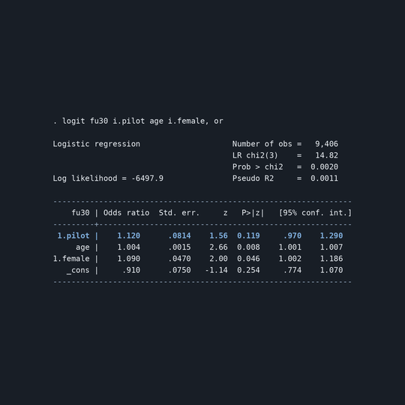
Same Data, Different Answer
We ran the same logistic model on the same data. The only thing that changed was the structure: one row per person instead of one row per workflow step, with every record accounted for. The strong effect disappeared.
Follow-Up: 71.4% → 52.8%
Odds Ratio: 1.84 → 1.12
95% CI: 0.97 to 1.29, Now Includes 1
Notes:
GA: So here it is. Same data. Same model. Same command.
GA: On the first pass, 71.4% completed follow-up. After the rebuild, 52.8%. The odds ratio went from 1.84 to 1.12.
PJ: And look at the confidence interval. The first pass gave us 1.71 to 1.98, tight and far from 1. The rebuilt model gives us 0.97 to 1.29. That interval includes 1.
GA: Which means we cannot say evening walk-in hours improved follow-up. The effect might be small. It might be nothing.
PJ: Notice something else. The first confidence interval was very narrow. That is because the model treated 48,000 rows as 48,000 independent pieces of information, when they were really about 9,400 people. It made us far more certain than we had any right to be.
GA: Bad structure did not just inflate the effect. It inflated our confidence.
PJ: So what is the honest answer for leadership?
GA: The honest answer is: we do not know yet. The pilot may have a modest effect. To find out, we need a stronger design, for example rolling evening hours out department by department and comparing over time.
PJ: Now think about what would have happened if George had sent the first result that afternoon.
GA: Leadership would have seen an 84% improvement in the odds of follow-up. They would have expanded evening staffing across all four departments, and spent real money on a result created by the structure of the data.
PJ: That is why this matters. Not because of a p-value. Because a real decision was about to be made.
GA: And here is the part I want every student to hear. Both of these models ran without a single error. Stata did everything I asked, both times.
PJ: Only one of them answered the question that was actually asked.

Slide 12
Teaching Stata Through Failure
Step 1: Predict Before You Run
The mistakes in this project were not embarrassing detours. They were the most valuable part of the analysis. So we now build them into how we teach. Instead of clean examples that work the first time, learners work with imperfect data and practice finding what is wrong before they trust what is right.
Before running any command, learners write down the N they expect and the direction of the effect. When the output disagrees, the surprise becomes the lesson.
Step 2: Break It on Purpose
Learners receive a do-file that runs cleanly and answers the wrong question. Working in pairs, one writes the code and one asks the questions, and they find the hidden flaws together.
Step 3: Keep a U-Turn Log
Learners record every decision they reversed and why. We grade the reasoning, not just the final output, so changing course is rewarded instead of hidden.
Notes:
PJ: So far we have told you what went wrong in our analysis. Now we want to talk about what we did with it as teachers.
GA: Because honestly, this project taught me more than any clean example ever did. And that made us ask: why do we keep teaching Stata as if data is always clean?
PJ: So we changed how we teach. Three steps.
PJ: Step one: predict before you run. Before learners execute anything, they write down two things: how many observations they expect, and which direction they expect the effect to go.
GA: If I had done that, I would have written "about 9,400 patients." And when Stata said 48,212, I would have stopped immediately.
PJ: Exactly. The prediction takes thirty seconds. And when the output disagrees with it, the learner is suddenly curious instead of confident. The surprise becomes the lesson.
GA: Step two: break it on purpose. We give learners a do-file that looks just like my first pass. It runs cleanly. No errors. And it gives the wrong answer.
PJ: A do-file that crashes is easy to fix. A do-file that runs perfectly and is still wrong is what teaches judgment.
GA: Learners work in pairs. One writes the code. The other asks the questions: What is one row? What did the merge drop? Where did this N come from? Halfway through, they switch.
PJ: And here is what we noticed. Learners rarely question their own output. But they will happily question their partner's. The pairing makes doubt part of the job instead of an insult.
GA: Step three: keep a U-turn log. Every time a learner reverses a decision, like changing the unit of analysis or rethinking a merge, they write down what they changed and why.
PJ: And we grade the log, not just the final answer. Once learners get credit for documenting a reversal, they stop hiding reversals. That is where transparency comes from.
GA: Everything we used today is available for your own classroom. If you scan the QR code, the last section of the Anysoma site has the simulated data files and the complete do-file.
PJ: Use them. Break them. find what we missed.

Slide 13
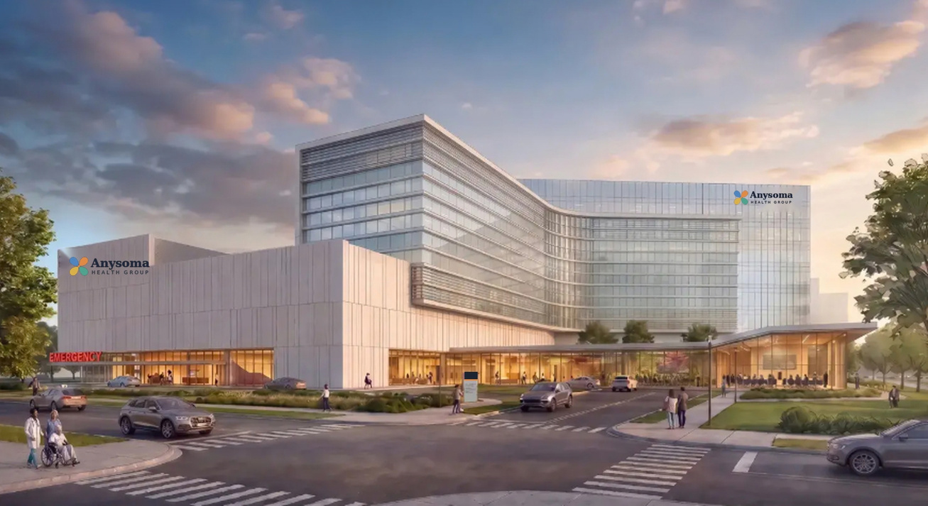
What We Want You to TAKEAWAY
What We Want You to TAKEAWAY
Teach the Unit of Analysis First
Make Failure Visible and Safe
Put Judgment Into the Code
Before any model, ask what one row represents. Every model answers a question about its rows, so make learners say it out loud.
Plant errors, predict before running, and reward the learner who finds the flaw. Mistakes become method, not embarrassment.
Use isid, assert, and notes so the do-file stays skeptical even when no reviewer is in the room.
Notes:
GA: If you remember only three things from today, here they are.
GA: First: teach the unit of analysis before you teach the model. Every regression answers a question about its rows. My first model answered a question about workflow steps, because I never asked what one row was.
PJ: Second: make failure visible and safe. Plant the errors. Ask learners to predict before they run. And reward the person who finds the flaw first. When mistakes are part of the lesson plan, learners stop hiding them.
GA: Third: put judgment into the code. isid, assert, and notes take seconds to write. But they keep asking the hard questions every time the analysis runs, whether or not anyone is watching.
PJ: (Points to the r(459) image.) And one last thing. At the start of this talk, we asked you to hold on to this error message.
PJ: Most of us were taught to see r(459) as a problem to get rid of. Today we hope you see it differently. It was the moment the data stopped lying politely and told us the truth.
GA: It was the most useful line of output Stata ever gave us.

Slide 14

Questions and Resources
Thank you for joining us. Every failure in this talk came from a real pattern in applied work, and every fix is something you can use in your own classroom tomorrow. We would love to hear your questions, and your own stories of data that lied politely.
Explore Anysoma
Scan the code to explore the clinic, the simulated data, and the complete do-file. Everything is free to use in your own teaching.
Notes:
PJ: We would love to take your questions. And while we do, keep your phones out. This code takes you back to Anysoma, where you can download the data files and the do-file we used today.
GA: Use them in your classes. Change them. Plant new errors. Let your students find what we missed.
PJ: And if you have your own story of data that looked right and wasn't, we would love to hear it. That's how we all get better at this.
GA: Thank you.
If the room is quiet, seed a question:
"What is the most misleading dataset you have ever trusted, and what finally tipped you off?"
"Which of the three teaching steps would be hardest to use in your setting?"

Slide 15

Thank You
George Anyumba, DrPH
Paris Johnson, DrPH
george.anyumba@baltimorecity.gov
paris.johnson@baltimorecity.gov

