Slide 1
From Qualtrics to Word
Automating survey workflows in Stata
Inah Ko
Office of Graduate and Postdoctoral Studies, University of Michigan
2026 Stata Conference
Notes:
Hello, I'm Inah Ko from the University of Michigan.
Today I'll share a workflow I developed to move survey data from Qualtrics to a formatted Word report, using Stata as the central working environment.
The workflow uses Python and R where they are useful, but Stata coordinates the overall process.
So let me start with why I built this

Slide 2
Same steps, but new or revised surveys
Download
Download/Import current survey data
Clean
Remove test, preview, invalid, incomplete cases
Label
Check and label variables
Small changes made it risky to reuse an old do-file without checking
Recode
Check and recode values/scales
Plot
Make figures for different types of data
Report
Paste each figure into Word
Notes:
This is the basic workflow – repeating
None of these steps…, but I was repeating the same..across…,and even small change meant
And if I reuse the old…might still run, ..no longer match
So I wanted a workflow that uses the current survey info directly, instead of me checking…rewriting
This is how I organized the workflow

Slide 3
Stata as the central working environment
One workflow, multiple tools
Download & clean
Python for download
2. Parse & apply metadata
Python for QSF
3. Generate plots
R for plotting
4. Assemble report
Qualtrics
responses
Word
report output
Current data
Labeled data
Figures
Word report
Notes:
I have mainly used Stata, but preferred R, because..flexible
Then, when I started automating…Python, communicating API
I also used it to read the Qualtrics QSF file, which contains the survey metadata in JSON format.
So I kept Stata at the center and used R and Python where they were most useful.
Python runs inside the do-file through Stata's built-in Python integration, and R is called from Stata as an external script.
Before I walk through the workflow, I want to briefly explain how I used generative AI while developing the code.

Slide 4
How the workflow was developed
I designed and validated the workflow, using generative AI as a coding assistant.
My role
workflow design + validation
AI role
coding assistant
Defined tasks and desired outputs
Ran and tested code locally
Reviewed intermediate and final outputs
Identified errors and special cases
Revised rules
Drafted Stata, Python, and R code
Helped debug syntax
Suggested implementation options
Notes:
I designed + validated, AI = coding assistant
Define what I wanted the workflow to do
So the main challenge was not just getting the code to run, but making sure it was doing the right thing.
With that in mind, let me walk through the workflow itself. For each step, I'll show what files it uses, what it generates, and how those files carry forward to the next step.

Slide 5
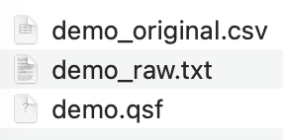
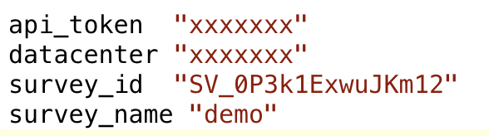



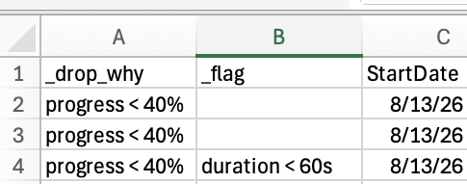
1. Download & clean data: preserve first, then modify
Preserve
2_clean.do
Original files
kept unchanged
Download
Cleaning
Document
Qualtrics API
Exclude
save dropped cases
+ cleaning summary
Clean analysis
sample
Python inside Stata
record reason
before dropping
Process
Stata raw
dataset
Flag
keep suspicious
responses for review
1_download.do
Notes:
The workflow starts by connecting to Qualtrics from Stata.
I provide the Qualtrics API information and specify …Example “demo".
Python then uses that information to download the survey metadata file, the QSF, and the response data.
So I no longer need to log in
The original files are kept unchanged, and the workflow creates a Stata dataset for processing.
Then I apply the cleaning rules I want to use, such as removing preview responses, and the workflow records what was excluded and why.
Some responses are not removed but only flagged, for example very short durations, so I can review them before I decide.
These steps are handled in the first two do-files
The result is a clean Stata dataset, with the cleaning decisions documented in a separate file.
At this point, I have the current survey data in Stata.

Slide 6
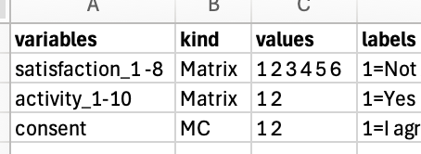
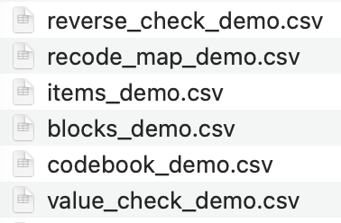


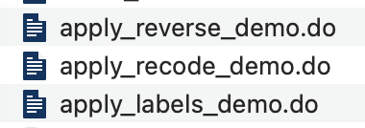

2. Parse, validate, and apply survey metadata
No single source was enough, so the workflow combines and checks multiple sources
Review files
CSV files to inspect
Inspect
Response data
3_label.do
Parse QSF metadata + match exported variables
Survey metadata
Generated do-files
Correctly labeled and recoded Stata dataset
Original CSV
question row
Information used together
Apply
Notes:
The next step is to make sure the labels and coding match the current survey.
This was the most complicated part of the workflow, because no single source gave me everything I needed.
The Stata dataset tells me which exported variables actually exist.
The QSF has the question text, the answer choices and their value codes, and the display order.
And the original CSV provides additional header information that helps match each exported variable to the right item in the QSF, especially for matrix and multi-select questions.
So the workflow combines those sources, parses the QSF metadata, and matches exported variables back to survey items based on question type.
It then creates review files and the Stata do-files that apply the labels and recodes.
I inspect those outputs first, and then apply them to create the final labeled and recoded dataset.
So the pattern here is: generate, inspect, then apply.
I added the inspect step because the problems I worried about most were not errors that stop the code. They were outputs that looked reasonable but were based on the wrong interpretation.
At this point I have a dataset I trust: the responses are cleaned, and the variables are correctly labeled and recoded. Now I can use this dataset to make the figures and the report.

Slide 7



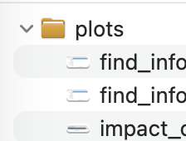

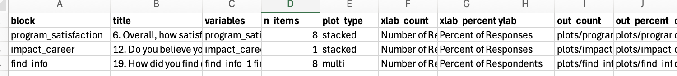
3. Generate plots using R from Stata
Stata tells R what to plot, R makes the figures, and Stata checks the output.
4_make_plots.do
Labeled & recoded Stata dataset
Stata creates a plotting instruction
variables • titles • plot types • output paths
PNG figures
ready for report
Stata checks the figure files
Stata calls R script
Scale type • label order • colors • plot type
Item /question structure
Information used together
Notes:
For plotting, I wanted the R script to be reusable across surveys rather than rewriting R code for each questionnaire.
So this step starts with the labeled and recoded Stata dataset and the item list created in the previous step.
Stata uses those files to create a plotting instruction file. Each row tells R which variables belong together, the title, the plot type, and where the output should be saved.
Then Stata calls the R script and R creates the figures from the labeled Stata data and the plotting instructions.
For the order and colors of the answer choices, the script looks at the response labels, not the numeric codes.
In simple terms: Stata decides what to plot, and R handles how to draw it.
R also writes a plot log. Then Stata checks that the expected PNG files were actually created.
Now I have all the figures. The final step is to assemble them into the Word report.

Slide 8

4. Assemble the Word report in Stata
Stata uses the figure list, plot information, and PNG files to build the report automatically.
Plotting instruction file
figure order • titles
5_make_report.do
Stata checks that required files exist
missing figures stop the process
Word report
Stata assembles the report
adds headings • inserts figures
preserves image proportions
Plot information
width • height
PNG figures
figure files created by R
Order comes from the plotting instruction file.
Image dimensions come from the plot log.
Information used together
Notes:
The final processing step comes back to Stata.
It uses the plotting instruction file, the plot log, and the PNG figures created in the previous step.
The instruction file tells Stata which figures to include and in what order, while the plot log provides the width and height of each figure.
Before creating the document, Stata checks that every required figure exists, and it stops if any figure is missing.
Then Stata uses its built-in putdocx command to add the headings, insert the figures, preserve their proportions, and save the Word report.
So this removes the final manual copy-and-paste step.
Now let’s look at the final report.

Slide 9
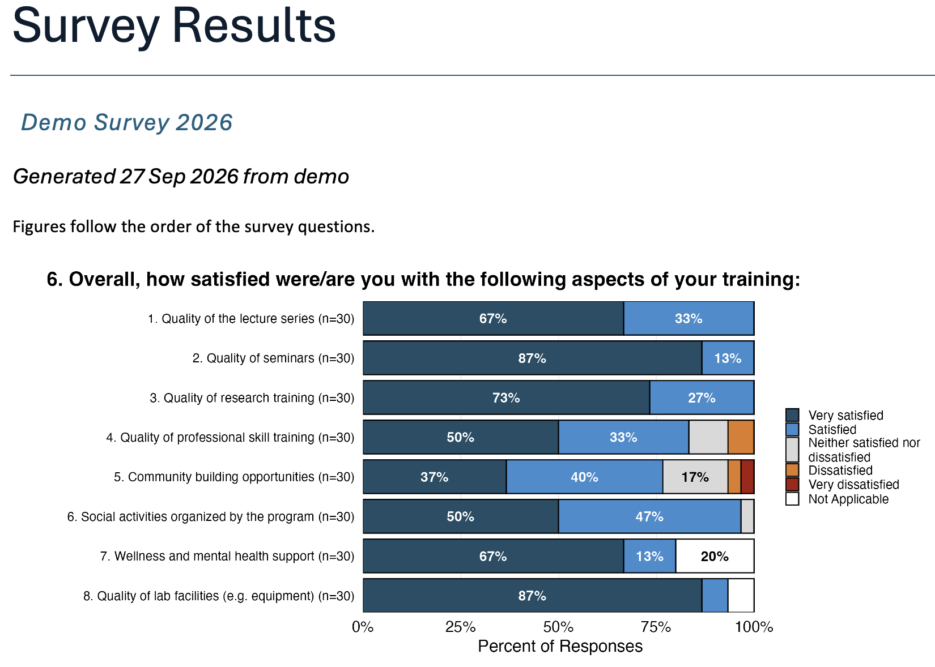
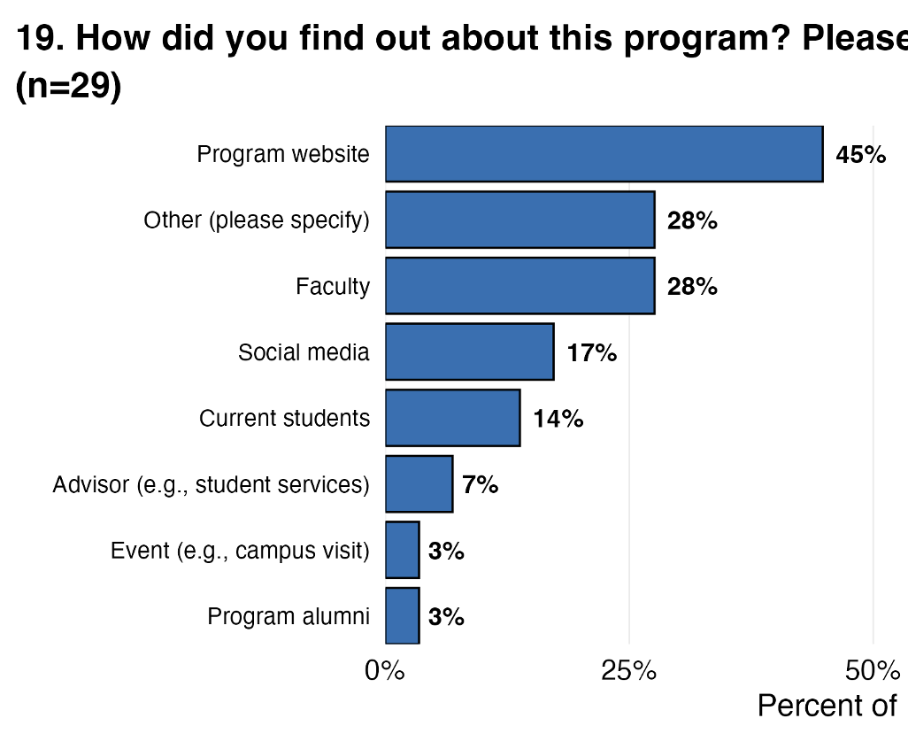
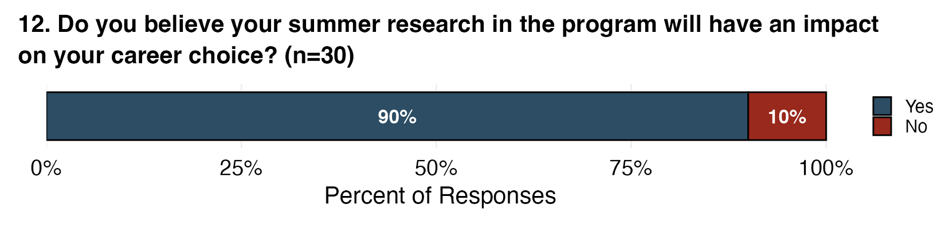
From Survey Data to Final Report
1_download.do
2_clean.do
3_label.do
4_make_plots.do
5_make_report.do
Notes:
When I run these five do-files in order, from downloading the data to building the report, this is the final Word report I get.
The figures can differ depending on the question structure.
Here you can see an ordered scale, a multi-select question, and a yes-or-no question.
I still review the outputs, but I no longer rebuild the labels, recodes, and plot setup by hand each time.
The workflow creates them from the current survey information and gives me specific files to check.
So, to wrap up, there are three things I want to emphasize from this workflow.

Slide 10



What I learned from this workflow
Stata could stay at the center of the workflow
Current survey metadata helped drive repetitive steps
Automation worked best with visible checks
Notes:
First, I found that Stata could stay at the center of the workflow while Python and R handle specific tasks.
That let me use those tools where they were useful without moving the entire workflow out of Stata.
Second, I used the current survey information to handle the repetitive steps. So I don't have to rewrite the code for small survey changes.
And third, automation worked best when I could still check the results at each step.
The goal was not full automation. It was to remove repetitive manual work without hiding the decisions.

Slide 11
Inah Ko
inahko@umich.edu

